Slide 1

The French Revolution
© Student Handouts, Inc.
www.studenthandouts.com

Slide 2
The Old Regime (Ancien Regime)
Old Regime – socio-political system which existed in most of Europe during the 18th century
Countries were ruled by absolutism – the monarch had absolute control over the government
Classes of people – privileged and unprivileged
  Unprivileged people – paid taxes and treated badly
  Privileged people – did not pay taxes and treated well

Slide 3
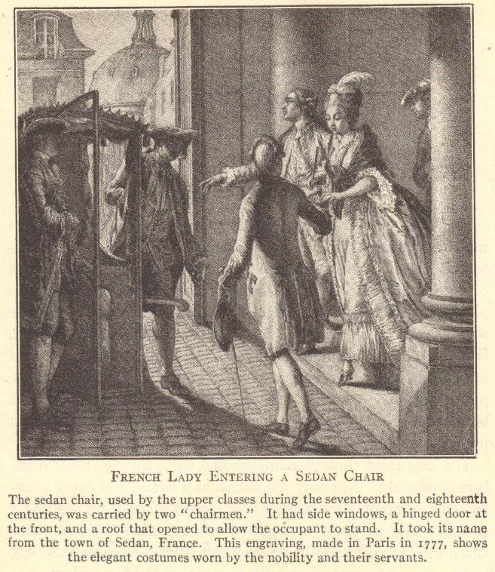

Slide 4
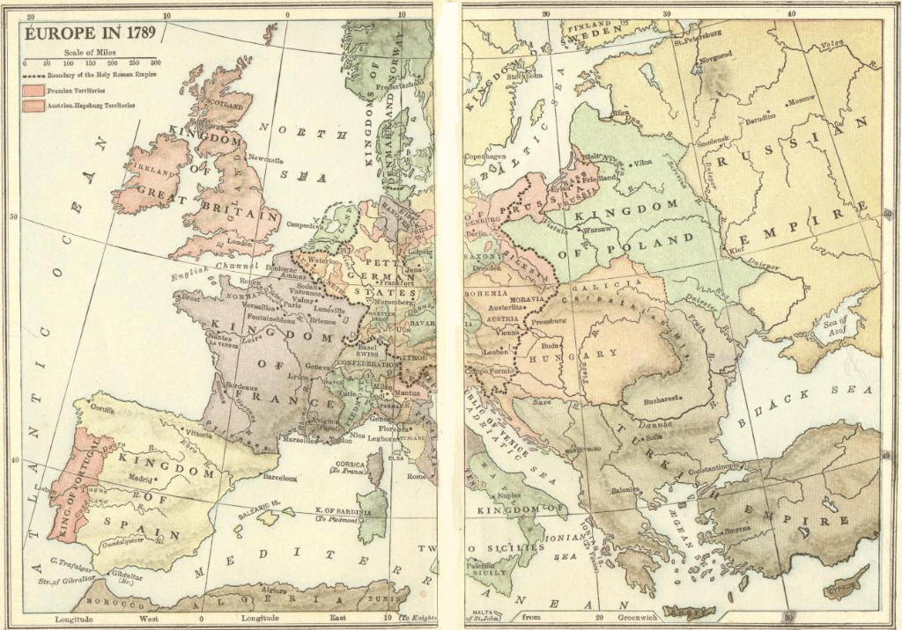

Slide 5
Society under the Old Regime
In France, people were divided into three estates
  First Estate
    High-ranking members of the Church
    Privileged class
  Second Estate
    Nobility
    Privileged class
  Third Estate
    Everyone else – from peasants in the countryside to wealthy bourgeoisie merchants in the cities
    Unprivileged class

Slide 6
The Three Estates
Estate | Population | Privileges | Exemptions | Burdens
First | Circa 130,000 High-ranking clergy | Collected the tithe Censorship of the press Control of education Kept records of births, deaths, marriages, etc. Catholic faith held honored position of being the state religion (practiced by monarch and nobility) Owned 20% of the land | Paid no taxes Subject to Church law rather than civil law | Moral obligation (rather than legal obligation) to assist the poor and needy Support the monarchy and Old Regime
Second | Circa 110,000 Nobles | Collected taxes in the form of feudal dues Monopolized military and state appointments Owned 20% of the land | Paid no taxes | Support the monarchy and Old Regime
Third | Circa 25,000,000 Everyone else: artisans, bourgeoisie, city workers, merchants, peasants, etc., along with many parish priests | None | None | Paid all taxes Tithe (Church tax) Octrot (tax on goods brought into cities) Corvée (forced road work) Capitation (poll tax) Vingtiéme (income tax) Gabelle (salt tax) Taille (land tax) Feudal dues for use of local manor’s winepress, oven, etc.

Slide 7
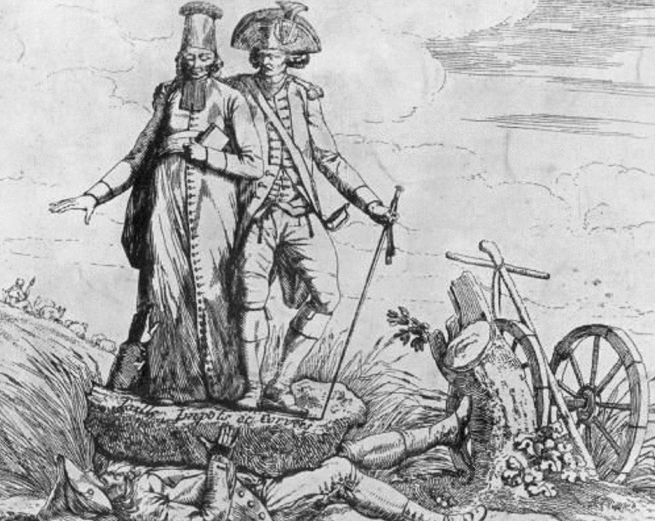
What does this contemporary political cartoon say about conditions in France under the Old Regime?

Slide 8
Government under the Old Regime:
The Divine Right of Kings
Monarch ruled by divine right
  God put the world in motion
  God put some people in positions of power
  Power is given by God
  No one can question God
  No one can question someone put in power by God
  Questioning the monarchy was blasphemy because it meant questioning God

Slide 9
What the King Did
Appointed the Intendants, the “petty tyrants” who governed France’s 30 districts
Made decisions regarding war and peace
Made all laws
Could imprison anyone at any time for any reason (blank warrants of arrest were called lettres de cachet)
Controlled justice by appointing judges
Controlled the military
Levied all taxes and decided how to spend the money
Appointed the people who would collect his taxes and carry out his laws

Slide 10
Economic Conditions under the
Old Regime
France’s economy was based primarily on agriculture
Peasant farmers of France bore the burden of taxation
Poor harvests meant that peasants had trouble paying their regular taxes
  Certainly could not afford to have their taxes raised
Bourgeoisie often managed to gather wealth
  But were upset that they paid taxes while nobles did not

Slide 11
France Is Bankrupt
The king (Louis XVI) lavished money on himself and residences like Versailles
Queen Marie Antoinette was seen as a wasteful spender
Government found its funds depleted as a result of wars
  Including the funding of the American Revolution
Deficit spending – a government spending more money than it takes in from tax revenues
Privileged classes would not submit to being taxed

Slide 12
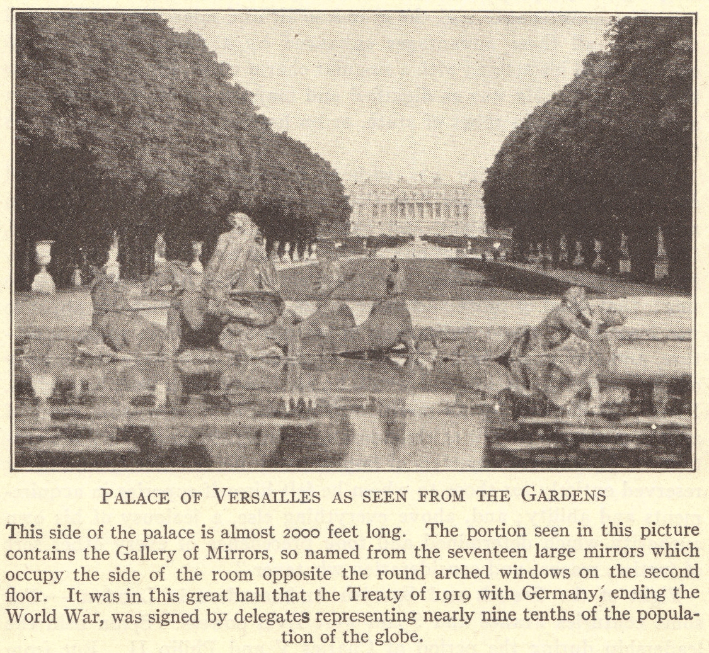

Slide 13
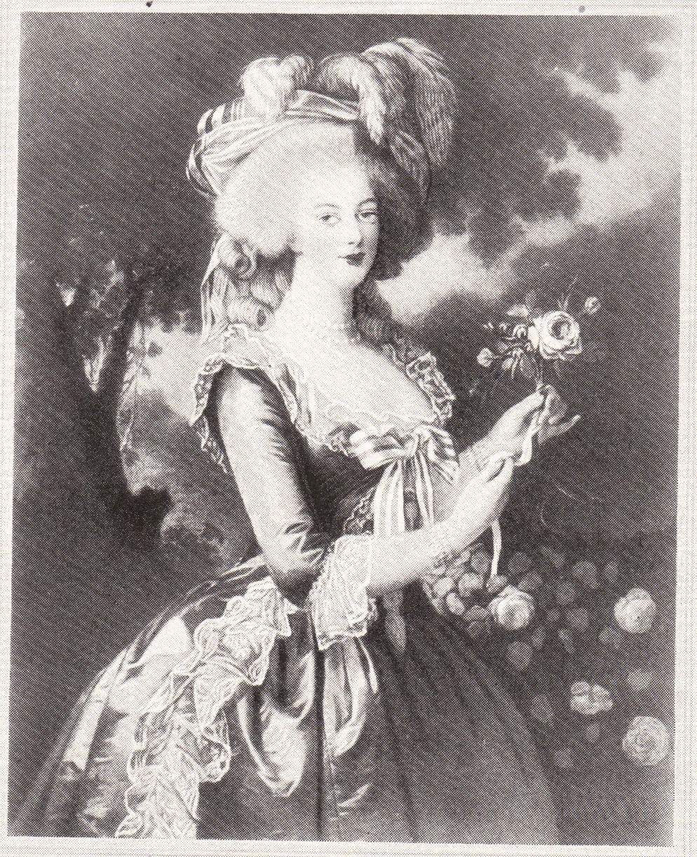

Slide 14
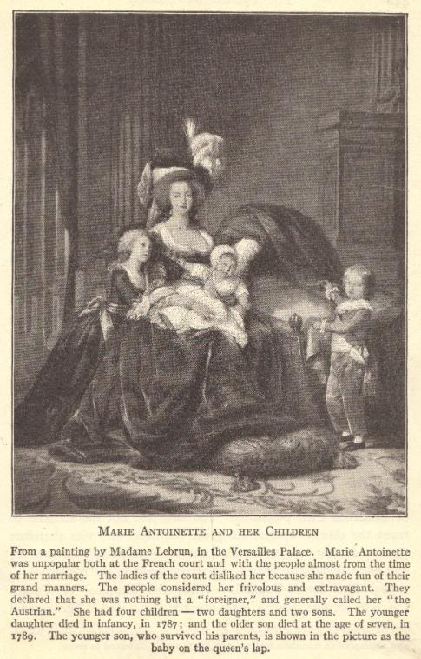

Slide 15
Philosophy of the French Revolution: The Enlightenment (Age of Reason)
Scientists during the Renaissance had discovered laws that govern the natural world
Intellectuals – philosophes – began to ask if natural laws might also apply to human beings
  Particularly to human institutions such as governments
  Philosophes were secular in thinking – they used reason and logic, rather than faith, religion, and superstition, to answer important questions
  Used reason and logic to determine how governments are formed
    Tried to figure out what logical, rational principles work to tie people to their governments
  Questioned the divine right of kings

Slide 16
Long- and Short-term Causes
Long-term causes
  Also known as underlying causes
  Causes which can stem back many years
Short-term causes
  Also known as immediate causes
  Causes which happen close to the moment the change or action happens
Example: A person is fired from his or her job.
  Long-term cause(s): The person is often late to work and is generally unproductive on the job.
  Short-term cause(s): The person fails to show up for work and does not call the employer.
Key: One typically does not happen without the other. Events which bring important change (or action) need both long-term and short-term causes.

Slide 17
Long-term Causes of the French Revolution
Everything previously discussed
Absolutism
Unjust socio-political system (Old Regime)
Also
System of mercantilism which restricted trade
Influence of other successful revolutions
Poor harvests which left peasant farmers with little money for taxes
Influence of Enlightenment philosophes
England’s Glorious Revolution (1688-1689)
American Revolution (1775-1783)

Slide 18
Short-term Causes of the French Revolution
Bankruptcy
Caused by deficit spending
Financial ministers (Turgot, Necker, Calonne) proposed changes
Great Fear
Worst famine in memory
Estates-General
Louis XVI had no choice but to call for a meeting of the Estates-General to find a solution to the bankruptcy problem
Had not met since 1614
But these were rejected
Assembly of Notables voted down taxation for the nobility in 1787
Hungry, impoverished peasants feared that nobles at Estates-General were seeking greater privileges
Attacks on nobles occurred throughout the country in 1789
All three estates
Set in motion a series of events which resulted in the abolition of the monarchy and a completely new socio-political system for France

Slide 19
Preparing for the Estates-General
Winter of 1788-1789
  Members of the estates elected representatives
Cahiers
  Traditional lists of grievances written by the people
  Nothing out of the ordinary
    Asked for only moderate changes

Slide 20
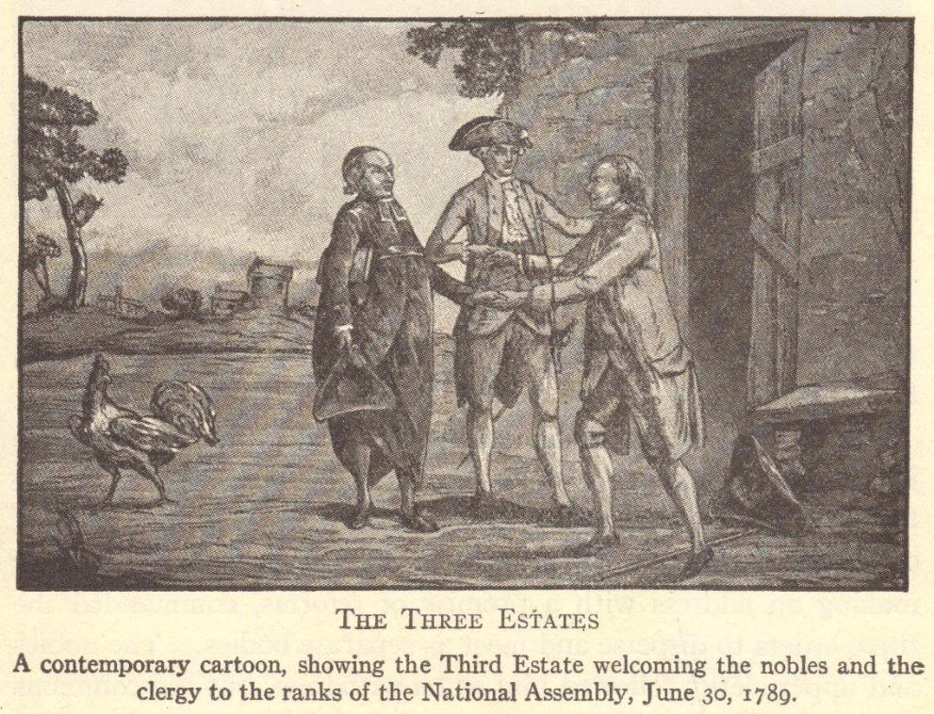

Slide 21
Meeting of the Estates-General:
May 5, 1789
Voting was conducted by estate
  Each estate had one vote
  First and Second Estates could operate as a bloc to stop the Third Estate from having its way
◊ First Estate + ◊ Second Estate - vs. - ◊ Third Estate
Representatives from the Third Estate demanded that voting be by population
  This would give the Third Estate a great advantage
Deadlock resulted

Slide 22
First Estate = 1 Vote or 130,000 Votes
Third Estate = 1 Vote or 25,000,000 Votes
Second Estate = 1 Vote or 110,000 Votes

Slide 23
Tennis Court Oath
The Third Estate declared itself to be the National Assembly.
Louis XVI responded by locking the Third Estate out of the meeting.
The Third Estate relocated to a nearby tennis court where its members vowed to stay together and create a written constitution for France.
On June 23, 1789, Louis XVI relented. He ordered the three estates to meet together as the National Assembly and vote, by population, on a constitution for France.

Slide 24
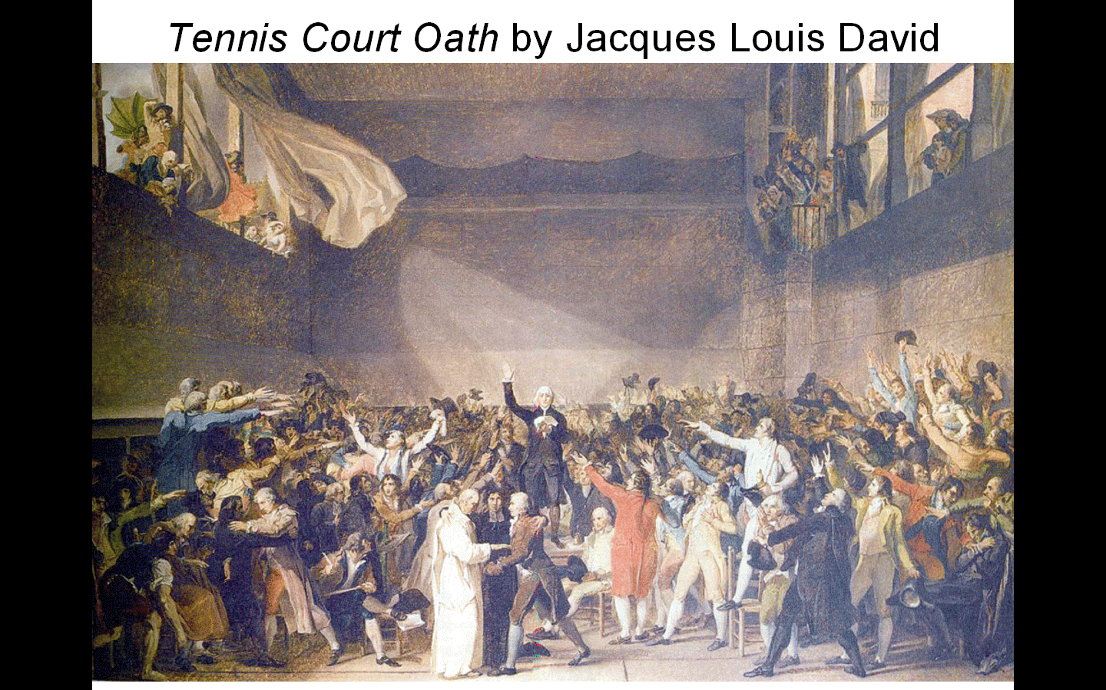
Tennis Court Oath by Jacques Louis David

Slide 25
The Tennis Court Oath
“The National Assembly, considering that it has been summoned to establish the constitution of the kingdom, to effect the regeneration of the public order, and to maintain the true principles of monarchy; that nothing can prevent it from continuing its deliberations in whatever place it may be forced to establish itself; and, finally, that wheresoever its members are assembled, there is the National Assembly;
“Decrees that all members of this Assembly shall immediately take a solemn oath not to separate, and to reassemble wherever circumstances require, until the constitution of the kingdom is established and consolidated upon firm foundations; and that, the said oath taken, all members and each one of them individually shall ratify this steadfast resolution by signature.”

Slide 26
Review Questions
1. What was the Old Regime?
2. How does an absolute monarchy (absolutism) operate?
3. Describe the size, privileges, exemptions, and burdens of the three estates.
4. What is deficit spending?
5. Describe the type of thinking used by the philosophes.
6. What were the underlying (long-term) causes of the French Revolution?
7. What were the immediate (short-term) causes of the French Revolution?
8. Explain the debate over voting which occurred in the Estates-General.
9. What was the Tennis Court Oath?

Slide 27
Four Phases (Periods) of the French Revolution
National Assembly (1789-1791)
Legislative Assembly (1791-1792)
Convention (1792-1795)
Directory (1795-1799)

Slide 28
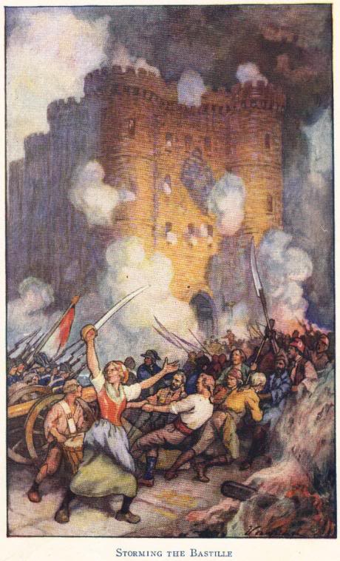
National Assembly (1789-1791)
Louis XVI did not actually want a written constitution
When news of his plan to use military force against the National Assembly reached Paris on July 14, 1789, people stormed the Bastille

Slide 29
Uprising in Paris
People of Paris seized weapons from the Bastille
July 14, 1789
Small groups – factions – competed to control the city of Paris
Uprising spread throughout France
Nobles were attacked
Records of feudal dues and owed taxes were destroyed
Many nobles fled the country – became known as émigrés
Louis XVI was forced to fly the new tricolor flag of France
Parisians organized their own government which they called the Commune

Slide 30


Slide 31
Goodbye, Versailles! Adieu, Versailles!
Parisian Commune feared that Louis XVI would have foreign troops invade France to put down the rebellion
  Louis XVI’s wife, Marie Antoinette, was the sister of the Austrian emperor
A group of women attacked Versailles on October 5, 1789
  Forced royal family to relocate to Paris along with National Assembly
  Royal family spent next several years in the Tuileries Palace as virtual prisoners

Slide 32
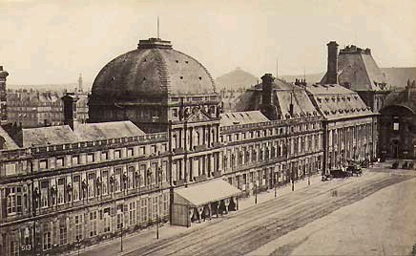
Tuileries Palace (Paris, France)

Slide 33
Changes under the National Assembly
Abolishment of guilds and labor unions
Reforms in local government
Taxes levied based on the ability to pay
Many nobles left France and became known as émigrés
Declaration of the Rights of Man
Abolition of special privileges
Constitution of 1791
Equality before the law (for men)

Slide 34
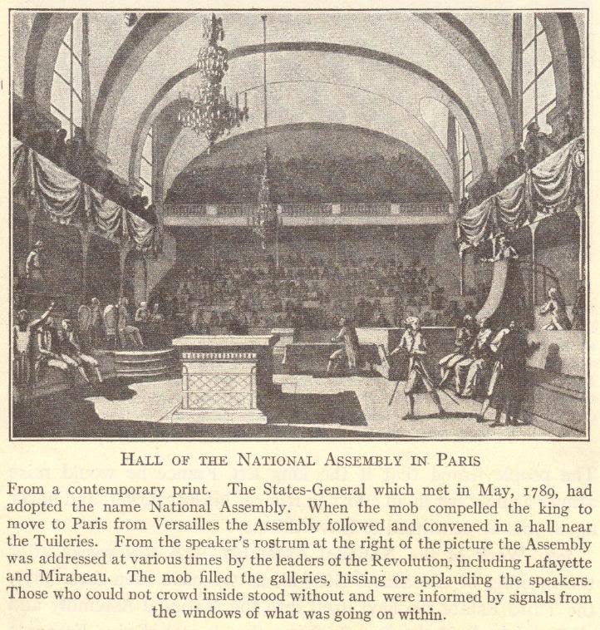

Slide 35
Declaration of the Rights of Man
Freedom of religion
Right of the people to create laws
Right to a fair trial
“Liberty, equality, fraternity!”
Freedom of the press
Guaranteed property rights
Freedom of speech

Slide 36
Declaration of the Rights of Woman
Journalist Olympe de Gouges argued in her Declaration of the Rights of Woman that women are equal citizens and should benefit from governmental reforms just as men did.
Madame Jeanne Roland also served as a leader in the women’s rights movement, and was able to heavily influence her husband (a government official).
Women did gain some rights during the French Revolution, but these were designed for purposes other than liberating women.
Women could inherit property, but only because doing so weakened feudalism and reduced wealth among the upper classes.
Divorce became easier, but only to weaken the Church’s control over marriage.

Slide 37
End of Special Privileges
Church lands were seized, divided, and sold to peasants
Civil Constitution of the Clergy required that Church officials be elected by the people, with salaries paid by the government
  2/3 of Church officials fled the country rather than swear allegiance to this
All feudal dues and tithes were eradicated
All special privileges of the First and Second Estates were abolished

Slide 38
Reforms in Local Government
The 30 provinces and their “petty tyrants” (Intendants) were replaced with 83 new departments
  Ruled by elected governors
New courts, with judges elected by the people, were established

Slide 39
Constitution of 1791
Democratic features
  France became a limited monarchy
    King became merely the head of state
  All laws were created by the Legislative Assembly
  Feudalism was abolished
Undemocratic features
  Voting was limited to taxpayers
  Offices were reserved for property owners
This new government became known as the Legislative Assembly

Slide 40
Legislative Assembly (1791-1792)
Royal family sought help from Austria
  In June, 1791, they were caught trying to escape to Austria
Nobles who fled the revolution lived abroad as émigrés
  They hoped that, with foreign help, the Old Regime could be restored in France
Church officials wanted Church lands, rights, and privileges restored
  Some devout Catholic peasants also supported the Church
Political parties, representing different interests, emerged
  Girondists
  Jacobins

Slide 41
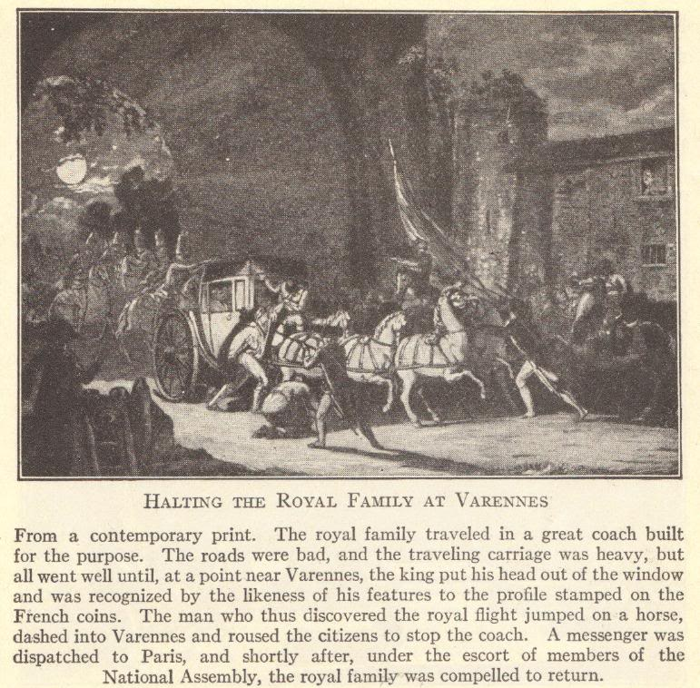

Slide 42
Opposition to the New Government
European monarchs feared that revolution would spread to their own countries
  France was invaded by Austrian and Prussian troops
In the uproar, the Commune took control of Paris
  Commune was led by Danton, a member of the Jacobin political party
Voters began electing representatives for a new convention which would write a republican constitution for France
  A republic is a government in which the people elect representatives who will create laws and rule on their behalf
  Meanwhile, thousands of nobles were executed under the suspicion that they were conspirators in the foreign invasion

Slide 43
Convention (1792-1795)
On September 22, 1792, the Convention met for the first time
Established the First French Republic
Faced domestic opposition and strife
  Girondists were moderates who represented the rich middle class of the provinces
  Jacobins (led by Marat, Danton, and Robespierre) represented workers
Faced opposition from abroad
  Austria, England, Holland, Prussia, Sardinia, and Spain formed a Coalition invading France

Slide 44
Abolishment of the Monarchy
The Convention abolished the monarchy
  As long as the royal family lived, the monarchy could be restored
  Put the royal couple on trial for treason
    Convictions were a foregone conclusion
  Louis XVI was guillotined on January 21, 1793
  Marie Antoinette was guillotined on October 16, 1793
  Daughter Marie-Thérèse was allowed to go to Vienna in 1795
    She could not become queen because of Salic law, which did not allow females to succeed to the throne
  Son Louis-Charles, a.k.a. Louis XVII (lived 1785-1795) was beaten and mistreated until he died in prison

Slide 45
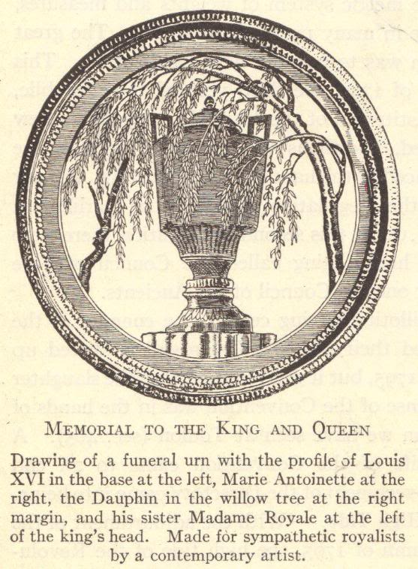

Slide 46
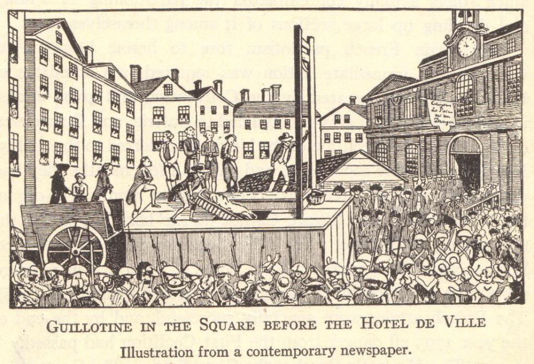

Slide 47
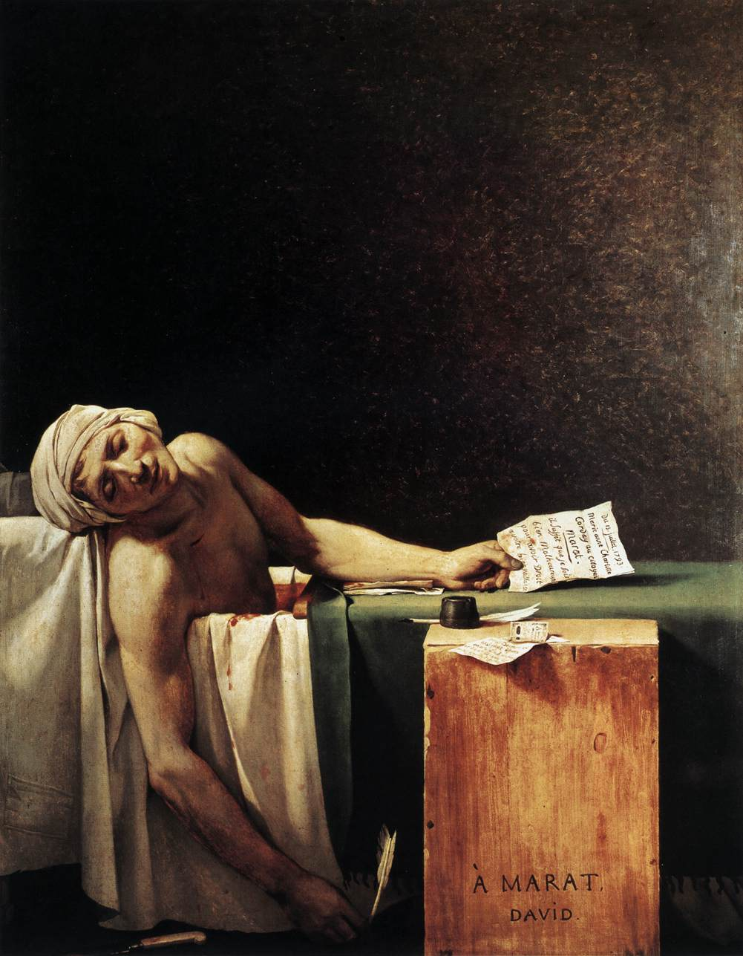
The three most memorable Jacobins were Georges Danton, Maximilien Robespierre, and Jean-Paul Marat.
Because of a debilitating illness, Marat was eventually forced to work from home. He was assassinated (in the tub while taking a medicinal bath) by Charlotte Corday, a Girondist sympathizer, in July, 1793.
The Death of Marat by Jacques-Louis David

Slide 48
Growing Coalition against the French
Convention drafted Frenchmen into the army to defeat the foreign Coalition
  These troops were led by General Carnot
  The people supported military operations because they did not want the country back under the Old Regime
Rouget de Lisle wrote the “Marseillaise”
  Became the French national anthem
  Inspired troops as they were led into battle
After two years
  Coalition was defeated
  France had gained, rather than lost, territory

Slide 49
Reign of Terror:
September 5, 1793-July 27, 1794
Despite military successes, the Convention continued to face problems domestically
Danton and his Jacobin political party came to dominate French politics
Committee of Public Safety
  Headed by Danton (and later Robespierre)
  Those accused of treason were tried by the Committee’s Revolutionary Tribunal
  Approximately 15,000 people died on the guillotine
    Guillotine became known as the “National Razor”
    Including innovative thinkers like Olympe de Gouges and Madame Jeanne Roland

Slide 50
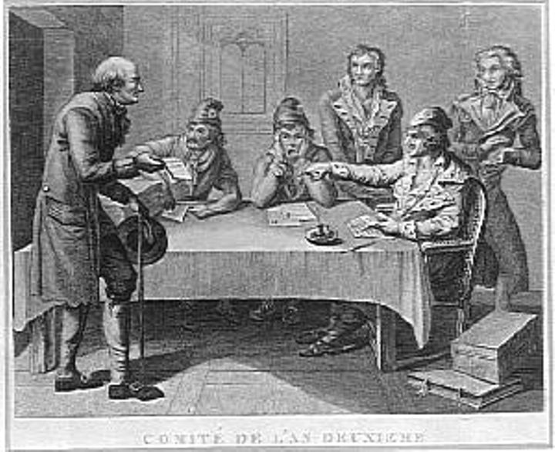
Committee of Public Safety

Slide 51
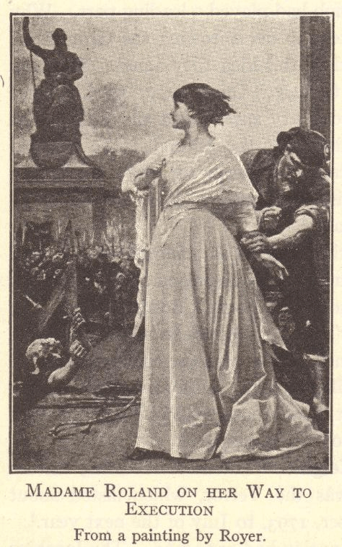

Slide 52
End of the Reign of Terror
Members of the Girondist political party tried to end the Reign of Terror initiated by the Jacobin political party
  This opposition to the Committee of Public Safety caused many Girondists to be tried and executed for treason
Eventually, even Georges Danton wanted to end the executions
  This resulted in Danton being tried and executed for treason
Maximilien Robespierre became leader of the Committee of Public Safety
  He continued the executions
  Convention came to blame Robespierre for the Reign of Terror
Thermidorean Reaction
  July 27, 1794 – ended the Reign of Terror
  Convention sent Robespierre and other members of the Committee of Public Safety to the guillotine
    Robespierre was guillotined on July 28, 1794

Slide 53
Constitution of the Year III of the Republic (1795)
With the foreign invaders vanquished and the Reign of Terror at an end, the Convention was finally able to inaugurate its new constitution
Constitution of the Year III of the Republic (1795) created the Directory

Slide 54
Government under the Directory
Executive
5 directors appointed by the Legislature
Legislature
Lower house (500 members) proposed laws
2/3 of the Legislature would initially be filled by members of the Convention
Qualifications
Girondists (middle-class party) had defeated the Jacobins (working- and peasant-class party)
Upper house (250 members) voted on these laws
Girondists’ constitution stated that suffrage (the right to vote), as well as the right to hold office, were limited to property owners

Slide 55
Other Parting Reforms
Passed by the Convention
Adopted the metric system
Established a nationwide system of public education
Ended slavery in France’s colonies
Dealt the final blow to feudalism by abolishing primogeniture (the system whereby the oldest son inherited all of his father’s estate)
Ended debt imprisonment
Drew up a comprehensive system of laws

Slide 56
Directory (1795-1799)
The Directory suffered from corruption and poor administration.
The people of France grew poorer and more frustrated with their government.
Despite, or perhaps because of, these struggles, the French developed a strong feeling of nationalism – they were proud of their country and devoted to it.
National pride was fueled by military successes.
It would be a military leader – Napoleon Bonaparte, coming to power through a coup d’état – who would end the ten-year period (1789-1799) known as the French Revolution.

Slide 57
Review Questions
1. What Paris building was stormed on July 14, 1789?
2. What human rights were established in France by the Declaration of the Rights of Man?
3. How did Olympe de Gouges fight for women’s rights?
4. What were émigrés, and why did French revolutionaries view them as a threat?
5. Name and describe the two political parties that competed for power in revolutionary France.
6. What was the Committee of Public Safety?
7. Describe the Reign of Terror and explain how it eventually came to an end.
8. Were the “excesses” of the French Revolution justified? Why or why not?
9. Looking back at the first half of 1789, could the French Revolution have been avoided? If so, how?

