Slide 1
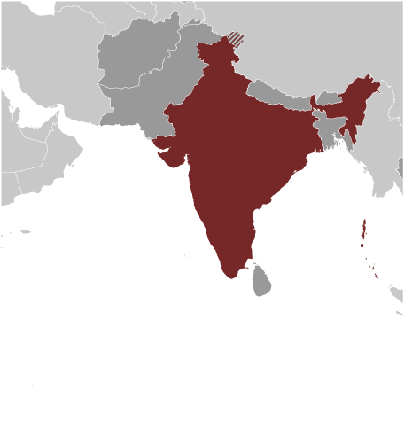
INDIA
A Quick Overview of Indian History
© Student Handouts. Inc.

Slide 2
FYI:
Historically, India’s geographic boundaries were bigger than they are today
Bangladesh + India + Pakistan = India
Bangladesh and Pakistan did not exist as separate countries until after India gained independence from Great Britain in 1947
“Northwest India” generally means Pakistan
Ancient Indian cities, such as Harappa and Mohenjo-daro, are located in what is now Pakistan

Slide 3
India’s Geography
As large as Europe, minus Russia
Population: 1.15 billion (2010 estimate)
  Second only to China
Himalayan Mountains (northeast)
  Separate India from Tibet and western China
Northwest
  Historic route of land invasions
    Alexander the Great, Mughals
Indian Ocean (route of British conquest)
Climate
  Hot (except in highlands)
  Land – very fertile to semi-desert

Slide 4
Ganges and Indus River Valleys
Northern India
Early 1900s
  Archaeologists discovered ruins of Mohenjo-daro (circa 2600 BCE) and Harappa (circa 2600 BCE)
Bronze and copper
Fired brick
Picture writing (undeciphered)
Farming, jewelry-making, and woven cloth
Engineering – drainage systems
Civilization ended circa 1900 BCE

Slide 5
Aryan Invasion (ca. 1700-1300 BCE)
Invaders came from Europe
  Traced through Indo-European language roots
Ruled India for hundreds of years
Set up small kingdoms ruled by rajahs
Conquered native Dravidians
Created modern Hinduism from Dravidian religious traditions and their own ideas
Established India’s caste system

Slide 6
Vedic Age (circa 1500-500 BCE)
Vedas written in Sanskrit (India’s literary language)
Mahabharata
Ramayana

Slide 7
Alexander the Great
(ca. 327/326 BCE)
Macedonian (Greek) who led conquering forces across northern India
Ruled briefly
Greeks expelled from most of India after Alexander’s death
Continued contact with Alexandrian successor state, the Seleucid empire, to the west

Slide 8
Maurya Empire (322-185 BCE)
Dynasty begun by Chandragupta Maurya
Asoka (grandson), 273-232 BCE
  Ruled all of India
  Converted to Buddhism
  Religious tolerance, generosity, wisdom, and kindness
  Spread Buddhism – Burma, Ceylon, Siam, Tibet
  War and disunity after his death

Slide 9
Gupta Dynasty (320-467 CE)
Northern India reunited
Trade
  With West
  Burma, Indochina, Java, Sumatra
  Buddhism and Hinduism spread out
    Cultural diffusion

Slide 10
Mughal Empire (1526-1858)
12th century – Muslim invasion
1500 – Central Asians, led by Mughals (Moguls), established a kingdom in northern India
Akbar (1556-1605)
  Conquest of central India
  Efficient and strong government
  Religious tolerance
  Business and commerce encouraged
Architecture
  Forts, mosques, palaces, tombs
    Taj Mahal – Agra, India – Tomb for a Mogul emperor’s favorite wife

Slide 11
End of the Mughal Empire
17th century – empire crumbled
  Fighting between smaller kingdoms
  English, French, and Portuguese traders gained influence
1763 – Seven Years’ War
  English (British East India Company) won control of India from the French
  Taken over by the British government under Queen Victoria (British Raj, 1858-1947)
    Independent after World War II (1947)

Slide 12
Hinduism
Escape sins of life by attaining purity and perfection of the soul
Caste system
  Process starts in lowest caste (Untouchables)
  Soul reincarnated in person of higher caste
  Must carry out duties of the caste
  Repeated rebirths
  Soul ultimately becomes perfect and merges with the soul of Brahma (principal god)

Slide 13
Castes
Original castes
  Brahmin (priests)
  Warriors
  Farmers and traders
  Sudra (servants)
Eventually divided by occupation into thousands of castes
  Lowest – the Untouchables
    Strict purification rituals if others contact them
    Today – legal protections under Indian law, but prejudice still exists

Slide 14
Hinduism (Continued)
All life is sacred
  Animals respected
  Cow is sacred
  Most Hindus are vegetarians
Basic beliefs
  World is evil
  Reincarnation after death (animal or human)
  Soul purified by completion of caste duties
  Reverence for animals
  Escape world’s evils through prayer

Slide 15
Buddhism
Founded by Gautama (563-483 BCE)
  Age 30 – Gave up position and wealth to study the right way to live
  Called Buddha (“the enlightened one”)
Life is evil and suffering
  Can be avoided by good desires
Eightfold Path
  Do not gossip, have impure thoughts, hate, lie, or steal
Rare in India today, but spread throughout East Asia

Slide 16
Culture
Kalidasa (6th century CE)
  Playwright and poet
  Fairy stories and animal fables
Art and architecture
  Temples covered with designs and figures

Slide 17
Science
Mathematics
  Zero
  Decimal point
  Minus sign
  “Arabic” numerals (Europe got them from Arab traders, who got them from India)
Gupta Period (320-467 CE)
  Leaders in dyeing, tanning leather, soap and glass making
Textiles
  Cotton, cashmere, calico, chintz – all originally Indian terms

Slide 18
Review Questions
After 1947, India split into what three separate countries?
What two ancient Indus River Valley civilizations were discovered by archaeologists in the early 1900s?
The Vedas were written in what language?
What religion was practiced by the Mughal emperors?
Describe India’s caste system.
What is the origin of the term “Arabic numerals”?

