Slide 1
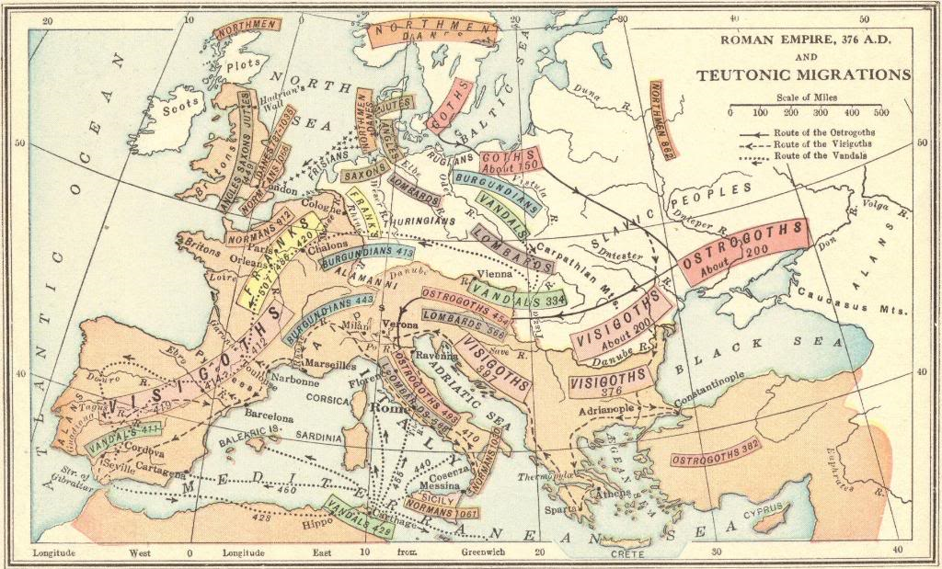
The Barbarian Invasions: The Migration Period in Europe, 300-700 C.E.
© Student Handouts, Inc.
www.studenthandouts.com

Slide 2
End of the Roman Empire
476 C.E.
  Traditional date for the end of the Roman empire
  “Barbarian” Germanic general Odoacer deposed the last Western Roman emperor, Romulus Augustus
Who were these barbarians who are charged with ultimately bringing down the Roman empire?

Slide 3
Who were the barbarians?
Barbarians – term applied by the Romans to any group they considered uncivilized
  From a Greek word meaning “anyone who is not Greek”
Barbarians were all of the groups/tribes living in Europe
  Europe was not populated like it is today
  Different tribes were migrating around the continent
  For example: “Germanic tribes” describes a lot of different tribes who lived in the general area now called Germany, but they did not think of themselves as “Germans,” and went on to eventually found completely different countries, such as the Germanic Franks founding France

Slide 4
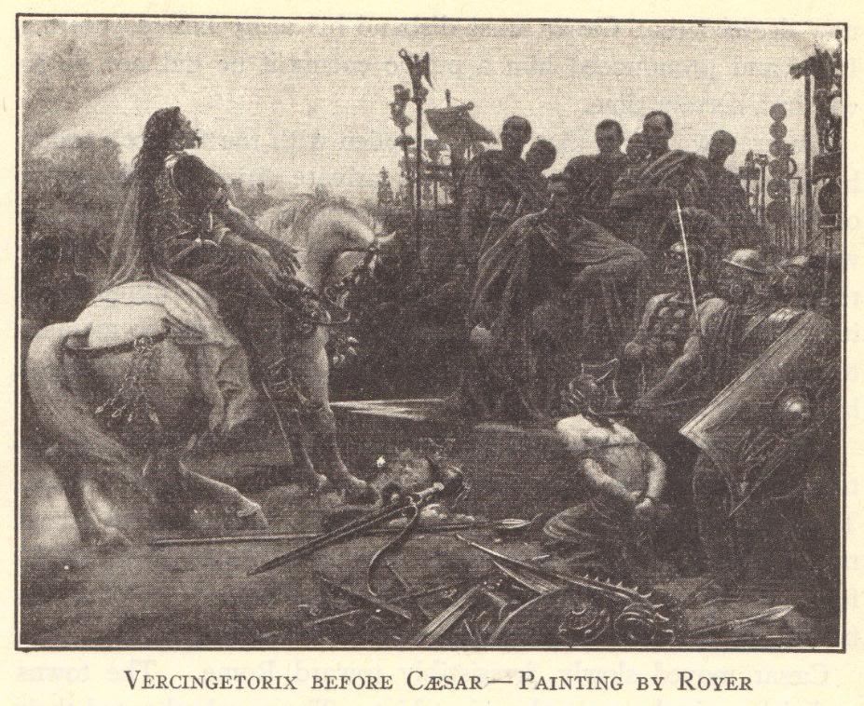
Romans had a long history of conquering the peoples of Europe
Julius Caesar conquered the Gauls of what is now called France
Those European tribes who remained independent of Rome were considered barbaric by the Romans

Slide 5
European Migrations
First phase of migrations (circa 300-500 CE)
  Germanic peoples of northern Europe who settled throughout Europe (territory and border lands of Roman empire)
  Such as the Alamanni, Alans, Angles, Burgundians, Franks, Goths (Ostrogoths and Visigoths), Jutes, Langobards, Lombards, Saxons, Suebi, Vandals
Second phase of migrations (circa 500-700 CE)
  Slavic tribes of eastern Europe
  Such as the Bulgars
Division into phases not very important
  These tribes took centuries to eventually settle
  By the time they settled, a new migratory wave—the Viking invasions—took place starting in the 700s

Slide 6
This map shows the movement southward of the tribes of northern Europe. For example, the Goths originated in Scandinavia. By 150 C.E., the Goths were living on the southern shores of the Baltic Sea. By 200 C.E., the Goths were in southeastern Europe along the Black Sea. Here, the Goths split, with those living in the east called Ostrogoths, and those in the west called Visigoths.

Slide 7
Germanic Culture
Tiu = Tuesday
Woden = Wednesday
Thor = Thursday
Frig = Friday
Economy
  Hunters and farmers
War culture
  Tribes always fighting one another
Religion
  Valhalla – warriors’ heaven
  Animal and human sacrifice
  Gods survive in our days of the week
  Gradually converted to Christianity through exposure to the Roman empire and Christian missionaries

Slide 8
Germanic Justice
Trial by ordeal
  Innocence proven by survival of a trial
  For example, retrieving an object from boiling water or walking over hot coals
  If the person survived the ordeal, or healed quickly, the verdict was innocent
  Modern era version: Salem Witchcraft Trials
Trial by combat
  Winner of the fight is innocent of the crime, or winner of the dispute
  Modern era version: Dueling
These trials survived through the Middle Ages in Europe

Slide 9
Angles, Saxons, and Jutes
400s
Moved into Britannia as the Roman empire declined
Gave the area its name
  England = “Angle’s land”
Old English language
  Most closely related to Frisian, a German dialect
Beowulf

Slide 10
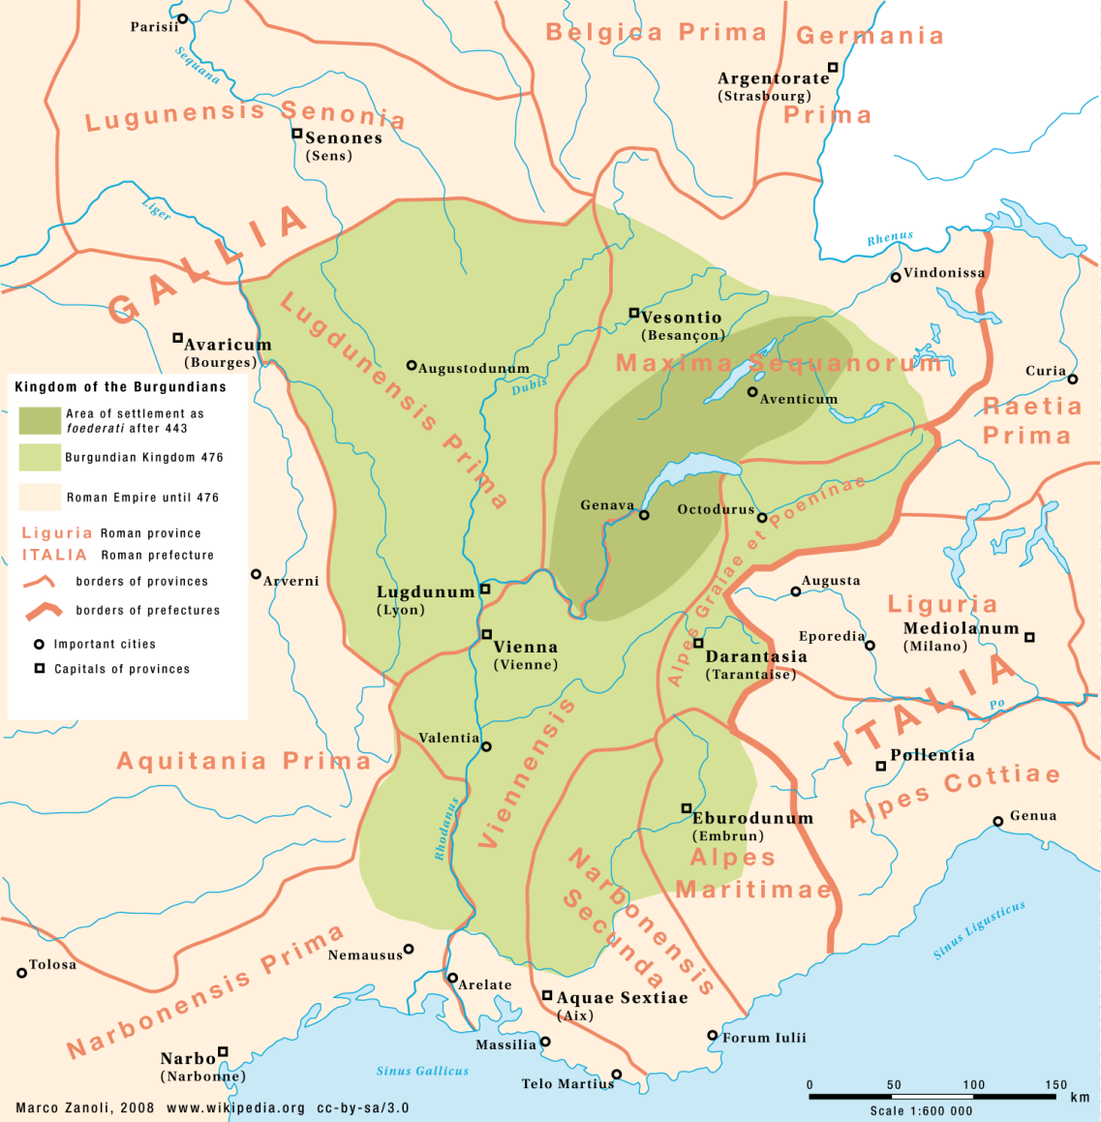
The Burgundians
Late 400s to 530s
Founded a kingdom in southern Gaul (modern France) in the Valley of the Rhone
Notes:
Image courtesy of Wikipedia: http://upload.wikimedia.org/wikipedia/commons/4/46/Map_Burgundian_Kingdom_EN.png

Slide 11
The Vandals
Led by Genseric (lived circa 389 CE-477 CE)
  Crossed Gaul, to Spain, to north Africa
  Established Vandal kingdom around Carthage and on islands such as Corsica and Sardinia
Famously sacked Rome in 455 C.E.
  After murder of Emperor Valentinian III
  Plundered city’s riches – origin of term vandalism
  Kidnapped emperor’s widow, Licinia Eudoxia, and daughters, Eudocia and Placidia
    Eudocia was married off to Huneric, the son of Genseric
Finally conquered by the Eastern Roman empire in 533 CE

Slide 12
The Franks
Kingdom in Gaul
  Became known as “France” after the Franks
United under King Clovis (lived circa 466-511 CE)
  First king of France (ruled 481-511 CE)
  Married Christian Burgundian princes, Clotilde
  Converted to Christianity

Slide 13
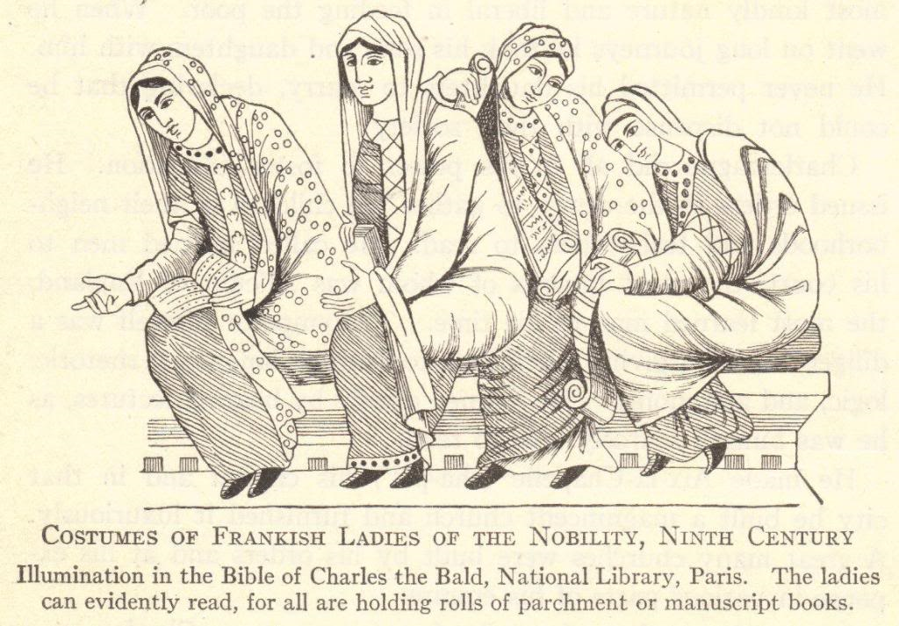

Slide 14
Review Questions
What is the traditional date for the end of the Roman empire?
Who were the barbarians?
Describe elements of ancient Germanic culture that are still with us.
How did England get its name?
Explain the origin of the term vandalism.
How did France get its name?

Slide 15
The Lombards
Invaded Italy following the death of Emperor Justinian (Eastern Roman empire) in 565 CE
568 CE
  Under leadership of Alboin
  Set up a powerful kingdom in the Italian peninsula
    Modern Italian region of Lombardy
    Conquered by France’s King Charlemagne in 774

Slide 16
The Huns
From Asia, east of the Volga River
  Their migration pushed the Goths into the Roman empire, ca. 370 CE
Led by Attila the Hun (lived 406-453 CE)
Campaign in Gaul
  Sacked various cities
  Finally defeated by alliance of Romans and Visigoths under General Aetius at the Battle of Chalons (451 CE)
450 CE – Emperor Valentinian III’s sister, Honoria, sent him an engagement ring (to avoid a forced marriage)
  Attila used this pretext to attempt an invasion of Rome (452 CE)
  According to legend, Pope Leo I, helped by St. Peter and St. Paul, convinced Attila at the Po River to halt his advance
  Attila retreated and died a year later, allegedly by choking to death on his own blood (from a nosebleed) while in a drunken stupor following his wedding to Ildico

Slide 17
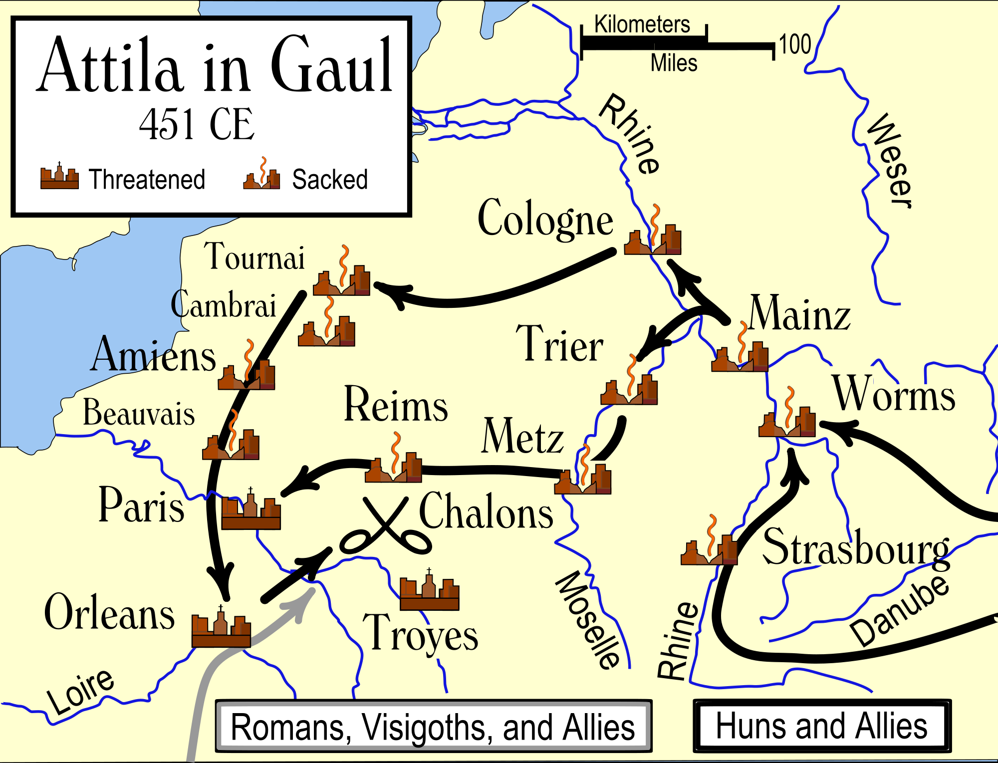
Notes:
Image courtesy of Wikipedia: http://upload.wikimedia.org/wikipedia/commons/thumb/3/3c/Attila_in_Gaul_451CE.svg/2000px-Attila_in_Gaul_451CE.svg.png

Slide 18
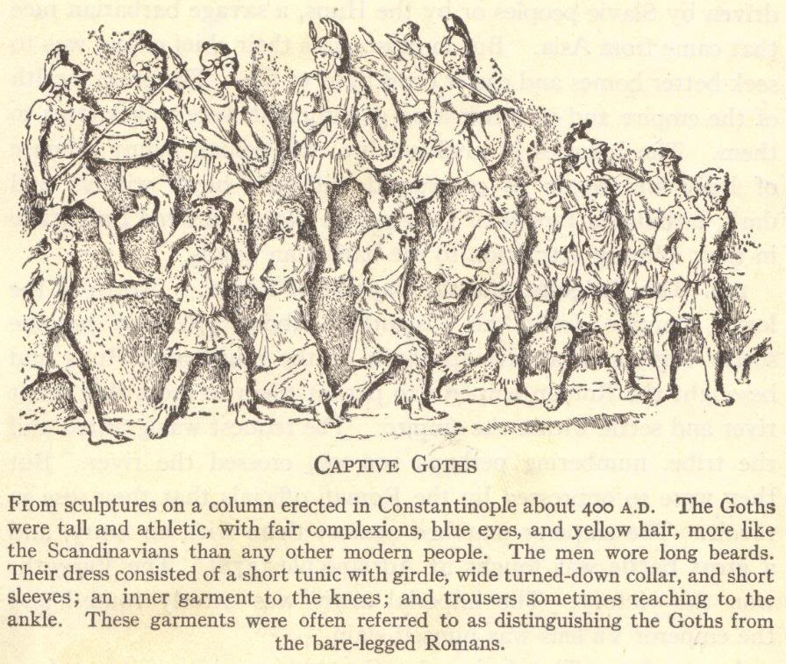
The Goths split into the Visigoths (West Goths) and Ostrogoths (East Goths) around the year 200 CE.

Slide 19
The Visigoths (West Goths)
Led by Alaric I (lived ca. 370-410 CE)
Pushed into the Roman empire by the westward migration of the Huns
  378 CE – Romans defeated by the Visigoths at the Battle of Adrianople
Sacked Rome in 410 CE
Eventually settled in Spain
  Visigothic kingdom in Spain lasted until Arab Muslim invaders arrived in 711 CE
    These Muslim rulers were not expelled until completion of the Reconquista under Ferdinand and Isabella in 1492

Slide 20
The Ostrogoths (East Goths)
Led by Theodoric the Great (lived 454-526)
  Raised at the court in Constantinople as a traditional hostage, returning to the Ostrogoths at age 31
Kingdom in Italy
  Capital city – Ravenna
    Center of art and learning
  Conquered by Emperor Justinian (Eastern Roman empire) in 554 CE

Slide 21
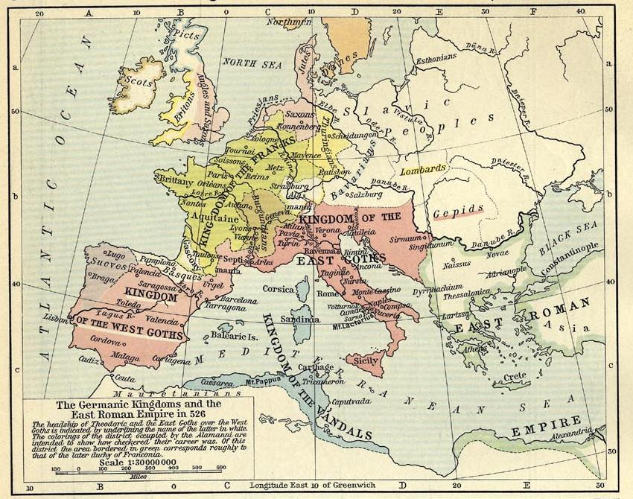

Slide 22
Odoacer and the Fall of Rome
476 CE – the barbarian general, Odoacer, dethroned the last Western Roman emperor, Romulus Augustus
  No one even knows which tribe he belonged to, only that he was Germanic
  The conquest of the Western Roman empire was a long process, and a lot of factors contributed to Rome’s decline
This date (476 CE) is traditionally used for the end of the Roman empire and the beginning of the Middle Ages, circa 500-1400 (or Dark Ages, circa 500-800)

Slide 23
The Dark Ages (500-800 CE)
Universal rule under Rome collapsed
  Separate barbarian kingdoms ruled in Rome’s place
Economic decline
  Trade
    Infrastructure fell apart (roads and bridges)
    Piracy in the seas hurt trade
    Few coins minted
  Industry
    With limited trade, little demand for goods
    Fewer skilled workers trained
    Depopulation of cities (workers returned to farms)
Culture and learning
  Illiteracy grew
  Ancient wisdom of Greece and Rome largely lost
    Preserved by Christian monks (Europe) and Muslim Arabs (Middle East and northern Africa)

Slide 24
Review Questions
Describe the conquests of Attila the Hun.
At what battle, fought in 378 CE, did the Visigoths defeat the Romans?
Where did the Visigoths eventually settle and establish a kingdom?
Who made Ravenna an important cultural center?
How was Europe governed following the fall of Rome?
Explain why the period of 500-800 CE is commonly referred to as the Dark Ages.

