Slide 1
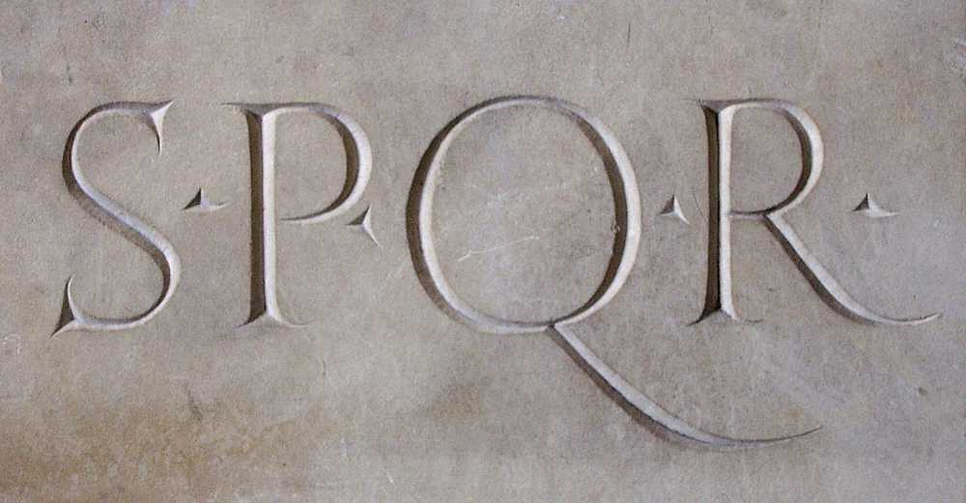
The Establishment of the Roman Republic
(c) Student Handouts, Inc.
www.studenthandouts.com

Slide 2
Geography of Rome
Protection for Rome and Italy
Unification of Italy under Rome
Fertile soil and mild climate
Rome built on seven hills
Alps
Barrier to the north
Seas
Barriers on other three sides
Poor harbors in eastern Italy
Little interference from cultures to the east
Farming and Trade
Rome centrally located on peninsula
Apennine Mountains run north-south
Not a barrier to unification of the peninsula
Good location for capital city
Good for farming
No need to import foodstuffs
Central location in Mediterranean
Good for trade
Launching point for expansion throughout Mediterranean region

Slide 3
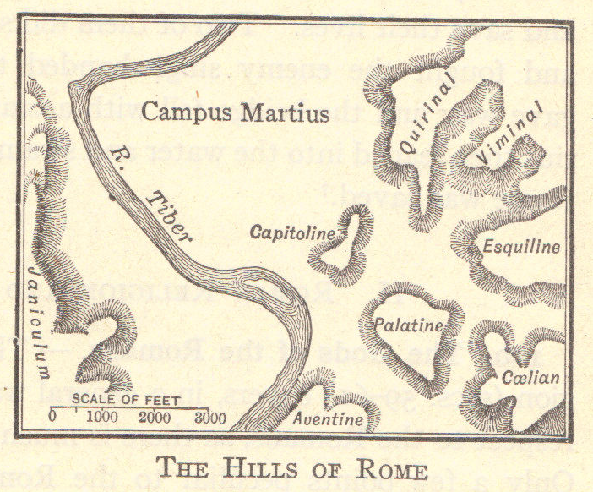

Slide 4
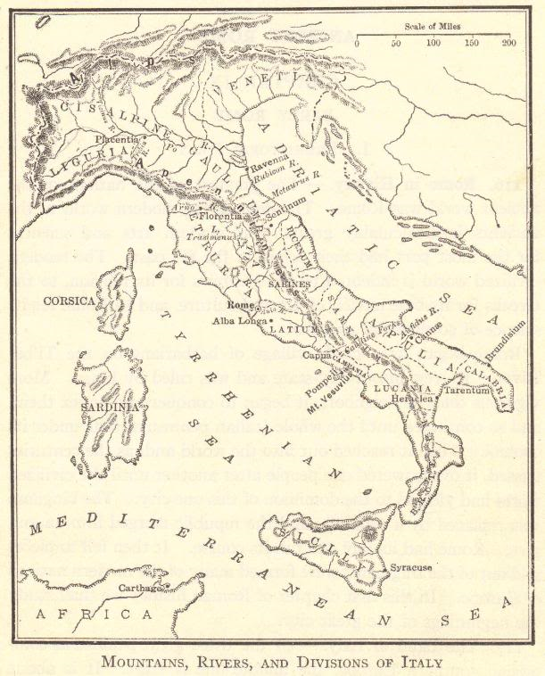

Slide 5
Others Living in Italy
Greek colonists
  Eastern portion of Sicily
  “Heel” and “toe” of Italy
Carthaginian colonists
  Western portion of Sicily
Gauls
  Between Alps and Po River

Slide 6
The Etruscans
Mystery – their origins are lost to prehistory
  Numerous hypotheses
    Indigenous (first humans to live in region)
    Migrated from east, north, or south, circa 1000 BCE
Lived north of Rome
  Region today called “Tuscany” after them (ancient Etruria)
  Enemies of the Romans
Taught the Romans:
  Arch in architecture, drainage and sewer-building, phalanx military formation

Slide 7
The Latins
Indo-European tribe from the north
Circa 1200 BCE – Settled south of the Tiber River in an area that came to be called Latium
Latin League formed for protection
  Rome was the leading city in this league
Legend of the founding of Rome in 753 BCE
  Twin brothers Romulus and Remus
    Ordered drowned by uncle who wanted throne
    Instead raised by a she-wolf
    Grew up and killed their uncle
    Romulus killed Remus in a fight over what to name the city

Slide 8
Three Major Periods of Roman History
Roman Republic
Roman Empire
Roman Origins
Earliest settlements on Palatine Hill
753 BCE – Legendary founding of Rome by Romulus and Remus
Circa 1000-509 BCE
509-31 BCE
Etruscan kings overthrown under leadership of Lucius Junius Brutus, the traditional founder of the Republic, in 509 BCE
Ended with Battle of Actium in 31 BCE
Began when Octavian’s forces defeated the forces of Antony and Cleopatra
End of Western Roman Empire traditionally dated to 476 CE, when last emperor, Romulus Augustus, deposed
31 BCE-476 CE
Eastern Roman (Byzantine) Empire continued until conquered by the Turks in 1453
Republic = “thing of the people”

Slide 9
Government: Patricians and Plebeians
Patricians
Nobles
Controlled the government of the Republic
Plebeians
Common people
Few rights and little power
Could not run for public office
Could not marry into the nobility (the patrician class)
Little say in the creation of laws
Continuously threatened to secede from Rome and create their own city
Executive power
Two consuls elected for a one-year term
Elected by adult male patricians
Legislature
Senate – upper house
About 300 patricians
Controlled by about 12 families
Served for life
Assembly – lower house
All free, adult males who could afford weaponry
All acts had to be approved by the Senate

Slide 10
Other Elected Roman Officials
Aediles ran city (“local”) government.
Censors kept track of citizen lists, and in later years took charge of public morality.
Dictators, with absolute power, were elected by the Senate in times of emergency to rule for six months.
Praetors were in charge of administering justice.
Quaesters were in charge of Roman finances.

Slide 11
The Plebeians Earn Greater Rights:
The Growth of Democracy in Rome
ASSEMBLY: Senate could no longer veto laws made by the Assembly (the “Comitia”).
TWELVE TABLES: Laws were written down. This protected plebeians from biased patrician judges. 450 B.C.E.
TRIBUNES: Right to elect tribunes. These were officials with veto (“I forbid”) power over the Senate.
PUBLIC OFFICES: These were opened to plebeians.
INTERMARRIAGE: Plebeians were given the right to marry patricians.

Slide 12
From Rome to Italy
509-265 B.C.E.
  Rome came to control all of Italy south of the Po River
386 B.C.E.
  Gauls from the north plundered and burned Rome
  Rome got rid of the Gauls by paying them a large amount of gold
Rome turned its direction from the Gauls and conquered:
  The remaining Etruscans
  Its former allies in the Latin League
  Tribes in central Italy (such as the Samnites in 290 B.C.E.)
  Greeks in the south

Slide 13
Why was Rome so successful?
Infrastructure: Well-built military roads radiating from Rome
Treatment of conquered peoples
Strategy: Divide and control
Military ability

Slide 14
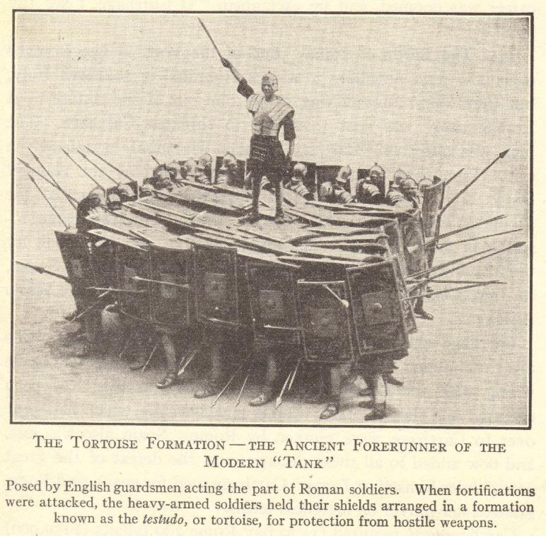
Military Ability
Great soldiers
Well-trained
All volunteers

Slide 15
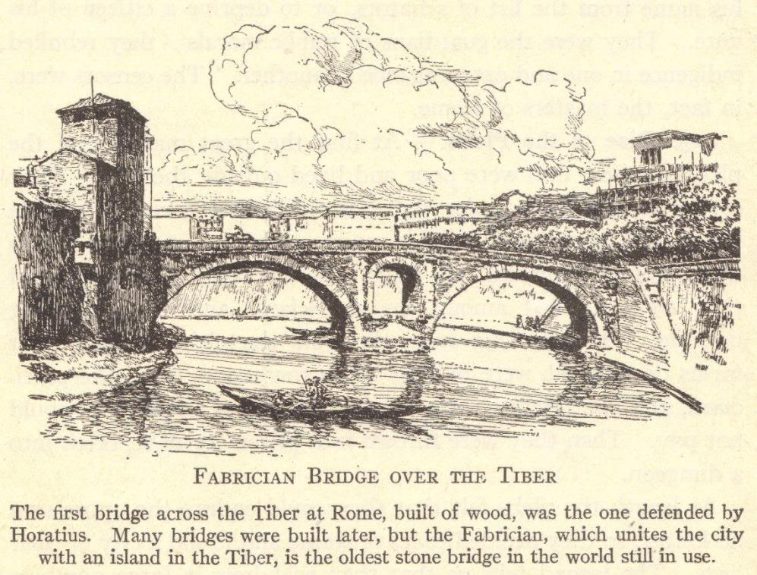
Infrastructure
Few geographical barriers on the Italian peninsula
Military roads radiated from Rome
  Troops could be sent quickly to quell unrest in any area
  Dual purpose—roads came to allow quick and easy travel by tax collectors, traders, travelers, and officials
Famous roads
  Appian Way
  Flaminian Way
  Valerian Way
Public funds dedicated to building and maintaining the Republic’s infrastructure

Slide 16
Strategy: Divide and Control
Rome’s fear:
  That allies and colonies would unite against Roman Rule
Rome’s solution:
  Keep groups under Roman control disunited
How it was done:
  Forbade alliances between them
  Separate privileges and treaties

Slide 17
Treatment of Conquered Peoples
Conquered peoples were treated well
  Some received full Roman citizenship, including suffrage
  Some controlled their own affairs but paid tribute and gave soldiers to the Roman army
Colonies
  Rome established colonies in conquered areas, each protected by a garrison of Roman soldiers
  Republic encouraged intermarriage
    Led to the spread of Roman culture and language (Latin)

Slide 18
Review Questions
What are the geographic barriers of the Italian peninsula?
Apart from the Latins, what other groups lived in Italy?
According to tradition, who founded the Roman Republic in 509 BCE?
Who were the patricians, and what rights did they have?
Who were the plebeians, and what rights did they have?
Why was Rome so successful?

