Slide 1
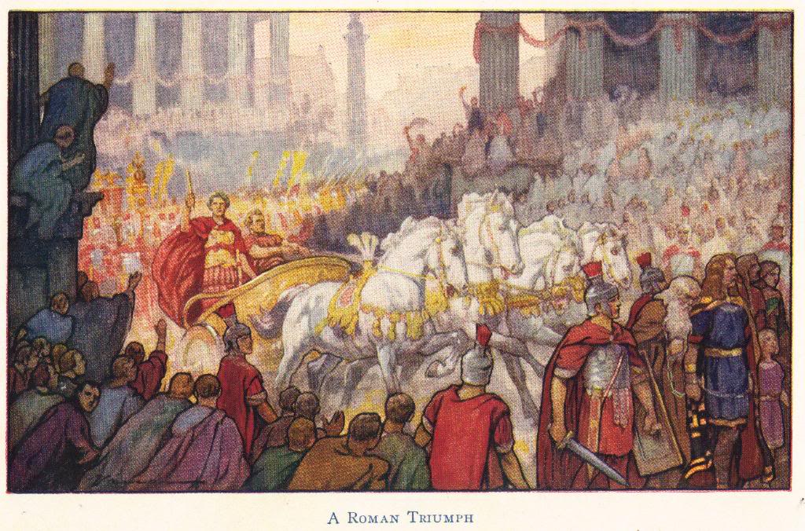
The Rise and Fall of the Roman Empire
© Student Handouts, Inc.
www.studenthandouts.com

Slide 2
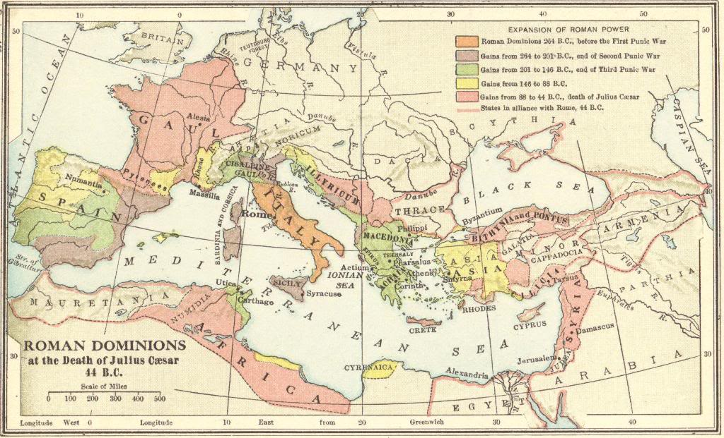

Slide 3
What was the Roman Empire?
There were two periods of Roman government.
  Roman Republic
    509 BCE-30 BCE
  Roman Empire
    30 BCE-476 CE
Rome technically had an “empire” under the Roman Republic.
  But the term “Roman Empire” refers to the time period, beginning with Augustus, when Rome was ruled by emperors.

Slide 4
Octavian Becomes Augustus
Octavian was sole ruler of Rome after his forces defeated Antony and Cleopatra at the Battle of Actium
The Senate gave him the name “Augustus,” meaning “most high”
23 BCE – Octavian, now referred to as Augustus, was made consul for life by the Senate
  Also made “Princeps,” meaning “first citizen”
    Origin of the word “prince”
  Also made “Imperator,” meaning “successful general”
    Origin of the word “emperor”
  Also made “Pontifex Maximus,” or “chief religious leader
    Origin of the word “pontiff” (used to describe the pope today)
  Also made a tribune
  He had the power to call the Senate, veto the Senate’s laws, and make laws himself

Slide 5
Primus inter pares
“First among equals”
Augustus and later emperors tried to maintain the façade that they were elected officials rather than dictators
Being “first among equals” gave the illusion that an emperor was the most prestigious and important member of the Roman Senate, but that each senator was simultaneously equally important
In reality, the Roman emperors ruled with little input from anyone else

Slide 6
Rome under Augustus:
A Golden Age
Attempted to reform public morals by promoting family life (largely unsuccessful).
Established a strong money system.
Extended citizenship to more and more provincials.
Jesus, the founder of Christianity, was born in the Roman province of Judea during the reign of Augustus.
Encouraged the growth of business.
Built and maintained the empire’s infrastructure (e.g., roads).
Said he “found Rome a city of bricks and left it a city of marble.”
Established fire and police departments for Rome.
Began the practice of declaring emperors gods, and of picking their own successors. (He called Haley’s Comet the spirit of Caesar.)

Slide 7
Pax Romana – Roman Peace
Rome controlled the entire Mediterranean region and beyond
  Complete control = almost no warfare
This peace lasted nearly 200 years
More and more provincials were granted official Roman citizenship

Slide 8
Roman Emperors after Augustus
Great variety in the quality of those emperors who succeeded Augustus
The office of emperor was initially designed to be hereditary
  But from the start, there was confusion as to which family member would inherit the throne
  Some emperors proved to be cutthroats, or insane, or both
  The military came to play an enormous role in selecting who would become emperor

Slide 9
Tiberius (14-37 CE)
Stepson of Augustus
Abolished the Assembly
Capable general who extended the frontier in the north
Strengthened the empire
Appeared to dislike ruling, and gradually retired to the island of Capri

Slide 10
Caligula (37 CE-41 CE)
Son of famed military leader Germanicus, the nephew and adopted son of Tiberius
Earned his name “Caligula,” meaning “little boots,” by the Roman army as a child (he was dressed like a soldier)
Two years of good, effective rule, interrupted by a severe illness, and followed by two years of horrible rule
Members of family and perceived enemies
  Exiled some, killed some, and forced others to commit suicide
Assassinated in 41 CE by members of the Praetorian Guard

Slide 11
Claudius (41-54 CE)
Brought southern Britannia (what later became Great Britain) under Roman control, as well as several kingdoms in the East
Opened the Senate up to provincials
Became emperor because he was the last adult male of his family (brother of Germanicus and uncle of Caligula)
Conducted a census of the empire in 48 CE
  5,984,072 Roman citizens

Slide 12
Nero (54-68 CE)
Considered a tyrant
Came to power after his mother allegedly poisoned his predecessor, Claudius
Murdered his mother, his stepbrother, and two of his wives
Also killed his teacher, the famous philosopher Seneca
Fire in Rome (64 CE)
  Nero was accused of setting the fire, and of fiddling while the city burned
  Nero blamed the fire on the new religious group known as “Christians”
Forced to commit suicide

Slide 13
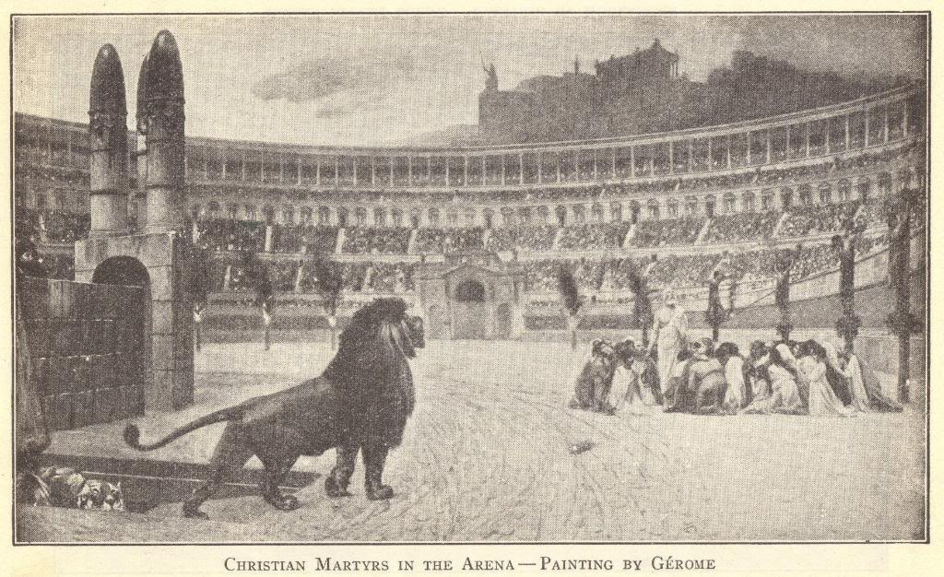

Slide 14
Year of the Four Emperors (69 CE)
Brief period of civil war after the death of Emperor Nero
Four emperors ruled in quick succession
  Galba
  Otho
  Vitellius
  Vespasian
Illustrated the problems of imperial succession

Slide 15
Vespasian (69-79 CE)
Built the Colosseum in Rome
  Place where gladiatorial combats were held
First Jewish Revolt (66-70 CE)
  Destruction of the Temple in Jerusalem, in the Roman province of Judea
  Carried out by Vespasian’s son, Titus
  This was the Second Temple (516 BCE-70 CE)
    First Temple (built by King Solomon ca. 960 BCE) had been destroyed in 586 BCE when the Babylonians conquered the Jews and embarked on what became known as the Babylonian Captivity
Succeeded by son Titus, then son Domitian

Slide 16
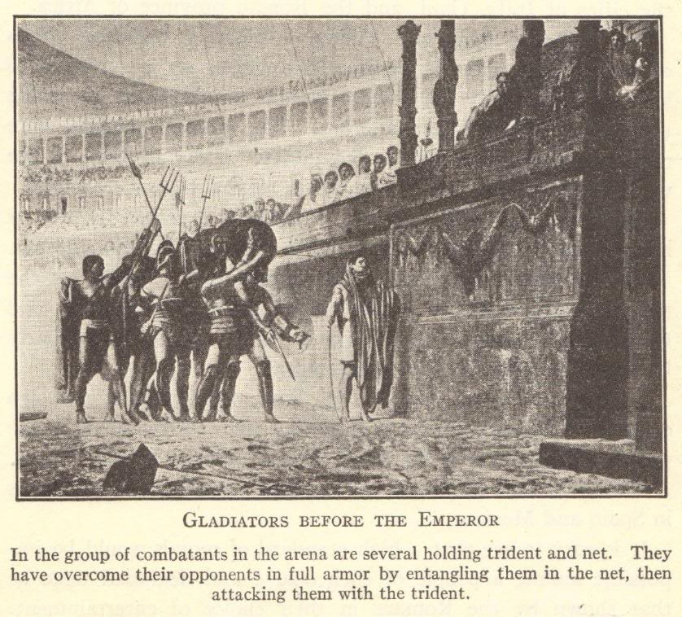

Slide 17
Trajan (98-117 CE)
Born into a non-patrician family in what is now Spain
Massive public works program in Rome
  Trajan’s Column, Trajan’s Forum, Trajan’s Market
Oversaw the expansion of the empire to its greatest extent
Considered to have been a great emperor

Slide 18
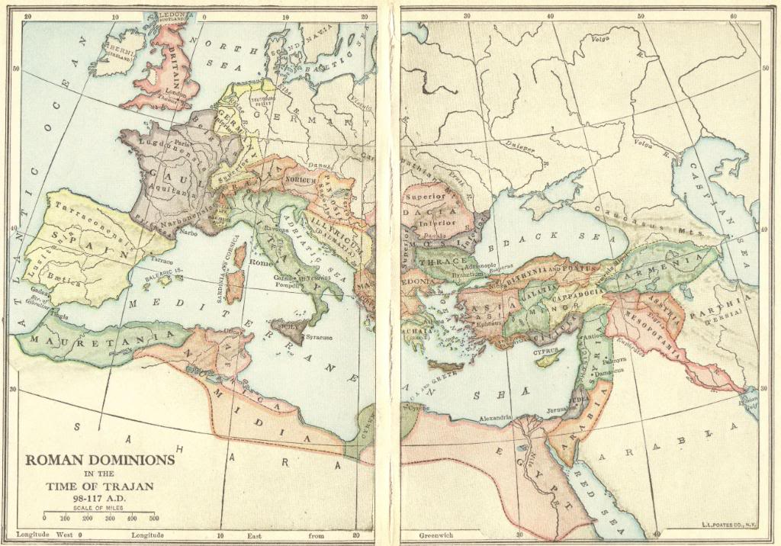

Slide 19
Hadrian (117-138 CE)
Strengthened the empire’s defenses
  Hadrian’s Wall separated Roman territory in Britannia from the Picts (in what is roughly now Scotland)
Under Hadrian, the Romans put down the Second Jewish Revolt (Bar Kokhba Revolt), 132-136 CE
  Also known as the Second Jewish-Roman War
  Led by Simon Bar Kokhba, a man many believed to be the messiah
  Jews forced to leave Jerusalem after defeat
    Many historians date this as the official start of the Jewish Diaspora

Slide 20
Review Questions
What are the dates for the Roman Republic and the Roman Empire?
Explain the meaning of the Latin phrase primus inter pares.
Describe the accomplishments of Augustus.
What was the Pax Romana?
How do Caligula and Nero represent the problems of hereditary succession?
Describe the First and Second Jewish Revolts, including their causes and effects.

Slide 21
Marcus Aurelius (161-180 CE)
Stoic philosopher
  Wrote book Meditations
Succeeded by his son, Commodus (180-192 CE)
  The characters in the Russell Crowe film “Gladiator” are very loosely based on Marcus Aurelius and Commodus
The end of the reign of Marcus Aurelius was the end of the Pax Romana (27 BCE-180 CE)

Slide 22
Diocletian (284-305 CE)
Rome had a century of chaos following the death of Marcus Aurelius
  The “Crisis of the Third Century”
  Diocletian was the first emperor in 100 years to properly restore order and end the violence
Absolute ruler who ended all personal liberties
Administration
  Increased the bureaucracy for more effective administration
  Divided the empire into two administrative realms (east and west) in 285 CE
    This was the first step in the creation of what would become two separate empires
      Roman (Western) Empire
      Byzantine (Eastern) Empire

Slide 23
Constantine (312-337 CE)
Moved the capital from Rome to Byzantium
  Renamed the city Constantinople
    Today the city is Istanbul (in modern Turkey)
Constantine and Christianity
  His mother, Helena, had converted to Christianity
  Edict of Milan (313 CE)
    Christianity legalized (religious toleration)
  Converted to Christianity on his deathbed

Slide 24
Justinian (527-565 CE)
Powerful emperor of the Eastern (Byzantine) empire headquartered at Constantinople
  Married Theodora, an intelligent courtesan
Managed to reunite the Eastern and Western empires for a time, but this did not last
Rewrote Roman law (Corpus Juris Civilis, or the Justinian Code)
  Still the basis for civil law in several countries
Plague of Justinian (541-542 CE)
  Bubonic plague severely hurt the Byzantine empire
  Emperor Justinian became sick, but recovered
  Recovery for the Byzantine empire took hundreds of years

Slide 25
The Two Empires
Emperor Diocletian had believed that dividing the empire for administrative purposes would strengthen the empire
  He was wrong
  Once Constantine set up Constantinople as a capital city, the east/west split deepened
Western (Roman) Empire
  Ended officially in 476 CE when the last emperor, Romulus Augustus, was deposed by a barbarian, Odoacer
Eastern (Byzantine) Empire
  Lasted until 1453 when the empire was conquered by the Ottoman Turks

Slide 26
Why did Rome fall?
Economic Reasons
Gap between rich and poor
Impoverished workers became tied to the land as coloni (sold as the land was sold)
As fewer members of the lower classes could afford to buy goods (no purchasing power), manufacturing and trade declined
Large estates became self-sufficient, further hurting manufacturing and trade
Military Reasons
Roman Republic
Reliance on barbarian troops
Armies were servants of Rome
Roman Empire
Armies made and unmade emperors
Not ultimately loyal to Rome
Could not be counted on to fight their fellow barbarians
Interested in obtaining booty, not defending Rome or furthering Rome’s interests

Slide 27
Why did Rome fall?
Political Reasons
Decline in patriotism
East/West split
Social Reasons
Population decline
Religious divisions
Democracy did not exist in reality
Citizens lost their tie (voting rights) to the state
Patriotism became based on loyalty to an emperor, not to Rome
Two empires created problems regarding loyalty
No orderly succession
Murders, forced suicides, and civil wars frequently accompanied the transition from one emperor to the next
Hunger
Plagues
War
Decline in intellectual culture
People did not dedicate themselves to public service and intellectual pursuits
People instead spent their leisure time watching chariot races and gladiatorial contests
Eastern and Egyptian cults took away the popularity and status of traditional Roman religion
New faiths like Christianity directly questioned and challenged concepts such as imperial divinity
Most emperors did not inspire respect or loyalty

Slide 28
Why is ancient Rome so important to world history?
Administration of a vast empire
Christianity
Architecture
Engineering
Historians
Jewish Diaspora
Literature
Roman law
Romance languages
Transmission of Greek (Hellenistic) culture
The Romans did not necessarily create and invent everything that they are commonly given credit for. What the Romans were best at was taking something (like the Etruscan arch), adapting it, and putting it to great use (such as in the construction of aqueducts).

Slide 29
Administration of a Vast Empire
Empire included over 100,000,000 people of diverse backgrounds, cultures, and places
  Rome learned to adapt its policies on a local level to fit the people of a given area
  Citizenship gradually extended to all free men of the empire
Solid, strong bureaucracy that kept things running smoothly the majority of the time
  Empire’s administration run by countless proconsuls, procurators, governors, and minor officials
  Four prefectures, further divided into dioceses, then into provinces
Strong infrastructure
  Facilitated movement by officials, soldiers, traders, travelers, etc.

Slide 30
Christianity
Christianity started in the Roman province of Judea
Pax Romana and Roman infrastructure
  Early Christians, as citizens of the Roman Empire, could travel freely throughout the empire
  There was a significant number of Christians in Rome by 64 CE, the year Nero blamed them for the fire (ca. 30 years after Jesus died)
  According to tradition, Paul of Tarsus (St. Paul) used his Roman citizenship to have his criminal trial relocated to Rome from Caesarea (in Judea-Palestine) in the 60s CE
Christianity finally gained acceptance with the Edict of Milan (313 CE) and Constantine’s conversion
  Future Roman emperors were Christians
  As the Western Roman Empire fell apart, the city became the headquarters of the Roman Catholic Church
    The Pope used the imperial title “Pontiff”
    The Church ended up ruling the city of Rome and surrounding areas
    Church used Roman administrative districts, such as dioceses, in its administration

Slide 31
Architecture & Engineering
A large part of Rome’s success was due to the importance Rome placed on building and maintaining the empire’s infrastructure
  Aqueducts, bridges, dams, harbors, roads
Public buildings
  Amphitheaters (e.g., Colosseum), basilicas (oblong halls), government offices, palaces, public baths, theaters, etc.
Architecture
  Basic style was copied from the Greeks
  Arch copied from the Etruscans
  Dome
  Vault

Slide 32
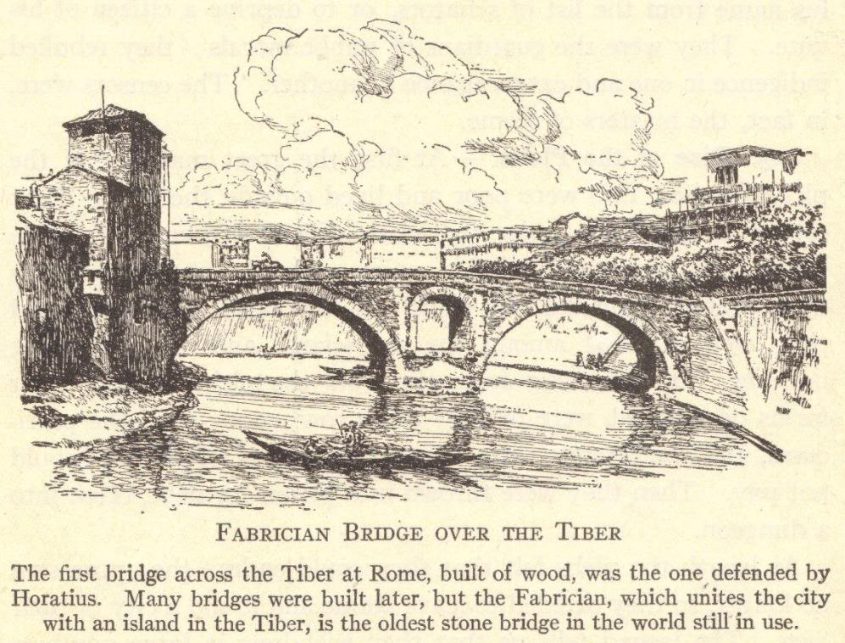

Slide 33
Historians and
Historical Writings
Julius Caesar (100-44 BCE)
  Commentaries on the Gallic Wars
Cicero (106-43 BCE)
  Letters and orations
  Called the “Father of Latin prose”
Livy (59 BCE-17 CE)
  Annals, history of Rome from beginnings to Augustus
Plutarch (46-120 CE)
  Parallel Lives, comparison of Greek and Roman heroes
  Moralia, a collection of essays, etc., on customs and mores
Tacitus (ca. 56-ca. 117 CE)
  Germania, about the Germanic tribes of Europe
  Annals and Histories, about the emperors of his time

Slide 34
Literature
Playwrights
  Plautus and Terence
  Mostly a copy of the Greek style
    But Greek plays were designed to instruct
    Roman plays were designed merely to entertain
Poets
  Virgil (70-19 BCE)
    Aeneid, epic poem based on Homer’s Iliad
  Horace (58-8 BCE)
    Odes
    Lyric poetry praising an idyllic, simple time in early Roman history

Slide 35
Jewish Diaspora
Judea-Palestina (roughly modern Palestine or Israel) was a Roman province
The Romans put down a series of uprisings
The future Emperor Titus destroyed the Second Temple of Jerusalem and carried its spoils to Rome (70 CE)
After the Bar Kokhba Revolt (132-136 BCE), the Jews were forced to migrate from the area around Jerusalem
  Jews were never again a large presence in Israel-Palestine until the 20th century

Slide 36
Roman Law
Started with the Twelve Tables (450 BCE)
Developed over a thousand years
  Included decisions of judges, ideas of the Republic and Empire, and rulings of emperors
  Public law
    Relationship of citizen to state
  Private (civil) law
    Relationships between people
  Peoples law (jus gentium)
    Rights of foreigners
Justinian Code (6th century CE)
  Encapsulated the previous 1000+ years of Roman law
  Still used as the basis of civil law in many parts of Europe

Slide 37
Romance Languages
“Romance” meaning “Roman”
Romance languages developed from Latin
  French
  Italian
  Portuguese
  Romanian
  Spanish
English
  Old English was a Germanic language
  William the Conqueror, of Normandy (in France), brought French (a Romance language) to England in 1066
  Middle English (the forerunner of the English spoken today) is a mixture of these old Germanic and French languages
  About half of modern English can be traced to Latin
Law, medicine, and science
  Scientists have traditionally used Latin as a “universal language”
  Our scientific names, and most legal and medical terminology, is Latin
Religion
  The Catholic Church preserved the Latin language
  Catholic masses were said in Latin until the 1960s

Slide 38
Roman Science
The Romans were not great scientists like the Greeks had been
  Little original thought
Pliny the Elder (23-79 CE)
  Natural History, a collection of all known botanical, geographical, medical, physiological, and zoological information available
  But Pliny never verified his information
Galen (131-201 CE)
  Summarized all Greek medical knowledge
  His work was almost the entire basis for anatomy and physiology studies for centuries to come
In science, as in all else, the Romans were practical
  Public health and sanitation were important
  Aqueducts brought fresh water and sewers took away dirty water
  Hospitals served soldiers (triage), etc.

Slide 39
Transmission of Greek (Hellenistic) Culture
Preserved and transmitted Greek culture to the West
Greek texts, etc., were popular in Rome
When Rome fell, the Catholic Church (monks) continued to preserve and transmit Greek texts and ideas

Slide 40
Review Questions
Who split the empire into two halves, and why?
Explain the relationship between Emperor Constantine and Christianity.
Describe the accomplishments of Emperor Justinian.
When did the Western (Roman) and Eastern (Byzantine) empires officially end, and why?
Explain the economic, military, political, and social reasons for the fall of the Western Roman Empire.
Name and describe at least three contributions of Roman civilization to world history.

