Slide 1
Government in Britannia from the Romans to the Model Parliament
© Student Handouts, Inc.
www.studenthandouts.com

Slide 2
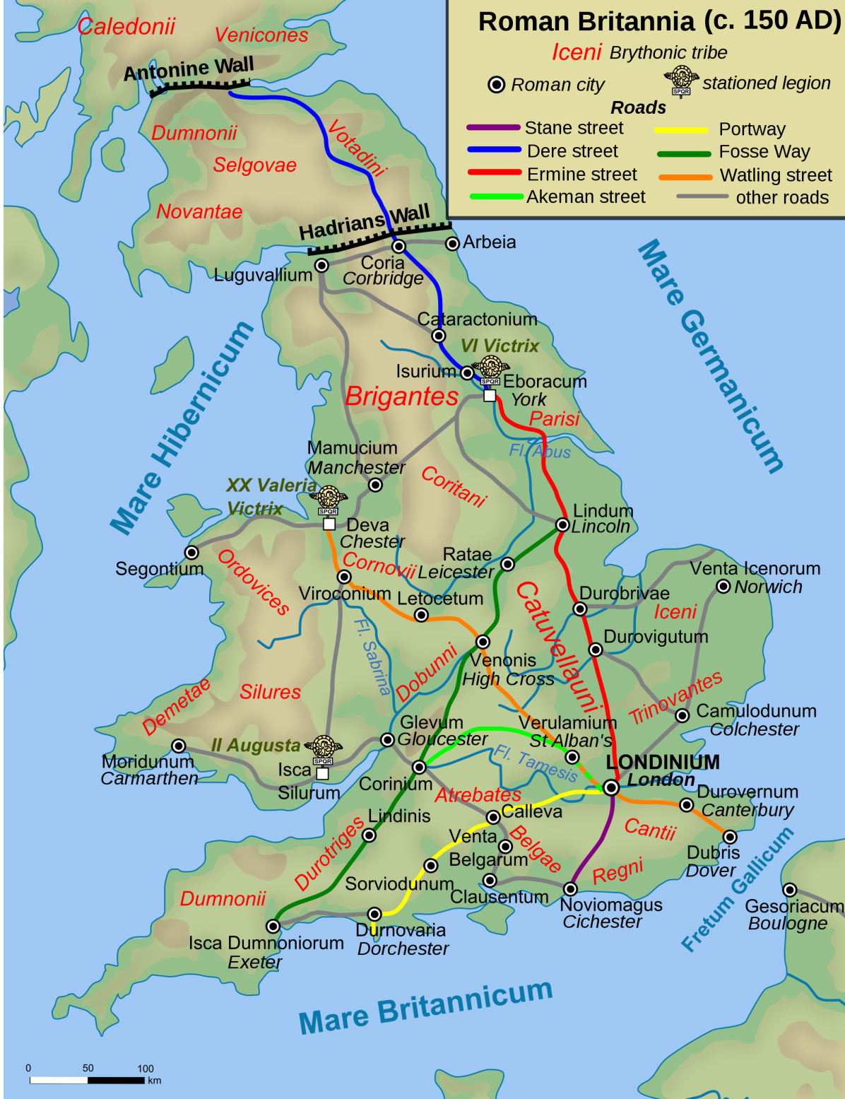
Roman Britain
Island of Britannia, and the native Britons who lived there, were ruled by the Roman empire
Conquered in 43 CE under Emperor Claudius
Roman troops pulled out by 410 CE as Rome declined
Established city of Londinium
Ruled according to Roman law
Germanic tribes began invading Britannia in the early 400s as Rome declined
Notes:
Map courtesy of Wikipedia: http://upload.wikimedia.org/wikipedia/commons/thumb/e/ee/Roman_Roads_in_Britannia.svg/2000px-Roman_Roads_in_Britannia.svg.png

Slide 3
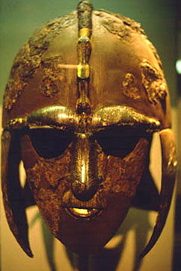
The Anglo-Saxons
A collection of Germanic tribes (Angles, Saxons, Jutes, and more)
From Angeln, Lower Saxony, Jutland peninsula, and elsewhere
Invaded along the eastern and southern coasts
Settled in farming villages rather than in trading cities
Pushed the bulk of native Britons to the west (to places like Cornwall and Wales)
Spoke Old English
Eventually converted to Christianity
Helmet found at the Sutton Hoo archaeological dig (a burial site). It probably belonged to Raedwald of East Anglia (died circa 624 CE).
Notes:
Image courtesy of Wikipedia: http://upload.wikimedia.org/wikipedia/commons/7/77/Sutton.hoo.helmet.jpg

Slide 4
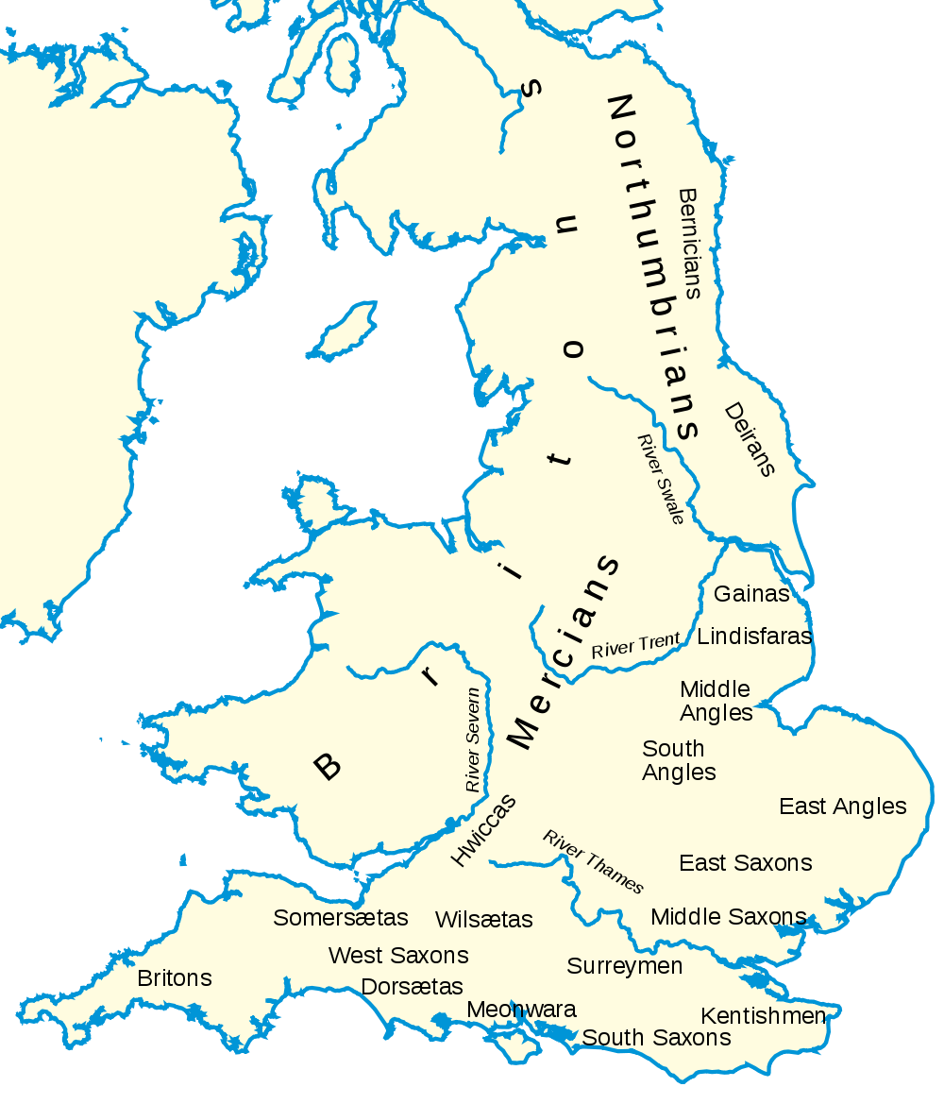
King Alfred’s Response to the Viking Invasions
Anglo-Saxon kings ruled various kingdoms, like Sussex and Wessex
Alfred of Wessex – became first English king, Alfred the Great
Helped to repel Viking invasions which started circa 800 CE
Set up the burghal system
Alfred lived ca. 849-899, reigned 871-899
Notes:
Image courtesy of Wikipedia: http://upload.wikimedia.org/wikipedia/commons/thumb/e/ee/Britain_peoples_circa_600.svg/1000px-Britain_peoples_circa_600.svg.png

Slide 5
Burghal System under the Anglo-Saxons
Burhs (boroughs) established under Alfred the Great
Fortified towns
Expensive to man and maintain
Shires
Administrative districts
Shire is synonymous with county
Shire was expected to pay for the support and maintenance of its borough
Shires were governed by a shire reeve, or sheriff
Reeve – Term dating back to Old English that means a representative of the crown
Notes:
Notes for the teacher: Shire is Old English, related to the word shear, meaning to rip or divide; in this case, England was divided into shires. The word county, a French word, was used in place of shire after the French-speaking Normans invaded England in 1066. This background (a review if this material was covered while studying the Middle Ages) is important because it illustrates the development of a centralized government, and because burgesses, wealthy commoners representing the boroughs, were a crucial part of the Model Parliament.

Slide 6
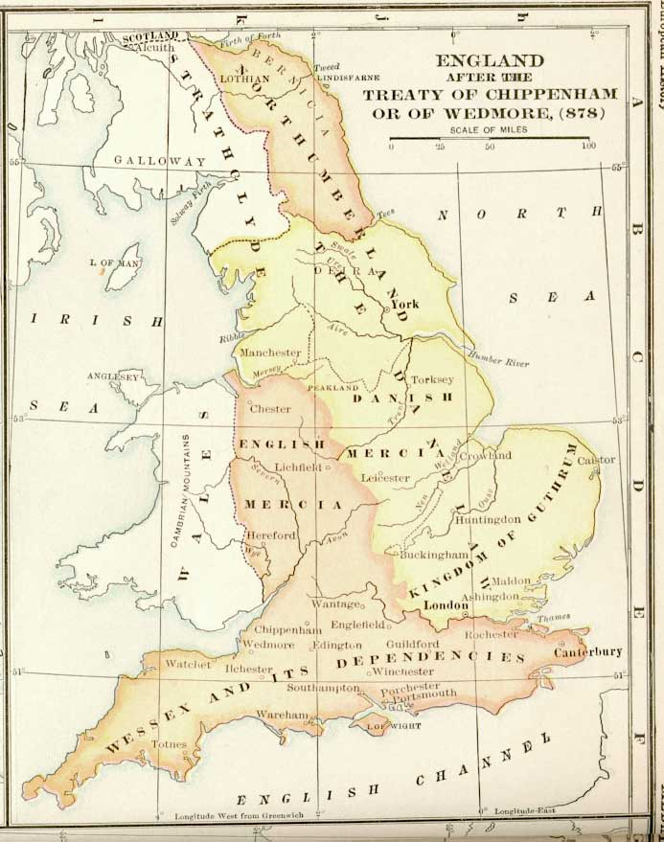
Danelaw
Danelaw describes the territory ruled by the Danes (Vikings), the treaties between the Danes and the Anglo-Saxons, and the laws of the Danish settlers
Weregeld (were = man; geld = money) – payment for the death of a person
The higher the person’s rank, the higher the payment
But we would not recognize most of the Danish system of law and government
Notes:
Image courtesy of Wikipedia: http://upload.wikimedia.org/wikipedia/commons/3/37/England-878ad.jpg
Danish law was essentially the same as Anglo-Saxon law. The weregeld ended as it was replaced with capital punishment towards the end of the Middle Ages. However, historians and legal scholars argue that it stuck around in common law, in the form of wrongful death lawsuits.

Slide 7
11th-Century Kings of England
Canute (Cnut) the Great
Harold Harefoot (Harold I)
Harthacnut
Reigned 1016-1035
Reigned 1035-1040
Reigned 1040-1042
Edward the Confessor
Reigned 1042-1066
Harold Godwinson (Harold II)
Reigned January-October, 1066

Slide 8
Norman Conquest, 1066
Edward the Confessor died without a clear heir
Plenty of people wanted the throne
Harold Godwinson ruled for most of 1066
His sister had been the wife of Edward the Confessor
Considered the last Anglo-Saxon king of England
William the Conqueror (William I)
Illegitimate son of the Duke of Normandy and cousin of Edward the Confessor
Won English throne from Harold Godwinson at the Battle of Hastings
Crowned on Christmas Day, 1066
England under William I
Centralized government
Kept 1/5 of the land for himself and divided the rest among his loyal followers
King of England, but a vassal to the king of France (because of Normandy)
William I and the French lords under him spoke French
Development of Middle English (combination of Old English and French)
Notes:
Notes for the Teacher: Again, a lot of this is basic review of the Middle Ages. It is important in terms of government centralization because the lords established under William I owed complete loyalty to him. It is also important to point out to students that this is the time when the English language as we know it began to develop.

Slide 9
Review Questions
What group ruled the Britons from 43 to 410 CE?
What group(s) invaded Britannia beginning in the early 400s?
What group settled in England beginning around 800 CE?
What was the burghal system?
How and why did the Normans conquer England in 1066?
How did William the Conqueror establish civilized government in England?

Slide 10
Henry II (Ruled England, 1154-1189)
Henry II married Eleanor of Aquitaine
Added Aquitaine to his lands in France
Henry II’s development of the English legal system
Circuit courts
Royal judges visited each part of the realm at least once a year
These royal judges heard legal cases and collected taxes
Slowly, these judges started creating common law throughout the realm by using common sense and establishing precedent
Jury system
No more trial by combat, etc.
Loyal, respected citizens (men) who knew the parties in a dispute answered the judge’s questions regarding the case
Juries became extremely popular and spread
Juries were part of the royal court system only
Notes:
Notes for the Teacher: The development of common law is important for understanding law (especially tort law) in the United States. It should be pointed out to students that because judges were appointed by the king (central government) and traveled throughout England, the common law these judges developed was not specific to particular areas.

Slide 11
King John (Ruled 1199-1216)
Henry II was succeeded to the throne by his son, Richard the Lionheart
Richard the Lionheart (Richard I) spent most of his time in France or fighting in the Third Crusade
Fun fact: A lot of historians believe that the Robin Hood stories are set in the time when King Richard was abroad, and John was left in England
Richard died, leaving the English throne to his brother, John
King John
Foreign relations
Lost all of his northern French lands to Philip Augustus
Domestic issues
Unfair ruler with harsh tax policies (taxes used to finance failed foreign wars)
Tried to take power from the Church
Threatened the self-governing charters of towns
Nobles eventually had enough and revolted
Notes:
Notes for the Teacher: Tying King John to the medieval tales of Robin Hood explains the character and policies of King John in a way that students quickly understand, since most everyone is aware of the Robin Hood stories.

Slide 12
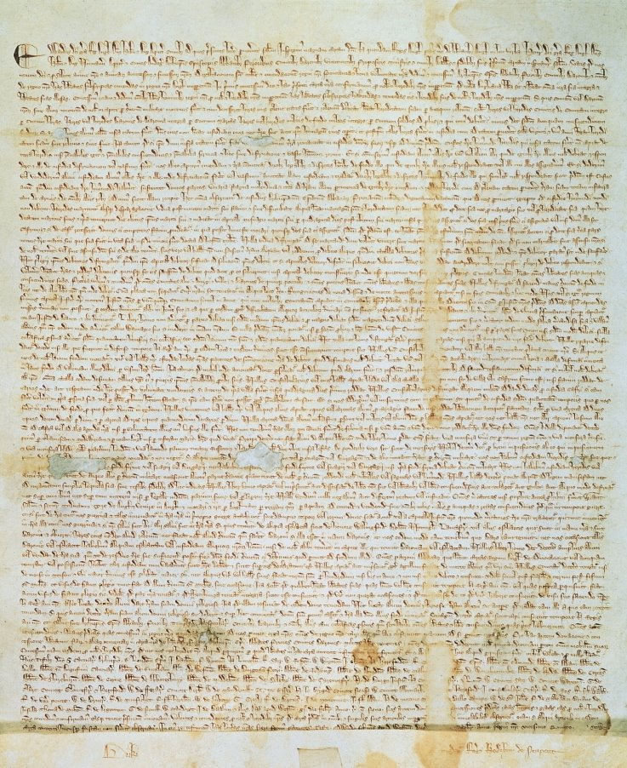
Magna Carta (1215)
Nobles met with King John at Runnymede, just west of London
Forced King John to sign the Magna Carta (Great Charter)
Due process of law
No unlawful seizure of a freeman’s property
Right to a jury trial
Important idea:
In times of crisis, a monarch could be forced to relinquish or share power with others in order to get what he/she wanted (in this case, tax revenue)
Magna Carta granted power to nobles
Later, other groups would move to have the rights of Magna Carta applied to themselves
Notes:
Image courtesy of Wikipedia: http://upload.wikimedia.org/wikipedia/commons/0/02/Magna_Carta.jpg
Notes for the Teacher: In many ways, the development of parliamentary democracy in England is the struggle between the monarchy, nobility, and commoners for power. The extension of rights and power to one group typically followed some sort of crisis or boiling point, with power extended to a group to either keep another group or person from holding power, or to gain political loyalty from the empowered group. Although discussions of this concept can become rather cynical, it is likewise condescending to tell students that power-sharing and empowerment have occurred historically through altruistic handholding.

Slide 13
Model Parliament, 1295
King John succeeded by his son, Henry III (reigned 1216-1272)
Henry III succeeded by his son, Edward I (reigned 1272-1307)
Edward I
At war with the French, Scots, and Welsh, and needed money for these wars
Called a meeting of a parliament to establish taxes to support these wars
Edward I knew that the nobles did not want to pay more tax money
He needed another group to check the power of the wealthy, powerful lords
Model Parliament, November, 1295
Edward I summoned bishops and nobles (lords)
Edward I also summoned two burgesses (wealthy, property-owning non-nobles) and two knights from each county (a.k.a. shire)
This mixture of commoners and the nobility served as a model for later parliaments
Notes:
Notes for the Teacher: When the “rotten boroughs” of the 19th century are later explained to students, the importance of including this seemingly supplemental borough/burgess information here will be evident.

Slide 14
Development of Parliament
14th century
Kings continued to call together this mixture of people when new taxes were needed
Houses of Parliament gradually developed
House of Lords – nobles
House of Commons – burgesses and knights
Parliament was started by Edward I to check the power of the lords
Gradually, Parliament became powerful
Parliament grew to be a check on the power of the monarchy
Future monarchs would have to deal with the power of Parliament

Slide 15
Review Questions
How did English law develop under Henry II?
How did royal judges create common law?
Describe how early juries functioned.
Why was King John unpopular?
What rights were established under the Magna Carta?
In creating the Model Parliament, how did Edward I attempt to check the power of the lords?

