Slide 1
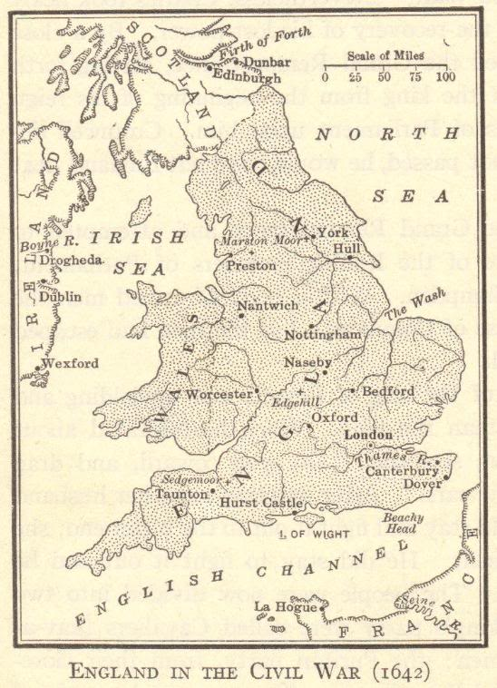
The Rise of Parliamentary Democracy in England
© Student Handouts, Inc.
www.studenthandouts.com

Slide 2
James I
James Stuart (James VI of Scotland) inherited the English throne from his cousin, Elizabeth I, in 1603
  Elizabeth I died without producing an heir
  James VI of Scotland became James I of England
Problems with Parliament
  Fought over money
  Fought over religion
    Refused to make reforms to “purify” the English church of Catholic practices
    All he agreed to was a new translation of the Bible (the “King James Version”)

Slide 3
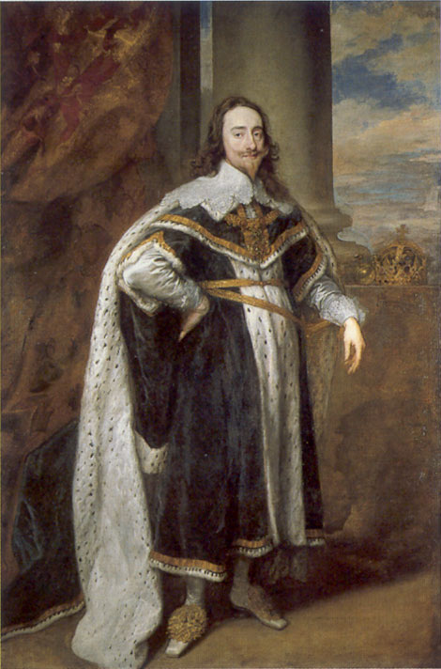
Charles I
Charles I inherited the throne from his father in 1625
  Fought with Parliament over money
    Needed funding for wars with France and Spain
  Dissolved Parliament whenever he couldn’t get his way
    1628 – recalled Parliament
    In exchange for money, Charles I had to sign the Petition of Right
    He signed it, then ignored it
Notes:
Image courtesy of Wikipedia: http://upload.wikimedia.org/wikipedia/commons/9/96/King_Charles_I_by_Antoon_van_Dyck.jpg

Slide 4
Petition of Right (1628)
Parliament had Charles I sign it in exchange for funding
Petition of Right guaranteed basic liberties
  Only Parliament could levy taxes
  No martial law during peacetime
  Habeas corpus – prisoners could not be held indefinitely without trial; they had the right to go before a judge and hear charges
  Soldiers could not be quartered (billeted) in private homes
Charles I signed it, then ignored it
  Attempted to rule as an absolute monarch
  1629 – Charles I dissolved Parliament
    Set up fines and fees on the people
    Increasingly unpopular

Slide 5
Religious Problems
Protestants wanted to get rid of what they saw as Catholic elements in the Church of England
Charles I wanted to keep the Anglican (English) church as it was
  Wanted to make the religion universal throughout England and Scotland
    Introduced an Anglican prayer book to Scottish Presbyterians
    Scots rebelled and threatened an invasion of England
    Charles I had to recall Parliament yet again for funds for the defense of England

Slide 6
Parliament Again in Session
Fall, 1641 – Parliament attempted to limit royal power
January, 1642 – Charles I tried to arrest the leaders of Parliament, but they got away
Mob gathered outside of the palace
Charles I fled to the north of England and raised an army

Slide 7
English Civil War (1642-1651)
Charles I’s supporters – Royalists (a.k.a. Cavaliers)
Parliament’s supporters – Puritans (a.k.a. Roundheads or Parliamentarians)
  Led by Oliver Cromwell and his New Model Army
    1647 – took Charles I prisoner
1649 – Charles I brought to trial and executed (beheaded) for treason against Parliament
  Dramatic challenge to concept of absolute monarchy
  Monarch was not “the state” because he/she was subject to the laws of the state
Civil war (a.k.a. Puritan Revolution) was actually several separate civil wars
  But all fought for essentially the same reasons, and by almost the same groups
  Charles II (son of Charles I) defeated by Oliver Cromwell’s New Model Army
    Lived in exile in Europe until 1660

Slide 8
Commonwealth (1649-1660)
Historians give different dates for this period
  Civil war (a.k.a. Puritan Revolution) waged (especially during the early years), with different groups struggling for control of Parliament
  1649-1660 – period during which the Stuarts were out of power in England
Parliament was dismissed
Cromwell established a republican government with a constitution written by John Lambert
  But Cromwell ripped up the constitution
    Cromwell became a dictator

Slide 9
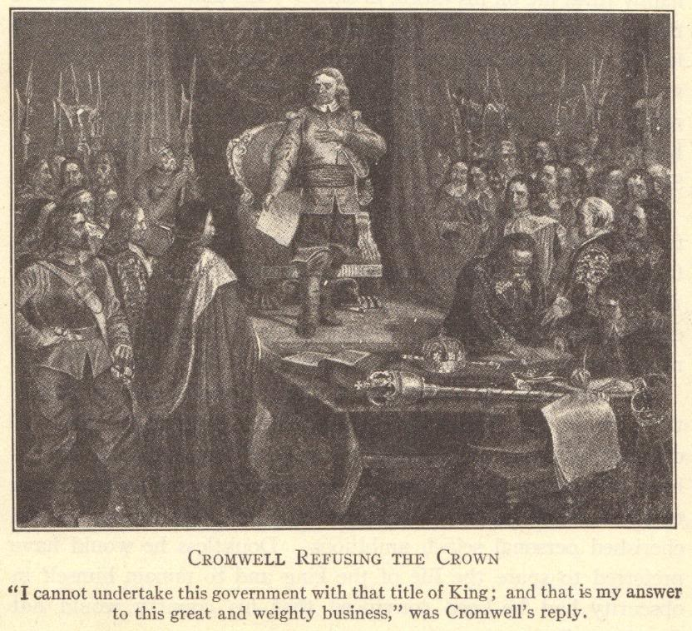

Slide 10
Cromwell and the Puritan Revolution
Tried to create a Puritan society in England
  Attempted to “purify” it by banning “sinful” activities
  “Sinful” activities included dancing, sports, and theater
Some religious toleration
  Christians
    Protestants were tolerated
    Catholics were not tolerated
  Jews
    Had been expelled in 1290
    Cromwell let them back into England

Slide 11
Conquest of Ireland
English had ruled and colonized Ireland for over 500 years
  But Irish disliked and fought against foreign rule
  Most Irish were Catholic and opposed to Protestant Puritan reforms
  Cromwell was extremely anti-Catholic
Irish rebelled against Cromwell
  Cromwell’s New Model Army landed in Ireland in 1649
  Fighting was bitter and violent
    Cromwell’s forces forcibly evicted civilians and destroyed food supplies, sparking a large famine
Act of Settlement (1652)
  Cromwell’s forces won
  All land owned by Catholics who’d fought Cromwell was confiscated by Cromwell’s government
  Circa 12,000 soldiers were paid with confiscated Irish lands
  The class of wealthy Catholic landowners was effectively destroyed in Ireland
    Irish came to work as tenant farmers on their ancestral lands

Slide 12
Restoration
Oliver Cromwell died in 1658
  His son, Richard Cromwell, briefly ruled after his death
Parliament invited Charles I’s son to be king
  The period when the Stuart dynasty (under Charles II) was restored to power is known as the Restoration
Reign of Charles II (1660-1685)
  1679 – Charles II agreed to right to writ of habeas corpus – “to have the body”
    From earlier Petition of Right
    Prisoner could demand to be brought before a judge to hear charges (could not be held indefinitely)

Slide 13
Political Parties Develop
Charles II died in 1685
  He had no legitimate heir
First political parties in Parliament debated who’d be heir to the throne
  Tories
    Supported Charles II’s brother, James, who was a Catholic
  Whigs
    Did not want a Catholic monarch
James II came to the throne in 1685 when his brother, Charles II, died

Slide 14
Reign of James II (1685-1688)
James II put Catholics in power (against English law)
  He dissolved Parliament when it objected
James II was married twice
  First wife – Anne Hyde
    Daughters Anne and Mary raised as Protestants
      Mary married Prince William of Orange (part of the Netherlands)
  Second wife – Mary of Modena – Catholic
    Gave birth to son, James Francis Edward Stuart
    A Catholic son threatened Protestant rule in England

Slide 15
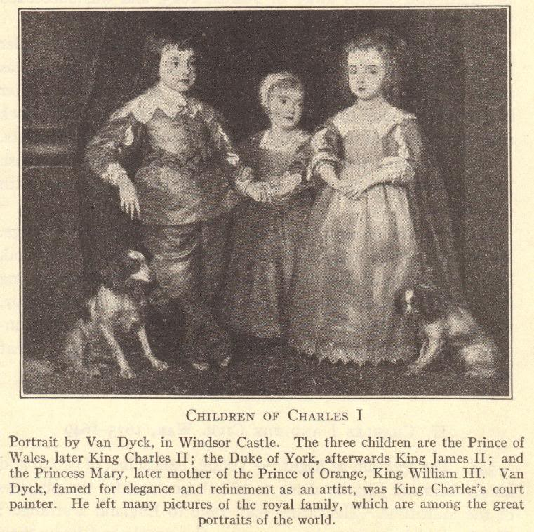
William III and Mary II were not only husband and wife, but first cousins. William III was the son of Mary, sister of Charles II and James II.

Slide 16
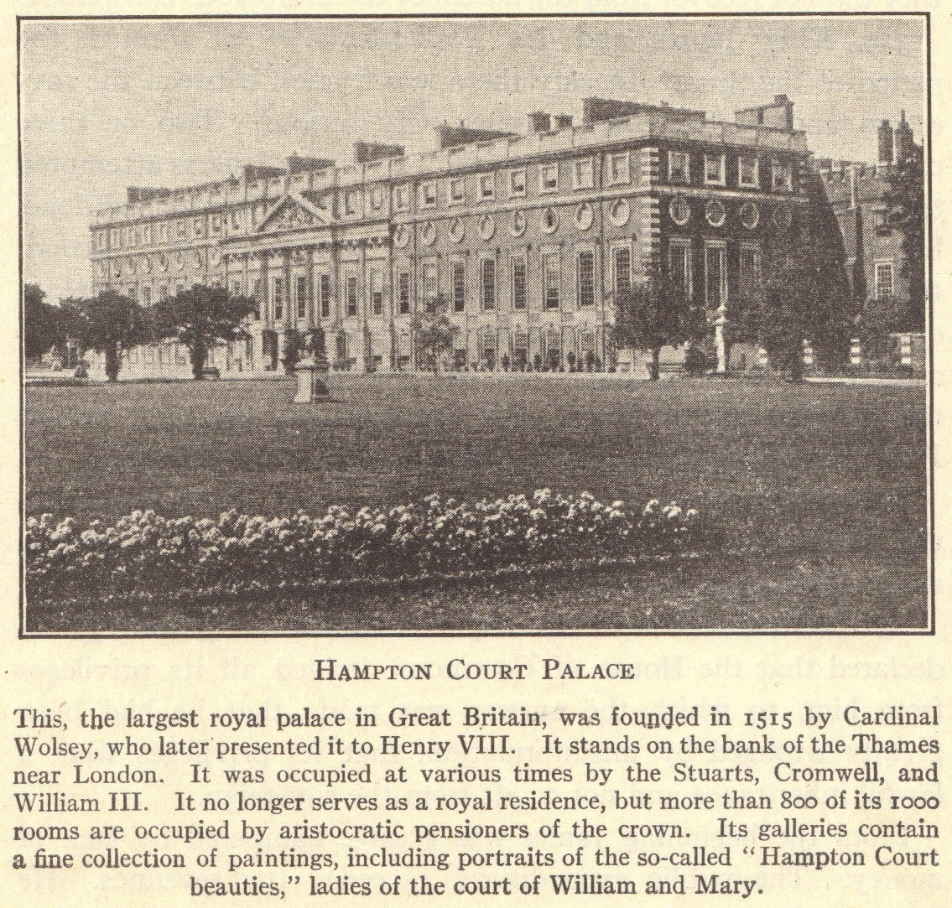
Glorious Revolution
Parliament was scared that Catholic monarchs would rule England
Some members of Parliament offered the throne to James II’s Protestant daughter, Mary, and her husband, William
James II fled to France

Slide 17
English Bill of Rights (1689)
England became a constitutional monarchy
  Monarch’s power limited by laws
  William and Mary consented to these changes
English Bill of Rights
  No taxation without consent of Parliament
  Monarch could not suspend the laws of Parliament
  Freedom of speech for parliamentary debates
  Citizens free to petition the monarch regarding grievances

Slide 18
Cabinet System
Dilemma
  1688 – no monarch could hold the throne without Parliament’s consent
  But Parliament needed the monarch’s permission to rule
18th century (1700s)
  Representatives of the majority party formed a cabinet
  Cabinet worked closely with the monarch
  Leader of the cabinet – Prime Minister
  Prime minister and his/her cabinet are effectively the leaders of the British government today
    Since the joint reign of William and Mary, the role of the monarch has weakened to the point of being only a ceremonial head of state

Slide 19
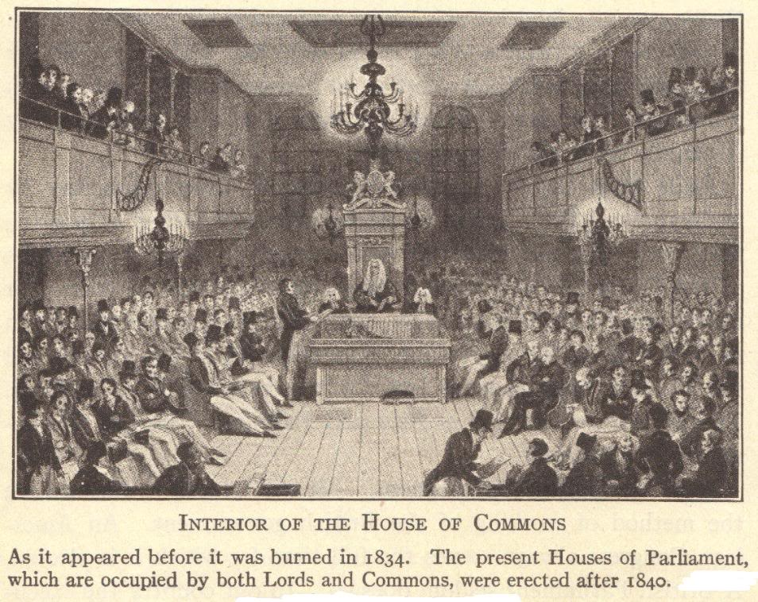

Slide 20
Time Line of 17th-Century England
1603
James I (James VI of Scotland) inherited the English throne from his cousin, Elizabeth I.
1625
Charles I inherited the English throne from his father, James I.
1628
1642
Charles I was beheaded for treason.
Charles I signed the Petition of Right.
1649-1660
1660
1649
The English Civil War, also called the Puritan Revolution, began.
England was run as the Commonwealth, led primarily by Oliver Cromwell.
The Restoration period began as Charles II (son of Charles I) was crowned king.
1685
James II inherited the throne from his brother, Charles II.
1688
James II fled England.
1689
William III and Mary II took the throne of England. They agreed to the English Bill of Rights.

Slide 21
Review Questions
How did the House of Stuart (the Stuart dynasty) come to power in England?
Why did James I and Charles I have conflicts with Parliament?
Describe the Puritan Revolution led by Oliver Cromwell.
How and why was Ireland conquered and colonized under Cromwell’s leadership?
What was the Restoration?
What events led up to James II losing the English throne?
During the 17th century, many English people came to associate Protestantism with parliamentary democracy, and Catholicism with absolute monarchy. Do you agree with this way of thinking? Why or why not?
Notes:
Notes for the teacher: Regarding the last question, students can be prompted to think about Protestants who butted heads with Parliament, like Henry VIII and Elizabeth I, as well of foreign rulers. Were different forms of Christianity used as the pretexts for squabbles that were ultimately about power?

