Slide 1

Early Peoples through the Agricultural Revolution
© Student Handouts, Inc. www.studenthandouts.com

Slide 2
Scientists Who Study Prehistory
Anthropologists
Study human cultures, both past and present
Cultures are the ways that groups of people live and see the world
Archaeologists
Excavate the sites where human beings used to live
Examine the artifacts (objects made by human beings) that cultures left behind
Paleontologists
Study fossils
Fossils are evidence of life preserved in rocks

Slide 3
What Is Prehistory?
Prehistory is everything that happened before written records.
Writing developed in different places at different times.
This means that, technically, the dates for prehistory vary around the world.
Historians using the term prehistory are generally referring to time before the very first human writing, about 5,000 years ago (circa 3000 BCE).

Slide 4
What is the Stone Age?
Although there is some overlapping in some parts of the world, prehistory is roughly equivalent to the Stone Age.
The dates used by historians and archaeologists typically refer to the earliest time that some turning point occurred.
  For example, the Sumerians of Mesopotamia developed writing thousands of years before writing was used by European tribes.
  The time period when Sumerians were literate and Europeans were illiterate is considered historical as opposed to prehistorical because writing existed in the world (even though Europeans weren’t using writing yet).
The Stone Age is divided into two parts:
  Old Stone Age – also called the Paleolithic Age
  New Stone Age – also called the Neolithic Age

Slide 5
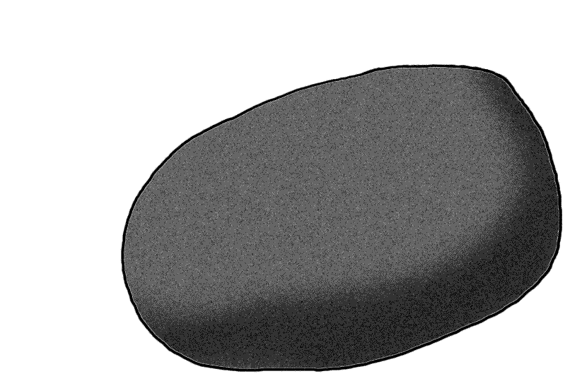
Prehistoric Stone Tools
This shows how a point was made from rock.
Notes:
Image courtesy of Wikipedia: http://upload.wikimedia.org/wikipedia/commons/6/6a/Levallois_Point-Animation.gif

Slide 6
The Stone Age
Old Stone Age
Humans migrated across the globe
End of the Paleolithic coincided with the end of the last ice age
New Stone Age
Neolithic Age
8000-3000 BCE
Paleolithic Age
2,500,000 to 8000 BCE
Made stone chopping tools
Humans made numerous tools, as well as jewelry, from bone, wood, stone, tusks, etc.
Pottery
Agriculture (farming)
Animal domestication
Modern human beings overlapped with Homo erectus and Neanderthals
Modern human beings left as the only hominids on the planet
Permanent settlements
Hunter-gatherers
Cave paintings and small carvings

Slide 7
The Last Ice Age
Humans (nomadic hunter-gatherers) spread out across the globe (in bands of 25-70 people) in search of game and edible plants.
The ice age ended about 10,000 years ago (8000 BCE), leaving humans living all over the world.
Temperatures increased, creating a longer growing season. The ice receded, making the land drier and better for growing plants. During the ice age, a lot of large game was hunted to extinction (like wholly mammoths). The invention of farming allowed people to maintain a steady food supply.
The ice created a bridge between what we now call Siberia and Alaska. Humans crossed this bridge to North America and spread to South America very quickly.
The ice bridge between Siberia and Alaska melted, leaving humans in the Americas separated from the rest of the world.

Slide 8
The Agricultural Revolution
The Neolithic Revolution is also called the Agricultural Revolution. People developed farming for the first time.
For generations, humans had noticed plants growing where they had spit out seeds.
Humans began planting seeds on purpose, which was the invention of farming.
The first farming method was slash-and-burn. Farmers burnt grass and trees to clear a field. The ashes fertilized the soil. Farmers relocated every few years after exhausting the soil.
People continued to hunt, returning to their farms to harvest their crops. Eventually, people built permanent homes near their farms so they could store and guard their grain.
Permanent homes made following game difficult. Eventually, farmers domesticated animals, such as cattle, goats, pigs, and sheep. Animals ate farm waste while fertilizing the soil.

Slide 9
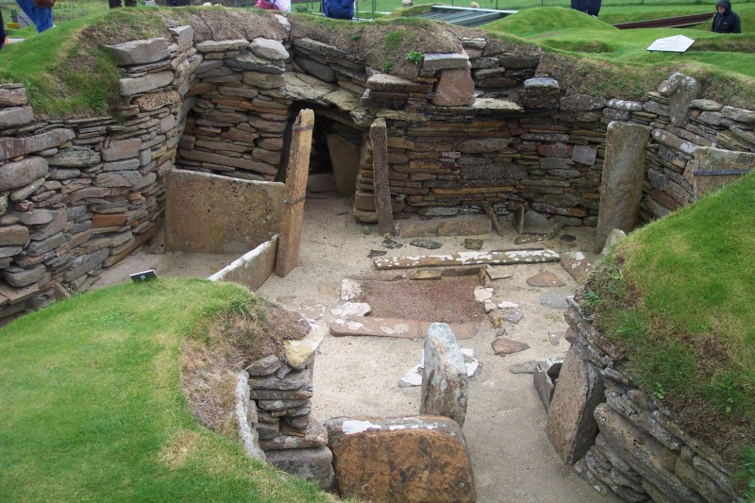
Neolithic Village: Skara Brae in Scotland
Notes:
Image courtesy of Wikipedia: http://upload.wikimedia.org/wikipedia/commons/3/31/Orkney_Skara_Brae.jpg

Slide 10
Agriculture around the World
Africa (Nile River Valley)
5000 BCE
Wheat, barley
China
6000 BCE - Millet
5000 BCE - Rice
India (Indus River Valley)
5000 BCE
Cotton
Iraq (Mesopotamia - Fertile Crescent)
Central America and Mexico
5000 BCE
Beans, corn, squash
5000 BCE
Wheat, barley
Peru
3000 BCE
Tomatoes, potatoes

Slide 11
Catal Huyuk
One of the world’s very first permanent settlements
  Populated 7500-5700 BCE
Located in what is now Turkey
Population of approximately 6,500 people
  1,000 dwellings crammed together like a honeycomb
  No streets – people climbed out through ladders in their ceilings
Supported by agriculture and animal domestication
  Barley, peas, wheat
  Cattle, sheep
Famous because it is so well-preserved
Trivia: The oldest-known village in the world existed in Jericho (in modern-day Israel) in 9000 BCE.:

Slide 12
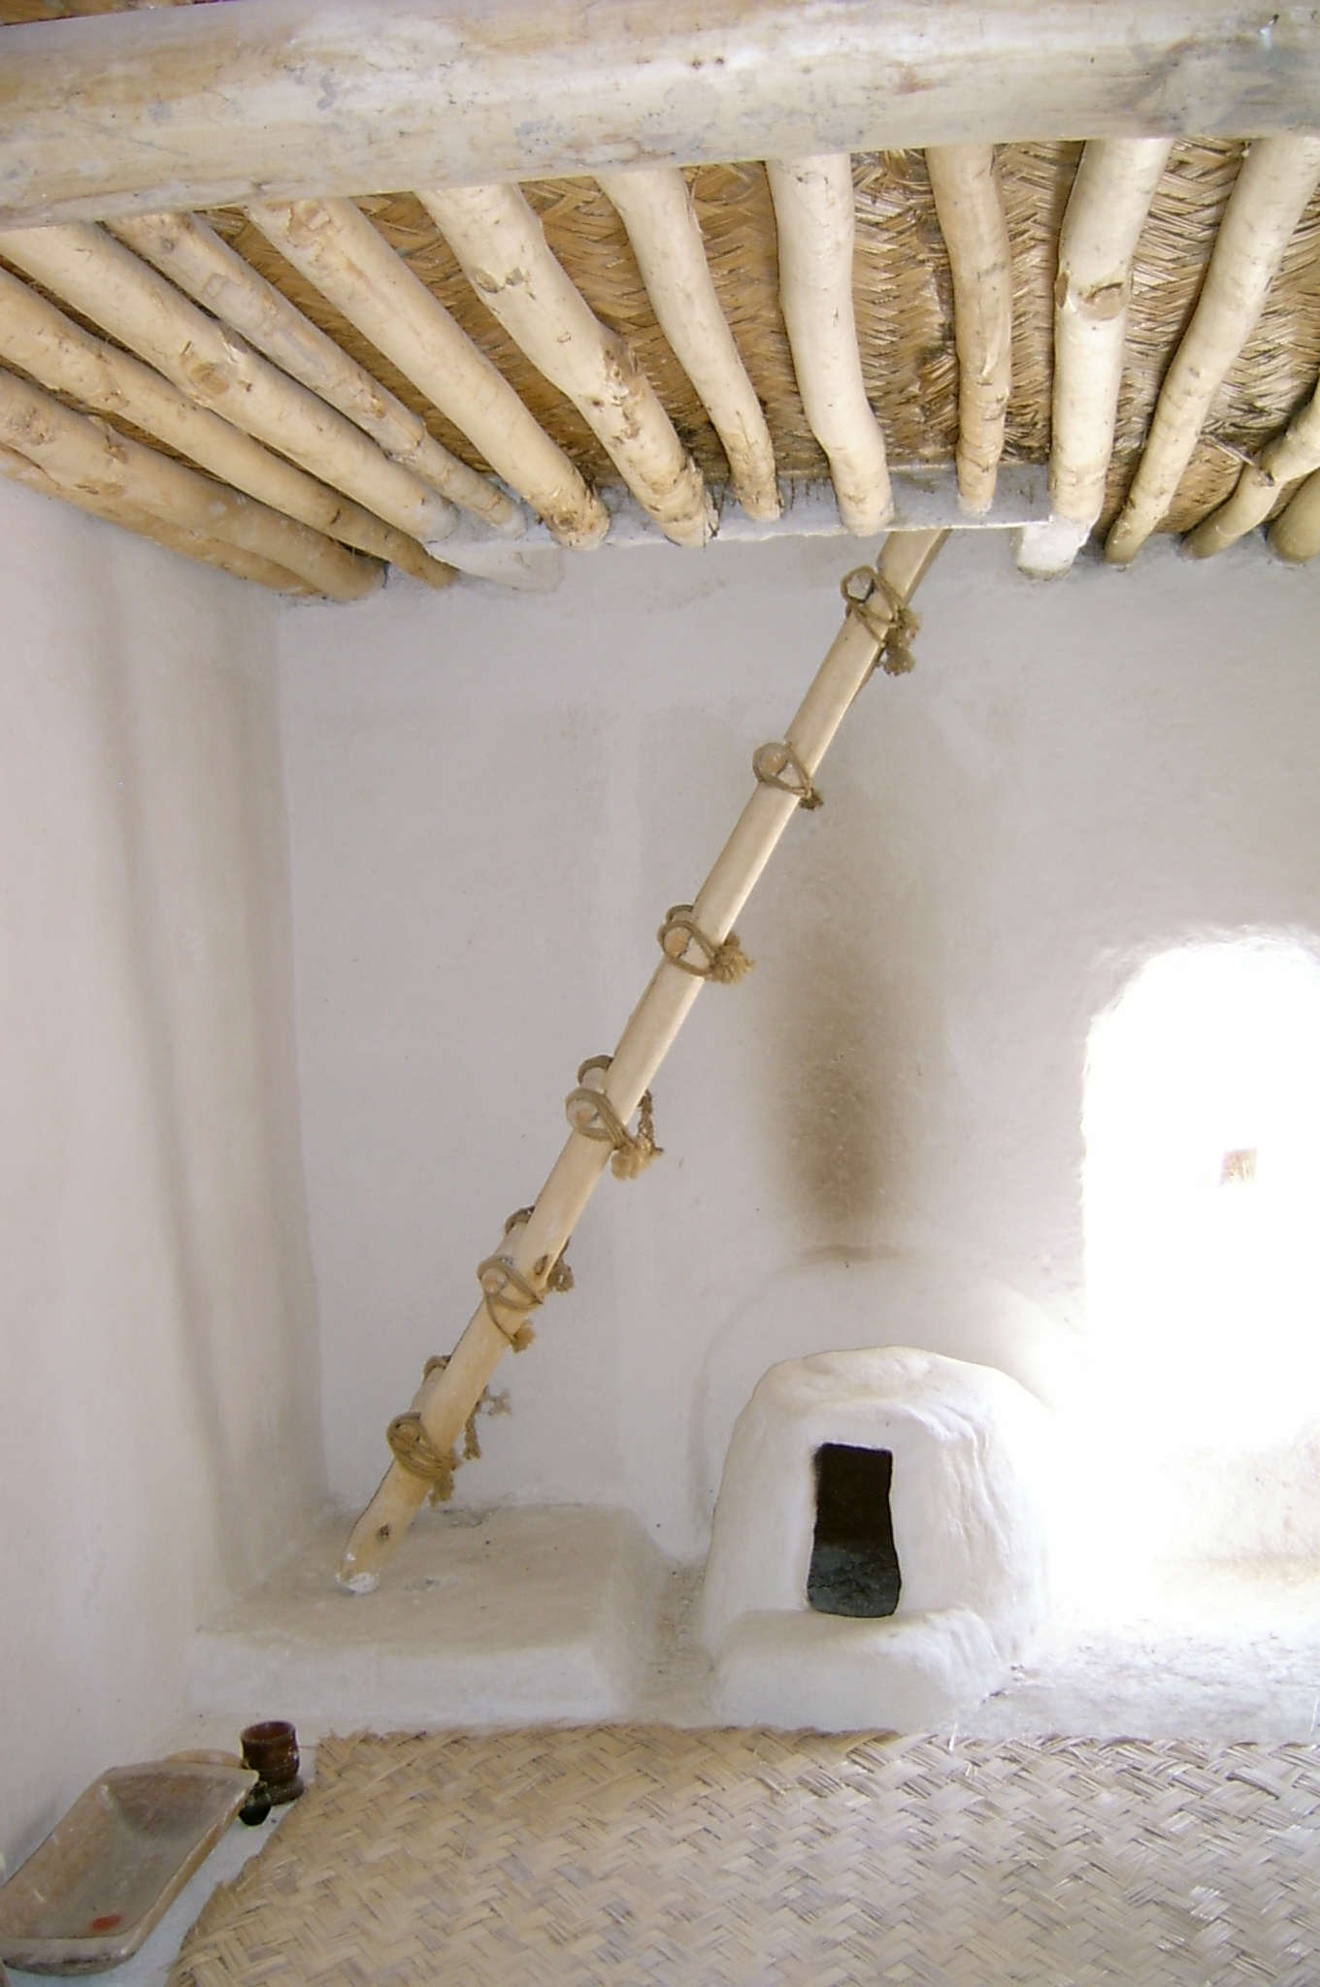
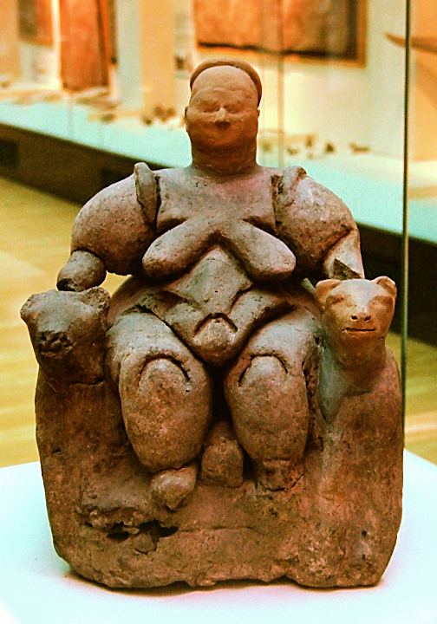
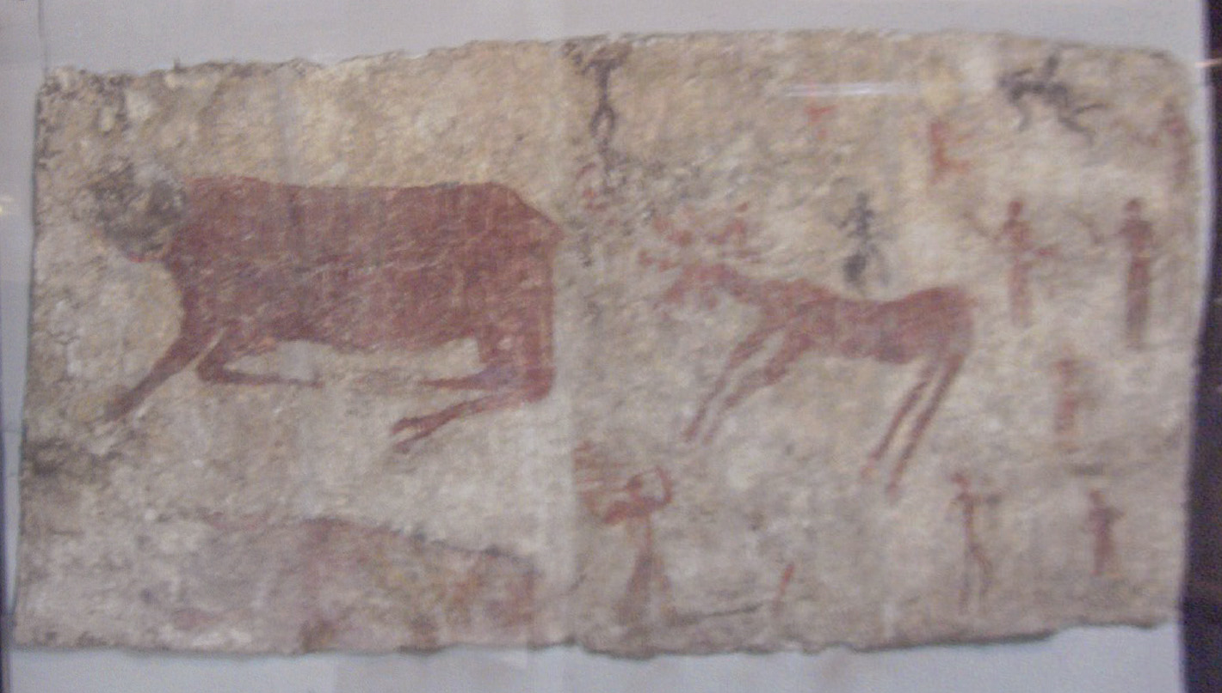
Catal Huyuk
Mother goddess from Catal Huyuk.
Typical Catal Huyuk interior (restoration).
Wall mural of Catal Huyuk.
Notes:
Images courtesy of Wikipedia: http://upload.wikimedia.org/wikipedia/commons/2/2c/Catal_H%C3%BCy%C3%BCk_Restauration_B.JPG ; http://upload.wikimedia.org/wikipedia/commons/7/7d/Ankara_Muzeum_B19-36.jpg ; http://upload.wikimedia.org/wikipedia/commons/c/c2/Museum_of_Anatolian_Civilizations003.jpg

Slide 13
Why Live in a Settled Community?
Pros
Cons
Common culture expressed
Mutual protection
Disease spreads more rapidly among a dense population
Near farms
Grain and seed storage
Grain stores were tempting to raiders
Permanent settlements suffered from natural disasters (drought, fire, floods)

Slide 14
Review Questions
Describe the work of three types of scientists who study prehistory.
Generally, when did prehistory end and history begin?
How did the Neolithic (New Stone Age) differ from the Paleolithic (Old Stone Age)?
How did humans reach the Americas during the last ice age?
What was life like in a settled community such as Catal Huyuk?
Imagine that you are a nomadic hunter-gatherer living 5,000 years ago. Would you maintain your lifestyle, or would you start farming? Explain your answer.

