Slide 1
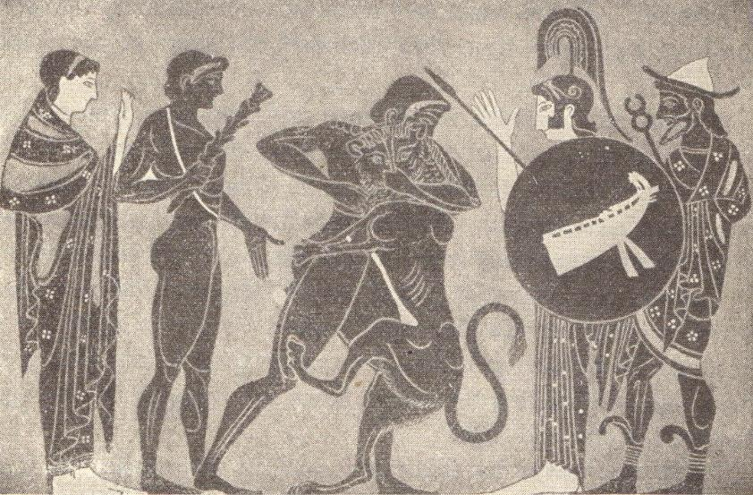
The Glory That Was Greece
© Student Handouts, Inc. www.studenthandouts.com
Notes:
Photo: An early Greek vase painting. At the left are shown the nymph or local goddess Nemea, and Jolaus, the brother and companion of Hercules, holding the hero’s club; at the right, the goddess Minerva and the god Mercury, watching the combat.

Slide 2

The Early Greeks
Hellenes – Indo-European nomads – Dorian, Aeolian, and Ionian tribes
Circa 1400-1000 B.C.E. – migration from Black Sea and Danube regions → modern-day Greece and Turkey
Conquered Cretans and other natives
Circa 1000 B.C.E. – controlled Greece, some of Asia Minor, and Aegean islands
Notes:
Possible anecdote: The Greeks do not call themselves Greeks, but rather Hellenes. They call their country Hellas.

Slide 3
The Age of Homer
Circa 1000 B.C.E.-circa 750 B.C.E.
Greece’s “Dark Ages” – little information known
Iliad and Odyssey
Troy discovered by Heinrich Schliemann
People – farmers, traders, and warriors
Crops and livestock – cattle, grapes, olives, sheep, wheat
Notes:
Possible anecdote: The writings of “Homer” (actually oral traditions of unknown authorship) are our primary source for information on this time period. Heinrich Schliemann discovered the ruins of Troy, but his poor archaeological methods destroyed much of the remains of Homeric Troy.

Slide 4
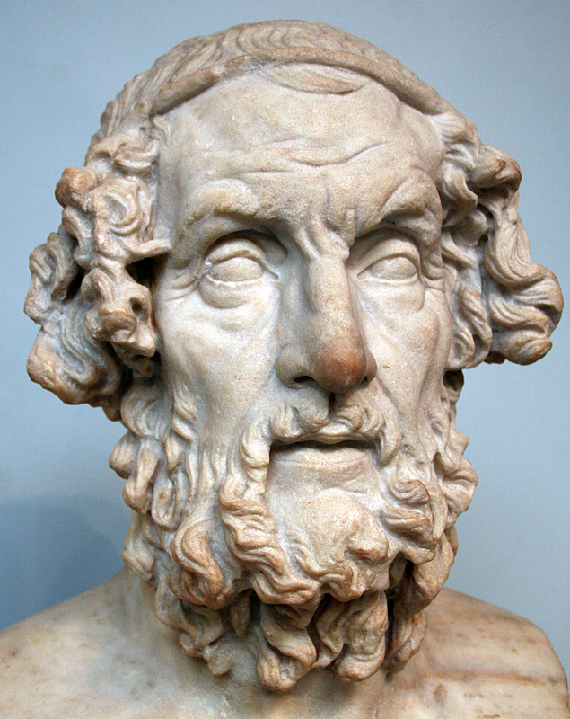
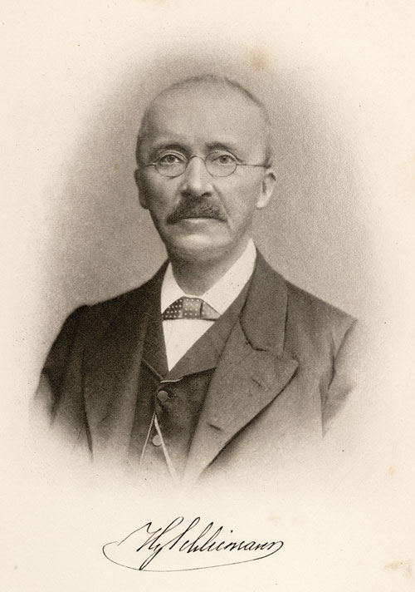
The Age of Homer
Homer
Schliemann
Notes:
Pictures: Homer (dating to Hellenistic period) and Heinrich Schliemann

Slide 5
The Geography of Greece
Mountains
  Hindered communication and unification
  Caused growth of independent city-states
Seas and seaports
  Peninsula with irregular coastline
  Seaports encouraged development of trade
Poor farmland
  Few crops could be grown
  Forced to trade
  Became leading traders of Aegean and eastern Mediterranean
Notes:
Possible anecdote: Location, location, location! That is, a focus on how the ancient Greeks created a thriving economy based on both their area’s negative (could not produce enough food) and positive (coasts allowed trading for food) geographic factors.

Slide 6
Greece’s Colonies
Circa 800-600 B.C.E.
Colonized areas around the Mediterranean – Italy’s west coast (Naples), Sicily (Syracuse), southern France (Marseilles), Egypt, Byzantium (Constantinople/Istanbul)
Spread Greek culture, language, religion
Notes:
Possible anecdote: The ancient Greeks were not closely genetically related to the ancient Phoenicians, but did “take over” in the Mediterranean as the Phoenician presence declined.

Slide 7
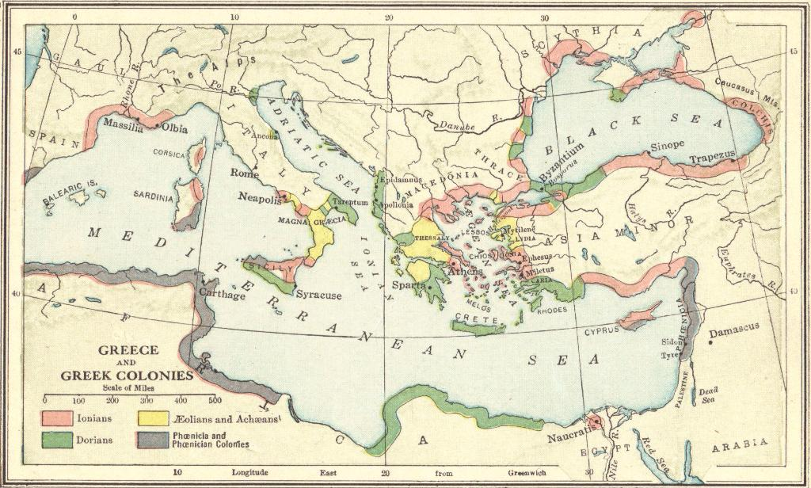
Greece and the Greek Colonies
Notes:
Possible anecdote: The ancient Greeks were not closely genetically related to the ancient Phoenicians, but did “take over” in the Mediterranean as the Phoenician presence declined.

Slide 8
Forces Uniting the Greeks
Ancestry
Language
Literature
Religion
Olympic Games

Slide 9
Forces Uniting the Greeks
Ancestry
Believed in a common ancestor – Hellen
Language
Spoke different Greek dialects but could understand one another
Used Phoenician alphabet and added vowels
Literature
Homer’s Iliad and Odyssey
Mythological tales

Slide 10
Forces Uniting the Greeks
Religion
Greek pantheon of gods and goddesses living on Mount Olympus
Olympic Games
Every four years
Began in 776 BCE
Intellectual games – art, drama, music, poetry
This four-year period was called the Olympiad
Physical games – boxing, broad jumps, chariot racing, dashes, discus throwing, distance running, javelin throwing
Zeus, Athena, Hades, etc.

Slide 11
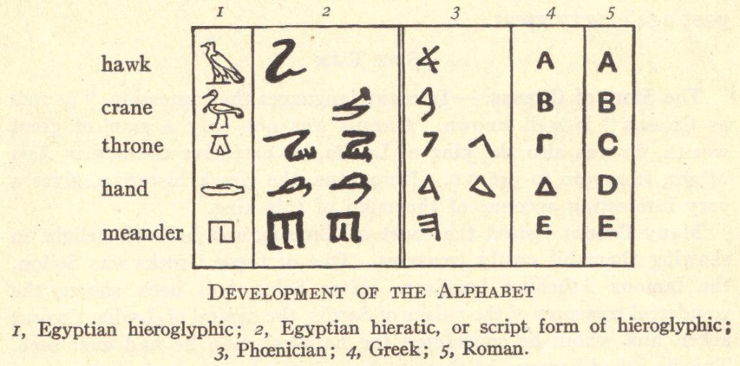
Greek Language and Alphabet
Notes:
Possible anecdote: The development of the modern Latin alphabet (used in English) from Greek, which developed from Phoenician, which developed from Egyptian. Students might note the use of Greek letters in fraternity, sorority, and other organizations.

Slide 12
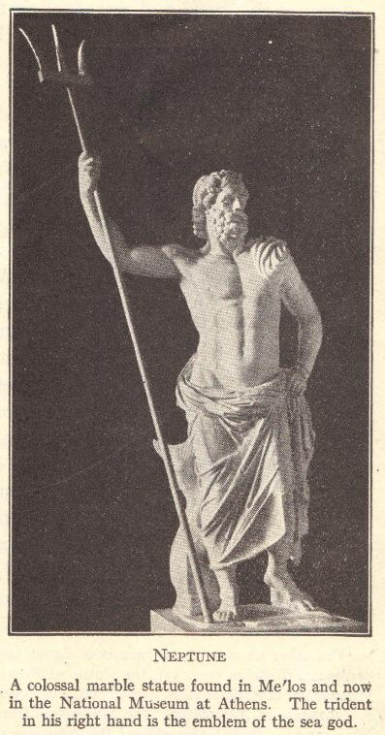
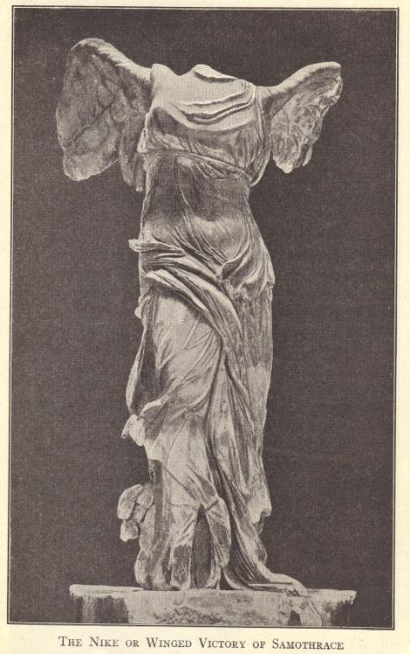
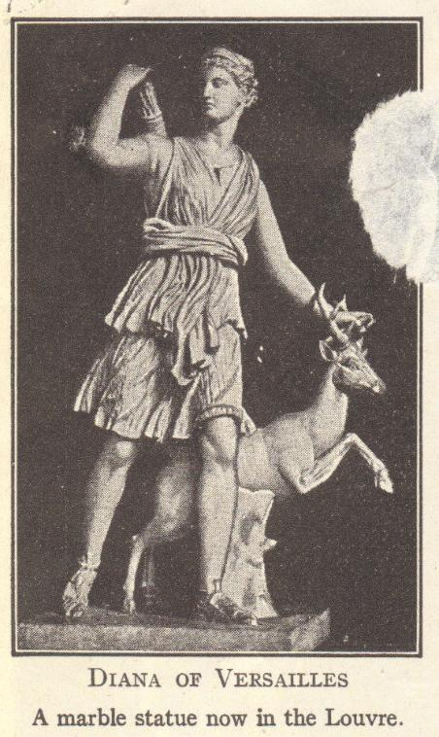
Greek Religion
Notes:
Possible anecdote: Discussion of Greek gods and goddesses.

Slide 13
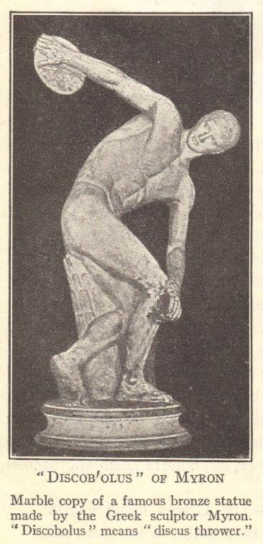
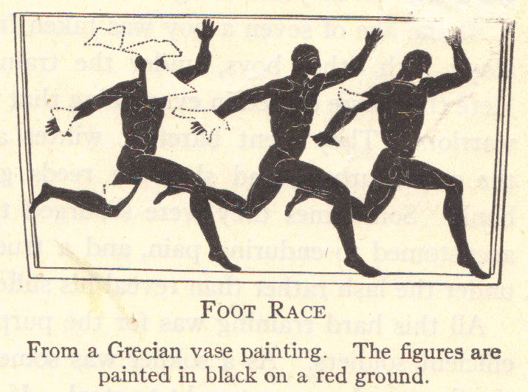
Olympic Games
Notes:
Possible anecdote: Comparison of ancient Greek games with today’s games.

Slide 14
Forces Disuniting the Greeks
First Loyalty Was to City-State
Often fought one another
This disunity eventually allowed the Macedonians to conquer Greece
Geography
Mountains divided city-states and hindered communication
Different Types of Government
Athens – democracy
Sparta – authoritarian and militaristic nature
Also aristocracies, oligarchies, and tyrannies
Notes:
Possible anecdote: Discussion of the various types of government.

Slide 15
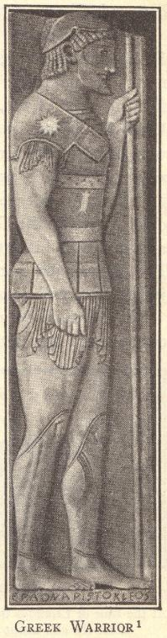
Sparta
Spartans conquered Peloponnesians
  Peloponnesians became slaves, or helots
    Helots outnumbered Spartans 20 to 1
    Spartans feared that helots would revolt
    Spartans became heavily militaristic in response
Notes:
Possible anecdote: Discussion of ancient slavery and how it differed from American slavery (slaves were war captives, etc.).

Slide 16
The Life of a Spartan
Birth
Newborns brought to ephors (leaders) for examination
Sickly babies left to die of exposure
Age 7
Boys sent to military school for strict physical training
Age 20
Young men became soldiers
But lived in the barracks until age 30
Healthy babies
Boys lived with their parents until age seven
Girls stayed with their parents until marriage, and learning weaving, cooking, cleaning
Weapons and endurance training
Frequent beatings
Taught basic reading and to be laconic (use brief speech)
Allowed to get married
Age 30
These soldiers became citizens
Could vote and could live in their own homes
Remained in the military until age 60

Slide 17
Review Questions
The early Greeks came from where?
What archaeologist discovered the remains of Troy?
Describe the geography of mainland Greece.
What forces united the Greeks?
Explain the evolution of the Greek alphabet.
Compare the life of a Spartan male with the life of an American male today.

Slide 18
Athens and Athenian Democracy
Democracy
  Demos (“people”) + kratein (“to rule”)
Democracy developed through various reforms over 200 years (circa 620s B.C.E.-420 B.C.E.)
  Draco
  Solon
  Clisthenes
  Pericles
Draco
Solon
Clisthenes
Pericles
Notes:
Possible anecdote: Discussion of American democracy and its formation.

Slide 19
Draco
Athenian noble
621 B.C.E. – credited with putting down first written laws of Athens
  Severe (modern English term draconian meaning “severe” or “harsh”)
  Written “in blood, not ink”
  Written laws meant that judges could not show favoritism or make up laws
Notes:
Possible anecdote: Literary reference in the Harry Potter books with the character of Draco Malfoy (Harry’s Hogwarts nemesis).

Slide 20
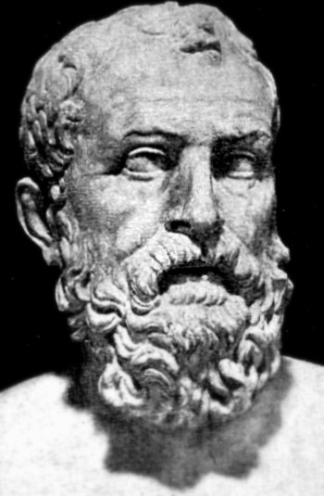
Solon
594 B.C.E. – rewrote Draco’s laws
Helped the poor
  All citizens could participate in the legislature
  Ended debt enslavement
  Canceled land mortgages
  Limited amount of land a person could own
Notes:
Possible anecdote: Discussion of United States laws which benefit the poor.

Slide 21
Clisthenes
508 B.C.E.
Enlarged Athenian Assembly and increased its powers
Created Council of 500 to represent the different classes
  Created and administered laws after they were approved by Assembly
Officials were elected
Executive power
  Ten generals called strategi (singular strategus)
  Elected for one year
Citizenship granted to some freedmen (former slaves) and to some immigrants
Ostracism
  Names written on ostrakon (piece of broken potsherd) once a year
  Most votes = ten years of exile
Notes:
Possible anecdote: Compare and contrast the reforms of Clisthenes with the laws and government of the modern United States.

Slide 22
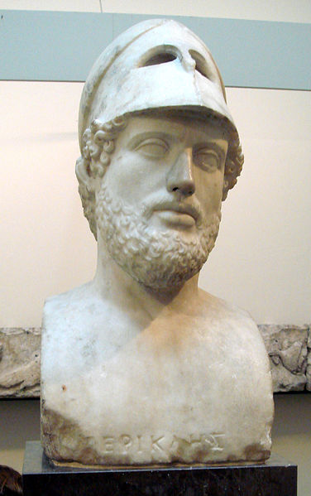
Pericles
“Golden Age of Pericles” – 461-429 B.C.E.
Repeatedly elected as a strategus
All citizens could hold public office
People were paid for government service
“Golden Age of Pericles” also saw developments in art and architecture
Notes:
Possible anecdote: Discussion of payment for government service, and the reality that before this was the case, only the wealthy could afford to serve in government.

Slide 23
Athenian Democracy: Its Flaws
Athens’ adult population: Circa 300,000
  150,000 foreigners and slaves (not citizens)
  100,000 women and others
  50,000 male citizens with voting rights
Direct democracy – the citizen had to be there to vote (typically 5,000-6,000 voted at a time)
Women had few rights and opportunities
Slavery played a major role in the economy
Orators often used forceful and coercive language, rather than logic, to sway voters
Notes:
Possible anecdote: Rights of women today. Compare and contrast direct democracy and representative democracy. Discuss problems inherent to reliance on slave labor.

Slide 24
Persian Wars: 500-479 B.C.E.
Greeks lived in Asia Minor since at least 1000 B.C.E.
Persian empire expanded in the 5th century B.C.E. to include Asia Minor
500 B.C.E. – Greeks in Miletus led a revolt
Athens and other city-states came to aid of Miletus
Persians won and King Darius swore revenge against Athens for interfering
Notes:
Possible anecdotes: Discuss the concept of alliances and the reasons alliances are formed.

Slide 25
First Persian War (490 B.C.E.)
King Darius sent fleet to attack Athens
  Set anchor 26 miles northeast of Marathon
Battle of Marathon
  Spartans could not help because of a religious festival
  Athenians were outnumbered but still defeated the Persians
Notes:
Possible anecdote: Legend of Greek soldier, Pheidippides, who ran the 26 miles to Marathon to tell the city about the Athenian victory (origin of the term marathon).

Slide 26
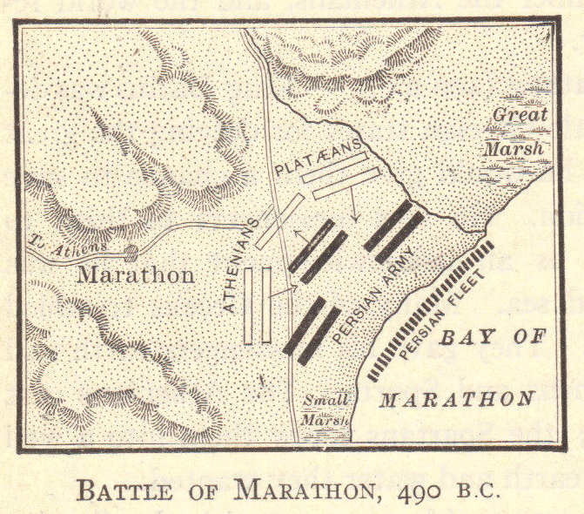
Battle of Marathon (490 B.C.E.)
Notes:
Possible anecdote: Discuss the Athenian military strategy and tactics.

Slide 27
Second Persian War (480 B.C.E..)
Xerxes (son of Darius) led army of 500,000 while Persian fleet sent along Greek coast
  Xerxes attacked by land from the north
  300 Spartans led by Leonidas
    Attempted to block Pass of Thermopylae
    Traitor betrayed them and showed Persians another route
    All 300 Spartans killed after inflicting heavy casualties
  Athens destroyed
    But Athenians had spent 10 years building up their navy
    Athenians defeated Persian fleet in the Strait of Salamis
Notes:
Possible anecdote: Discuss Battle of Thermopylae (and possibly the film “The 300”).

Slide 28
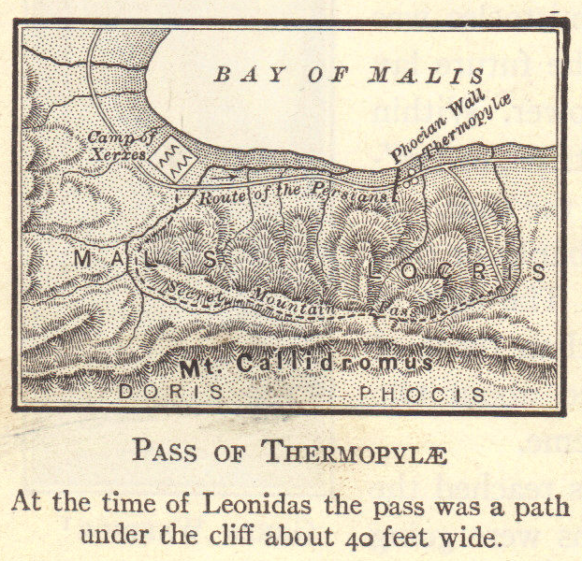
Battle of Thermopylae (480 B.C.E.)

Slide 29
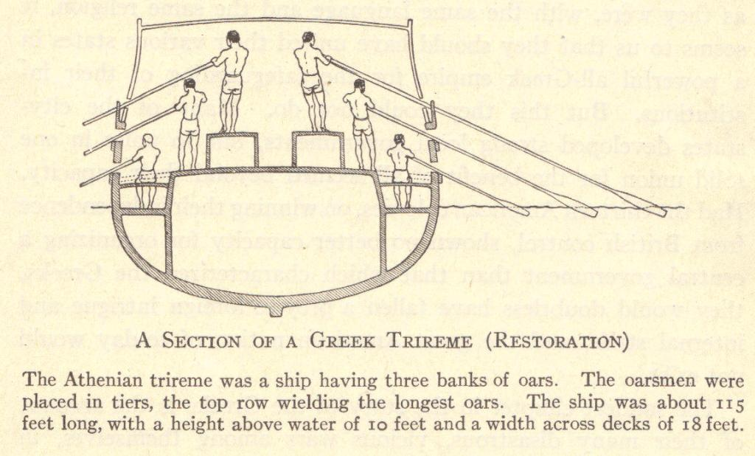
Second Persian War
479 B.C.E. – Spartans led defeat of Persians at Plataea
Persian fleet destroyed at Mycale
Notes:
Possible anecdote: Discuss naval warfare at this time.

Slide 30
Significance of the Persian Wars
Persian empire declined
Greek civilization and culture flourished
Wealth from increased trade
Started the Greek onslaught against the Persian empire
  Completed by Alexander the Great of Macedonia in 331 B.C.E.
Notes:
Possible anecdote: Discussion of how, historically, the fall/decline of a major power can create a vacuum which neighboring powerful city-states (or nations) seek to fill.

Slide 31
Athens Leads Greece
Great leadership
  Aristides and the Delian League (a.k.a. Confederacy of Delos) to protect against possible future Persian invasions
    Alliance became the basis for the Athenian empire
    Members paid protection money to Athens
  Cimon – expelled Persians from Black Sea shore
  Pericles and his “Golden Age”
Increased trade brought wealth

Slide 32
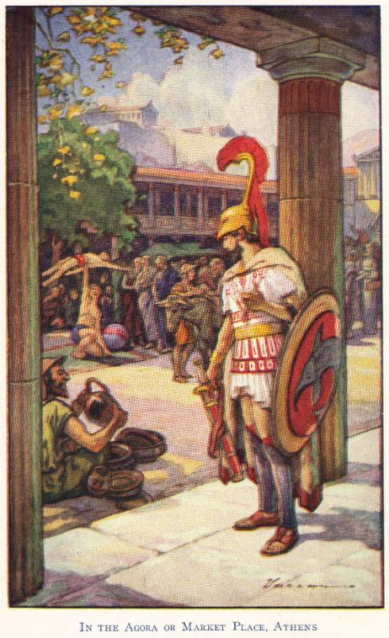
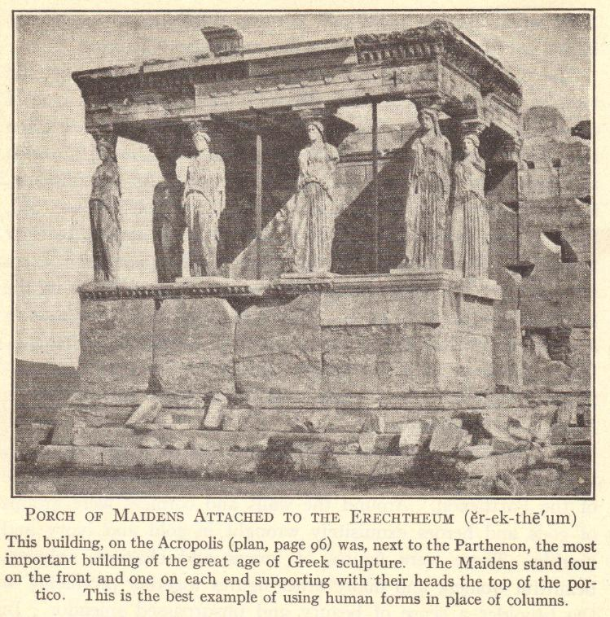
Athens

Slide 33
Athenian-Spartan Rivalry
Spartans created Peloponnesian League to rival Delian League
Sparta
  Peloponnesian League dominated land
  Oligarchic rule
Athens
  Delian League dominated sea
  Democratic rule
Corinth
  Joined Peloponnesian League
  Threatened Athenian sea supremacy
461 B.C.E. – war between Athens and Sparta
  445 B.C.E. – signed a truce

Slide 34
Peloponnesian Wars
431 B.C.E. – war began again
Circa 430 B.C.E. – plague struck Athens
  1/3 of population died, including Pericles
Athens attacked Syracuse (ally of Sparta), located in southern Italy, at sea
  Athens lost
Battle of Aegospotami (404 B.C.E.)
  Spartans allied with Persians and defeated Athenians
  Spartans conquered Athens and destroyed its defensive walls

Slide 35
Sparta Leads Greece
404-371 B.C.E.
Sparta’s support of oligarchic rule upset the lower classes in other Greek city-states
Battle of Leuctra (371 B.C.E.)
  Thebes was first to revolt
  General Epaminondas led Thebans to defeat Spartans
Battle of Mantinea (362 B.C.E.)
  Thebes defeated by Sparta and Athens
Battle of Chaeronea (338 B.C.E.)
  Philip II of Macedon defeated Athenians and Thebans
League of Corinth (337 B.C.E.)
  Philip II of Macedon had Greek city-states pledge to stop warring one another

Slide 36
Review Questions
What ancient Greek city-state first developed democracy?
How did Draco, Solon, Clisthenes, and Pericles advance democracy?
What features of Athenian society were undemocratic?
Describe the Greek wars with the Persians.
What were the causes and outcomes of the Peloponnesian wars?
Who got the Greek city-states to pledge to stop warring one another with the League of Corinth?

Slide 37
Hellenic Culture
“Hellenic” refers to Greek culture among those who considered themselves to be Greek during the centuries before Alexander the Great
Much of what is considered typically “Greek” and which greatly influenced the course of Western civilization was created and developed during this time
Notes:
Possible anecdote: Compare/Contrast “Hellenic” (Greek culture among Greeks) and “Hellenistic” (Greek culture spread among non-Greeks).

Slide 38
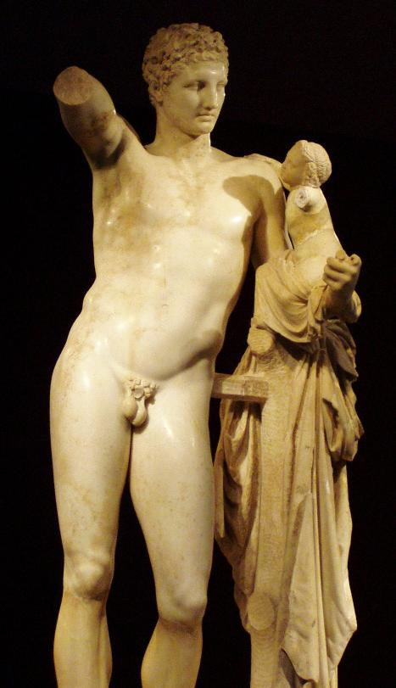
Greek Architecture and Art
Architecture of the Acropolis
  Parthenon designed by Ictinus
    Gold and ivory statue of Athena designed by Phidias
  Optical illusions and engineering used to avoid building appearing curved from a distance
Sculpture
  Lifelike and proportionate
  Attention to detail
  Emphasis on the beauty of the human form
Hermes and Dionysos by Praxiteles
Notes:
Possible anecdote: Many Greek statues were later taken by the Roman conquerors, and many that survive either passed through Italy or are Roman copies.

Slide 39
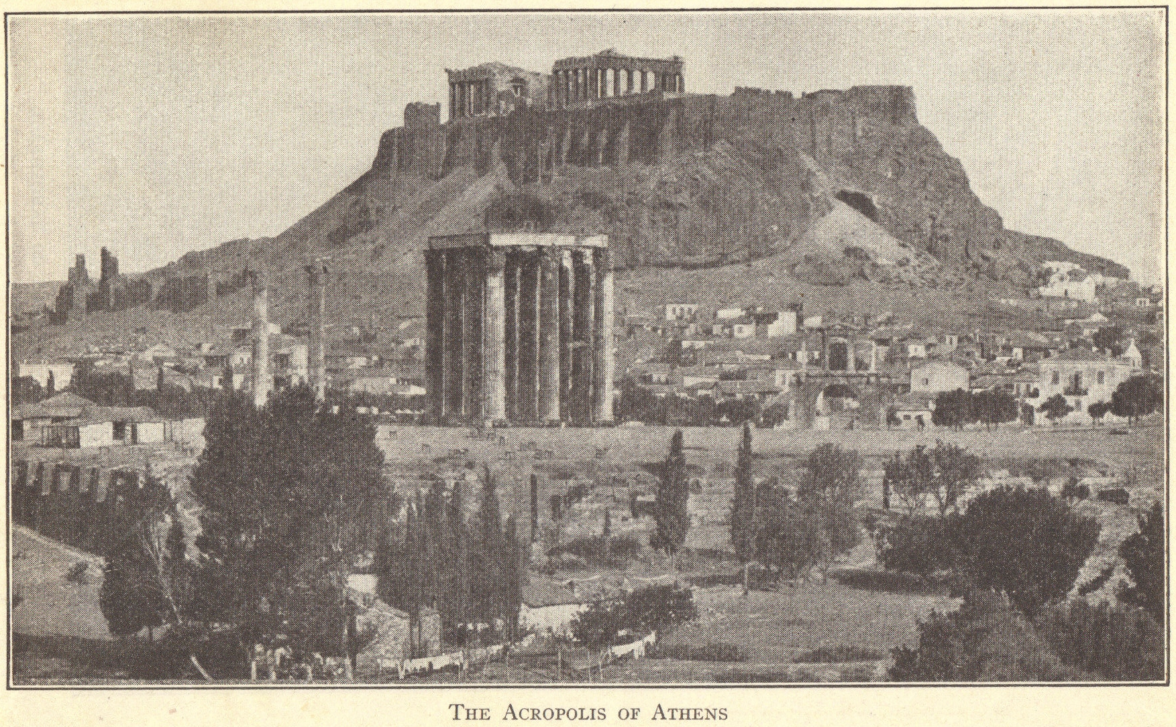
The Acropolis in Athens
Notes:
Possible anecdote: Discussion of Greek gods and goddesses; construction of the Acropolis.

Slide 40
Leaders in Greek Science
Thales
Pythagoras
Democritus
Hippocrates

Slide 41
Thales
Lived circa 624 B.C.E.-circa 546 B.C.E.
Called the “father of natural science”
Believed the basic substance in the world is water, which changes its form (ice, liquid, steam) but not its composition

Slide 42
Pythagoras
Lived circa 580 B.C.E.-circa 490 B.C.E.
Called the “father of numbers” – mathematician who believed everything could be numbered
Pythagorean Theorem: “The square of the hypotenuse of a right angle is equal to the sum of the squares on the other two sides.”

Slide 43
Democritus
Lived circa 460 B.C.E.-circa 370 B.C.E.
Everything made of atoms so small they cannot be divided

Slide 44
Hippocrates
Lived circa 460 B.C.E.-370 B.C.E.
Called the “father of medicine”
Believed that diseases have natural rather than supernatural causes
Hippocratic Oath – still taken by medical personnel today

Slide 45
Greek Drama
Purpose
  Educative – taught history and morality
Presentation
  Open-air amphitheaters
  Little scenery
  Originally sung by a chorus, but later chorus members developed into actors
Themes
  Gods, divine laws, and fate dominate human destiny

Slide 46
Greek Dramatists
Aeschylus (525-456 B.C.E.)
Called the “father of Greek drama”
Prometheus Bound
Agamemnon
Sophocles (496-406 B.C.E.)
Oedipus Rex
Antigone
Euripides (480-406 B.C.E.)
Medea
The Bacchae
Aristophanes (448-380 B.C.E.)
The Frogs
The Clouds

Slide 47
Greek Philosophy
“Love of knowledge” – Search for answers to life’s big questions
Early Sophists
Socrates
Plato
Aristotle

Slide 48
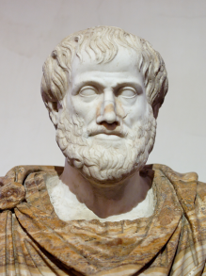
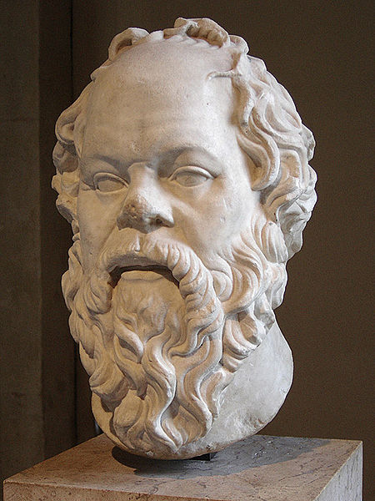
Greek Philosophers
Sophists (5th century B.C.E.)
“Men of wisdom”
Measured everything by its usefulness
Criticized gods, government, and conventional morality
There is no absolute truth
Socrates (469-399 B.C.E.)
There is absolute truth – “Know thyself” – Socratic dialogue
Convicted of corrupting the youth – forced to drink hemlock
Plato (427-347 B.C.E.)
Dialogues written record of Socrates’ dialogues
The Republic – ideal state administered by philosophers
Founded the Academy which lasted 800 years
Aristotle (384-322 B.C.E.)
Macedonian student of Plato
Tutor to Alexander the Great
Opened the Lyceum in Athens
Created the basis for scientific inquiry

Slide 49
The Greeks and History
Knowledge of the past had consisted of myths and legends.
The first true historians attempted to base their writings on facts.
Herodotus (484-425 B.C.E.)
Called the “father of history”
The Inquiries or The Histories
Traveled to learn and write about the Persian Wars
Much information about foreign customs, etc.
Gave the gods a role in historical events
Thucydides (471-400 B.C.E.)
Called the “first scientific historian”
History of the Peloponnesian Wars
Discussed cause and effect
Gave the people involved the main role in historical events
Notes:
Possible anecdote: Discuss the development of the historical method of inquiry. Discuss that the word used by Herodotus meant “inquiries” (ἱστορίαι) in Greek, but which came to mean “history” in Latin and English.

Slide 50
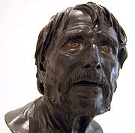
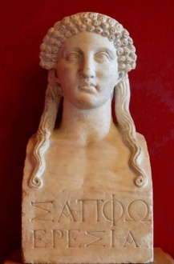
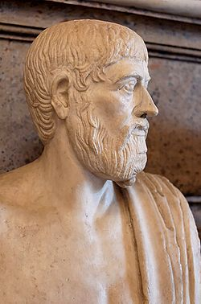
Greek Literature
Hesiod (late 8th century B.C.E.)
  Theogony – poem about Greek gods
  Work and Days – poem about the life of a farmer
Sappho (ca. 620 B.C.E.-ca. 570 B.C.E.)
  Lyric poetry (sung accompanied by a lyre)
  Hymn to Aphrodite
Pindar (522-443 B.C.E.)
  Paeans
  Greeks considered him their greatest lyric poet

Slide 51
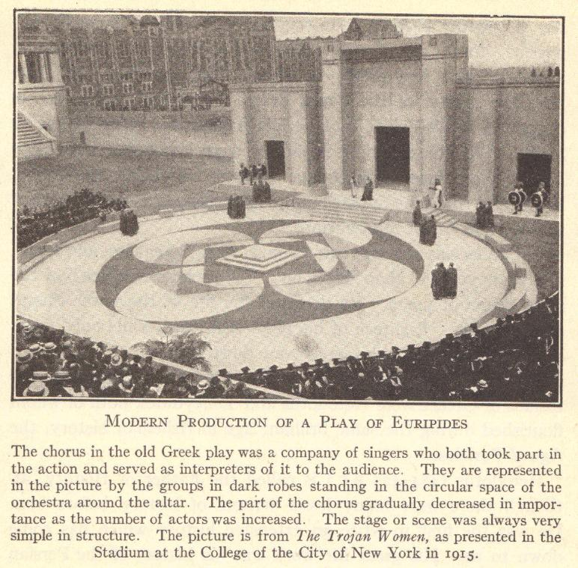
Greek Literature
Notes:
Possible anecdote: Students may have read a Greek play in a literature class.

Slide 52
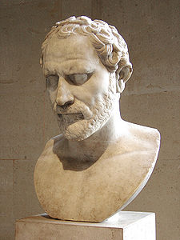
Greek Oratory
Art of oratory introduced by the Sophists
Demosthenes (384-322 B.C.E.)
  Warned Greeks about Philip of Macedonia’s plans
  English word philippic means “tirade against someone”
Demosthenes

Slide 53
Greek Education
“A perfect mind in a perfect body”
Education largely informal
Formal education
  Not for girls (learned domestic arts at home)
  Boys sent to private schools at age seven
  Slave – pedagogue – watched over him and taught him how to behave
  Grammar, reading, writing, math, music, oratory
  Age 12 – began gymnastics
Only for upper classes
Development of citizens who could participate in government and public affairs
Notes:
Possible anecdote: Informal education included listening to orators, hearing and reading poetry, attending plays, etc.

Slide 54
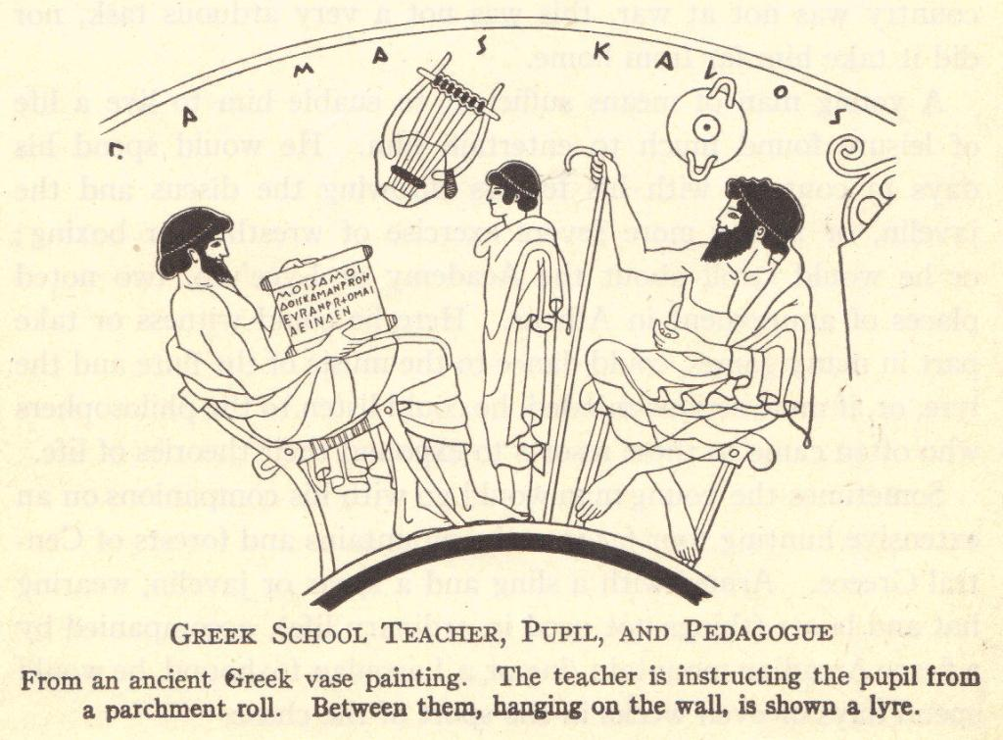
Notes:
Possible anecdote: Informal education included listening to orators, hearing and reading poetry, attending plays, etc.

Slide 55
Review Questions
What does the term Hellenic mean?
Describe Greek architecture and art.
What did Pythagoras and Hippocrates contribute to the sciences?
What questions and criticisms were raised by ancient Greek philosophers?
In what ways were Herodotus and Thucydides true historians?
Compare education in ancient Greece to education in the United States today.

