Slide 1
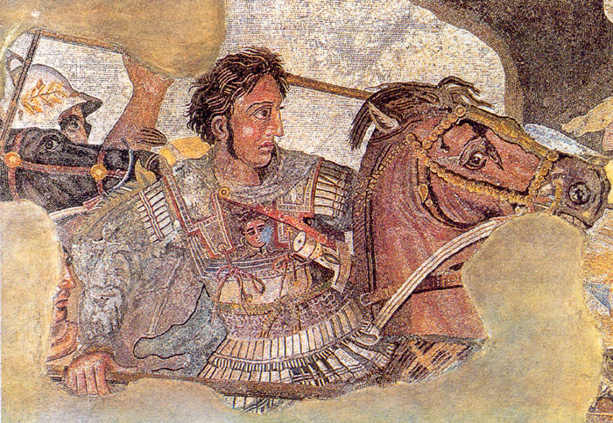
Macedonia, Alexander the Great, and the Hellenistic World
© Student Handouts, Inc.

Slide 2
Macedonia
Macedonians were culturally and ethnically related to the Greeks
  Actually looked upon as sort of “barbarian cousins” by the Greeks of Athens, Sparta, etc.
King Philip II of Macedonia
  Expanded his territory north to the Danube River and south into the Greek peninsula
  Conquered all city-states except Sparta by 338 B.C.E.
  Killed while planning to attack Persia (336 B.C.E.)

Slide 3
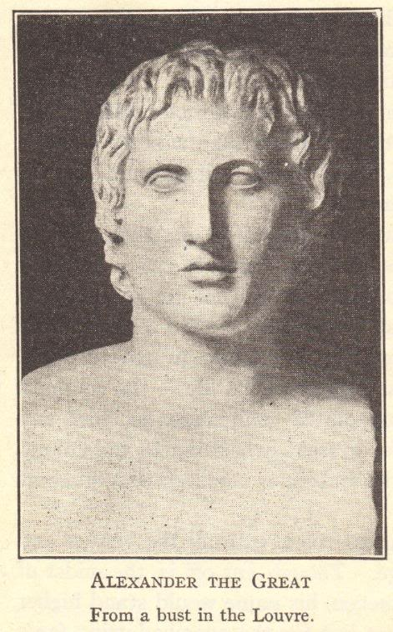
Alexander the Great
Tutored by the philosopher Aristotle
Precarious position because his mother was not Macedonian (making Alexander half Macedonian), and his father took a Macedonian as a new wife
Wanted to conquer Persia like his father
Wanted to spread Greek culture throughout the world

Slide 4
Alexander the Great
Philip was killed by companions of Alexander
Alexander came to the throne at age 20 (336 B.C.E.

Slide 5
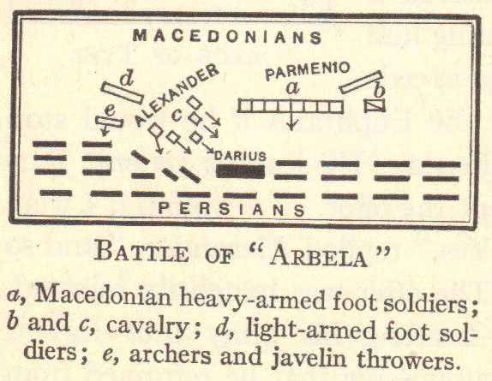
Alexander the Great
First put down local revolts, including destroying Thebes
Invasion of Persia and beyond
  35,000 troops
  Granicus (334 B.C.E.)
  Issus (333 B.C.E.)
  Arbela (331 B.C.E.)
  City-states along the Mediterranean
    Phoenician Tyre
  Egypt
    Founded Alexandria
  India
    Reached Indus River
  Set up capital in Babylon (located in modern-day Iraq) in 324 B.C.E.
Died of a fever in 323 B.C.E. at age 33

Slide 6
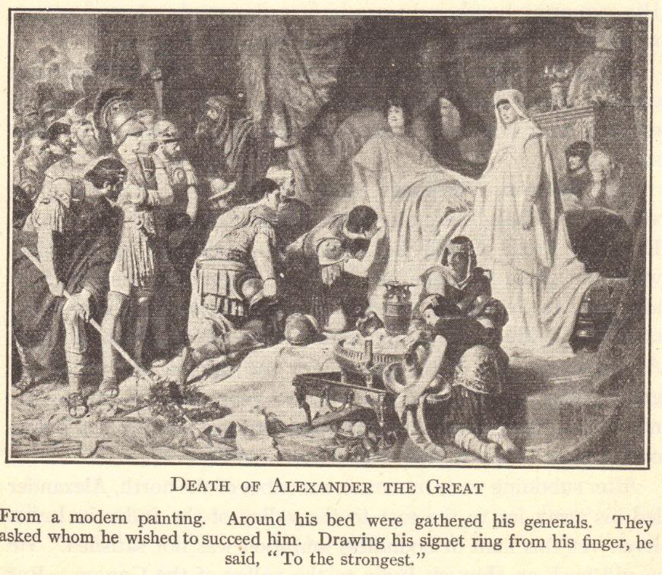

Slide 7
Alexander’s Empire
Fell apart after Alexander’s death
Generals fought for control of empire
Empire divided
  Egypt – Ptolemy
  Most of Asian empire – Seleucus
  Macedonia and Greece – Antigonus
New dynasties ruled for hundreds of years until conquered by Rome

Slide 8
Alexander’s Impact on World History
Spread Greek culture beyond the Greeks
  “Pan-Hellenism”
  Founded numerous cities
  Married a daughter of Darius
    Encouraged his soldiers to take Persian wives
  Worshiped foreign gods and goddesses
    Recognized as foreign incarnations of Greek gods
  Encouraged trade throughout his empire
  Settled Greeks throughout his empire
    Greek culture became “Hellenistic” as it spread and mingled with other cultures

Slide 9
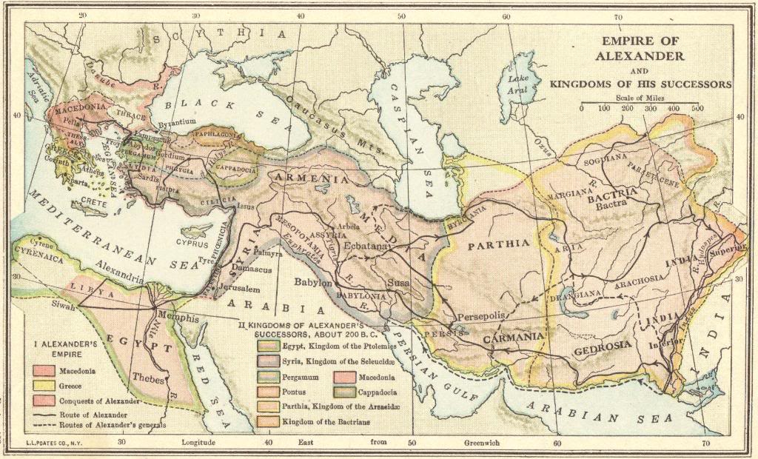

Slide 10
Alexandria, Egypt
City in Egypt founded by, and named after, Alexander the Great
Ptolemy came to rule Egypt after Alexander’s death
Ptolemies built a university in Alexandria – “Library of Alexandria”
  Included 700,000 volumes written on papyrus
  Center of research and scholarship

Slide 11
Hellenistic Science
Many practical, useful inventions
Euclid (lived circa 300 B.C.E.)
  Greek who lived and worked in Alexandria, Egypt
  “Father of Geometry”
    Theorems in plane geometry (“Euclidean geometry”)
Archimedes (circa 287 B.C.E.-circa 212 B.C.E.)
  Greek who lived and worked in Sicily
  Principle of specific gravity
  Law of floating bodies
  Used levers, pulleys, and screws to build things such as catapults

Slide 12
Hellenistic Science
Eratosthenes (circa 276 B.C.E.-circa 195 B.C.E.)
  Greek born in modern-day Libya
  Geographer and librarian of Alexandria, Egypt
  Closely determined the earth’s diameter
  Measured earth’s distance from the sun with 99% accuracy
  Used lines of longitude and latitude on a map
  Believed earth is round
    One could sail India by sailing west
Aristarchus of Samos (310 B.C.E.-circa 230 B.C.E.)
  Heliocentric model – first to advocate that the earth revolves around the sun
Hipparchus (circa 190 B.C.E.-120 B.C.E.)
  Invented plane and spherical trigonometry
  Predicted eclipses of the moon and sun

Slide 13
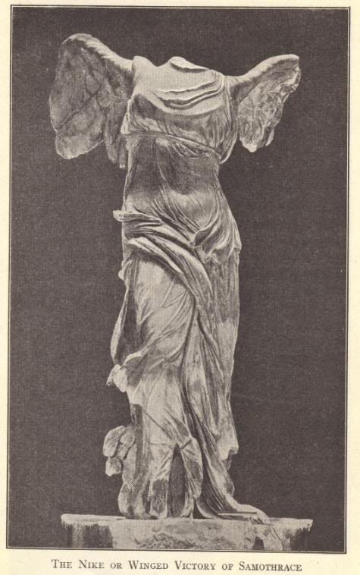
Hellenistic Art and Architecture
Architecture
  Built many impressive public buildings
  Baths, libraries, palaces, theaters
  Pharos – lighthouse of Alexandria – 400 feet high
Art
  More lifelike – showed more expression
  Action, grief, motion, pain
  The Death of Laocoon, Winged Victory of Samothrace, Venus de Milo

Slide 14
Hellenistic Philosophy
Cynics (Cynicism)
  Diogenes (412-323 B.C.E.)
  Hatred of power and worldly possessions
Stoics (Stoicism)
  Zeno of Citium (334-262 B.C.E.)
  Acceptance, courage, patience
  Roman emperor Marcus Aurelius (121-180 C.E.) was a Stoic philosopher (wrote Confessions)
  Stoic belief in human brotherhood influenced Christianity
Epicureans (Epicureanism)
  Epicurus (341-270 B.C.E.)
  No life after death
  Pleasure and pain measure what is good and bad
  Life is to be enjoyed, particularly by searching for knowledge

Slide 15
Hellenistic Literature
Few Hellenistic works had enduring value
Preserved classical Greek heritage
  Spread throughout Alexander’s former empire
  Particularly at Alexandria, Egypt
  Middle East kept and preserved Greek heritage during the fall of Rome and Europe’s Dark Ages
    Europeans rediscovered this Greek heritage during the Crusades

Slide 16
Hellenistic Culture in the Roman World
Greek cities of southern Italy piqued Roman interest in Greek culture
  Many southern Italian, Sicilian, and other Mediterranean cities which came under Roman control had been founded by Greeks
Romans spread Greek culture throughout their own empire
  Much Roman art generally copied Greek art

Slide 17
Hellenistic Civilization Declines
Endured for approximately 300 years
Wealth and power in the hands of a few
Reliance on slavery
  Free persons could not find work
  Slave labor cheaper (in the short-term) than investments in new inventions and technologies
  Slave revolts
Continuous warfare among city-states
Easy target for Roman conquest

Slide 18
Review Questions
Under what circumstances did Alexander the Great come to the Macedonian throne?
Name at least three modern-day countries which were conquered by Alexander the Great.
What does the term Hellenistic mean?
Describe the work of a Hellenistic scientist or mathematician.
Describe a Hellenistic philosophy.
What caused the fall of Hellenistic society?
Imagine that you are a Babylonian living during the time of Alexander. How might you view Alexander’s conquests? Would you consider him “great”?

