Slide 1
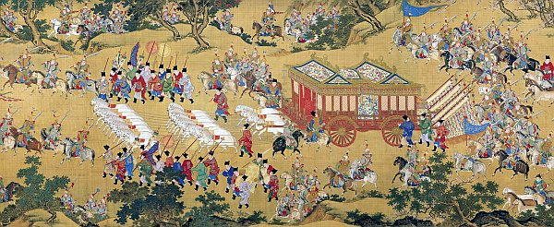
The Han Dynasty of China:
A Chinese Golden Age
(206 BCE-220 CE)
© Student Handouts, Inc.
Notes:
Image courtesy of Wikipedia.

Slide 2
Historical Setting of the Han
Followed the Qin dynasty
  221-206 BCE
  Qin ended in rebellion and civil war due to weak ruler and unrest (206-202 BCE)
Han dynasty was China’s second imperial dynasty
  206 (or 202) BCE-220 CE
    Over 400 years
Followed by the Three Kingdoms
  220-265 CE

Slide 3
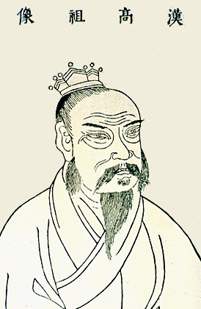
Liu Bang – Emperor Gaozu of Han
Civil war
  Two strong leaders
    Xiang Yu (aristocratic general)
    Liu Bang (peasant-class general under Xiang Yu)
202 BCE
  Liu Bang beat Xiang Yu for good
    Liu Bang declared start of Han dynasty
Liu Bang reigned
202 BCE-195 BCE.

Slide 4
Two Periods of the Han Dynasty
Former Han
  Also called the Western Han
  206 BCE-9 CE
Interrupted by the Xin dynasty
  Under Wang Mang
  9-23 CE
Later Han
  Also called the Eastern Han
  25-220 CE

Slide 5
Government under the Han
Centralized government
  Capital cities
    Chang’an
      206 BCE-9 CE (all of the Former or Western Han) and 190-195 CE (Later or Eastern Han)
    Luoyang
      25-190 CE and 196 CE (most of the Later or Eastern Han)
    Xuchang
      196-220 CE (very end of the Later or Eastern Han)
Lowered taxes
Less harsh punishments

Slide 6
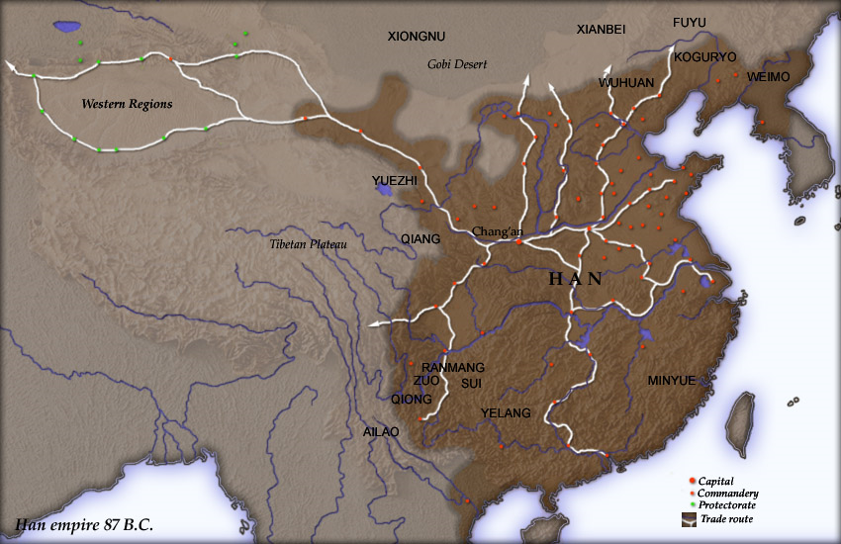
Notes:
Image courtesy of Wikipedia: http://upload.wikimedia.org/wikipedia/commons/c/c3/Han_map.jpg

Slide 7
Empress Lu
One of Liu Bang’s widows
Retained power by naming various children as emperor in turn
Example of power gained through the manipulation of court politics
  Families vied for power
  Alliances among powerful and influential people

Slide 8
Wudi – The Martial Emperor
Wudi lived 141-87 BCE
Used warfare to expand the Chinese empire
  Northern steppes
    Xiongnu – steppe nomads from the north and west
    Commonly raided Chinese villages
    Traditionally kept at bay through bribery
    Wudi made allies of the Xiongnu’s enemies and sent in 100,000 soldiers
    Pushed the Xiongnu back
    Settled soldiers on former Xiongnu lands
    But the nomads of the steppes provided ongoing conflict
  Modern-day Korea, Manchuria, Vietnam, etc.
    Conquered and colonized
Borders under Wudi nearly what they are today

Slide 9
Social Classes under the Han
Emperor
Governors and Kings
Nobles, Scholars, and State Officials
Peasants (Farmers)
Artisans and Merchants
Soldiers
Slaves

Slide 10
Bureaucracy under the Han
Taxes supported the government and military
Merchants
  Paid taxes
Peasants
  Gave the government a portion of their annual crops
  Each year gave a month of labor (for public works projects) or of military service

Slide 11
Civil Service under the Han
Over 130,000 employees
18 ranks of employees
Civil service exams
  Confucian principles described the qualities that emperors wanted in civil servants
  Wudi set up a Confucian-themed school
  Formal examinations in Confucianism, history, law, and literature for civil service positions
  Theoretically a merit-based system
    But poor could not afford to educate their children
  In effect until the downfall of China’s last dynasty in 1912

Slide 12
Technology under the Han
Paper
Invented in 105 CE
Collar harness
Horses could carry heavier loads
Plow
The Chinese made one with two blades
Much more efficient
Books became inexpensive to produce; expanded education
Bureaucracy grew and became more efficient
Best harness available at the time worldwide
Wheelbarrow
Invented independently (Greeks had invented as well)
Central wheel and axle let Chinese wheelbarrows carry very heavy weights
Waterwheel
Used to power things such as the bellows for smelting iron

Slide 13
Review Questions
What dynasty preceded the Han?
Who founded the Han dynasty?
What are the two periods of the Han dynasty?
Imagine that you are a Chinese soldier relocated to former Xiongnu lands. What might your life be like?
Explain how the civil service system both was and was not a merit-based system.
Describe Chinese technological advances under the Han.

Slide 14
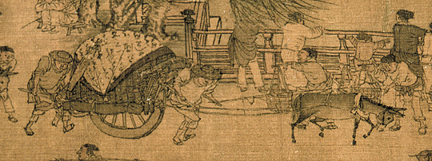
Agriculture under the Han
Population of 60,000,000 to be fed
Farming thought to be a pivotal and honored occupation
But in reality small farmers were burdened by government taxes and became heavily indebted to the rich
Ancient Chinese wheelbarrow
Notes:
Image courtesy of Wikipedia.

Slide 15
Commerce and Trade under the Han
Trade and commerce were not respected but were still very important
Government had monopolies
  Salt mining
  Iron forging
  Coin minting
  Alcohol brewing
Government engaged in industry
  Silk weaving
Growth of trade along the Silk Roads

Slide 16
Silk Roads under the Han
Trade routes across Asia
  To Mediterranean (access to Europe) in the west
    Chinese silks were sold in the marketplaces of the ancient Roman empire
  To Yellow Sea and China Sea (access to Japan) in the east
Traded silk and other goods
Cultural diffusion
  Trade goods reflected the many cultures across this trading region

Slide 17
Unification of the Han Empire
Colonization
Farmers sent to settle new areas
Settlers encouraged to marry locals
Assimilation
Established Confucian schools in colonized areas
Chinese became the common written language

Slide 18
Historians during the Han Period
Sima Qian (145-85 BCE)
Ban Biao (3-54 CE)
Began writing the History of the Former Han Dynasty
Known as the Grand Historian
Records of the Grand Historian
Told Chinese history from the first dynasties
Early version of the historical method
Examined artifacts and official records
Interviewed eyewitnesses and others
Toured historical sites for perspective
Completed by his son, Ban Gu, and daughter, Ban Zhao

Slide 19
Roles of Women under the Han
Traditional Roles
Confucianism limited women to the home and to subservience to men (fathers, husbands, sons)
Women worked hard for their families with little reward
Women with Power
Some women wielded political power because of court alliances
Nuns
e.g., Empress Lu
Educated
Lived apart from families
Medicine practitioners
Shop managers
Writers
Paradox?
Ban Zhao
Helped finish her father’s History of the Former Han Dynasty
Wrote Lessons for Women
Urged women to obey the Confucian social order
Also encouraged women to be industrious
Went against convention by writing professionally

Slide 20
Rich vs. Poor
Inheritance law was the root cause of the problem
  Land divided among male heirs (sons)
  Reduced the size of plots with each generation
  Small farmers couldn’t support themselves and had to borrow money
    Became indebted to rich, aristocratic landowners
    These aristocratic landowners did not have to pay taxes
  Decreased tax revenue for the government
    Government pressed peasants even harder for taxes
  Rich grew richer and poor grew poorer

Slide 21
Rich Get Richer, Poor Get Poorer
Peasant farmers grew poorer as they could not afford to pay taxes
Peasants were forced to borrow money from rich aristocratic landowners who didn’t pay taxes
Rich aristocratic landowners foreclosed on the peasants’ farms, decreasing the land owned by peasants
With less land owned by peasants, the government took in less tax revenue, and had to pressure the remaining peasant landowners even harder for tax money

Slide 22
Wang Mang
32 BCE-9 CE – unstable, chaotic period
3-9 CE – Wang Mang, a Confucian scholar, served as regent for an infant Han emperor
9 CE – Wang Mang overthrew the Han and became emperor
Wang Mang’s rule called the Xin dynasty

Slide 23
Xin Dynasty under Wang Mang
Changes under Wang Mang
  Minted more money to solve the budget crisis
    Led to inflation
  Established public granaries to feed the poor
    Cost more money
  Land redistribution
    Upset wealthy, aristocratic landowners

Slide 24
End of the Xin Dynasty
11 CE – flood killed thousands and displaced millions
  Not enough food
  Peasant revolts
  Wealthy aristocrats joined the revolts
    Upset over land redistribution
23 CE – Wang Mang assassinated
23-25 CE – chaos
25 CE – Han family regained power

Slide 25
Later (or Eastern) Han Dynasty
25-220 CE
Imperial family eventually regained power after Wang Mang
Initially brought prosperity to China
Eventually fell apart for largely the same reasons that the Former (Western) Han fell apart
Followed by the Three Kingdoms

Slide 26
Review Questions
How were farmers viewed during the Han dynasty, compared to how they were treated?
In what ways was the Han government engaged in industry?
Imagine that you are an ancient trader along the Silk Roads. What goods would you trade? With what cultures would you interact?
Describe Chinese colonization under the Han dynasty.
What was life like for women under the Han dynasty?
Explain the crisis which allowed Wang Mang to come to power.

