Slide 1
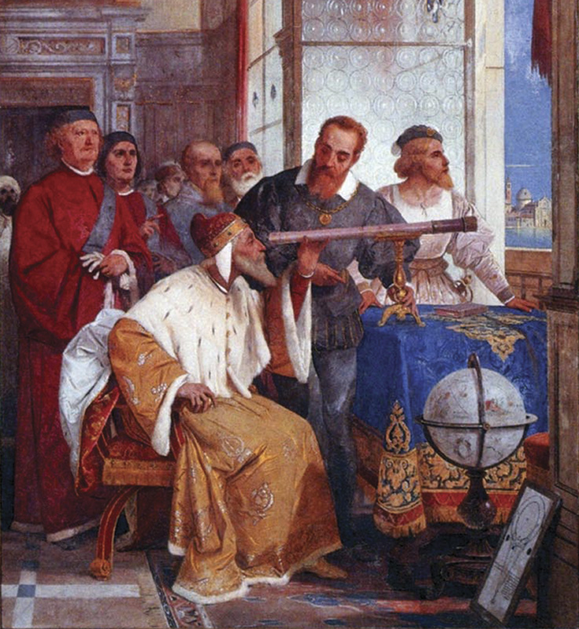
The Scientific Revolution
(1500s-1700s)
© Student Handouts, Inc.

Slide 2
What was the Scientific Revolution?
Beginning of modern science
Scientific method: Depends upon logic, observation, and reason rather than faith
Created the technologies and techniques that built the modern world
Created paradigm of our solar system

Slide 3
Revolution in Epistemology and Philosophy
Universities formed
Rediscovery of classical science
Leading figures
  Bacon
  Brahe
  Copernicus
  Descartes
  Galileo
  Kepler
  Newton

Slide 4
Nicolaus Copernicus (1473-1543)
Earth revolves around the sun
Book On the Revolutions of the Heavenly Spheres
Heliocentric theory:
  Sun is the center of the universe

Slide 5
Tycho Brahe (1546-1601)
Danish royal astrologer
Follower of Ptolemaic system
Observed and mapped over 700 stars in a 20-year period

Slide 6
Sir Francis Bacon (1561-1626)
Preferred inductive reasoning and facts over theory
Invented the scientific method

Slide 7
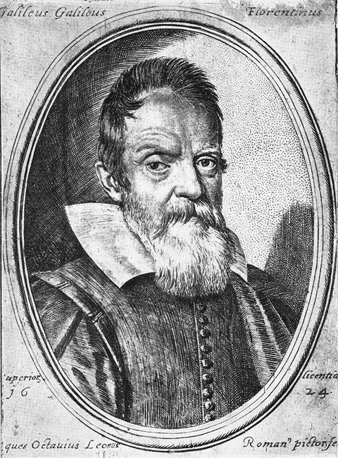
Galileo Galilei (1564-1642)
“I recant”
Invented the telescope, pendulum clock, thermometer, water pump, and sector
Discovered speed of acceleration for gravity

Slide 8
Johann Kepler (1571-1630)
Brahe’s student for 20 years
Living during 30 years of war
Loved the planets and made it his life’s work to explain the motion of planets
Invented Three Laws of Planetary Motion

Slide 9
Rene Descartes (1595-1650)
Deductive logic
Deduced the existence of God
Invented Cartesian geometry (xy axis)
“I think therefore I am”

Slide 10
Sir Isaac Newton (1642-1727)
The Principia
Tied up the loose ends of Kepler and Galileo
Three Laws of Motion
Defined gravity and its laws
Invented optics and calculus

Slide 11
Rise of the Scientific Community
Developed the modern scientific method
Universe ordered according to natural laws
Discovered that scientific laws can be discovered by human reason
Took the role of a deity or god out of the study of the universe
Mechanical views of the universe
Deistic view of God

Slide 12
Review Questions
Describe the Scientific Revolution.
What astronomer, author of On the Revolutions of the Heavenly Spheres, believed that the earth revolves around the sun?
Who is credited with inventing the scientific method?
Who came up with the Three Laws of Planetary Motion?
What famous Italian astronomer was convicted of heresy by the Inquisition?
What English scientist defined gravity?

