Slide 1
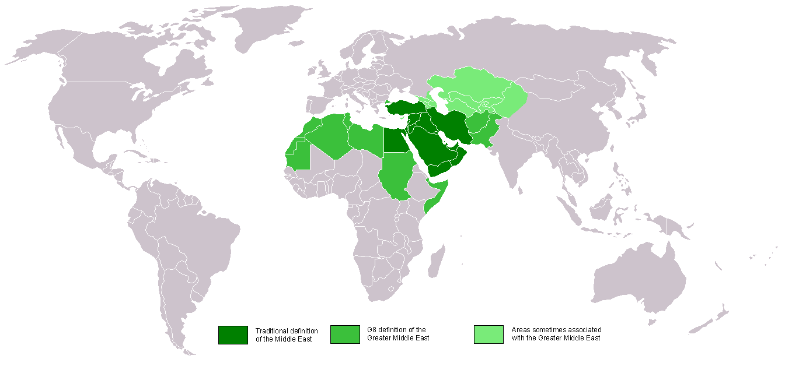
Imperialism in the Middle East and Southwest asia
© Student Handouts, Inc.

Slide 2
GEOGRAPHY
Diverse region stretching around the eastern Mediterranean coast to the Indus valley
Includes Afghanistan, Persia (Iran), and the Turkish empire
  Ottoman Turks defeated in World War I
    Ottoman lands administered by the League of Nations
Rich oil reserves

Slide 3
BRITISH INTERESTS
Suez Canal in Egypt, 1869
  Short route between Mediterranean Sea and Indian Ocean
  Egypt independent from Great Britain in 1922
    But British controlled canal until 1960s
Mandates following World War I – under the League of Nations
  Mesopotamia – Iraq
  Palestine – Israel
    Included Transjordan (Jordan)
Kuwait
  Declared by invading Britons after World War I to be an “independent sheikdom under British protectorate”
  Independent in 1961

Slide 4
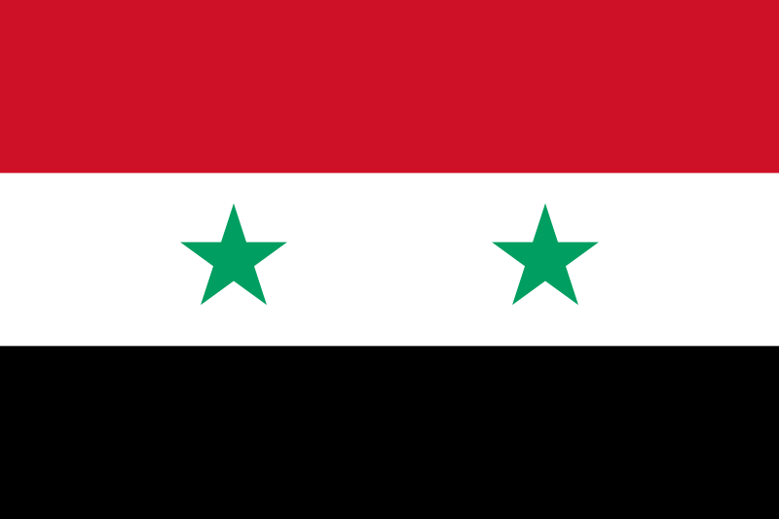

FRENCH INTERESTS
French mandates (1923-1944) under the League of Nations
  Syria
  Lebanon

Slide 5
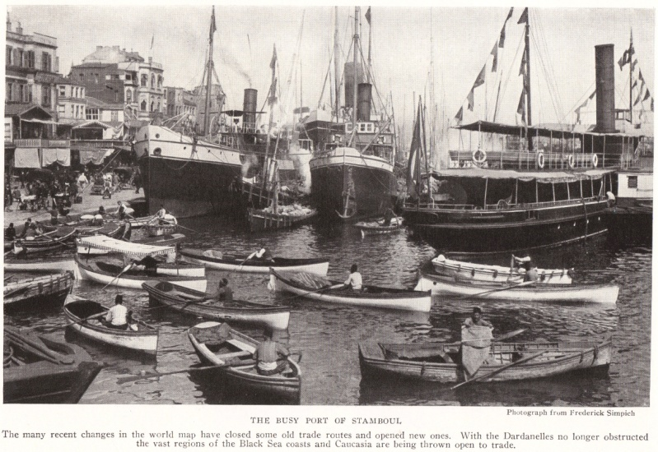
RUSSIAN INTERESTS
Russians (Soviets after 1917) sought control of Constantinople (Istanbul)
  Warm-water port linking the Black Sea to the Mediterranean Sea
Acquisition and control of territory in Caucasus and Central Asia
Istanbul, 1922

Slide 6
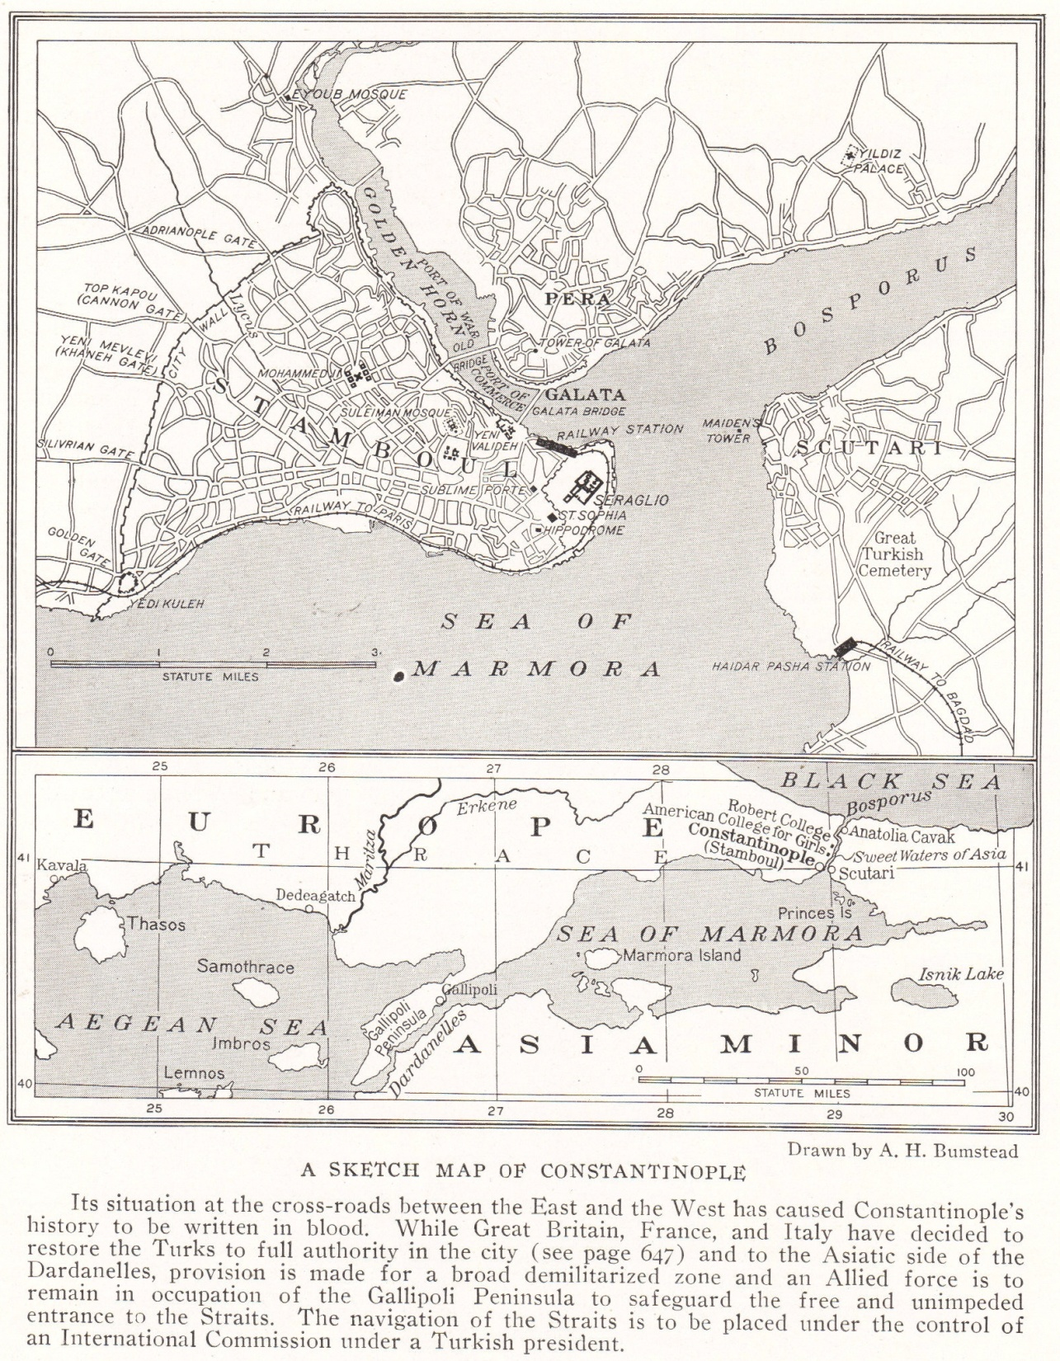

Slide 7
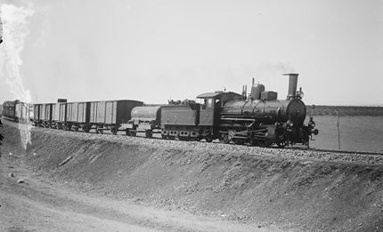
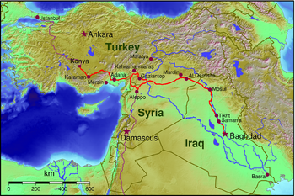
GERMAN INTERESTS
Berlin-to-Baghdad Railroad
  If thoroughly completed, it would have allowed transport from Germany, through Iraqi oil fields, to port on the Persian Gulf
  Route completed between Berlin and Baghdad by 1940

Slide 8
CONFLICTS BETWEEN GREAT BRITAIN AND RUSSIA
Russia attempted moving into Afghanistan, India (Pakistan), and Persia (Iran)
Afghanistan – ruled by Great Britain until independent in 1919
India (including Pakistan) – ruled by Great Britain until independent in 1947
1907 – compromise over Persia (Iran)
  Northern third – Russian sphere of influence
  Southeastern third – British sphere of influence
  Remaining middle third – “no man’s land”
  Never colonized but lost territory to Russia and Britain during the Qajar era (1794-1925)

Slide 9
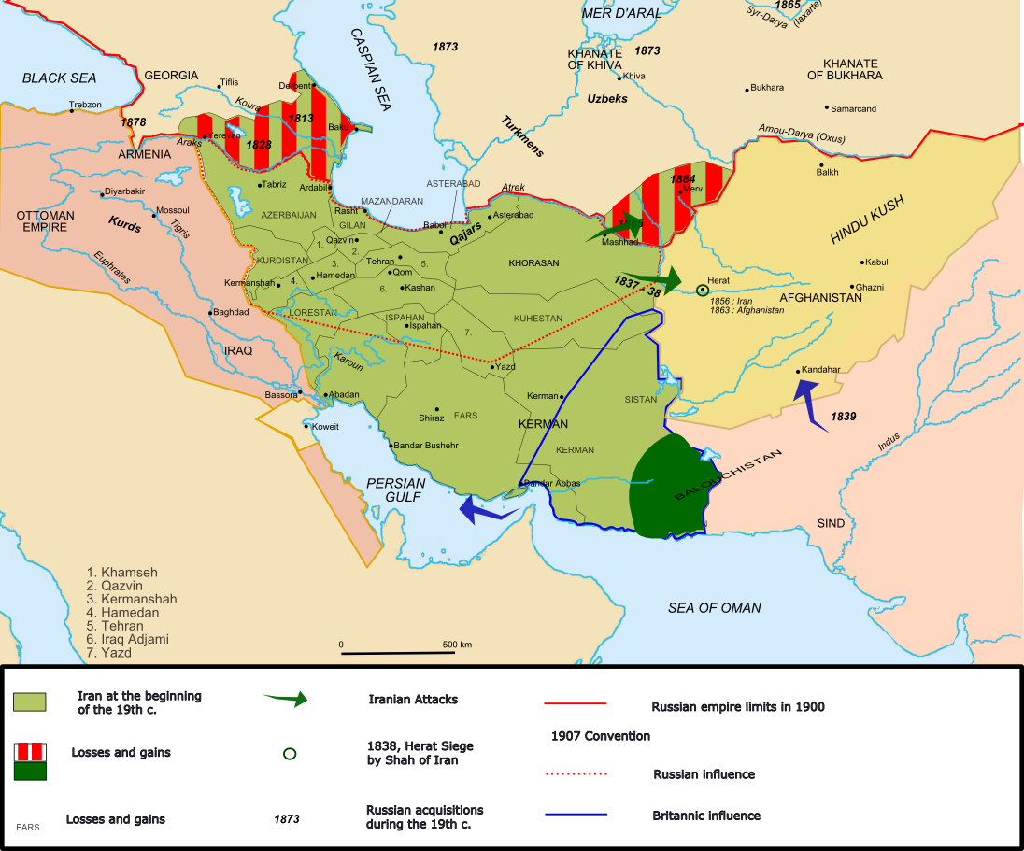

Slide 10
Review Questions
What two native empires ruled the Middle East and southwestern Asia in the nineteenth century?
What natural resource of this region was of most interest to foreign imperialist powers?
What foreign powers held control in this region under mandates granted by the League of Nations?
Notes:
Answers: Ottoman and Persian (or Qatar) empires. Oil. Great Britain and France.

