Slide 1
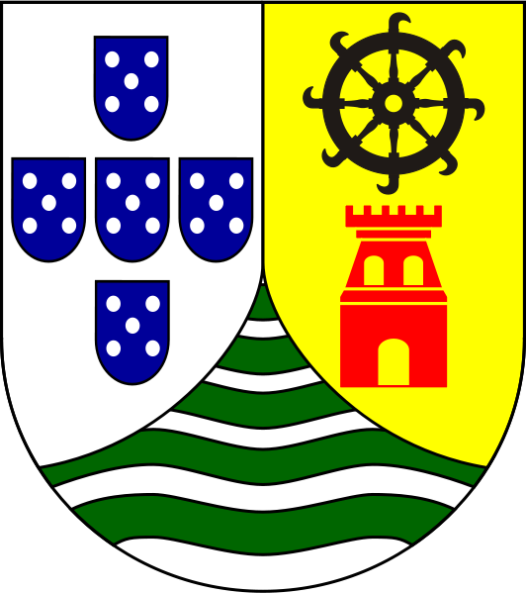
Europeans in Asia:
The Early Years of Empire Building
© Student Handouts, Inc. www.studenthandouts.com
Notes:
Possible anecdote: Portuguese flag for its Indian Ocean outposts; theme of change within the Indian Ocean region

Slide 2
The Portuguese
1510: Portuguese seize Goa
1511: Portuguese conquer Malacca
1500s: Portuguese in control of the European-Asian spice trade from outposts and forts
Why? Control of the spice trade
How? Firepower
Where? Indian Ocean and around Africa
Notes:
Possible anecdote: Brutality of Portuguese military gains

Slide 3
The Dutch
1599: Dutch fleet returns with Asian spices
1602: Dutch East India Company forms
1641: Take Malacca from Portuguese and begin trading with China
1700s: Decline due to rising power of France and England
Why? Interest in spices and trading
How? Warships, trading vessels, and Dutch East India Company
Where? Cape Town (Africa) and Indian Ocean outposts (especially Spice Islands)
Notes:
Possible anecdote: Growth of the Netherlands following break from Spain; profits encouraged Dutch arts (e.g., Rembrandt)

Slide 4
The Spanish
1521: Magellan claims Philippines from Spain
1520s-1570s: Archipelago conquered
Why? Spanish link to Asia
How? Military and missionaries
Where? Silver from Spanish America passed through on its way to buy goods in China
Notes:
Possible anecdote: Philippines today almost uniformly Catholic; Philippines ruled by Spain until won by United States in Spanish-American War (1898)

Slide 5
India under the Mughals
1526: Babur founds the Mughal dynasty
1700s: European traders begin to enter mainland India along the coast
Why? °Mughals do not initially see Europeans as a threat
°Europeans want Indian textiles
How? °Warehouses and forts at coastal ports
°Europeans already on mainland as Mughal rule breaks down
Where? European rule begins in Bengal
Notes:
Possible anecdote: Early Mughal India actually much richer and more powerful than any European nation; discussion about fabrics (pre-synthetics) and how many (calicos, ginghams, etc.) are Indian in origin

Slide 6
European Ascendancy in India
Religious toleration ends
Hindu and Muslim princes begin fighting
Europeans play princes against one another
Civil wars
Tax increases
Peasant unrest
India’s central government collapses
British and French trading companies hire their own Indian troops (sepoys)
Notes:
Possible anecdote: Muslim-dominated northern India and Hindu-dominated southern India with tie-in to eventual split into Pakistan and India

Slide 7
Britain vs. France
1740-1748: War of the Austrian Succession (also known as King George’s War)
1756-1763: Seven Years’ War (known in the United States as the French and Indian War)
Britain and France compete for world domination
Britain and France both have trading operations in India
Notes:
Possible anecdote: Tie-in to American history and other world history themes

Slide 8
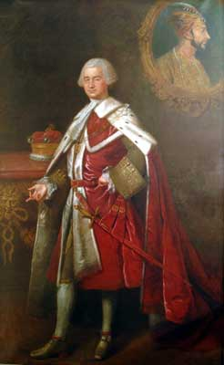
Robert Clive (1725-1774)
British East India Company agent
Commands British and Indian troops (sepoys) to defeat French in India
Gains control over Bengal and begins collecting taxes
British East India Company uses Bengal as a launching pad for controlling India
Notes:
Possible anecdote: Black Hole of Calcutta; reality that British trading company rather than British government took control of India

Slide 9
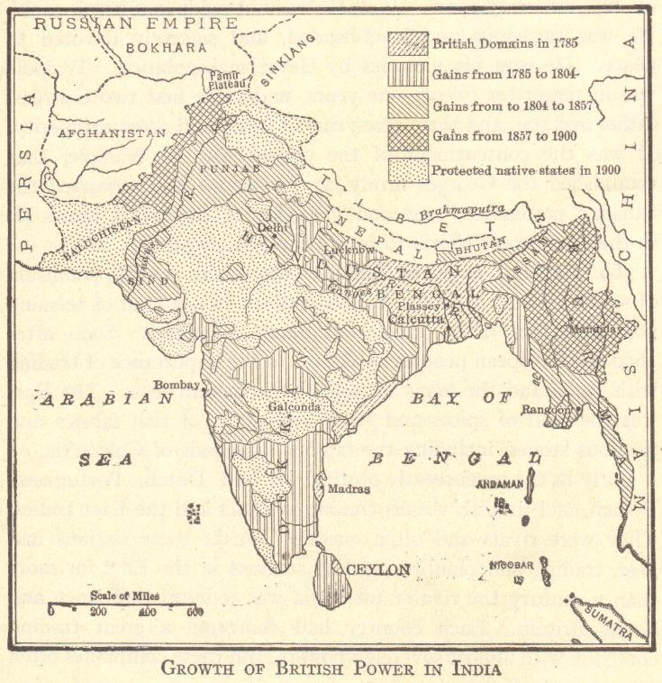

Slide 10
Questions
What attracted Europeans to Asia?
Which European nation was the first to acquire trading rights around the Indian Ocean?
What role did the Philippines play in Spain’s global trading empire?
How did Great Britain come to dominate India?

