Slide 1

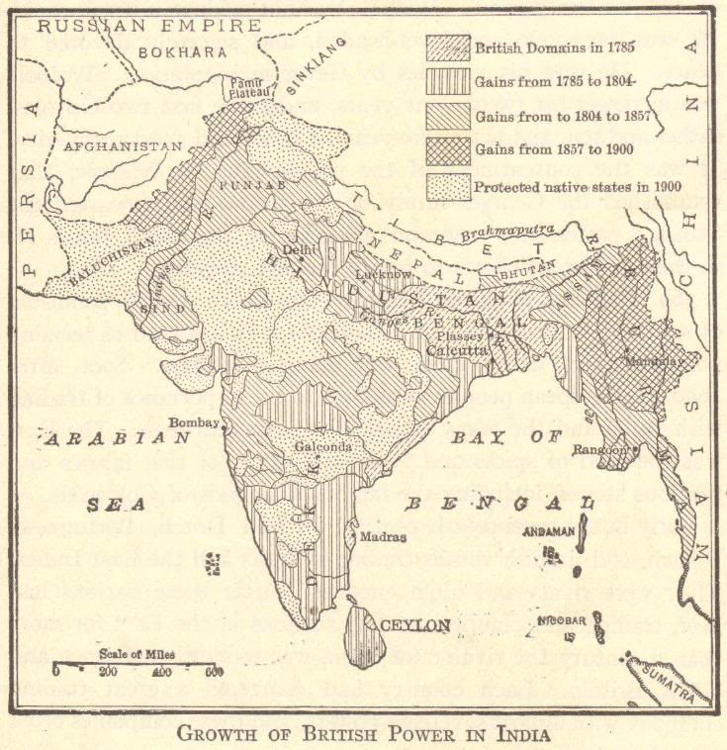

IMPERIALISM:
Beginnings and Basic Structures
© Student Handouts, Inc. www.studenthandouts.com

Slide 2
COLONIALISM SPEEDS UP
Age of Exploration
↓
Europeans raced for overseas colonies
↓
Growth of European commerce and trade worldwide
↓
Commercial Revolution
Notes:
Possible anecdotes: Colonization of the Americas, mercantilism, etc.

Slide 3
“OLD” IMPERIALISM
1500s-1700s
England, France, Holland, Portugal, and Spain
Wars over colonies
Notes:
Possible anecdotes: French and Indian War (Seven Years’ War), Spanish and Portuguese competition in Latin America, etc.

Slide 4
INTERLUDE – LATE 1700s-LATE 1800s
Europeans were preoccupied with happenings on the European continent and in the existing European colonies.
American Revolution
French Revolution
Napoleonic Wars
Latin American Wars for Independence
Growth of Nationalism
Industrial Revolution
Notes:
Possible anecdote: The loss of colonies in the Americas helped spur interest in new colonies while also illustrating the need for change in the nature of imperialism.

Slide 5
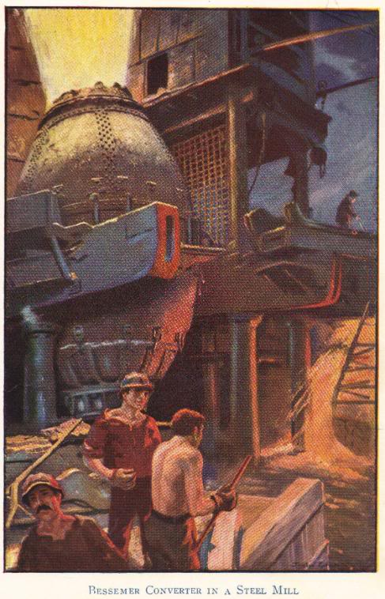
“NEW” IMPERIALISM
Beginning circa 1875
Renewed race for colonies
Spurred by needs created by the Industrial Revolution
  New markets for finished goods
  New sources of raw materials
Nationalism
  Colonies = economic and political power
  Social Darwinism = racist justification
Notes:
Possible anecdote: British textile mills required more cotton than could be produced in Great Britain.

Slide 6
WHAT IS “NEW” IMPERIALISM?
No longer about setting up colonies or exercising direct control over areas
Became largely economic
  Possession or control of an area for economic gain
  Spheres of influence and extraterritoriality rather than colonial settlement

Slide 7
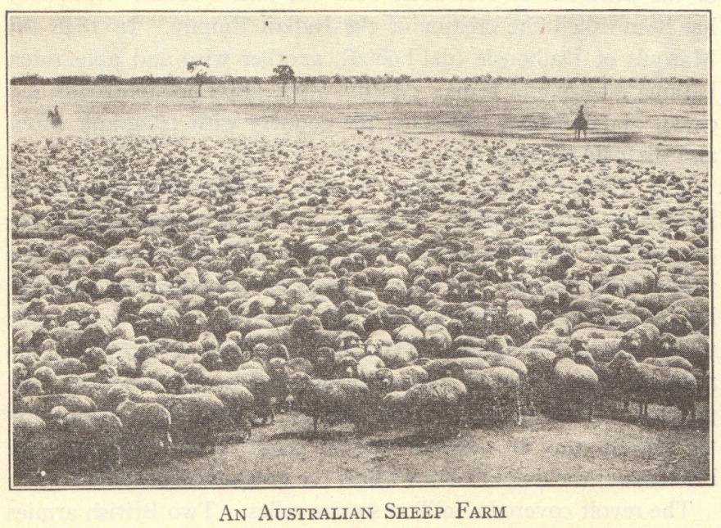
ECONOMIC MOTIVES
Markets for finished goods
  Products of British Industrial Revolution sold in China and India
Sources of raw materials
  Egypt – cotton
  Malaya – rubber and tin
  Middle East – oil
Capital investments
  Profits from Industrial Revolution invested in mines, railroads, etc., in unindustrialized areas
Notes:
Possible anecdote: Many foreign countries had to be coerced to purchase European goods. Railroads were built throughout Europeans’ colonial possessions and in areas where industrialized nations held economic and political influuence.

Slide 8
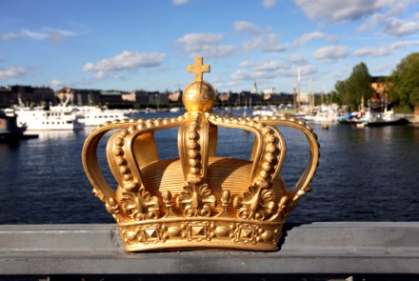
POLITICAL MOTIVES
Nationalism – national pride
“The sun never sets on the British empire.”
Large empires increased national pride
French acquisitions in Africa and Asia followed France’s defeat in the Franco-Prussian War
Notes:
Possible anecdote: The legacy of empires is reflected in languages spoken around the world today, particularly English.

Slide 9
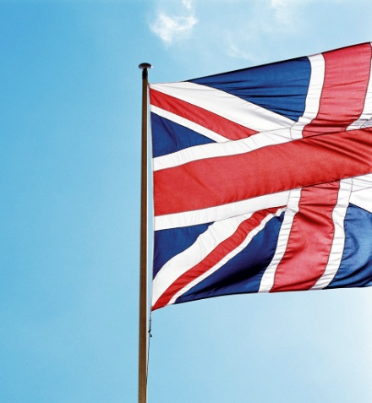
MILITARY MOTIVES
Bases
  British naval bases
    Aden, Alexandria, Cyprus, Hong Kong, Singapore
Manpower
  British – Indian sepoys
  French – north African troops
Notes:
Possible anecdote: Compare the use of native troops within the British and French empires with the use of “barbarian” troops within the Roman empire, with the idea that imperial powers historically have never had enough of their own troops to maintain their empires.

Slide 10
SOCIAL MOTIVES
Surplus population
  Japanese in Korea
  Italians in Africa
“White Man’s Burden”
  Rudyard Kipling’s poetry and prose
  Whites morally obligated to bring the “blessings of civilization” to “backward” peoples
  Cecil Rhodes – imperialism is “philanthropy—plus five percent”
Notes:
Possible anecdote: Did imperial powers bestow any positive benefits? Did these benefits outweigh the costs of colonization?

Slide 11

RELIGIOUS MOTIVES
Conversion to Christianity
End-of-the-century crusading spirit
Missionaries in Africa, Asia, Hawaii, etc.
†
Notes:
Possible anecdote: In what ways did well-intentioned missionaries become cultural imperialists?

Slide 12
JUSTIFICATIONS
Social Darwinism
  Interpreted Darwin’s evolutionary theory in terms of powerful nations
    “Only the strong survive”
  Powerful nations able to develop areas and resources being “wasted” by native peoples
Racism
  Increased feelings of white superiority
    Increased feelings of Japanese superiority
  Eugenics developed as a branch of science
Notes:
Possible anecdote: Racism and eugenics developed and/or increased simultaneously to justify the dominance of imperial powers, both among the Japanese and Europeans.

Slide 13
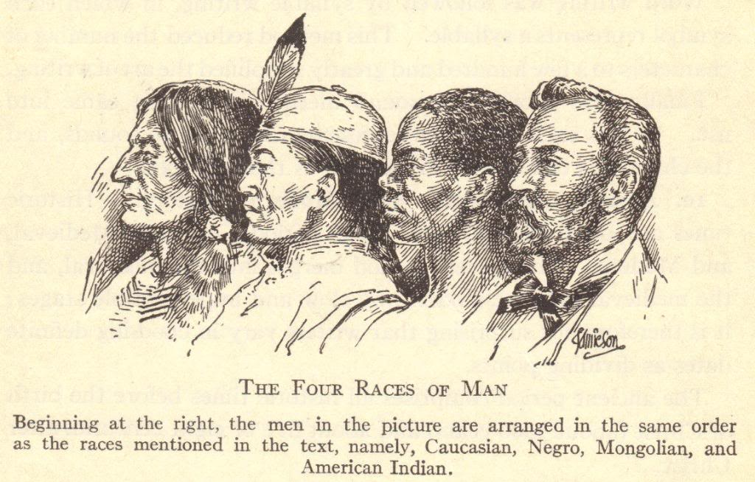
CONCEPT OF “RACES” CIRCA 1900
Notes:
Possible anecdote: Discussion about how the concept of races is outdated and has been proven incorrect through modern research into human migrations and DNA.

Slide 14
CONCESSION IMPERIALISM
Economic privileges and rights given for a specific purpose
U.S. and British oil concessions throughout the Middle East
Ottoman Turks granted Germany permission to build Berlin-to-Baghdad Railroad
Notes:
Possible anecdote: Where

Slide 15
SPHERE OF INFLUENCE IMPERIALISM
Exclusive or special control over an area
Examples
  British trading rights in China’s Yangtze valley
  French trading rights in southeastern China
  Japanese trading rights in Korea
Notes:
Possible anecdote: What does a sphere of influence entail? What did the granting of a sphere of influence mean for a host country?

Slide 16
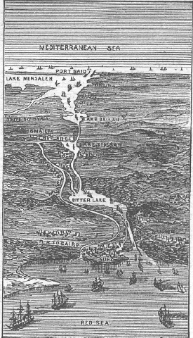
LEASEHOLD IMPERIALISM
Lease over an area
Suez Canal Corporation
  Suez Canal built by French in 1860s
  Controlled by British shortly thereafter until 1968
Panama Canal
  United States
Germans in Kiachow
French in Kwangchow
British in Weihaiwei
Plan of Suez Canal as envisioned in 1881.
Notes:
Possible anecdote: Discuss the differences between leasehold imperialism and simple foreign investment (particularly the historical use of military force to retain control over leaseholds).

Slide 17
PROTECTORATE IMPERIALISM
Foreign control exercised through native “puppet” rulers
French – Morocco (1906-1956)
British – Egypt (1914-1968)
  Britain held a sphere of influence in Egypt from 1882-1914
  Britain gained control of Egypt as Egypt’s protectorate when the Ottoman empire fell apart during World War I

Slide 18
ANNEXATION IMPERIALISM
Territory annexed and turned into a colony under the complete control of a foreign power
German colonies in east and southwest Africa – until 1918 and the end of World War I
French Indochine (Vietnam) – until 1955
British Burma – until 1948

Slide 19
MANDATE IMPERIALISM
Victors of World War I gained control over German possessions under mandates granted by the League of Nations
German East Africa → Great Britain
Pacific islands north of the equator → Japan
Syria → France

Slide 20
TRUSTEESHIP IMPERIALISM
Victors of World War II gained control over Japanese mandates plus the newer Japanese and German colonies under trusteeships granted by the United Nations
United States → Okinawa and Caroline Islands
Italy → Somalia

Slide 21
REVIEW QUESTIONS
Describe three motives for imperialism.
Describe three types of imperialism.
Which nations became imperial powers?
Which nations were controlled by imperial powers?
How did imperial powers justify their control over foreign nations?

