Slide 1
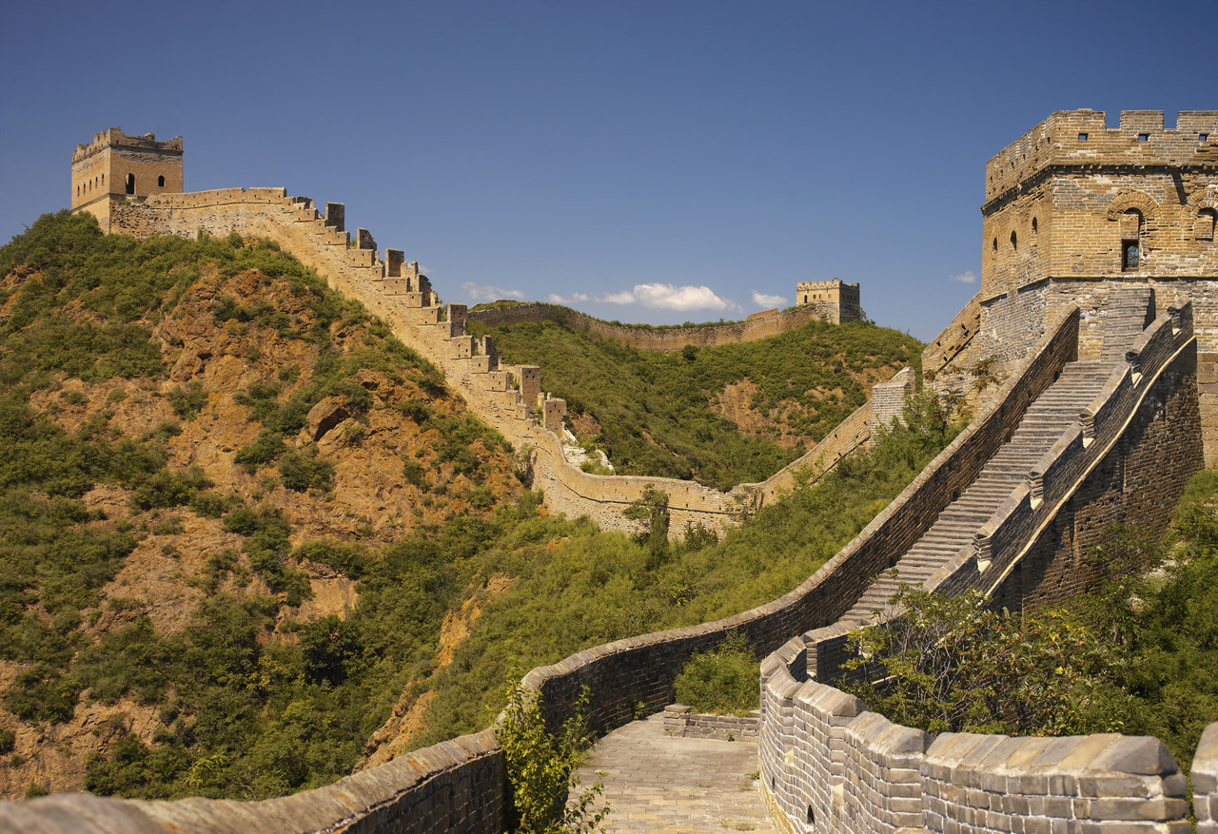
Imperialism in China
© Student Handouts, Inc.
www.studenthandouts.com

Slide 2
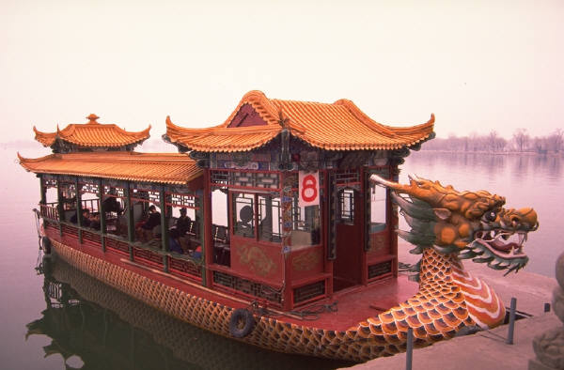
Early Contacts with Europeans
16th century – Portuguese traded for silk and tea
Portuguese followed by the Dutch and English

Slide 3
Chinese History
1644 – conquered by Manchus
  Qing dynasty
  Chinese forced to wear pigtails (sign of subservient status)
18th century
  Manchus began restricting Europeans – missionaries and traders

Slide 4
First Opium War
(1839-1842)
British brought opium from India to Canton
  Many Chinese became addicts
Chinese emperor forbade opium imports
  War between British and Chinese
Treaty of Nanking (1842)
  Four additional British ports in China
    Amoy, Ningpo, Foochow, Shanghai
  British control over Hong Kong
  China had to pay an indemnity
  China limited to 5% tariff

Slide 5
Other Westerners in China
Belgium, France, Holland (Netherlands), Portugal, Prussia (Germany), United States
Spheres of influence
  Exclusive trading areas
Extraterritoriality
  Tried in their own courts and under their own laws

Slide 6
Second Opium War
(1856-1860)
Also known as the Arrow War
Results
  More Chinese ports opened up to European trade
  Opium traffic legalized
  Protection of Christian missionaries
  All foreign vessels could navigate the Yangtze River
  U.S. and Russia also participated in peace process
    Russia’s border extended to Amur River
      Maritime Provinces – Pacific area without permafrost
      Founded Vladivostok in 1860

Slide 7
More Foreign Control of China
Annam, etc.
  Merged into French Indo-China (1883)
Burma (Myanmar)
  Annexed by British (1886)
Formosa
  Attacked and taken by Japanese (1895)
Korea
  Annexed by Japanese (1910)
Liaotung Peninsula (Manchuria)
  Concessions to Japanese (1910)

Slide 8
Manchuria
Imperial powers (particularly Japan and Russia) vied for control of the Manchurian Railway
France, Germany, and Russia coerced Japan to return the Liaotung Peninsula to China

Slide 9
New Scramble for China
France
  Kwangchow – 99-year lease
Germany
  Shantung Peninsula – sphere of influence
Great Britain
  Wei-hai-wei – naval base
  Yangtze valley – sphere of influence
Russia
  Liaotung Peninsula – lease
  Manchuria – economic concessions

Slide 10
Open Door Policy
Proposed by U.S. Secretary of State John Hay (1899)
Fear that China would be carved up between imperialist powers
Left China’s independence and territory intact
All nations could trade equally in China
Endorsed internationally
  But not always strictly followed

Slide 11
Boxer Rebellion (1900)
Chinese people resented foreign influence and power
Order of the Patriotic Harmonious Fists
  Called “Boxers” by Westerners
  Demanded that foreigners leave China
  Killed circa 300 and vandalized foreign property
European imperialists, Americans, and Japanese put down the rebellion
China paid $333,000,000 in damages and had to permit military forces in Peking (Beijing) and Tientsin

Slide 12
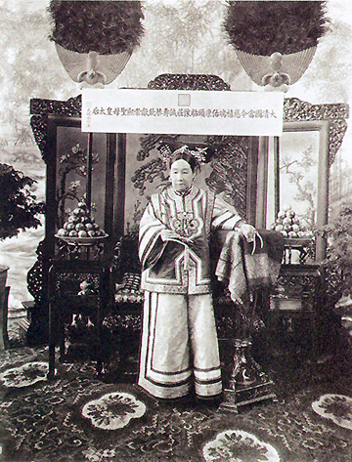
Fall of the Qing (Manchu) Dynasty
Empress Dowager Cixi (1835-1908)
  De facto Chinese monarch (1861-1908)
  “Make me unhappy for a day and I will make you unhappy for a lifetime.”
  Conservative and anti-foreign
  Blamed by many Chinese for foreign imperialist power in China

Slide 13
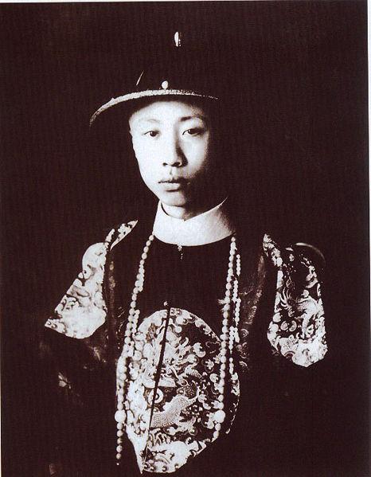
Fall of the Qing (Manchu) Dynasty
Emperor Puyi – the “Last Emperor”
  Lived 1906-1967
  Ruled China 1908-1912, and as a puppet for 12 days in 1917
  Puppet emperor of Manchukuo (Japanese-ruled Manchuria), 1932-1945
  Spent ten years in a Soviet prison after WWII
  Lived a quiet life as a regular citizen in communist China
  Died of disease during the Cultural Revolution (1967)

Slide 14
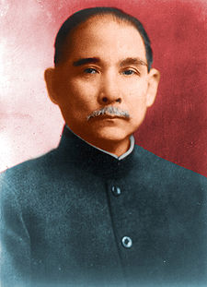

Republican Revolution
Sun Yat-sen (Sun Yixian)
  Founded Kuomintang (Nationalist party)
    Overthrew Manchu (Qing) dynasty
    Established a republic
    President of Chinese Republic who succeeded him – Yuan Shih-k’ai
Kuomintang symbol

Slide 15
Republic of China: Weaknesses
Disunity
  Local warlords fought Kuomintang for control
  Wars raged between 1912 and 1928
Foreign imperialists
  Americans, Europeans, and Japanese
Poor transportation
  1914 – only 6,000 miles of railroad track
    225,000 miles in the smaller United States
  Few decent roads

Slide 16
Foreign Imperialists
Twenty-One Demands (1915)
  Japan attempted to make China a Japanese protectorate
  Action condemned and stopped by other leading world powers
World War I and the Treaty of Versailles
  China attempted to abolish concessions and extraterritoriality
    Attempt failed
  China did not sign the Treaty of Versailles
  Japan gained mandate over most of Germany’s Asian possessions and rights

Slide 17
Three Principles of the People
Book published by Sun Yat-sen before his death in 1925
  Principle of Mínquán
    Democracy – the people are sovereign
  Principle of Mínzú
    Nationalism – an end to foreign imperialism
  Principle of Mínshēng
    Livelihood – economic development, industrialization, land reform, and social welfare – elements of progressivism and socialism

Slide 18

Growth of Communism
Sun Yat-sen appealed for Russian (Soviet) aid following the Versailles Conference
  1921-1925 – China received advisors, arms, communist propaganda, and loans
  Russia revoked its imperialist rights in China
Chinese flag, 1912-1928

Slide 19

The Kuomintang is Split
Right wing
  Business people
  Politicians
Left wing
  Communists
  Intellectuals
  Radicals
  Students

Slide 20
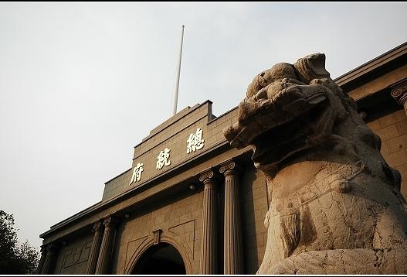
Nationalist Revolution
Sun Yat-sen succeeded by Chiang Kai-shek
Communists expelled by Kuomintang
1926-1928 – war to control the warlords
Capital moved from Peiping (a.k.a. Peking, today’s Beijing) to Nanking (Nanjing)
Presidential Palace under Kuomintang Government in Nanjing
Notes:
Possible anecdote: The Kuomintang changed the name of Peking/Beijing to Peiping (or Beiping) in 1928.

Slide 21
Civil War in China
1927-1932 and 1933-1937 – war between Communists and Nationalists
Communists – Mao Tse-tung (Mao Zedong)
Nationalists – Chiang Kai-shek
War halted 1932-1933 and 1937-1945 to fight Japanese aggression
Communists were victorious in 1949
Nationalists retreated to Formosa (Taiwan)
End of imperialism in China
  Hong Kong returned to China in 1997

Slide 22
Review Questions
What Chinese goods were sought by European traders?
What were the consequences of the First and Second Opium Wars?
Describe the Open Door Policy.
What was the Boxer Rebellion?
What were Japan’s Twenty-One Demands?
Describe Sun Yat-sen’s three principles.
What area of China remained under British control until 1997?

