Slide 1
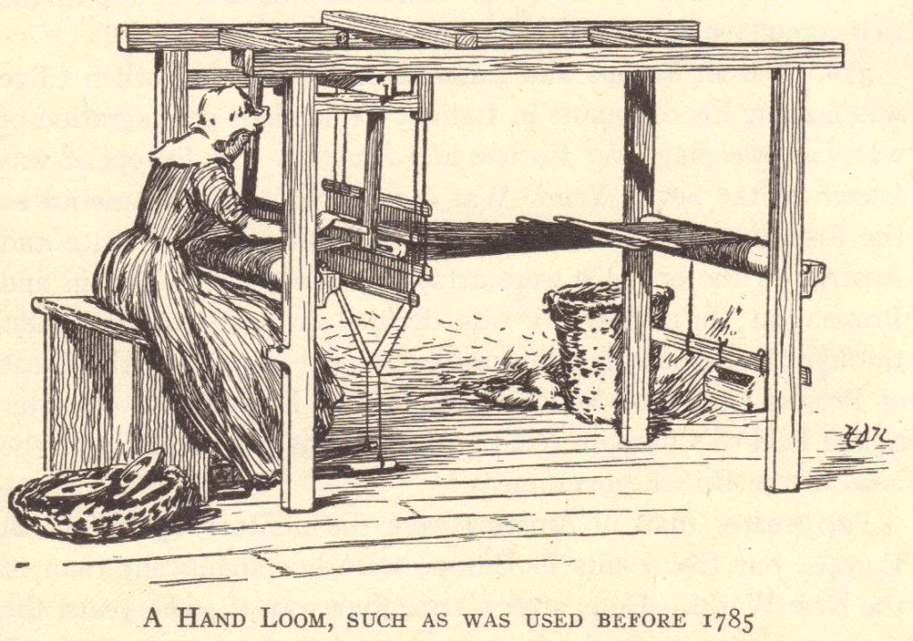
The Industrial Revolution
© Student Handouts, Inc.

Slide 2
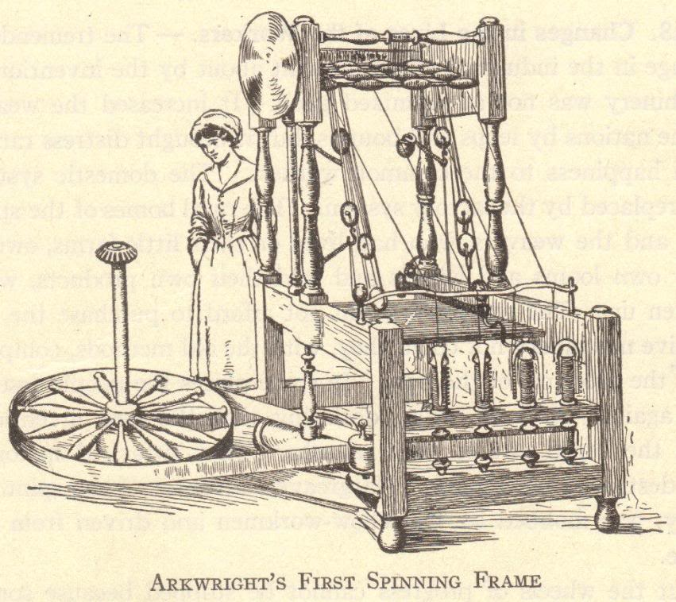
The First Industrial Revolution

Slide 3
Historical Significance of the Industrial Revolution
An ancient Greek or Roman would have been just as comfortable in Europe in 1700 because daily life was not much different – agriculture and technology were not much changed in 2000+ years
The Industrial Revolution changed human life drastically
More was created in the last 250+ years than in the previous 2500+ years of known human history

Slide 4
What was the Industrial Revolution?
The Industrial Revolution was a fundamental change in the way goods were produced, from human labor to machines
The more efficient means of production and subsequent higher levels of production triggered far-reaching changes to industrialized societies

Slide 5
The Industrial Revolution
Machines were invented which replaced human labor
New energy sources were developed to power the new machinery – water, steam, electricity, oil (gas, kerosene)
  Some historians place advances in atomic, solar, and wind energy at the later stages of the Industrial Revolution
Increased use of metals and minerals
  Aluminum, coal, copper, iron, etc.

Slide 6
The Industrial Revolution
Transportation improved
  Ships
    Wooden ships → Iron ships → Steel ships
    Wind-powered sails → Steam-powered boilers
  Trains
  Automobiles
Communication improved
  Telegraph
  Telephone
  Radio

Slide 7
Developments
Mass production of goods
  Increased numbers of goods
  Increased diversity of goods produced
Development of factory system of production
Rural-to-urban migration
  People left farms to work in cities
Development of capitalism
  Financial capital for continued industrial growth
Development and growth of new socio-economic classes
  Working class, bourgeoisie, and wealthy industrial class
Commitment to research and development
  Investments in new technologies
  Industrial and governmental interest in promoting invention, the sciences, and overall industrial growth

Slide 8
Background of the Industrial Revolution
Commercial Revolution
  15th, 16th, and 17th centuries
  Europeans expanded their power worldwide
  Increased geographic knowledge
  Colonies in the Americas and Asia
  Increased trade and commerce
  Guild system could not meet the demands of increasing numbers goods

Slide 9
Background of the Industrial Revolution
Scientific Revolution
  17th and 18th centuries
  Discoveries of Boyle, Lavoisier, Newton, etc.
Intellectual Revolution
  17th and 18th centuries
  Writings of Locke, Voltaire, etc.
Atmosphere of discovery and free intellectual inquiry
  Greater knowledge of the world
  Weakened superstition and tradition
  Encouraged learning and the search for better and newer ways of doing things

Slide 10
Development of the Domestic System of Production
Domestic system developed in England
Late 1600s-late 1800s
Domestic system of production – “putting out” system
  Businesspeople delivered raw materials to workers’ homes
  Workers manufactured goods from these raw materials in their homes (typically articles of clothing)
  Businesspeople picked up finished goods and paid workers wages based on number of items
Domestic system could not keep up with demand

Slide 11
Factory System
Developed to replace the domestic system of production
Faster method of production
Workers concentrated in a set location
Production anticipated demand
  For example: Under the domestic system, a woman might select fabric and have a businessperson give it to a home-based worker to make into a dress. Under the factory system, the factory owner bought large lots of popular fabrics and had workers create multiple dresses in common sizes, anticipating that women would buy them.

Slide 12
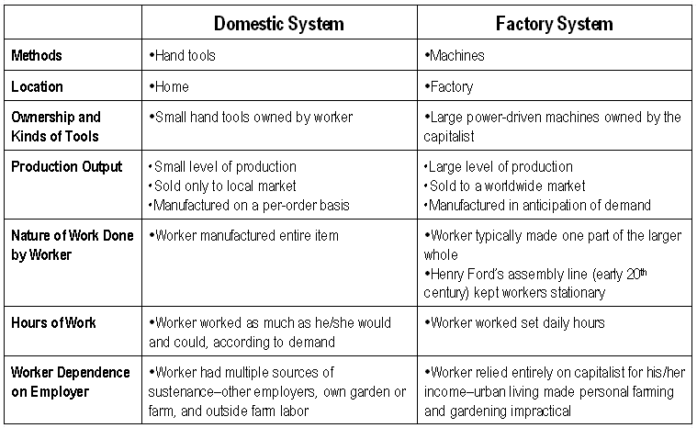

Slide 13
England: Birthplace of the Industrial Revolution
No concrete start date for the Industrial Revolution
Marked by gradual, slow changes
After 1750 – these changes were noticeable first in England

Slide 14
Why the Industrial Revolution Started in England
Capital for investing in the means of production
Colonies and Markets for manufactured goods
Raw materials for production
Workers
Merchant marine
Geography

Slide 15
England’s Resources: Capital
The Commercial Revolution made many English merchants very wealthy
These merchants had the capital to invest in the factory system – money to buy buildings, machinery, and raw materials

Slide 16
England’s Resources: Colonies and Markets
Wealth from the Commercial Revolution spread beyond the merchant class
England had more colonies than any other nation
Its colonies gave England access to enormous markets and vast amounts of raw materials
Colonies had rich textile industries for centuries
  Many of the natural cloths popular today, such as calico and gingham, were originally created in India
  China had a silk industry

Slide 17
England’s Resources: Raw Materials
England itself possessed the necessary raw materials to create the means of production
Coal – vast coal reserves powered steam engines
Iron – basic building block of large machines, railroad tracks, trains, and ships

Slide 18
England’s Resources: Workers
Serfdom and guilds ended earlier in England than other countries
English people could freely travel from the countryside to the cities
Enclosure Acts – caused many small farmers to lose their lands, and these former farmers increased the labor supply

Slide 19
England’s Resources: Merchant Marine
World’s largest merchant fleet
Merchant marine built up from the Commercial Revolution
Vast numbers of ships could bring raw materials and finished goods to and from England’s colonies and possessions, as well as to and from other countries

Slide 20
England’s Resources: Geography
England is the political center of Great Britain, an island
Great Britain (as the entire island was called beginning in 1707) did not suffer fighting on its land during the wars of the 18th century
Island has excellent harbors and ports
Damp climate benefited the textile industry (thread did not dry out)
Government stable
No internal trade barriers

Slide 21
“Necessity Is the Mother of Invention”
Spinning machine
Need to speed up weaving
Power loom created

Slide 22
“Necessity Is the Mother of Invention”
Power loom
Increased demand for raw cotton
Invention of the cotton gin

Slide 23
“Necessity Is the Mother of Invention”
Cotton gin
Demands for stronger iron
Improvements in iron smelting and the development of steel (Bessemer process)

Slide 24
“Necessity Is the Mother of Invention”
As more steam-powered machines were built, factories needed more coal to create this steam
Mining methods improved to meet the demand for more coal
The process of inventing never ends
One invention inevitably leads to improvements upon it and to more inventions
Notes:
Notes: An excellent example of this phenomenon is the personal computer or cell phone. Cell phones were initially used by professionals who needed fast communications for business. The everyday usefulness of cell phones was quickly apparent, increasing demand. Cell phone towers were built around the globe, and cell phone technology continues to grow more complex. Have students compare the original “brick” cell phone to the iPhone.

Slide 25
The Textile Industry
Textiles – cloths or fabrics
First industry to be industrialized
Great Britain learned a lot about textiles from India and China

Slide 26
The Birth and Growth of the Textile Industry
John Kay (English)
Flying shuttle, 1733
Hand-operated machine which increased the speed of weaving
James Hargreaves (English)
Spinning jenny, 1765
Home-based machine that spun thread 8 times faster than when spun by hand
Richard Arkwright (English)
Water frame, 1769
Water-powered spinning machine that was too large for use in a home – led to the creation of factories

Slide 27
The Birth and Growth of the Textile Industry
Samuel Crompton (English)
Spinning mule, 1779
Combined the spinning jenny and the water frame into a single device, increasing the production of fine thread
Edward Cartwright (English)
Power loom, 1785
Water-powered device that automatically and quickly wove thread into cloth
Eli Whitney (American)
Cotton gin, 1793
Device separated raw cotton from cotton seeds, increasing the cotton supply while lowering the cost of raw cotton
Elias Howe (American)
Sewing machine, 1846
Speed of sewing greatly increased

Slide 28
Development of Steam Engines
Early water power involved mills built over fast-moving streams and rivers
Early water power had problems
  Not enough rivers to provide the power needed to meet growing demand
  Rivers and streams might be far removed from raw materials, workers, and markets
  Rivers are prone to flooding and drying

Slide 29
Steam Power
Humans tried harnessing steam power for millennia
  Hero of Alexandria, Egypt – created a steam-driven device in the 1st century B.C.E.
Thomas Newcomen, England (1704)
  Created a steam engine to pump water from mines
James Watt, Scotland (1769)
  Improved Newcomen’s engine to power machinery

Slide 30
Steam Engines
By 1800, steam engines were replacing water wheels as sources of power for factories
Factories relocated near raw materials, workers, and ports
Cities grew around the factories built near central England’s coal and iron mines
  Manchester, Liverpool

Slide 31
Coal and Iron
Vast amounts of fuel were required to smelt iron ore to burn out impurities
Abraham Darby (1709)
  Discovered that heating coal turned it into more efficient coke
John Smeaton (1760)
  Smelted iron by using water-powered air pumps to create steam blasts
Henry Cort (1783)
  Developed the puddling process which purified and strengthened molten iron

Slide 32
Increases in Coal and Iron Production, 1770-1800
Coal production doubled
  6 million to 12 million tons
Pig iron production increased 250%
  1800 – 130,000 tons
Great Britain produced as much coal and iron as every other country combined

Slide 33
Bessemer Process and Steel
Prior to the Industrial Revolution, steel was difficult to produce and expensive
Henry Bessemer, 1856
  Developed the Bessemer process
  Brought on the “Age of Steel”
  Steel is the most important metal used over the past 150+ years
Other improvements in steel production
  Open-hearth furnace
  Electric furnace
  Use of other metals to produce various types of steel

Slide 34
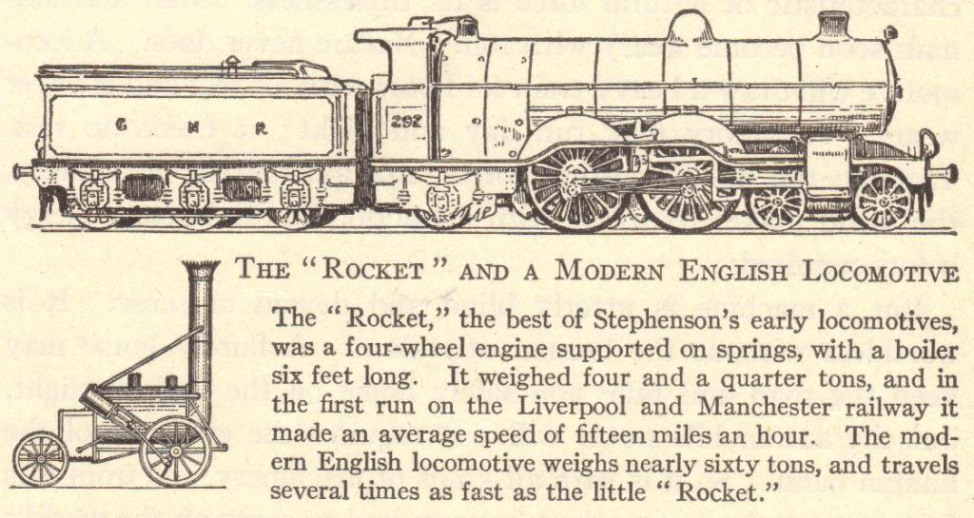
Transportation
Increased production
Search for more markets and raw materials
Better and faster means of transportation
Before the Industrial Revolution
  Canal barges pulled by mules
  Ships powered by sails
  Horse-drawn wagons, carts, and carriages
After the Industrial Revolution
  Trains
  Steamships
  Trolleys
  Automobiles

Slide 35
Transportation Revolution
Robert Fulton (American)
Steamboat (1807)
Sped water transportation
Thomas Telford and John McAdam (British)
Macadamized roads (1810-1830)
George Stephenson (English)
Locomotive (1825)
Improved roads
Fast land transport of people and goods
Gottlieb Daimler (German)
Gasoline engine (1885)
Led to the invention of the automobile
Rudolf Diesel (German)
Diesel engine (1892)
Cheaper fuel
Orville and Wilbur Wright (American)
Airplane (1903)
Air transport

Slide 36
Steamboats
Robert Fulton invented the steamboat in 1807
The Clermont operated the first regular steamboat route, running between Albany and New York City
1819 – the Savannah used a steam engine as auxiliary power for the first time when it sailed across the Atlantic Ocean
1836 – John Ericsson invented a screw propeller to replace paddle wheels
1838 – the Great Western first ship to sail across the Atlantic on steam power alone, completing the trip in 15 days

Slide 37
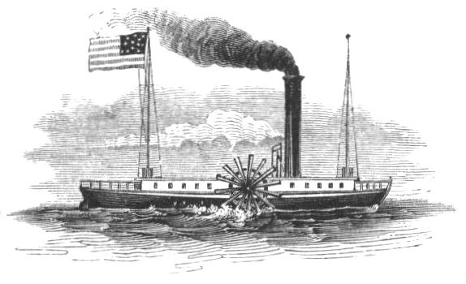

Slide 38
Macadamized Roads
Strong, hard roads invented by Thomas Telford and John McAdam
Improvement over dirt and gravel roads
Macadamized roads have a smooth, hard surface that supports heavy loads without requiring a thick roadbed
Modern roads are macadamized roads, with tar added to limit the creation of dust

Slide 39
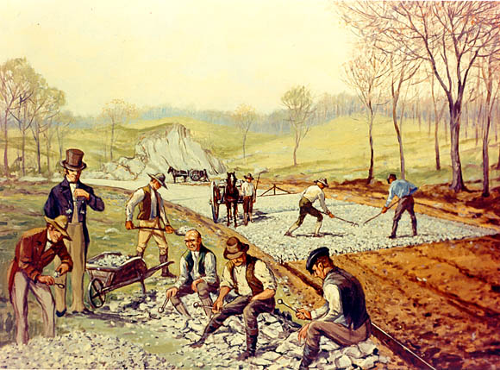

Slide 40
Railroads
1830 – Stephenson’s “Rocket” train traveled the 40 miles between Liverpool and Manchester in 1 ½ hours
1830-1870 – railroad tracks went from 49 miles to over 15,000 miles
Steel rails replaced iron rails
1869 – Westinghouse’s air brake made train travel safer
Greater train traveling comfort – heavier train cars, improved road beds, and sleeping cars

Slide 41
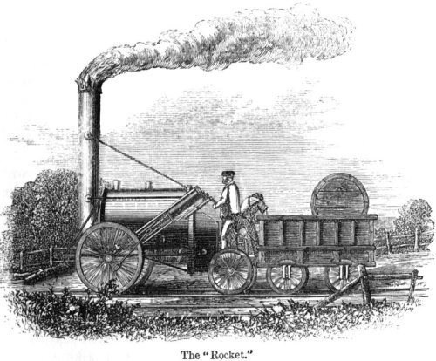

Slide 42
Communications Revolution
Samuel F.B. Morse (American)
Telegraph (1844)
Rapid communication across continents
Alexander Graham Bell (American)
Telephone (1876)
Human speech heard across continents
Cyrus W. Field (American)
Atlantic cable (1866)
United States and Europe connected by cable
Guglielmo Marconi (Italian)
Wireless telegraph, an early form of the radio (1895)
No wires needed for sending messages
Lee de Forest (American)
Radio tube (1907)
Radio broadcasts could be sent around the world
Vladimir Zworykin (American)
Television (1925)
Simultaneous audio and visual broadcast

Slide 43
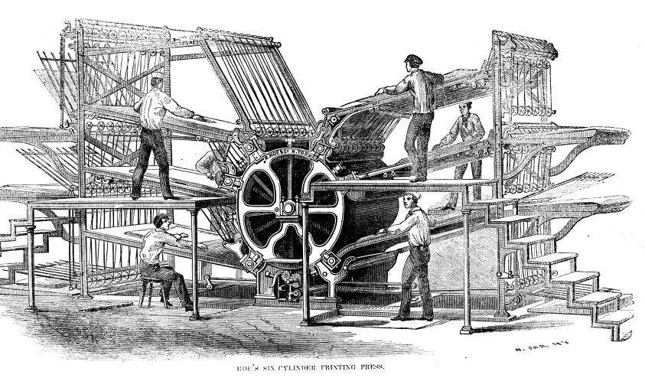
Printing Revolution
Printing – 1800-1830
  Iron printing press
  Steam-driven press
Rotary press – 1870
  Invented by Richard Hoe
  Printed both sides of a page at once
Linotype machine – 1884
  Invented by Ottmar Mergenthaler
  A machine operator could create a “line of type” all at one go, rather than having to individually set each letter
Newspapers became much cheaper to produce
  Cost of a newspaper plummeted
  Number of newspapers increased

Slide 44
Review Questions
What was the Industrial Revolution?
Describe at least three developments of the Industrial Revolution.
Compare and contrast the domestic and factory methods of production.
Why did the Industrial Revolution begin in England?
Explain why one invention or development leads to another.

Slide 45
Review Questions
Explain how developments in the textile industry sparked the Industrial Revolution.
Describe at least three developments in the area of transportation.
Describe at least three developments in the field of communications.
Considering the conditions necessary for industrialization to occur, how well equipped is the undeveloped world for becoming industrialized? Are modern undeveloped nations in a better or worse position than 18th- and 19th-century England?
Notes:
Note: Answers to all questions are found on slides 1-43. Question 9 is open to discussion and interpretation.

Slide 46
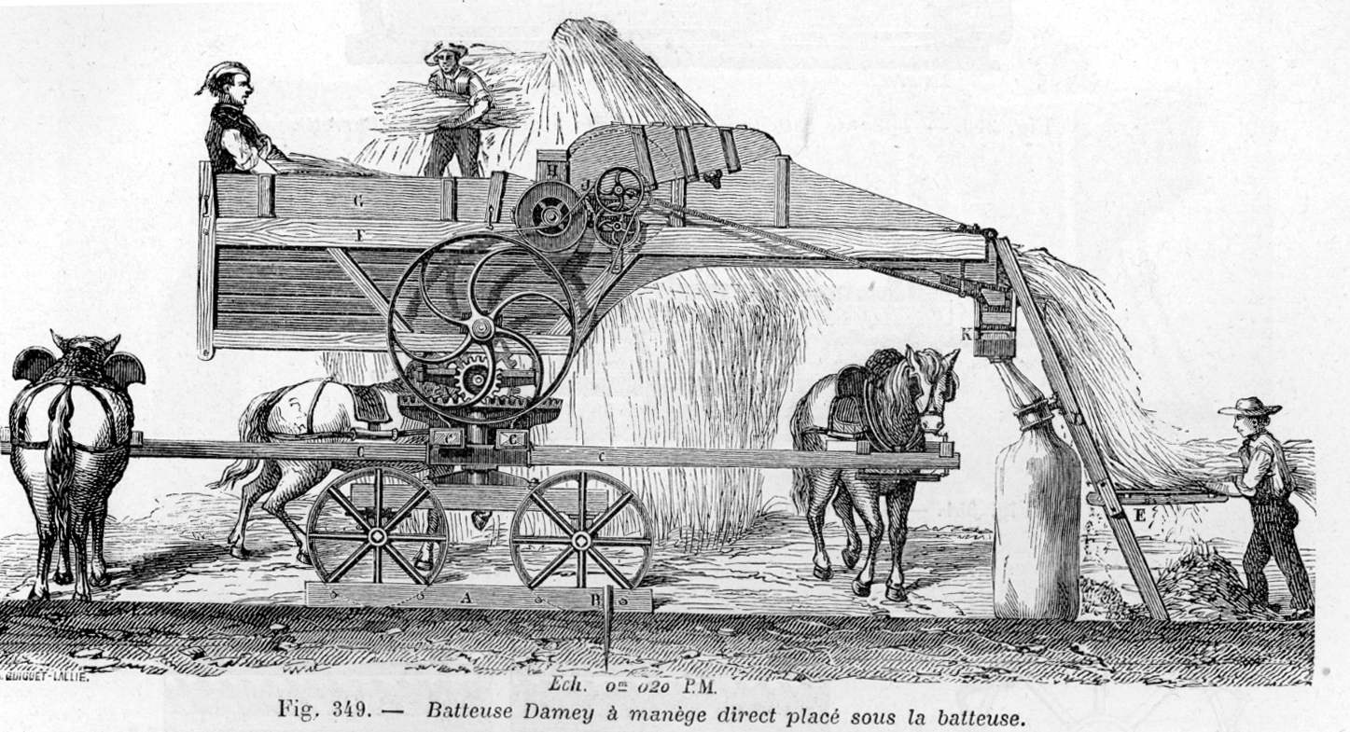
The Agricultural Revolution

Slide 47
The Agricultural Revolution
Agricultural methods had not changed much since the Middle Ages
Tools – hoe, sickle, wooden plow
Three-field system – farmers left 1/3 of the land fallow each year to restore fertility to the soil
Open-field system – unfenced farms with few improvements made to the land
No significant surplus – only enough food was made to feed the population

Slide 48
Agriculture and Industry
The Industrial Revolution brought machinery to farms
The use of farm machinery meant that fewer farm workers were needed
Displaced farm workers moved to the cities to find work in factories
  This is called rural-to-urban migration
Growing populations in urban cities required farmers to grow more crops
  Food to eat
  Raw materials (like cotton) for textile factories

Slide 49
Agricultural Innovators
Jethro Tull (English)
Seed drill: Planted seeds in straight rows as opposed to scattering them over a field
Horse-drawn cultivation: Loosened the soil and eliminated weeds
Lord Townshend (English)
Crop rotation: Ended the three-field system by illustrating how planting different crops in the same field each year kept the soil from becoming exhausted
Robert Bakewell (English)
Stock breeding: First to scientifically breed farm animals for increased production of, and better quality, beef, milk, wool, etc.
Arthur Young (English)
Agricultural writer: Popularized new farming methods and machinery
Justus von Liebig (German)
Fertilizers: Invented fertilizers to enrich exhausted soil, which increased the amount of available farmland

Slide 50
Agricultural Machinery
Eli Whitney – Cotton gin (1793) – Increased cotton production
Cyrus McCormick – Mechanical reaper (1834) – Increased wheat production
Other important inventions: Horse-drawn hay rake, threshing machine, steel plow
Steam engines, gasoline and diesel engines, and electric motors were added to farm machinery as these types of engines were invented.
The Industrial and Agricultural Revolutions complemented one another. Developments and needs in one created developments and needs in the other.

Slide 51
Agricultural Science
Agriculture became a science during the Agricultural Revolution
Farmers and governments invested in agricultural research
  Established agricultural schools, societies, and experimental stations
Progress in agriculture
  Pesticides, stock breeding, new foods, food preservation, new farming techniques and irrigation methods, frozen foods
Result
  Today, in the industrialized world, much more food is grown by far fewer farmers than was grown 200 years ago (or is grown today in the non-industrialized world)
Notes:
Notes: A good topic of discussion might focus on the modern taste for organic foods which do not emphasize technology. Question: What methods and technologies of the Agricultural Revolution do organic farmers utilize? How might our lives be different if we lived 200 years ago, when food was costlier and could not be easily preserved? Another point of discussion could focus on the differences in agricultural production between the industrialized and non-industrialized world.

Slide 52
Review Questions
Describe three features of agriculture before the Agricultural Revolution.
How did agricultural machinery change farm labor?
Describe the inventions or methods of at least three agricultural innovators.
Weigh the pros and cons of modern agriculture’s use of pesticides, preservation, and stock breeding.

Slide 53
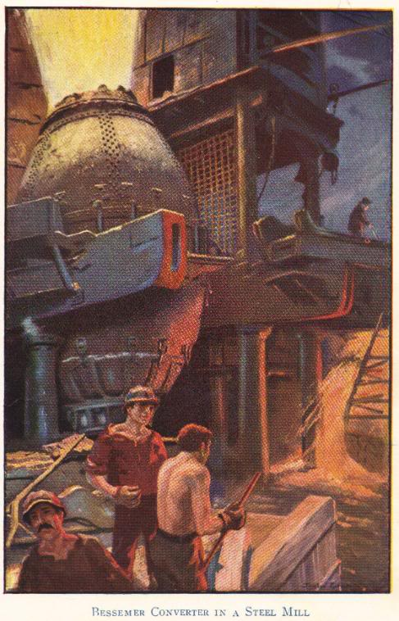
The Second Industrial Revolution

Slide 54
The First and Second Industrial Revolutions
The first, or old, Industrial Revolution took place between about 1750 and 1870
  Took place in England, the United States, Belgium, and France
  Saw fundamental changes in agriculture, the development of factories, and rural-to-urban migration
The second Industrial Revolution took place between about 1870 and 1960
  Saw the spread of the Industrial Revolution to places such as Germany, Japan, and Russia
  Electricity became the primary source of power for factories, farms, and homes
  Mass production, particularly of consumer goods
  Use of electrical power saw electronics enter the marketplace (electric lights, radios, fans, television sets)

Slide 55
The Spread of the Industrial Revolution
Mid-1800s – Great Britain, the world leader in the Industrial Revolution, attempted to ban the export of its methods and technologies, but this soon failed
1812 – United States industrialized after the War of 1812
After 1825 – France joined the Industrial Revolution following the French Revolution and Napoleonic wars
Circa 1870 – Germany industrialized at a rapid pace, while Belgium, Holland, Italy, Sweden, and Switzerland were slower to industrialize
By 1890 – Russia and Japan began to industrialize

Slide 56
Transportation
Railroads
  Industrialized nations first laid track in their own countries, then in their colonies and other areas under their political influence
  Russia – Trans-Siberian railroad (1891-1905)
  Germany – Berlin-to-Baghdad railroad across Europe to the Middle East
  Great Britain – Cape-to-Cairo railroad vertically across Africa
Canals
  Suez Canal (1869) – provided access to the Indian Ocean from the Mediterranean Sea without the need to sail around Africa
  Kiel Canal (1896) – North Sea connected to the Baltic Sea
  Panama Canal (1914) – provided access from one side of the Americas to the other without the need to sail around the tip of South America

Slide 57
Transportation
Automobiles
  Charles Goodyear – vulcanized rubber, 1839
  Gottlieb Daimler – gasoline engine, 1885
  Henry Ford – assembly line, 1908-1915
Airplanes
  Orville and Wilbur Wright – airplane, 1903
  Charles Lindbergh – first non-stop flight across the Atlantic, 1927
  20th-century – growth of commercial aviation

Slide 58
Review Questions
Compare and contrast the First and Second Industrial Revolutions.
When did the United States begin to industrialize?
Explain how trains and canals aided transportation, citing at least one example for each.
What contributions did Charles Goodyear, Gottlieb Daimler, and Henry Ford make to automobile production?

Slide 59
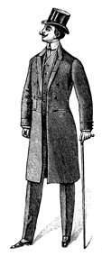
The Results of the Industrial Revolution

Slide 60
Results of the Industrial Revolution
Economic Changes
Expansion of world trade
Factory system
Political Changes
Decline of landed aristocracy
Social Changes
Development and growth of cities
Science and research stimulated
Industrial capitalism
Unemployment
Growth and expansion of democracy
Rise to power of businesspeople
Increased government involvement in society
Nationalism and imperialism stimulated
Increased power of industrialized nations
Improved status and earning power of women
Increase in leisure time
Population increases
Problems – economic insecurity, increased deadliness of war, urban slums, etc.
Increased standard of living
Mass production of goods

Slide 61
Economic Changes:
Expansion of World Trade
Increased production meant that industrialized nations produced more than could be consumed internally
Sought new foreign markets
Bought many raw materials from foreign markets
New iron, steam-powered ships, along with other technological advances, made international trade (and travel) cheaper, safer, and more efficient

Slide 62
Economic Changes: Expansion of World Trade – Free Trade and Tariffs
Free trade – trade without barriers or tariffs – was initially used
As nations competed for markets, protective tariffs were put in place to limit foreign competition within an industrialized nation and its colonies
Motivation was to protect businesses in the home country and colonies, but this often meant people in the home country or colonies paid inflated prices for goods
Notes:
Notes: Possible discussion about tariffs vs. free trade. Compare NAFTA and the European Union.

Slide 63
Economic Changes: Factory System Possible Due to Standardized Parts
Eli Whitney is popularly credited with the invention of interchangeable parts in the late 1700s
  But interchangeable parts had already been used in Europe
Before the late 1700s, each part of an item (like a musket) was made individually by a single person, with each part made to fit the whole
Standardized, or interchangeable, parts were created en masse to make a lot of duplicate products (such as hundreds of muskets)
Manufacturers decided upon standard sizes for their goods and created large quantities of components
  Such as deciding that a musket barrel should be two feet long and making 100 duplicate musket barrels, then deciding that triggers for these muskets should be two inches tall and making 100 2-inch triggers
Standardized parts could be kept in a set location in a factory
  As a worker assembled an article, he or she would take whatever parts were needed from a bin of standardized (interchangeable) parts

Slide 64
Economic Changes: Factory System Perfected with the Assembly Line
Developed by Henry Ford between 1908 and 1915
Brought the work to the worker instead of the worker to the work
Product moves along a conveyor belt, with each worker contributing labor along the way to create the finished product

Slide 65
Economic Changes: Factory System – Assembly Line Brings Division of Labor
Assembly lines bring the work to the worker, saving time
Each worker specializes in one part
An automobile worker may spend 30 years in a factory only ever putting passenger-side doors on motor vehicles
Focusing on one aspect of production can be repetitive but can also make a worker an expert at that particular aspect

Slide 66
Economic Changes:
Factory System
Manufacture comes from the Latin manu and facere, meaning to make by hand
  But during the Industrial Revolution, the meaning of manufacturer switched from the person who made an article by hand to the capitalist who hired workers to make articles
Workers no longer owned the means of production (simple hand tools)
  Instead, the newer means of production (expensive machinery) were owned by the capitalist

Slide 67
Economic Changes:
Mass Production of Goods
Motor vehicle production in the United States
  1895 – 33,000 motor vehicles
  1910 – 181,000 motor vehicles
  2000 – 5,542,000 passenger cars alone
Factors contributing to mass production
  Standardized (or interchangeable) parts
  Assembly line
  Labor division and specialization
Mass production meant more items were produced at lower costs
  More people could afford to buy manufactured goods, which in turn spurred demand

Slide 68
Economic Changes: Industrial Capitalism and the Working Class
Pre-Industrial Revolution rural families did not rely solely on wages for sustenance
  Owned their own farms or gardens where they raised most of their own food
  Made their own clothing
  Unemployment was rare
Industrialization destroyed workers’ independence
  Workers in cities did not have the means to grow their own food or make their own clothing
  Workers relied entirely upon their employers for wages with which they bought everything they needed

Slide 69
Economic Changes:
Industrial Capitalism’s Risks
Workers came to rely entirely on their employers for their livelihoods
  No more small family farms or gardens to provide extra food
  No more day-laboring for a neighboring farmer to earn extra money
  When the factory slowed down, the worker had nowhere to go for sustenance
Entrepreneurs assumed enormous risk in establishing new enterprises
  No more workers working from home – capitalists had to supply a factory
  No more custom orders – capitalists had to anticipate demand
  No more at-will laborers – workers relied on capitalists for steady labor

Slide 70
Economic Changes:
Industrial Capitalism
The financial investments required to run large industries brought about modern capitalism
Capital – wealth that is used to produce more wealth
Entrepreneur – person who starts a business to make a profit
Capitalist – person who invests his or her money in a business to make a profit
Corporation – company owned by stockholders who have purchased shares of stock
  Actual running of the company left to hired managers rather than to the stockholders
  As industries grew and small business operations faded into obscurity, the relationship between workers and business owners disintegrated

Slide 71
Economic Changes:
Industrial Capitalism’s Problems
Small manufacturers cannot compete with large corporations
Consumers must buy from large corporations
Workers have had to fight for decent wages and working conditions
Large corporations can influence the government

Slide 72
Economic Changes:
Increased Standard of Living
Mass production made manufactured goods less expensive, so more people could afford them
Standard of living wasn’t raised for everyone – factories paid low wages, and many immigrants and rural-to-urban migrants lived poorer lives than their parents and grandparents had lived

Slide 73
Economic Changes:
Unemployment
Overproduction
  Also called under-consumption
  Mass production anticipates demand – if goods don’t sell, a manufacturer produces less and lays off workers
Recession
  Overproduction across many industries with widespread lay-offs
Depression
  Long-lasting recession
Notes:
Notes: This is a great opportunity to discuss the recession which began in the fall of 2008. Regarding unemployment, this is a chance to bring economics lessons into the classroom, such as the belief among many economists that a 6% unemployment rate can be expected in a strong, healthy, capitalist economy.

Slide 74
Political Changes:
Decline of Landed Aristocracy
Before the Industrial Revolution – power was in the hands of the landed aristocracy and monarchs
  Landed aristocracy refers to lords, dukes, etc., who owned the land
  Although vassalage was gone by the 18th century, the working relationship between lords and peasants remained the same
    Peasants either worked the land for lords or rented land from them
  Wealth was based on agriculture, which meant that those who owned the most land were the wealthiest
    Landed aristocracy owned and controlled the most land, making this the wealthiest and highest-ranking socio-economic group
Industrial Revolution – factories became more valuable than land
  Wealth of the aristocracy dwindled
  Growing middle class, with wealth based in industry, wanted more political power

Slide 75
Political Changes:
Decline of Landed Aristocracy
Case Study: The Corn Laws
Problem: British landowners and agriculturalists (lords and farmers) wanted high prices for their corn.
Problem: The growing working class could not afford corn.
Problem: The price of corn declined following the repeal of the Corn Laws, decreasing the wealth, power, and prestige of the landed aristocracy in Great Britain.
Solution: Tariffs known as the Corn Laws established in 1815.
Solution: Repeal of the Corn Laws in 1846.
Solution: There was no solution. The landed aristocracy began its fall from economic and political power. Economic and political power shifted to the wealthy capitalist, middle, and working classes.
Notes:
Note: “Corn” is a British term for grain, and is not used here to mean “maize.”
Note: Students may find it interesting how the declining British aristocracy sought to prop itself up by marrying into wealthy industrial families. For fiction reading on this topic, students may enjoy Edith Wharton’s The Buccaneers. For nonfiction reading, students might want to research the 1895 marriage of Consuelo Vanderbilt to the Duke of Marlborough (Consuelo’s father gave the duke $2.5 million upon the marriage so that he could make repairs to Blenheim Palace).

Slide 76
Political Changes: Growth and Expansion of Democracy
The middle class grew during the Industrial Revolution
  Gained more rights
The working class effectively began with the Industrial Revolution
  The working class fought for rights in the workplace
  The working class demanded and earned a voice in government

Slide 77
Political Changes: Increased Government Involvement in Society
Government actions to help workers
  Legalization of unions
  Established minimum wage
  Standards for working conditions
  Forms of social security
Government actions to help consumers
  Regulation and inspection of goods and foodstuffs
Government actions to help businesses
  Laws to stop or limit monopolies
  Some governments took control of vital industries

Slide 78
Political Changes: Increased Power of Industrialized Nations
With wealth came power
Imperialism expanded
Imperialistic, industrialized nations built up their navies to gain and protect assets

Slide 79
Political Changes: Nationalism and Imperialism Stimulated
Increased production meant an increased need for raw materials
Industrialized nations expanded their colonial empires and spheres of influence in their search for more raw materials
  Worldwide scramble for colonies
  Fought the peoples in the lands they controlled
  Fought one another for colonies and spheres of influence
Governments saw imperialist expansion as the key to continued industrial growth and wealth

Slide 80
Political Changes:
Rise to Power of Businesspeople
Along with the working classes, businesspeople gained political rights
“Captains of industry” or “robber barons” – along with financiers
  Wealth brought political influence

Slide 81
Social Changes:
Development and Growth of Cities
Paris
18th century - 600,000 people
London
18th century – 500,000 people
Circa 1900 – over 6,200,000 in the London urban area
Circa 1900 – over 2,714,000 in the Paris urban area
Circa 2000 – over 11,000,000 in the Paris urban area
Circa 2000 - over 7,100,000 in the London urban area
Rural-to-urban migrants – people who left the countryside to live in cities
A sign of an industrialized nation is that a large proportion of the population lives and works in urban areas

Slide 82
Social Change: Development and Growth of Cities
Case Studies: Liverpool and Manchester
Liverpool
1800 – population under 100,000
Major British port city which grew during the Industrial Revolution
Manchester
1800 – population circa 328,000
1850 – population circa 1,037,000
1900 – population circa 2,357,000
Nicknamed “Cottonopolis” in the mid-to-late 19th century because of its textile factories
1850 – population over 300,000 (part of the increase due to Irish fleeing the potato famine)
1900 – population over 700,000
Population peaked in the 1930s and has been declining ever since due to the decline in manufacturing and imperialism
Began to decline after the Industrial Revolution but has stabilized due to new industries and greater business diversification
Notes:
Note: A great American example of a city’s growth and decline as a result of the rise and fall of industrialization is Detroit, Michigan. There are a lot of photographic resources online, as well as demographic information (such as censuses) which chronicle now closed factories, and the rising and falling population and average income which accompanied the rising and falling auto industry.

Slide 83
Social Changes: Improved Status and Earning Power of Women
Initially, factory owners hired women and children because they worked for lower wages
  This brought many women, otherwise impoverished, to cities to work in factories
  Governments limited the work of children and, at times, of women
Women gained economic power and independence
  Before industrialization, it was almost impossible for a woman to remain single and live on her own
  Factories and urban centers attracted women in large numbers
  Women fought for and eventually gained political rights
Notes:
Note: This is a complicated issue. The presence of women and children in factories, doing the same work as men for less pay, was a threat to men. Limiting the employment of women and children brought job security to men. It is easy to fall into the trap of labeling an end to child labor, and equal pay for women, altruistic when these actions benefited men quite a lot.
Note: Women continue to relocate to cities more than men. In New York City, there are approximately 100 adult women for every 85 adult men. A good discussion might focus on why women continue to be attracted to large urban areas.

Slide 84
Social Changes:
Increase in Leisure Time
Labor-saving devices invented and produced
  Vacuum cleaners
  Washing machines
  Refrigerators
Entrepreneurs and inventors developed new forms of entertainment
  Moving pictures
  Amusement parks
Birth of the weekend
  Traditionally, Western nations had Sunday (the Christian day of rest) as the only day off from work
  Saturday was added (after the struggles of Jewish labor unionists) to accommodate the religious observances of Jewish factory workers (whose Sabbath, or Shabbat, runs from Friday at sundown to Saturday at sundown)

Slide 85
Social Changes:
Population Increases
Agricultural Revolution
Increased food production
Lower food prices
People ate more
More healthy babies were born
Population skyrocketed
Europe
1750 – 144,000,000
1900 – 325,000,000
England
1750 - 11,000,000
1900 - 30,000,000
Many people immigrated to industrialized countries
  Numerous nationalities to the United States
  Irish to Manchester and Liverpool in England
Population growth in industrialized nations required growing even more food

Slide 86
Social Changes: Problems
Monotony of assembly lines and factory life
Loss of craftsmanship in manufactured goods
War became more deadly as weapons became more technologically advanced and were mass produced
Economic insecurity – workers relied entirely on their jobs for sustenance

Slide 87
Social Changes:
Science and Research Stimulated
Scientific and technological discoveries became profitable instead of simply beneficial
Companies and governments were willing to invest in research and development
Patent law
  Came into its modern form under England’s Queen Anne (reigned 1702-1714)
  Inventors have the exclusive right to produce their new inventions for a period of time
Notes:
Note: Queen Anne ruled while England’s empire was budding. As the empire grew and expanded, England’s type of patent law spread throughout its colonies (the future United States, Canada, Australia, etc.).

Slide 88
Review Questions
Describe the economic, political, and social changes which resulted from the Industrial Revolution.
What risks did workers face from the factory system of production?
How did women benefit from the Industrial Revolution?
Imagine that you are a government official in a developing nation. What lessons for your country might you take away from a study of the Industrial Revolution? What pitfalls might you want to avoid?

Slide 89
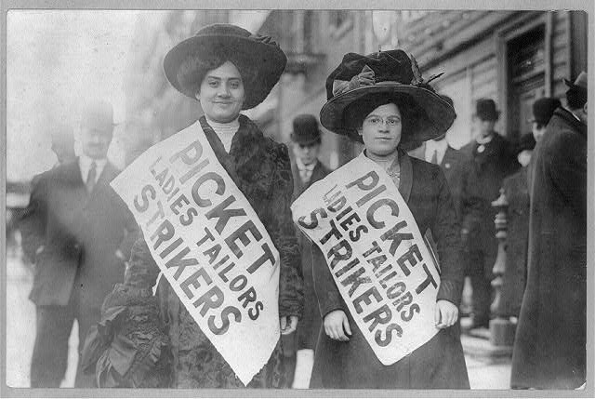
The Labor Movement

Slide 90
Changing Employee-Employer Relationships
Domestic system
  Workers and employers knew each other personally
  Workers could aspire to become employers
Factory system
  Workers no longer owned the means of production (machinery)
  Employers no longer knew workers personally
    Factories often run by managers paid by the corporation
  Relationships between employers and employees grew strained

Slide 91
Problems of the Factory System
Factories were crowded, dark, and dirty
Workers toiled from dawn to dusk
Young children worked with dangerous machinery
Employment of women and children put men out of work
  Women and children were paid less for the same work
Technological unemployment – workers lost their jobs as their labor was replaced by machines
Notes:
Note: Silas Marner by George Eliot describes the changing textile industry due to technological advances.

Slide 92
Poor Living Conditions
Factories driven solely by profit
  Businesses largely immune to problems of workers
Factory (also company or mill) towns
  Towns built by employers around factories to house workers
  Workers charged higher prices than normal for rent, groceries, etc.
    Workers often became indebted to their employers
    Created a type of forced servitude as workers had to stay on at their jobs to pay their debts
  Considered paternalistic by workers
    Some employers had workers’ interests at heart
    But workers wanted to control their own lives
Notes:
Note: Pullman in Chicago, Illinois, is an excellent example of a well-intentioned factory town being disliked by workers.

Slide 93
Slum Living Conditions
Factory towns – often built and owned by factories
  Not a strange concept to rural-to-urban migrants who were used to living on a lord’s estate or property
  Full of crowded tenements
  Few amenities
Tenements – buildings with rented multiple dwellings
  Apartment buildings with a more negative connotation
  Overcrowded and unsanitary
Workers were unsatisfied both inside and outside the factories

Slide 94
Rise of Labor Unions
Before labor unions, workers bargained individually – “individual bargaining”
  Before factories, a worker could bargain for better wages and working conditions by arguing his or her particular skills
  But in factories, work is routine and one worker can easily replace another
With labor unions, workers bargained together as a group, or collective – “collective bargaining”
  Organized groups of workers elected leaders to bargain on their behalf
  Used tools (such as strikes) to gain rights

Slide 95
Weapons Used by Unions and Employers
Weapons Used by Employers
At-will employment
Company unions
Weapons Used by Unions
Boycotts
Check-offs
Individual bargaining
Injunctions
Laws that limit union activities
Lockouts
Open shops
Right-to-work laws
Welfare capitalism
Yellow-dog contracts
Closed shops
Collective bargaining
Direct political action
Favorable labor legislation
Feather-bedding
Lobbying
Picketing
Sabotage
Strikes
Union label
Union shops
Relocation
Blacklists
Threat of foreign competition
Outsourcing
Notes:
Note: Under employers’ weapons, “relocation,” “outsourcing,” and “threat of foreign competition” are relatively new, coming into play in the last quarter of the twentieth century. These weapons make for a lively classroom discussion. For example, students might examine reasons why automobile manufacturing plants have relocated to nonunionized southern states, the number of automobiles imported into the United States each year, and the number of parts (engines, transmissions, etc.) which are no longer made at an individual automobile plant but are instead made by smaller, nonunionized suppliers.

Slide 96
British Labor Achievements
Year(s) | Event(s)
1799-1800 | Combination Laws: Outlawed unions and strikes.
1867 | Disraeli Reform Act: Suffrage for workers.
1875 | Repeal of the Combination laws; unions and strikes legalized. Union membership grew as a result.
1900 | Labour Party: Founded by bringing together different groups representing trade unions, etc.
1901 | Taft Vale Decision: House of Lords ruled that unions would have to pay financial damages caused by strikes (such as loss of income to employers), which threatened to end Britain’s unions.
After 1901 | Labour Party: Worked for workers’ rights. (Other major British political parties were Liberals [Whigs] and Conservatives [Tories].)
1906 | Trade Disputes Act: Protected union funds from the Taft Vale court decision. Achieved by Liberal and Labour parties working together.
1909 | Osborne Judgment: Banned trade unions from donating funds to political parties. Hurt the Labour party because poorer, working class party members could not provide salaries to party’s elected representatives.
1911 | Parliament Act: Stopped the House of Lords from vetoing laws passed by the House of Commons. Paid members of parliament an annual salary.
1920s | Labour Party: Surpassed the Liberal party in power.
1940s-1950s | Social security: Labour party government brought increased social programs, including socialized medicine, along with government control of several industries (electricity, steel, television).

Slide 97
Legal Protections for Workers
Limited hours for women
  Later – equal pay for equal work
Eventual end to child labor
  Schools and requirements for school attendance grew as children were removed from the workforce
Health and safety codes
Minimum wage
Legalization of unions

Slide 98
Rights of Female and Child Workers
Women and children could legally be paid less than men for the same work
  Factory owners were more willing to hire them
  Male workers grew resentful
English child laborers
  England had a history (going back to the 17th century) of training pauper children (even those younger than five years old) in a trade
  Poor children followed their mothers into factories
Early male-dominated unions fought to banish women and children from the workplace
  Eventually this strategy was abandoned
  Women eventually won right to equal pay for equal work
    Though women today, in reality, still earn less than men at the same types of work
Notes:
Note: It should be made clear that the workplace rights and limitations of women and children (and of workers as a whole) were gained incrementally. Teachers may choose to insert a slide listing that legislation of which they more specifically want students to be aware.

Slide 99
Social Insurance/Security
Type of Security | France | Germany | Great Britain | Italy | United States
Accident | 1928 | 1884 | 1906 | 1898 | By various state laws
Sickness | 1928 | 1883 | 1912 | 1898 | By various laws in some states
Old Age | 1910 | 1889 | 1908 | 1898 | 1935
Unemploy-ment | 1928 | 1911 | 1912 | 1947 | 1935
Socialized Medicine (Universal Health Care) | 1948 | 1884 | 1948 | 1948 | Medicaid for the poorest citizens in the 1960s; under Pres. Obama, conservative reforms set for all in 2014
Notes:
Note: The German government instituted social reforms to stop the spread of socialism.
Note: Most countries signed the “health care” portion of the Universal Declaration of Human Rights in 1948, with the United States being a notable exception.

Slide 100
Review Questions
How and why did employer-employee relationships change during the Industrial Revolution?
Describe living conditions in factory towns.
Describe the weapons used by employers and unions.
Why was the establishment of yearly wages for members of parliament important to the British Labour party?
What are the advantages and disadvantages of unions for workers and consumers?

Slide 101
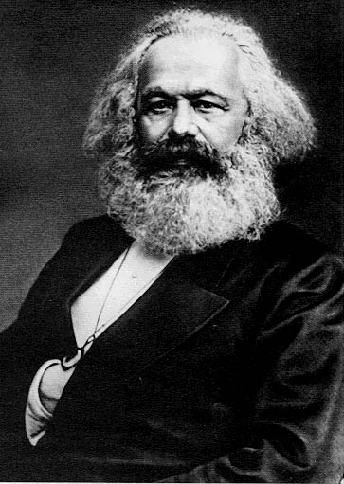
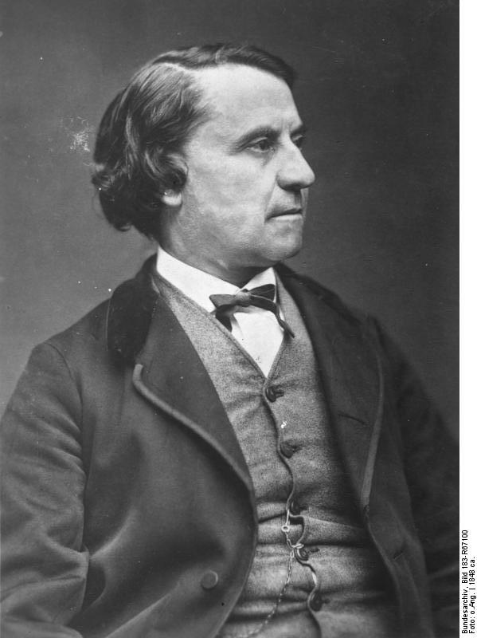
The Cooperative Movement and Socialism
Karl Marx
Louis Blanc

Slide 102
Cooperatives
First cooperative – 1844 in Rochdale, England
  Formed to fight high food costs
  30 English weavers opened a grocery store with $140
  Bought goods at wholesale
  Members of cooperative bought goods at cost
  Non-members paid “retail”
  Profits split among members
  By 1857 – over 1000 members and £100,000 in annual profits
Growth of cooperatives
  Spread to other industries – banking, building, insurance, printing, etc.
  By 1900 – 20% of Great Britain’s population had joined a cooperative
  Concept spread internationally

Slide 103
Socialism
Socialists – viewed the capitalist system as inherently wrong
  Belief that capitalism is designed to create poverty and poor working conditions because of its end goal of earning maximum profits for investors
Socialism – government owns the means of production
  Belief that if the government (“the people”) owns the means of production, these factories and industries will function in the public (as opposed to private) interest

Slide 104
Early Socialist Movement
First socialists were Utopians
  Strove to create a fair and just system
  Community divided tasks and rewards equitably
Robert Owen
Charles Fourier
Claude Saint-Simon
Louis Blanc

Slide 105
Robert Owen (1771-1858)
Utopian socialist
Owned a textile factory in New Lanark, Scotland
Set up a model community in New Harmony, Indiana
Decreased working hours
Improved working conditions and employee housing
Shared management and profits with employees
Proved that a socialist-based company could be profitable

Slide 106
Charles Fourier (1772-1837)
French philosopher
Coined the term féminisme
Advocated concern and cooperation as the means to create social harmony
Considered poverty to be the main cause of society’s problems
Envisioned workers (paid at least a minimum wage) living in “phalanxes” – communities living in a large shared structure

Slide 107
Claude Henri de Saint-Simon
1760-1825
As a young man he was in the Thirteen Colonies as part of the French assistance effort during the American Revolution
French socialist philosopher
Believed all human beings naturally greedy and eager to obtain wealth and higher social positions
  These tendencies were to be eradicated through education
Advocated an end to inheritances
  Movement of wealth from rich, powerful families to the state, which is an instrument of the people

Slide 108
Louis Blanc (1811-1882)
French socialist philosopher and politician
Blamed society’s ills on the pressure of competition
“From each according to his abilities, to each according to his needs.”
Came to political power during the Revolution of 1848
  Instituted labor reforms – believed everyone had the right to work
  Terrible June Days – forced from power after Blanc’s chief rival let Blanc’s public workshops (designed to give work to the unemployed) fail
  Returned to France, restored to power, and given a state funeral after his death
His writings greatly influenced later socialists

Slide 109
Karl Marx (1818-1883)
German socialist (communist) philosopher
Forced to leave Prussia for articles attacking the Prussian government
Relocated to France where he was considered too radical
  Wrote Communist Manifesto with Friedrich Engels (1848)
Relocated to England where he lived out the rest of his life
  Wrote Das Kapital – the “bible” of socialism (1867)
“Religion is the opiate of the people.”
  Belief that religion is designed to keep people submissive to those in power by promising them that their reward is in heaven

Slide 110
Marxism – Communism
Economic Interpretation of History
Economic changes lead to historical changes.
Historically, the wealthy classes have held all power.
Class Struggle
History has been a struggle between the rich and the poor.
Surplus Value
Workers produce all wealth but receive only enough to survive.
Inevitability of Socialism
In the Industrial Revolution, the struggle is between the capitalists (owners of the means of production) and the proletariat (workers).
“Surplus value” (profit) of the workers’ labor goes to the capitalists.
Industrial wealth leads to the concentration of wealth among fewer and fewer capitalists, while the living and working conditions of the proletariat grow worse.
The proletariat will eventually rebel and create a socialist state.
Notes:
Note: Anti-Marxists might argue that Marx has been proven wrong because working conditions have improved. Marxists might argue that the struggle of the proletariat is not yet over. Still others might argue that Marx was right in some respects and wrong in others; that is, no truly socialist state has ever been created, but governments have established many socialist-type reforms and institutions. An interesting class activity is to have students create two lists—one listing the industries the federal government does control, and another listing those businesses which remain privately owned. This discussion should get interesting once the class starts discussing the federal government’s involvement with industries such as banking and automobile manufacturing following the recession of late 2008.
Note: Marx referred to himself as a “communist” to separate himself from Utopian socialists.

Slide 111
Socialist and Communist Political Parties
First International
  Founded by Marx and others in 1864
  International Workingmen’s Association
  Urged proletariat to overthrow capitalism worldwide
  Broke apart in 1873
Second International
  Founded in 1889
  National parties more concerned with the politics of their respective nations
  Broke apart during World War I
Russian Revolution (1917)
  Communists – known as Bolsheviks, led by Vladimir Lenin, came to power following the overthrow of the tsar
Left and right wings
  Socialists – right wingers – advocated socialist reforms through voting
  Communists – left wingers – advocated socialist reforms through revolution
  Political parties of both types have existed throughout Europe, the United States, and all over the world since around the turn of the last century
Notes:
Note: The modern political meanings of “socialism” and “communism” vary somewhat from their historical meanings. An interesting student activity is to have students locate the political platforms of the Socialist and Communist parties of the United States, comparing and contrasting them.

Slide 112
Soviet-backed Communism
Russian communism
  Bolsheviks (Communists or Reds) won the Russian civil war against the Whites
  World’s first socialist/communist state
Comintern – Communist International
  Founded in Russia (Soviet Union) in 1919
  Sought to spread worldwide communist revolution
  Disbanded during World War II
Cominform – Communist Information Bureau
  Founded in Soviet Union in 1947
  Disbanded in 1956 as part of de-Stalinization
Soviet Union (and later China) spread communism through satellite states and via proxy wars during the Cold War
Notes:
Note: This information is provided as a general grounding for students who will later in the school year study the Cold War.
Note: It is very easy for students (and teachers) to confuse socialism/communism with totalitarianism. To avoid this trap, it might do well to focus on a largely socialist country like Norway rather than Stalin-era Russia. If one does look at Russia, the focus might be on Russia under Lenin rather than Russia under Stalin.

Slide 113
Syndicalists and Anarchists
Syndicalism and anarchism enjoyed popularity during the late 1800s and early 1900s
Syndicalism
  Businesses and distribution of income managed by trade unions
  Unions exist separate from the state as opposed to being part of the state
Anarchism
  Belief that all governments are bad for the people
  Advocates direct action to remove all forms of government
  Various individual ideologies for post-government societal organization
Notes:
Note: President William McKinley was assassinated by an anarchist in 1901.

Slide 114
Social Catholic Movement
Opposed to the atheism of socialism
  Yet also opposed to uncontrolled capitalism
Pope Leo XIII
  Advocated Catholic socialism in 1891 through his support of workers’ associations
Pope Pius XI
  1931 – condoned Catholic socialism while condemning communism
  Stated that workers should share in the profits and management of industry
Followed by like-minded Protestant organizations
Numerous Christian-based socialist political parties still active in Europe

Slide 115
Review Questions
What is a cooperative?
Describe the philosophies and actions of Robert Owen and Louis Blanc.
Explain Marxism in terms of the economic interpretation of history, class struggle, surplus value, and the inevitability of socialism.
Most modern industrialized nations possess some degree of socialism. Comparing the United States to countries such as China, France, and Great Britain, should the United States increase or decrease its number and scope of social programs and government ownership of industry? Why or why not?

