Slide 1
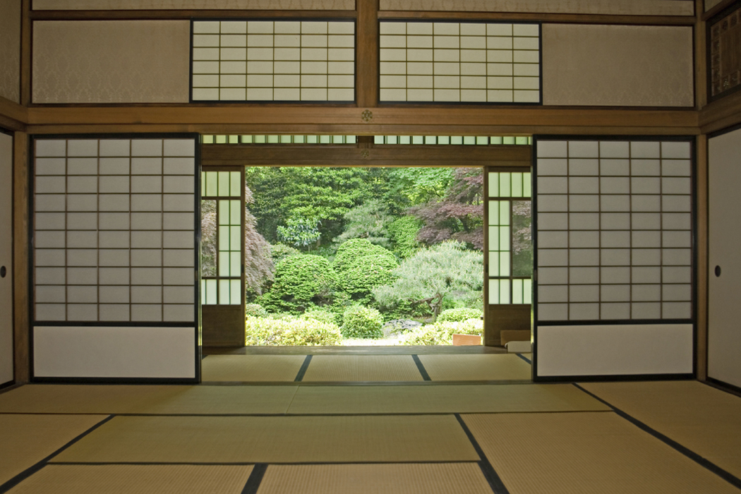
JAPAN: The Meiji Restoration, Japanese Imperialism, and the Build-Up to World War II IN ASIA
© Student Handouts, Inc.

Slide 2
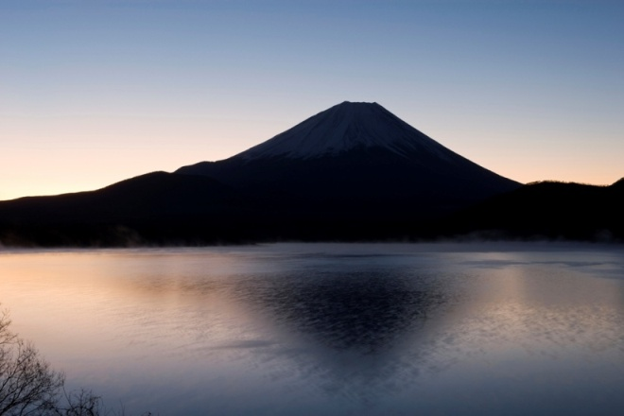
The Tokugawa Shogunate
Tokugawa family ruled Japan from 1603 until 1868 – also known as the Edo period
1635 – foreign trade limited to China, Korea, and Netherlands at Nagasaki a few times per year
Emperor (mikado) ruled in name only
Actual power held by the shogun

Slide 3
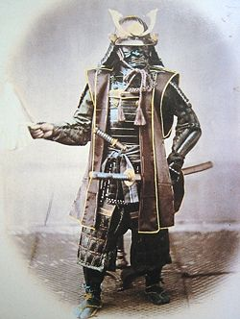
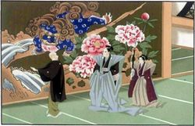
Japanese Feudalism
Samurai – lived by Bushido, the “way of the warrior” (chivalric code)
Ronin – those samurai without masters
Shogun
Ninja – a warrior trained to use unorthodox fighting methods (assassination, espionage, martial arts)
Daimyo
Samurai
Peasants, Merchants, etc.

Slide 4
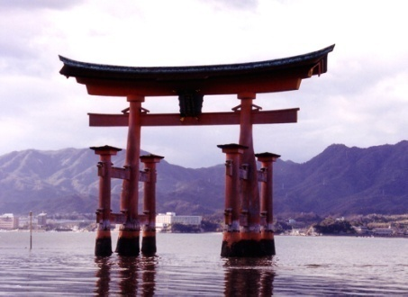
Japanese Culture and Economy
Religion
Mixture of native Shintoism (living spirits in all things) and Chinese Confucianism (based on the teachings of Confucius)
Economy
Growing internal trade during the Edo period
Merchants began to surpass the samurai in wealth
Rigid social stratification
But these limits were being tested by the end of the Tokugawa shogunate

Slide 5
End of Japanese Isolation
U.S. Commodore Matthew Perry (1794-1858)
1853 – gunboat diplomacy
1854 – trade treaty with the United States
Great Britain, Holland (Netherlands), and Russia soon gained similar trading rights
Townsend Harris (1804-1878)
United States Consul General to Japan
1858 – commercial treaty between U.S. and Japan
European powers soon gained similar rights in Japan

Slide 6
Japanese Reaction
Pros | Cons
“Dutch Learning” (Western knowledge) became very popular among many doctors, scholars, and scientists | Western knowledge went against many traditional Japanese beliefs
Japanese entrepreneurs, merchants, and budding industrialists stood to profit from increased trade | Traditional holders of prestige and power (daimyos and samurai) did not tend to profit from increased trade
Resentment Extraterritorial rights of Americans and Europeans Anti-foreign uprisings (1863-1864) Japanese ports in turn bombarded by foreign ships
Solution “If you can’t beat ‘em, join ‘em” Japanese could benefit from knowledge of what happened to China Japanese felt that they would be in a better position to renegotiate the trade treaties, and be less likely to be imposed upon, if they adopted Western ways (democracy, imperialism, industrialization, militarization, and modernization) – westernization

Slide 7
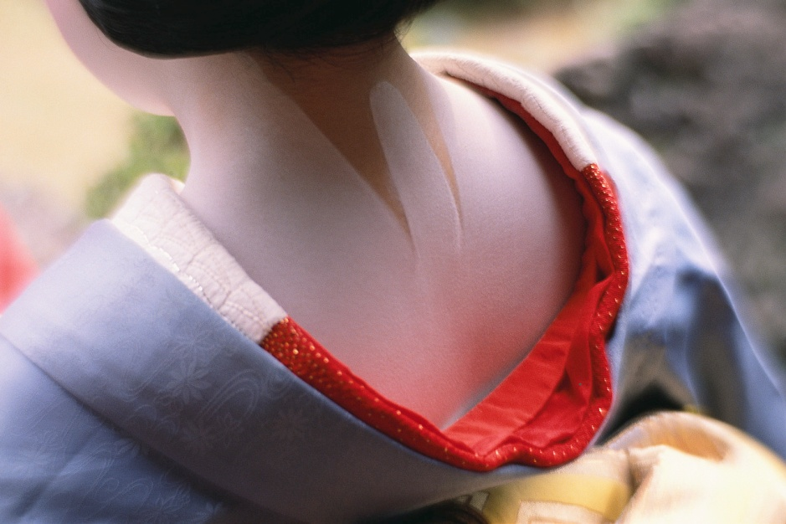
Meiji Restoration
Shogun forced to relinquish power
Power officially in hands of Emperor Mutsuhito
His reign was called the “Meiji”
Japan westernized
Quickly went to work crafting a constitution

Slide 8
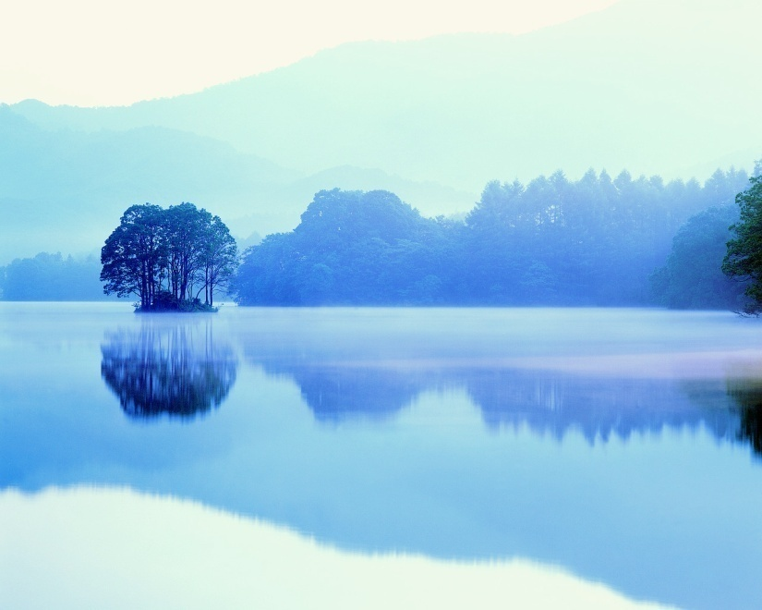
Governmental Reforms
Diet – Japan’s bicameral legislature
First convened – 1889
Meiji (Imperial) Constitution
Adopted – 1890
Followed until the end of World War II

Slide 9
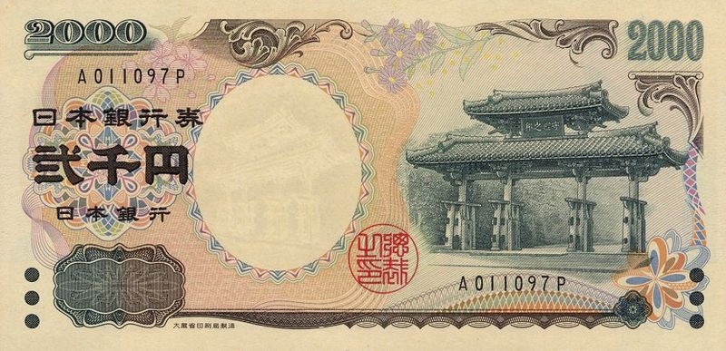
Economic Reforms
Abolition of feudalism
Currency (yen) adopted, 1872
Encouragement of foreign trade
Expansion and encouragement of industrialization
Growth of factories
First large factories manufactured textiles
First textile factory workers were girls and women
Land reform
Zaibatsu (large conglomerates) built and expanded

Slide 10
Military Reforms
Before the Meiji era: Armies were run by local daimyo and thus not subservient to a central government
Meiji era: Modern army and navy established which were loyal to the Japanese government
Used Prussia (Germany) as primary model
Firm belief that if Japan was to be taken seriously by Western powers, and was to avoid China’s fate, Japan would have to compete militarily
Conscription (1873) – all men had to serve for three years after turning twenty-one

Slide 11
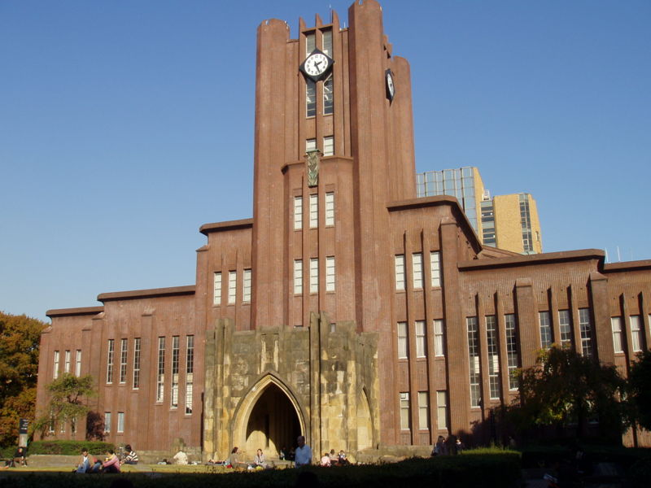
Social Reforms
Universal compulsory elementary education
Universities established
Westernization of many laws
Tokyo University

Slide 12
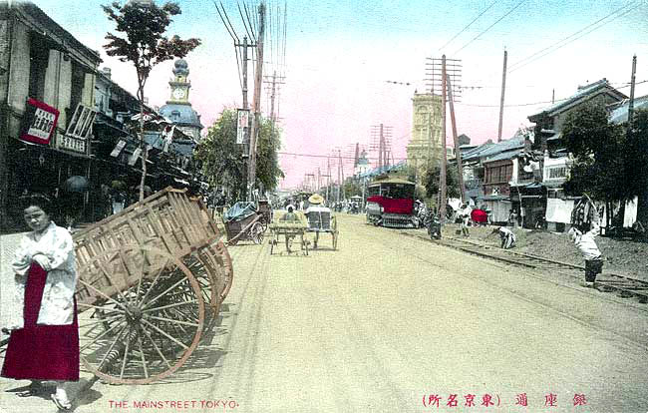
Social Changes
Adoption of Western architecture, fashions, music, and literary styles (magazines and novels)
Diversity of intellectual and political thought
Growing independence and empowerment of women
Movement of peasants from countryside to factories

Slide 13
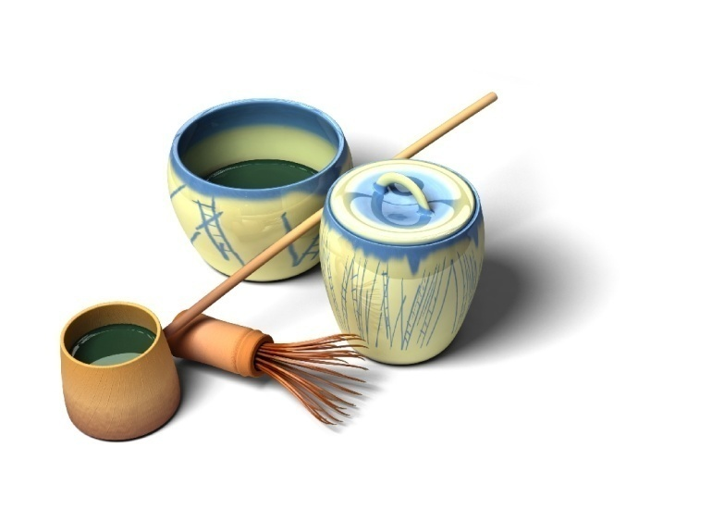
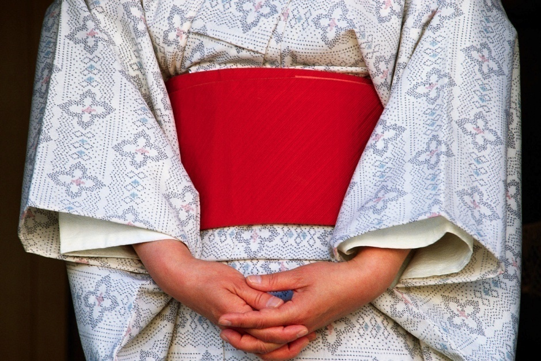
Imperialization of Japan
Why?
Lack of fertile land for agriculture
Markets for finished products
Need for the raw materials of industry
Population growth
Response to Western imperialism

Slide 14
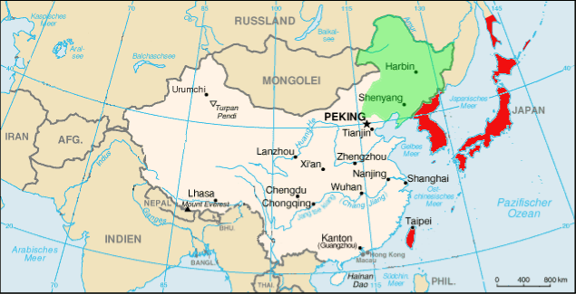
Meiji Japan at War
First Sino-Japanese War (1894-1895)
Gained:
Formosa (Taiwan)
Liaotung Peninsula (Manchuria) – soon forced to relinquish it
Sphere of influence in Korea
Russo-Japanese War (1904-1905)
Destruction of Russian fleet
Finally respected as a world power
Treaty of Portsmouth, 1905
U.S. President Theodore Roosevelt won Noble Peace Prize
Japan was granted the southern part of Sakhalin Island and a large sphere of influence in Manchuria
Annexation of Korea (1910)
World War I
Joined Allies
Received Germany’s mandates over Asian islands and its leases in the Shantung Peninsula

Slide 15
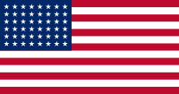
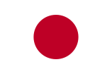
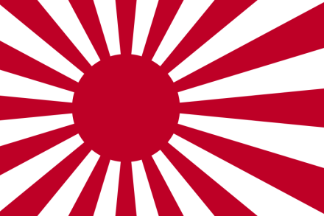
American and European Opposition
Washington Conference (1922)
Size limits on navies
5:5:3 ratio for Great Britain, United States, and Japan
Japanese resented these limitations
Nine Power Treaty
China’s independence and territory guaranteed
Open Door Policy reaffirmed
Four Power Pact
France, Great Britain, Japan, United States
One another’s colonial possessions would be respected
U.S. Japanese Exclusion Act (1924)
Imperial Flag of the Japanese Navy

Slide 16
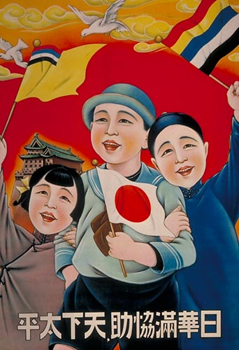
Conquest of Manchuria (1931)
Pretense that Chinese bandits were destroying the Southern Manchurian Railway
League of Nations
China asked League for help
Lytton Commission sent to China to investigate
Noted harshness of Japanese rule in Manchuria
Recommended that Japan withdraw from Manchuria
Japan instead withdrew from the League of Nations
Japanese propaganda poster: "With the cooperation of Japan, China, and Manchukuo, the world can be at peace."

Slide 17
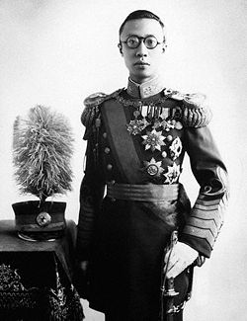
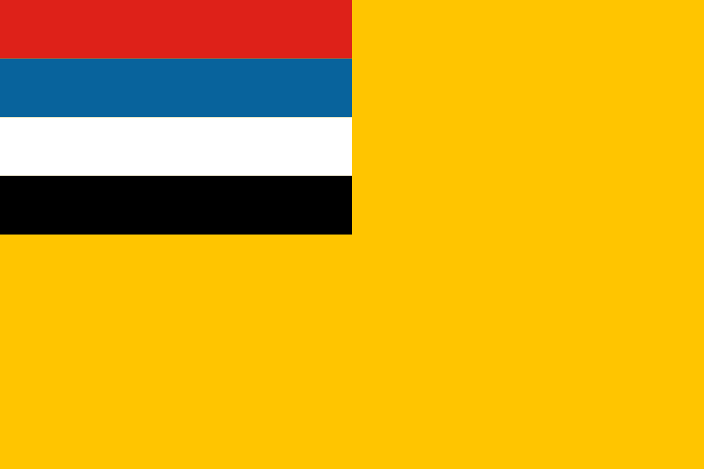
Japanese Manchuria: Manchukuo
Japan proclaimed its “independence” in 1931
Deposed (1912) Manchu emperor of China, Puyi, placed on throne as Manchurian emperor
Really a puppet of Japan
Stimson Doctrine – United States refused to recognize Japan’s actions
Emperor Puyi
Flag of Manchukuo

Slide 18
Japanese Invasion of China
Ignored international treaties – built up navy
Marco Polo Bridge Incident – July, 1937
Minor dispute between Chinese and Japanese troops
Neither side was ready to fully back down
Small spark started the Second Sino-Japanese War
1937-1945 – World War II in Asia
U.S. reaction
Americans boycotted Japanese goods
American companies continued to sell Japan cotton, oil, and scrap metal

Slide 19
Japan in World War II
1940 – Japan joined Axis with Germany and Italy
“Asia for Asians” philosophy
“Liberating” Asia from Western imperialism
In reality, replacing Western imperialism with Japanese imperialism
Attacked Burma, Dutch East Indies, French Indo-China, Philippines, Thailand, etc.
Japanese imperialism ended with World War II
Japan’s territory returned to older, traditional islands

Slide 20
Review Questions
How did the government of Japan change during the Meiji restoration?
Describe Japan’s rationale for its westernization.
Describe Japan’s imperialism and militarization.
Explain how Japan took control of Manchuria.
Imagine that you are a Japanese person watching events unfold in the 1850s and 1860s. How might you react? Do you see alternatives to the opening of your country to foreign trade? Do you agree that in order to compete with the Western powers, your nation must begin to behave like the Western powers? Explain.

