Slide 1
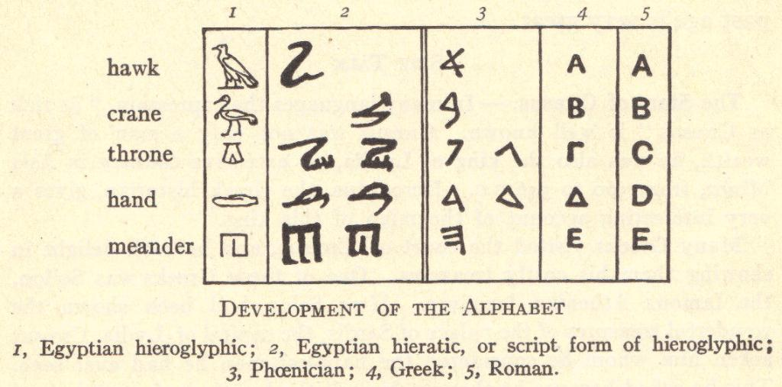
The Phoenicians
© Student Handouts, Inc. www.studenthandouts.com

Slide 2
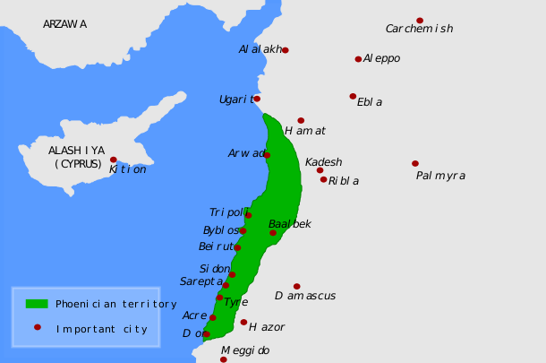
Geography
Phoenicia was located between the eastern Mediterranean coast and the Lebanon Mountains

Slide 3
Government
Not a unified nation
Consisted of independent city-states

Slide 4
Phoenicians Were Sailors
Sailing
No maps or modern technology
Sailed beyond Gibraltar (Pillars of Hercules)
Evidence that they may have circumnavigated Africa

Slide 5
Phoenician Colonies
Sailed and colonized throughout the Mediterranean beginning circa 1000 B.C.E.
Gades (Cadiz, Spain)
Carthage (Tunis, Tunisia)
Modern DNA testing links Palestinians, Lebanese, and residents of old Phoenician colonies

Slide 6
Trade
Leading sailors and traders of ancient world
They traded:
Cloth
Dye (purple dye prized by kings, made from shellfish murex)
Glass
Pottery
Traded for:
Tin (Britannia)
Hides, ivory, ostrich feathers, and slaves (Africa)
Gold, precious stones, and spices (India)

Slide 7
Alphabet
Carried their civilization and culture where they traded
Adopted and adapted Egyptian hieroglyphics into an alphabet off 22 symbols (letters) representing sounds

Slide 8
Review Questions
Where was Phoenicia located?
Name two Phoenician colonies.
Where did the Phoenicians trade?
What is considered to be the Phoenicians’ greatest contribution to the world?

