Slide 1
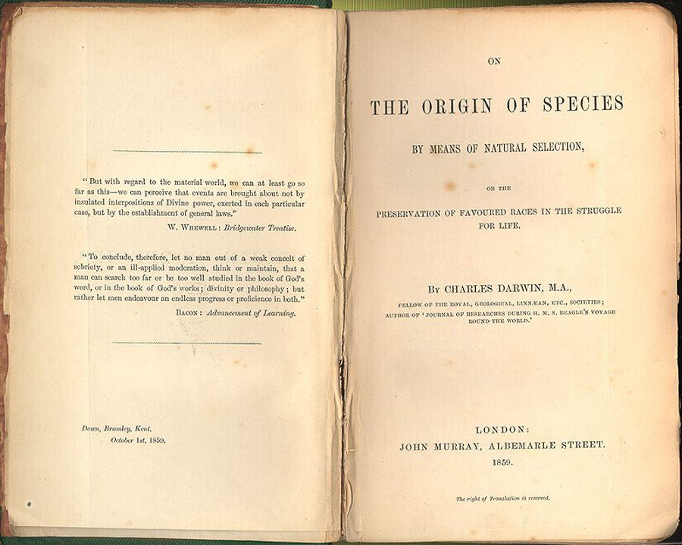
The Earliest Humans
© Student Handouts, Inc.

Slide 2
First Theories of Human Evolution
Charles Darwin
On the Origin of Species (1859)
First to link biological diversity to evolution
The Descent of Man, and Selection in Relation to Sex (1871)
Described human evolution
Saw aesthetic factors (“looks”) as sexual attractors
Thomas Huxley
Evidence as to Man’s Place in Nature (1863)
First book to describe human evolution
These scientists wrote about human evolution before human fossil evidence was ever discovered

Slide 3
Fossil Evidence for Evolution
Paleontology
Study of prehistoric life of all forms, typically using fossils
Paleoanthropology
Study of prehistoric human life (and human ancestry), typically using fossils
Mary and Louis Leakey
Lifetimes dedicated to finding fossil evidence of human ancestors in Africa
Olduvai Gorge
“The Cradle of Mankind”
Great Rift Valley in eastern Africa (Tanzania)
Erosion reveals layers of datable artifacts, bones, and fossils going back 2,000,000 years

Slide 4
Hominid Evolution
Hominids = “great apes”
Chimpanzees, gorillas, humans, and orangutans
Numerous intermediary fossils have been found
But scientists disagree on which are human ancestors and which are evolutionary dead ends
Homo habilis
Homo erectus
Homo sapiens neanderthalensis
Homo sapiens sapiens

Slide 5
Human Evolution
Homo habilis
2.4 to 1.4 million years ago
Fossils found in southern and eastern Africa
Used simple bone and stone tools
Nicknamed “handy man”
Homo erectus
1.8 million years ago to 70,000 years ago
First human ancestor to walk fully upright
Some made complex stone tools
Example – “Peking Man”
Descendants were humans and neanderthals

Slide 6
Neanderthals
Homo sapiens neanderthalensis
Circa 400,000 to 30,000 years ago
Lived in Europe and Asia
Archaeogenetics – analysis of ancient and modern DNA
Comparison of human and Neanderthal DNA shows that humans are not descended from Neanderthals
Genes reveal that Neanderthals had red hair and fair skin
Fair skin developed to aid in the absorption of Vitamin D from the sun in areas far north of the equator
Convergent evolution – different species (such as humans and Neanderthals) developing same characteristic(s)

Slide 7
Humans – Homo sapiens
“Homo” (Latin) means “man” or “human”
“Sapiens” (Latin) means “wise” or “intelligent”
“Homo sapiens” = “wise man” or “wise human”
Humans and Neanderthals both considered “sapiens”
Anatomically modern humans in Africa by 200,000 years ago
Middle Paleolithic period

Slide 8
Mitochondrial “eve”
Mitochondrial DNA
DNA that is passed from women
Mitochondrial “Eve”
Lived 60,000 to 250,000 years ago
Most recent common female ancestor of all living humans
Lived in or around modern-day Tanzania in Africa
She was part of a group of early humans
But only her mitochondrial DNA survives today
Grandmother
Mother
Daughter

Slide 9
Y-chromosomal “Adam”
Y-chromosome
DNA that is passed from men
Y-chromosomal “Adam”
Circa 60,000 years ago
Most recent common male ancestor of all living humans
Lived in Africa
He lived as part of a group of early humans
But only his Y-chromosome survives today
Grandfather
Father
Son

Slide 10
Humans – Homo sapiens sapiens – “Us”
Fully modern humans (like us) in Africa by around 60,000 years ago
Descendants of Mitochondrial Eve and Y-chromosomal Adam
Culture, language, music, etc.
“Out of Africa” theory
Archaeogenetics (analysis of ancient and modern DNA) shows that humans began spreading throughout, and out of, Africa beginning around 60,000 years ago
Early human migrations
Humans left southeastern Africa and spread throughout the continent
Humans traveled along the Indian Ocean to reach Australia
By 10,000 years ago, modern human beings had spread all over the globe

Slide 11
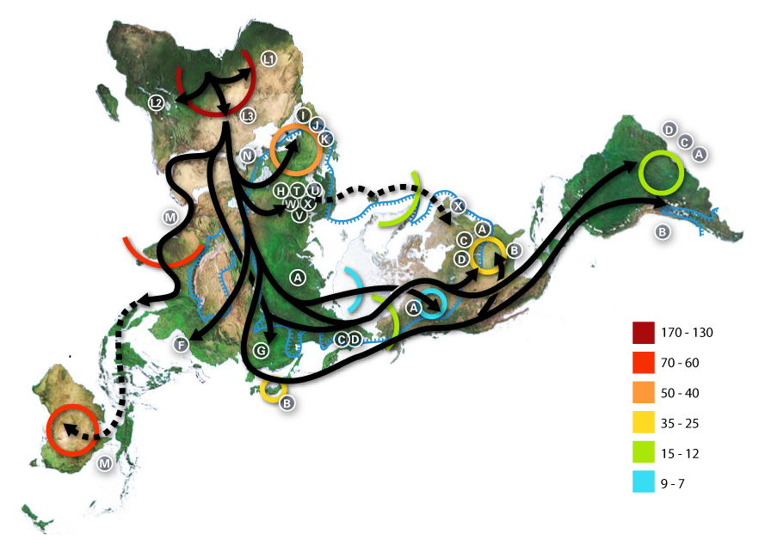
Early Human Migrations: Route of mDNA
← Africa
↑
North America
Numbers are thousands of years before the present.
Notes:
Map showing route of mDNA (mitochondrial DNA) around the world. Numbers are thousands of years before the present. Courtesy of Wikipedia: http://en.wikipedia.org/wiki/File:Map-of-human-migrations.jpg.
mDNA Haplogroups:
African: L, L1, L2, L3, L3
Near Eastern: J, N
Southern European: J, K
General European: H, V
Northern European: T, U, X
Asian: A, B, C, D, E, F, G (note: M is composed of C, D, E, and G)
Native American: A, B, C, D, and sometimes X

Slide 12
Review Questions
Who was the first person to link biological diversity to evolution?
What family of paleontologists dedicated their lives to finding the fossils of human ancestors at Olduvai Gorge in Africa?
What has archaeogenetics told us about Neanderthals?
Who was Mitochondrial Eve?
Who was Y-chromosomal Adam?
Describe the “Out of Africa” theory.
What parts of the world were the first to be settled by modern humans? The last?

