Slide 1
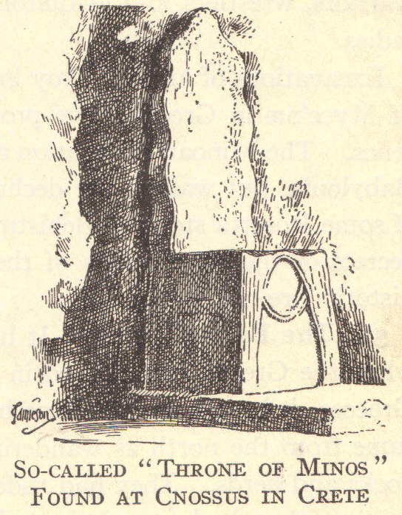
Ancient Crete: Minoan Civilization
© Student Handouts, Inc. www.studenthandouts.com

Slide 2
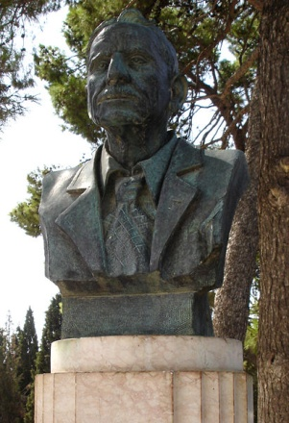
Archaeology
Cretan history previously known only through myths and legends
British archaeologist Sir Arthur Evans found and studied remains on Crete
Called “Minoan” civilization after numerous kings named Minos
Sir Arthur Evans

Slide 3
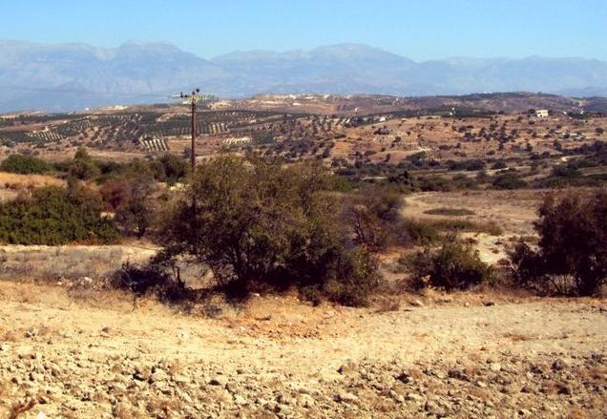
Natural Resources
Copper
Fertile soil
Gold
Good harbors
Lead
Silver

Slide 4
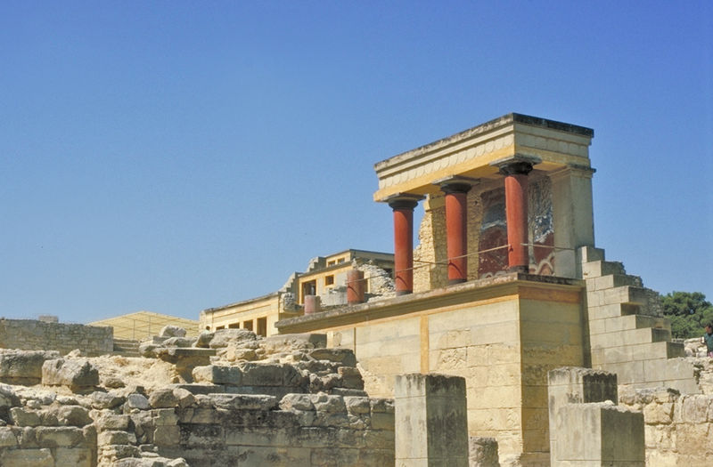
Early History
3000-1400 B.C.E. – Cretan empire
Parts of Asia and Greek peninsula, and other Aegean islands
Major cities
Knossos (a.k.a. Cnossus)
Phaestus

Slide 5
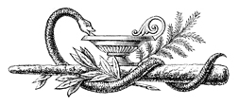
Economy
Leading sailors and traders before the Phoenicians
Traded metal goods, pottery, and textiles
Traded with Egyptians, Syrians, and others
Strong navy
Exacted tribute from neighbors
Protected the merchant marine

Slide 6
Decline and Fall
14th century B.C.E.
Conquered by barbarians from central and Eastern Europe
Hellenes attacked and destroyed Crete
Mixture of Cretans and Hellenes became the Greeks

Slide 7
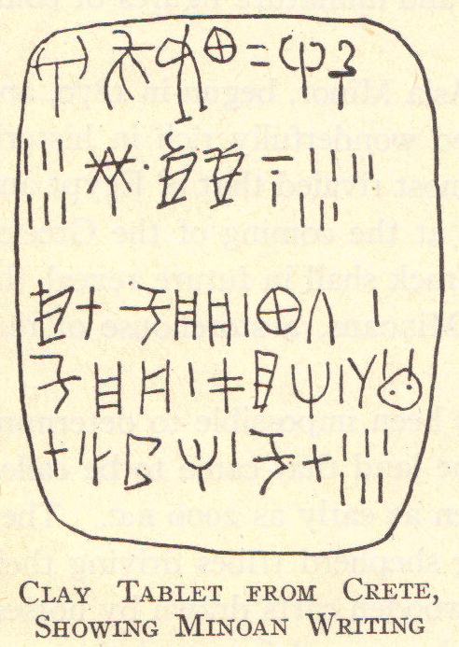
Legacy
Link between ancient Egypt and classical Greece
Cretan writing remains largely undeciphered
Palaces had baths, drains, and plumbing
Stressed athleticism – boxing, dancing, and running
Women enjoyed a level of equality with men

Slide 8
Art and Religion
Principal deity was a goddess
Art illustrates religious festivals and rituals
Colorful palaces
Painting, pottery, and sculpture

Slide 9
Review Questions
What famous British archaeologist first excavated and studied Minoan remains at Crete?
Upon what was the Minoan economy based?
What caused the decline of Minoan civilization?
Describe Minoan culture.

