Slide 1
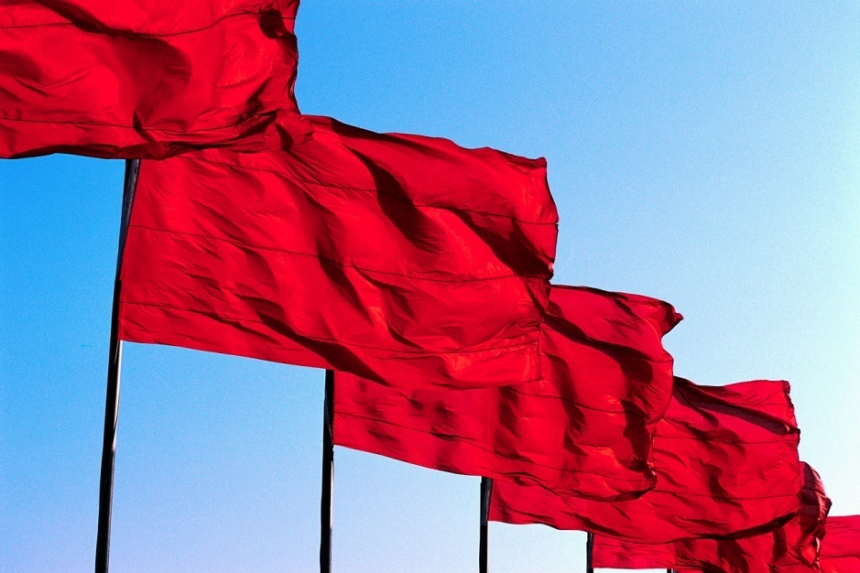
Revolution in China
© Student Handouts, Inc.

Slide 2
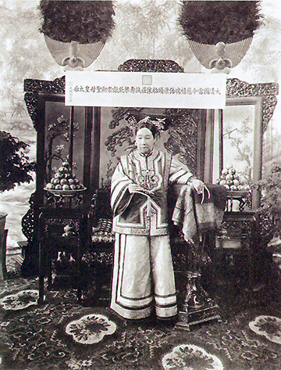
Fall of the Qing (Manchu) Dynasty
Empress Dowager Cixi (1835-1908)
  De facto Chinese monarch (1861-1908)
  “Make me unhappy for a day and I will make you unhappy for a lifetime.”
  Conservative and anti-foreign
  Blamed by many Chinese for foreign imperialist power in China

Slide 3
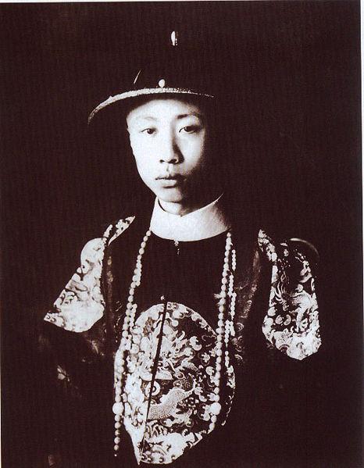
Fall of the Qing (Manchu) Dynasty
Emperor Puyi – the “Last Emperor”
  Lived 1906-1967
  Ruled China 1908-1912, and as a puppet for 12 days in 1917
  Puppet emperor of Manchukuo (Japanese-ruled Manchuria), 1932-1945
  Spent ten years in a Soviet prison after WWII
  Lived a quiet life as a regular citizen in communist China
  Died of disease during the Cultural Revolution (1967)

Slide 4
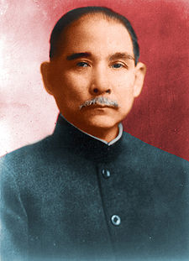

Republican Revolution (1912)
Sun Yat-sen (Sun Yixian)
  Founded Kuomintang (KMT) – Nationalist party
    Overthrew Manchu (Qing) dynasty
    Established a republic
    President of Chinese Republic who succeeded him – Yuan Shih-k’ai
Kuomintang symbol

Slide 5
Republic of China: Weaknesses
Disunity
  Local warlords fought Kuomintang for control
  Wars raged between 1912 and 1928
Foreign imperialists
  Americans, Europeans, and Japanese
Poor transportation
  1914 – only 6,000 miles of railroad track
    225,000 miles in the smaller United States
  Few decent roads

Slide 6
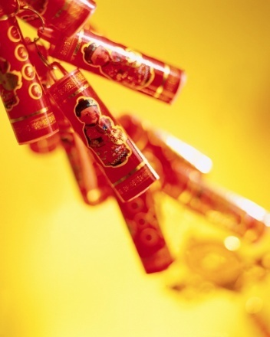
Foreign Imperialists
Twenty-One Demands (1915)
  Japan attempted to make China a Japanese protectorate
  Action condemned and stopped by other leading world powers
World War I and the Treaty of Versailles
  China attempted to abolish concessions and extraterritoriality
    Attempt failed
  China did not sign the Treaty of Versailles
  Japan gained mandate over most of Germany’s Asian possessions and rights

Slide 7
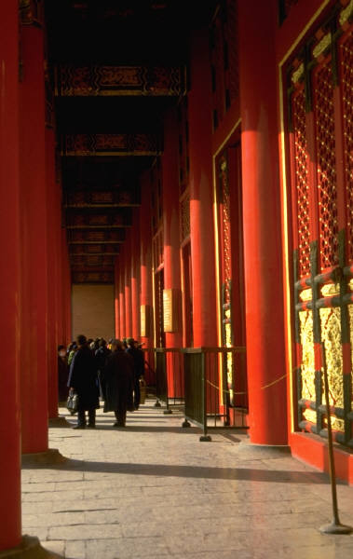
Three Principles of the People
Book published by Sun Yat-sen before his death in 1925
  Principle of Mínquán
    Democracy – the people are sovereign
  Principle of Mínzú
    Nationalism – an end to foreign imperialism
  Principle of Mínshēng
    Livelihood – economic development, industrialization, land reform, and social welfare – elements of progressivism and socialism

Slide 8

Growth of Communism
Sun Yat-sen appealed for Russian (Soviet) aid following the Versailles Conference
  1921-1925 – China received advisors, arms, communist propaganda, and loans
  Russia revoked its imperialist rights in China
Chinese flag, 1912-1928

Slide 9
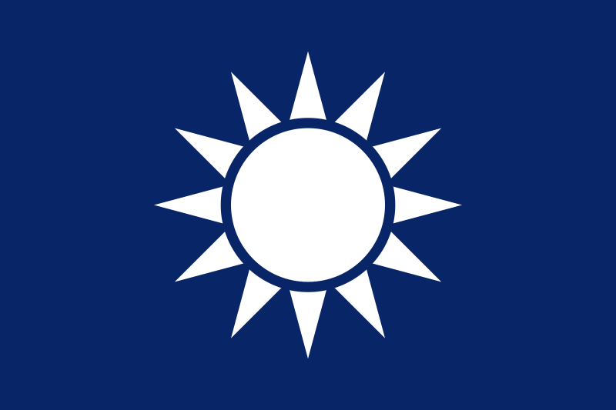
The Kuomintang (KMT) is Split
Right wing
  Business people
  Politicians
Left wing
  Communists
  Intellectuals
  Radicals
  Students

Slide 10
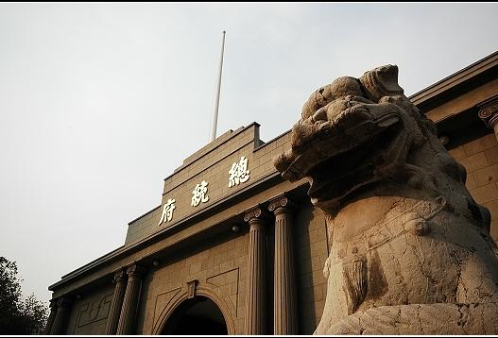
Nationalist Revolution
Sun Yat-sen succeeded by Chiang Kai-shek
Communists expelled by Kuomintang
1926-1928 – war to control the warlords
Capital moved from Peiping (a.k.a. Peking, today’s Beijing) to Nanking (Nanjing)
Presidential Palace under Kuomintang Government in Nanjing
Notes:
Possible anecdote: The Kuomintang changed the name of Peking/Beijing to Peiping (or Beiping) in 1928.

Slide 11

Civil War in China
1927-1932 and 1933-1937 – war between Communists and Nationalists
Communists – Mao Tse-tung (Mao Zedong)
Nationalists – Chiang Kai-shek
War halted 1932-1933 and 1937-1945 to fight Japanese aggression
Communists were victorious in 1949
Nationalists retreated to Formosa (Taiwan)
End of imperialism in China
  Hong Kong returned to China in 1997

Slide 12

Japanese Aggression
Japan was a threat to China – 1894-1941
1937 – Japanese invasion
  Japanese took control of north and areas along the coast
  Rape of Nanking
  Chinese Communists and Nationalists
    Intermittently were at peace as they united to fight against the Japanese
    Guerrilla and scorched earth tactics
    Received American aid against the Japanese

Slide 13

World War II
U.S. interest in China increased after Japanese attacked Pearl Harbor in 1941
Cairo Conference (1943)
  Chiang Kai-shek met with Allied leaders
  Discussed war in eastern Asia
Westerners gave up imperialist rights in China
U.S. Chinese Exclusion Act of 1882 repealed in 1943

Slide 14
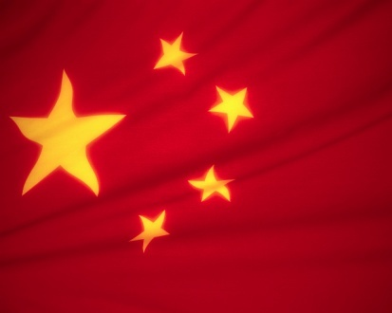
Communists in Control – 1949
Communists and Nationalists resumed civil war following World War II
Chiang Kai-shek’s Nationalist government wasted foreign economic aid
Many Kuomintang deserted to Communists
Manchuria – taken over by Communists in 1948
December, 1949 -- Communists in control
Chiang Kai-shek and Nationalists retreated to Formosa (Taiwan)

Slide 15
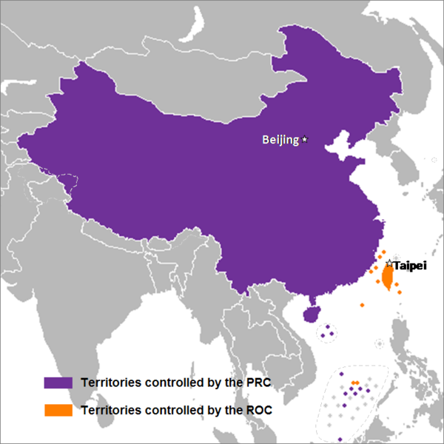
Geographical Changes
Communist China gained control over:
  Chinese
  Turkestan (Xinjiang)
  Inner Mongolia
  Manchuria
  Tibet
PRC = People’s Republic of China (Communists) / ROC = Republic of China (Nationalists)

Slide 16
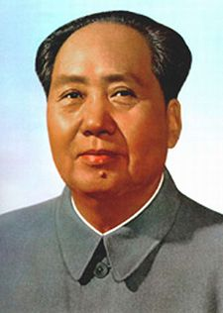
Political Changes under Mao
Communist government on mainland China
Mao Tse-tung (Mao Zedong)
  Chairman Mao – chairman of the Communist party and leader of China – 1943-1976
Mao Zedong
毛泽东
Notes:
Possible anecdote: Other men served as chairman of the republic (as opposed to both the party and the republic) as well as premier, but Mao was the de facto leader of China until his death in 1976.

Slide 17
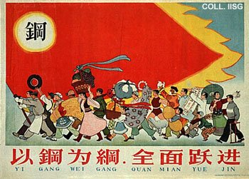
Economic Changes under Mao
First Five-Year Plan (1953-1957)
  Advances in agriculture and coal, electricity, iron, and steel production
Second Five-Year Plan (1958-1962)
  “Great Leap Forward”
  China became a leading industrial country
  Peasants organized into communes
  Widespread catastrophe – famine – at least 14,000,000 deaths
Propaganda Poster for the Great Leap Forward
Notes:
Note: Chairman Mao’s role as China’s leader became less significant following the failure of the Great Leap Forward.

Slide 18
Foreign Relations
Russia (Soviet Union)
  Growing split between USSR and China
    “Peaceful coexistence” policy of USSR viewed as surrender
  1960 – end of Soviet economic aid
Tibet
  Seized in 1962
Korea
  Aided North Korea in the Korean War (1950-1953)
Vietnam
  Supported North Vietnam and aided Viet Cong during Vietnam War (1959-1975)

Slide 19
Foreign Relations
Cold War
  Economic aid to Africa, Asia, and Latin America
“Atomic Club” (1964)
  Fifth overall, and first non-white, country to develop nuclear weapons
United Nations
  One of five permanent members of U.N. Security Council (1971, replacing Taiwan)
Relations with United States
  1972 – U.S. President Richard Nixon opened diplomatic relations with China

Slide 20
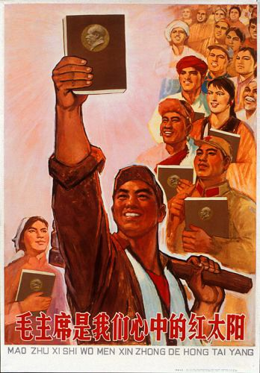
Mao’s Little Red Book
The Chinese Communist Party is the core of the Chinese revolution, and its principles are based on Marxism-Leninism. Party criticism should be carried out within the Party.
The revolution, and the recognition of class and class struggle, are necessary for peasants and the Chinese people to overcome both domestic and foreign enemy elements. This is not a simple, clean, or quick struggle.
War is a continuation of politics, and there are at least two types: just (progressive) and unjust wars, which only serve bourgeois interests. While no one likes war, we must remain ready to wage just wars against imperialist agitations.
Notes:
Note: Mao’s Quotations were published by the Chinese government from 1964 to 1976.

Slide 21
Mao’s Little Red Book
Fighting is unpleasant, and the people of China would prefer not to do it at all. At the same time, they stand ready to wage a just struggle of self-preservation against reactionary elements, both foreign and domestic.
China's road to modernization will be built on the principles of diligence and frugality. Nor will it be legitimate to relax if, 50 years later, modernization is realized on a mass scale.
A communist must be selfless, with the interests of the masses at heart. He must also possess a largeness of mind, as well as a practical, far-sighted mindset.
Women represent a great productive force in China, and equality among the sexes is one of the goals of communism. The multiple burdens which women must shoulder are to be eased.

Slide 22
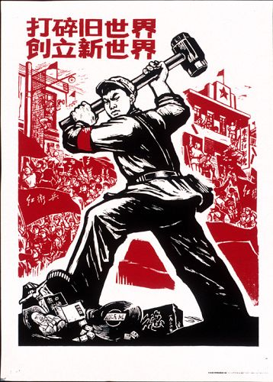
Cultural Revolution (1966-1969)
“Great Proletarian Cultural Revolution”
  Effort to revive interest in Mao’s ideas (and for Mao to regain power) after the failed Great Leap Forward
  Mao claimed that reactionary bourgeoisie elements were taking over the party
  Call for youths to engage in post-revolutionary class warfare
  Red Guards (consisting of young people) marched throughout China
  Older alleged reactionaries removed from positions of power

Slide 23
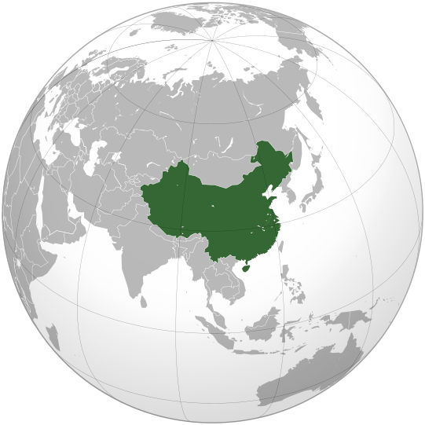
China after Chairman Mao
Mao died in September, 1976
“Gang of Four”
  Failed at a coup d’état in October, 1976
China continued to industrialize
One-Child Policy adopted – 1979
Tiananmen Square Massacre – 1989
Today – issues include:
  Balancing limited capitalism with communist ideals
  Environmental pollution
  Unequal male-to-female ratios resulting from One-Child Policy
  Control of Tibet

Slide 24
Review Questions
Which group led the Republican Revolution of 1912?
What common enemy united the Nationalists and Communists?
Who led the Communist Revolution?
Describe the Great Leap Forward.
Describe the Cultural Revolution.
What issues face China today?

