Slide 1
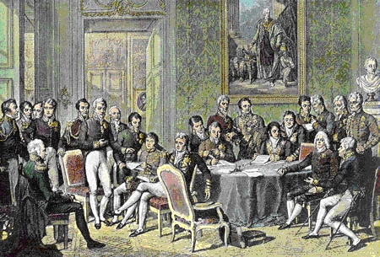
The Congress of Vienna
© Student Handouts, Inc. www.studenthandouts.com
Notes:
Anecdote: Prince Klemens von Metternich was the dominant European leader during this time.

Slide 2

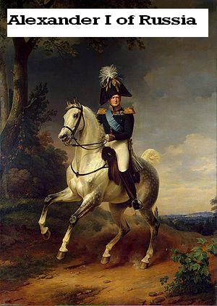
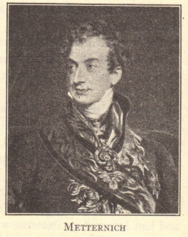
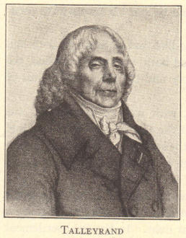
Congress of Vienna
(1814-1815)
European monarchs sought to turn back the clock to 1789 and restore Europe’s Old Regime
Members included the “Big Four” and France
  Austria – Prince Metternich
  England – Duke of Wellington and Lord Castlereagh
  France – Talleyrand
  Prussia – Frederick William III, Hardenberg, and Humboldt
  Russia – Tsar Alexander I
Notes:
Anecdote: Even though France had lost under Napoleon, Talleyrand was able to play the “Big Four” off one another and ensure that France was not severely punished.

Slide 3
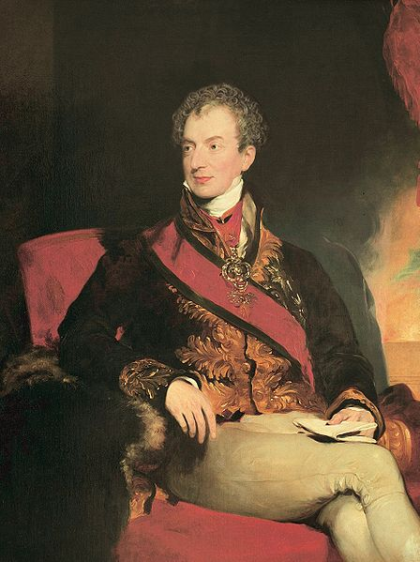
Metternich (1773-1859)
Opposed democracy and nationalism
Proposed principles of compensation and legitimacy
Notes:
Anecdote: Discussion of how Napoleon had spread the ideals of the French Revolution throughout the lands he conquered.

Slide 4
Compensation and Legitimacy
Compensation
  Napoleon’s enemies rewarded with land
  Other nations compensated for land taken
  Redrew the map of Europe
Legitimacy
  Restoration of pre-Napoleon rulers
  House of Bourbon – France, Spain, and the two Sicilies
  House of Braganza – Portugal
  House of Orange – Netherlands
  House of Savoy – Sardinia
  German princes – territories in the Confederation of the Rhine
  Pope and Catholic Church – Papal States
Notes:
Anecdote: Metternich restored the European dynasties of the Old Regime.

Slide 5
Territorial Changes
Austria gained Lombardy, Modena, Parma, Tuscany, and Venetia (all are areas in Italy)
England gained Cape Colony, Ceylon, Heligoland, Guiana, and Malta (areas in Africa, the Americas, and Asia)
Holland gained Austrian Netherlands (Belgium)
Prussia gained part of Poland, land along the Rhine River, 40% of Saxony, Swedish Pomerania, and Westphalia
Russia gained Finland and part of Poland
Sweden gained Norway
Notes:
Anecdote: The main idea to be gained here is that imperialism was confirmed in these territorial changes, and that no consideration was given to the thoughts of the “regular people” who lived in these areas.

Slide 6
Fate of Nationalism
People had no say over territorial changes
Language, nationality, and religion weren’t taken into consideration
Ideas of democracy and self-government were rejected by European leadership
Soon enough, concessions were made
Notes:
Anecdote: For the next 100 years, a few groups were able to gain concessions. For the most part, however, nationalistic drives were directly opposed to the status quo.

Slide 7
Louis XVIII of France
No more divine right of kings
Charter (Constitution) granted in 1814
Could not restore feudalism and serfdom
Continuing religious toleration guaranteed
Notes:
Anecdote: Discussion of concessions, with France as the example.

Slide 8
Buffer States
Designed to prevent France from again becoming a threat
Holland and Sardinia enlarged and strengthened
European nations guaranteed Switzerland’s neutrality
Notes:
Anecdote: Discussion of continuing Swiss neutrality and the purpose of buffer states.

Slide 9
Quadruple and Holy Alliances
Metternich desired to maintain the status quo and make the Vienna treaties permanent
Quadruple Alliance of 1815
  Austria, England, Prussia, and Russia
  France joined in 1818
  Pledged to put down democratic or nationalistic revolts
Holy Alliance
  Organized by Tsar Alexander I of Russia
  Most European monarchs joined
  Pledged to govern with charity, justice, and peace
    But none of them did so

Slide 10
Results of the Congress of Vienna
Concert of Europe – group of leading nations which periodically met to discuss issues regarding stability
Temporary suppression of democratic and nationalistic ideals
International peace – no general war in Europe until World War I a hundred years later
  Crimean War (1854-1856)
  Austro-Prussian War (1866)
  Franco-Prussian War (1870-1871)
Notes:
Anecdote: Discussion of how those wars which did break out were in large part expressions of the leading European countries’ own desires for nationalism and unification.

Slide 11
Review Questions
What countries made up the “Big Four” at the Congress of Vienna?
What were the principles of compensation and legitimacy?
How did the Congress of Vienna redraw the map of Europe?
What was the purpose of the Quadruple Alliance?
What were the results of the Congress of Vienna?

