Slide 1
The Dutch, French, and Italian Empires, and the Results of Imperialism
© Student Handouts, Inc.

Slide 2
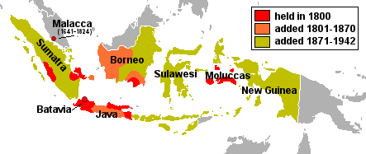
The Dutch Empire
DUTCH EAST INDIES
  Conquered and controlled beginning in the 16th century by the Dutch East India Company
  Territory of the Netherlands, 1800-1942
  575,000 square miles
  Borneo, Celebes, Indonesia, Java, Sumatra, West New Guinea
Notes:
Map courtesy of Wikipedia: http://en.wikipedia.org/wiki/File:Evolution_of_the_Dutch_East_Indies.png

Slide 3

The Dutch Empire
INDONESIAN INDEPENDENCE
  Nationalists led by Achmed Sukarno
  Movement followed Japanese invasion (World War II)
  Independent, 1949
  Indonesians took over Dutch property and forced the Dutch to leave, 1957
  United Nations gave Netherlands (Dutch) New Guinea to Indonesia

Slide 4
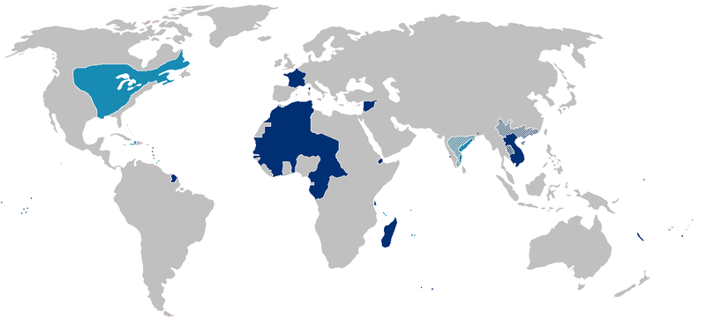
The French Empire
GEOGRAPHY
  Second in size to the British empire – 4,500,000 sq. mi.
  Africa – Algeria, Equatorial Africa, the French Cameroons, Morocco, Tunis, West Africa
  Asia – Indo-China
  Americas – French Guiana, Guadeloupe, Martinique
  Pacific – New Caledonia, New Hebrides
Notes:
Map courtesy of Wikipedia: http://en.wikipedia.org/wiki/File:France_colonial_Empire10.png

Slide 5
The French Empire
French Community – Communauté française
  Established in the constitution of the Fifth Republic (1958)
  Nations independent in 1960 – organization defunct by 1970s
Morocco
  1953 – France deposed the sultan
  1955 – sultan returned to power
  1956 – independent
Tunisia
  1955 – granted self-government
  1956 – independent
  1957 – became a republic

Slide 6
The French Empire
Indo-China
  Cambodia, Laos, and Vietnam
  Guerrilla warfare waged by communist-backed nationalists
  1950 – self-rule
  1955 – Cambodia and Laos withdrew from French Union
  1955 – Vietnam divided at 17˚ parallel
    North – communist – led by Ho Chi Minh
    1959-1975 – Vietnam War
      Fought between North Vietnam (Vietcong with Chinese support) and South Vietnam (backed by United States and Members of SEATO)
    Today – one united country – Vietnam
Notes:
Notes for the teacher: SEATO = Southeast Asia Treaty Organization.

Slide 7
The French Empire
Algeria
  1954-1962 – fought for independence
  March, 1962 – cease-fire
  July, 1962 – independent
French Guinea
  1958 – voted for its independence and joined the U.N.
Togoland and Cameroon
  France held trusteeships from League of Nations (after WWI) and United Nations (after WWII)
  Independent in 1960
  Did not join the French Community
  Joined the United Nations
Malagasy and Mali
  1960 – free states
  Joined the soon-defunct French Community

Slide 8
The Italian Empire
Libya
  Won from Turkey by war in 1912
  Independent, 1951
Ethiopia
  Conquered, 1936
  Independent, 1941
Eritrea
  1890 – acquired as an Italian colony
  1941-1951 – controlled by the British under United Nations mandate
  1962 – officially annexed by Ethiopia
  1993 – independent country
Somaliland
  1889 and on – acquired by treaties
  After World War II – United Nations trusteeship
  1960 – independent as Somalia

Slide 9
Results of Imperialism: For the “Mother” Country
Positives/Pros
Negatives/Cons
Increased industrial productivity from investments
Profits from trade
New drugs (e.g., quinine) and products from colonies
Wars – against both natives and competing imperial powers
Expense of maintaining large military and naval forces
Hatred and resentment from native peoples

Slide 10
Results of Imperialism: For the Colonized
Positives/Pros
Negatives/Cons
Natural resources developed
Industrialization
Raised standards of living
Improvements in education, medical care, and sanitation
Nationalism developed
Exposure to new ideas
Natural resources developed for benefit of mother country
Native labor poorly paid and often mistreated
Destruction of native cultures and languages
Western diseases, vices, and other problems
Racism
Discouragement of native industries that might compete with the imperial power
Lack of self-government and democracy

Slide 11
Review Questions
What company controlled the Dutch East Indies prior to 1800?
What sparked the movement for Indonesian independence?
What European country controlled the world’s second-largest empire?
Summarize the events of the Vietnam War.

Slide 12
Review Questions
Describe the colonization and independence of Ethiopia and Eritrea.
Describe the pros and cons of imperialism for an imperial power.
Describe the pros and cons of imperialism for a colonized nation.
Many now-independent colonies hold deep resentment toward their former imperial powers, while others have close working relationships (particularly members of the Commonwealth). How might you explain these different attitudes and feelings?

