Slide 1
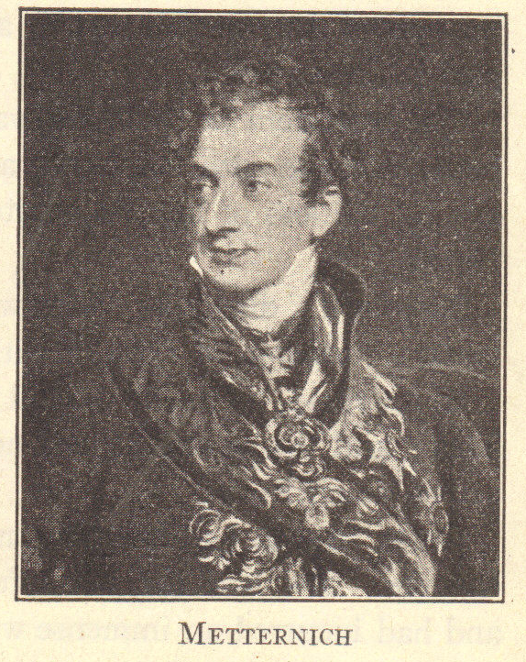
Era of Metternich
© Student Handouts, Inc. www.studenthandouts.com

Slide 2
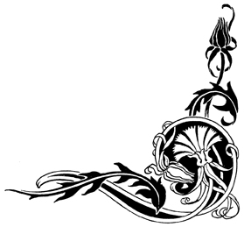
Prince Klemens von Metternich
Living symbol of reaction
Designed the Quadruple Alliance
Opposed all changes except restoration of the Old Regime

Slide 3
New Popular Terms
Conservative – person opposed to change
Liberal – person favoring gradual change
Radical – person favoring quick change that gets to the root of the matter
Notes:
Anecdote: “Radical” comes from the word “root.”

Slide 4
Discouraged Democratic and Nationalistic Movements
Quadruple Alliance and Concert of Europe suppressed revolts
Spy network used to uncover revolutionary activity
Strict censorship of education, the press, and speech

Slide 5

Democratic Revolts
Liberal movement within German universities
  Carlsbad Decrees (1819)
    Abolished student fraternities
    Established strict censorship of the press
    Placed spies in classrooms to monitor professors and students
Spanish Revolt (1820)
Revolts in Naples and Piedmont (1820)
Second French Revolution (1830)
Revolts in Austria, France, and Prussia (1848)

Slide 6

Nationalistic Revolts
Latin American Revolutions (1810-1825)
Greek War of Independence (1821-1829)
Italian Revolt (1830)
Belgian Independence Revolt (1830-1839)
Polish Revolt (1831)
Revolts in Bohemia, German states, Hungary, and Italian states (1848)

Slide 7

Spanish Revolt (1820)
Ferdinand VII had scrapped the liberal constitution of 1812
  Restored absolutism, Inquisition, and Old Regime
  Suppressed individual liberties
1820 – revolt – Ferdinand had to restore the 1812 constitution
Quadruple Alliance met in Verona in 1822
  Sent French army into Spain
Ferdinand restored to power
  Ruled as an autocratic despot
  No democratic progress in Spain for approximately 100 years

Slide 8
Italian Revolt (1820)
Revolts in Piedmont and Naples
Led by Carbonari (“charcoal burners”) – secret organization
  Wanted constitutions to limit royal absolutism
Congress of Laibach (1821)
  Quadruple Alliance had Austrian military suppress the revolts
    Austrian army – “fire brigade of Europe”

Slide 9

Latin American Revolutions
(1810-1825)
Independence movements arose following Napoleon’s invasion of Spain
Revolutions supported by Great Britain and United States
  Great Britain
    Wanted to trade with Latin America, which Spain had never permitted
  United States
    Also wanted to trade
    Sympathized with democratic ideals
    Monroe Doctrine (1823) – U.S. would not interfere in Europe, and Europe would not interfere in the independent nations of the Americas
  Support from the United States and Great Britain (a member of the Quadruple Alliance) kept Europe away

Slide 10
Greek Revolt (1821-1829)
Greeks revolted against Ottoman (Turkish) rulers
Metternich sided with the Turks
Britain, France, and Russia sided with the Greeks
Greece won its independence in 1829
Notes:
Anecdote: Many during the Romantic era were absorbed in the romantic ideals of nationalism and independence; the British poet Lord Byron fought in the Greek revolt and died in Greece.

Slide 11
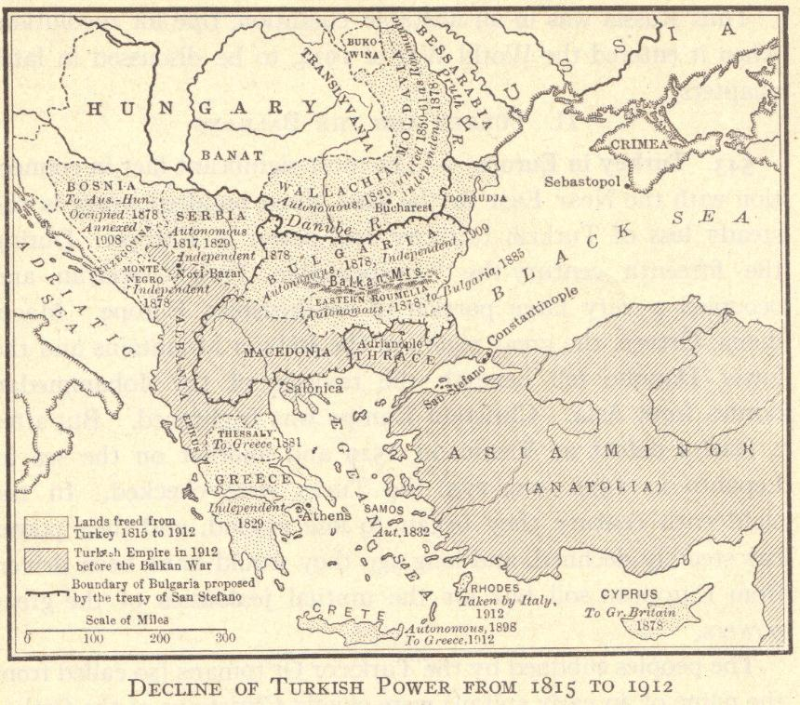

Slide 12
Review Questions
Who was Prince Klemens von Metternich?
What is a conservative?
What is a liberal?
What is a radical?
What were the Carlsbad Decrees?
Describe one of the nationalistic revolts of the early nineteenth century.

