Slide 1
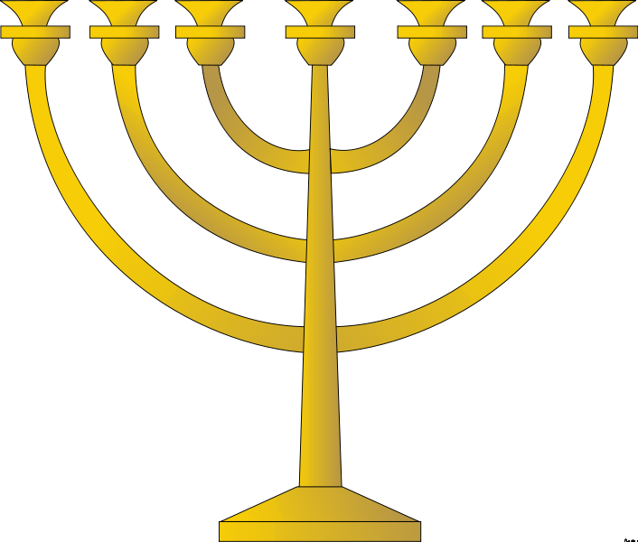
THE HEBREWS
© Student Handouts, Inc. www.studenthandouts.com

Slide 2
ORIGINS
Semitic nomads of Mesopotamia
Circa 2000 B.C.E. – patriarch Abraham led his people from Ur to the Mediterranean shore
Circa 1400 B.C.E. – relocated to Egypt because of a drought
  Biblical story of Moses and Passover

Slide 3
EARLY LEADERS
Originally ruled by judges, tribal elders, or rabbis
King Saul
  Reigned circa 1047-circa 1007 B.C.E.
King David
  Reigned circa 1007-circa 970 B.C.E.
King Solomon
  Reigned circa 970-circa 930 B.C.E.
King Rehoboam
  Reigned circa 930-circa 915 B.C.E.

Slide 4
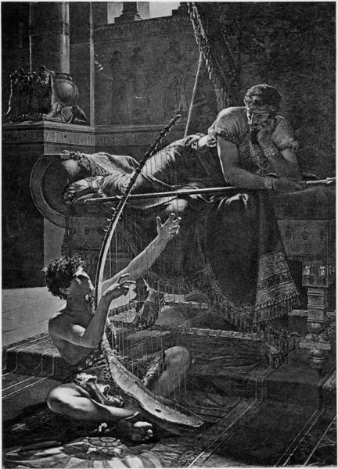
King saul
First real king
Anointed by Samuel
United Hebrews
David and Saul by Julius Kronberg (1885)

Slide 5
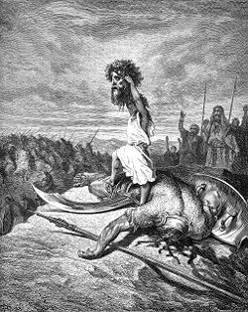
KING DAVID
Biblical story of David and Goliath
Extended boundaries
  Conquered Canaanites in Canaan
    Canaanites eventually intermarried with Phoenicians
  Conquered Philistines
    Origin of the term “Palestine”
Strong united government
Credited with writing “Psalms”

Slide 6
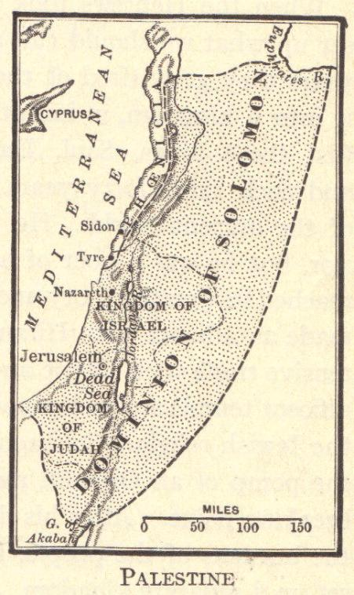
King solomon
Built a large palace
Built first Jerusalem Temple
  “First Temple Period”
Levied high taxes to pay for construction projects
  Made him somewhat unpopular
Credited with authoring “The Song of Solomon”

Slide 7
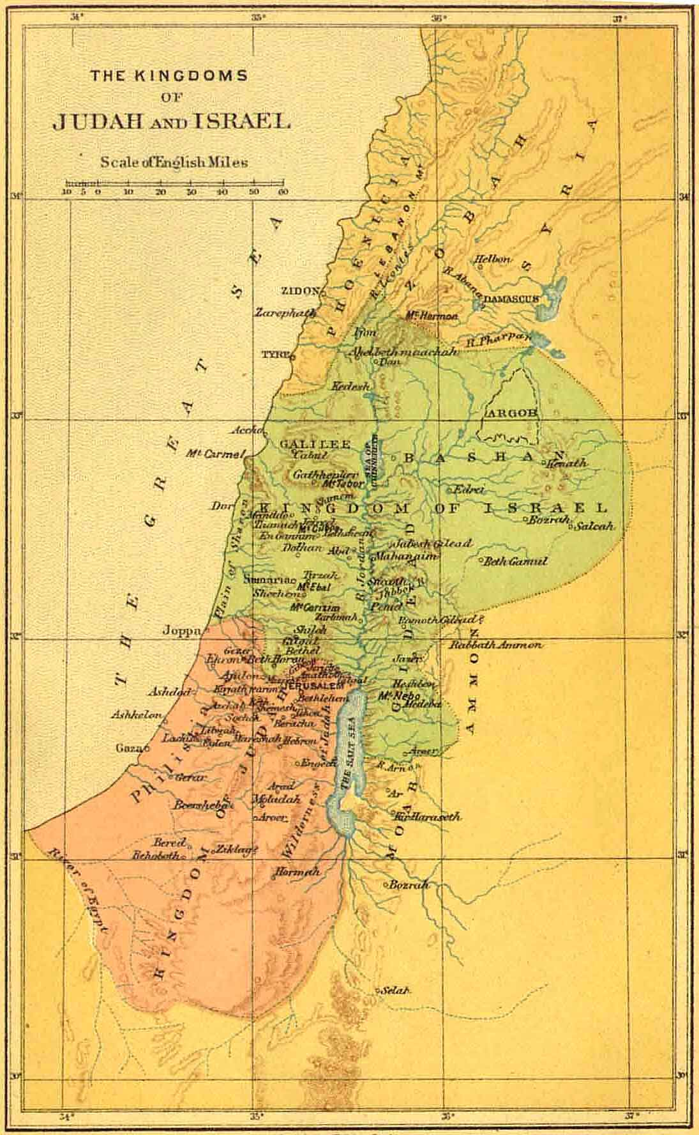
King rehoboam
Discontent over high taxes
Ten northern tribes revolted and established kingdom of Israel (932 or 931 B.C.E.)
Two southern tribes remained loyal as the kingdom of Judah
Separate states not as strong as unified state

Slide 8
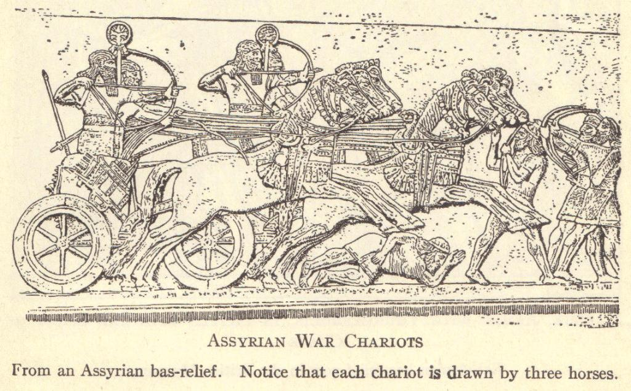
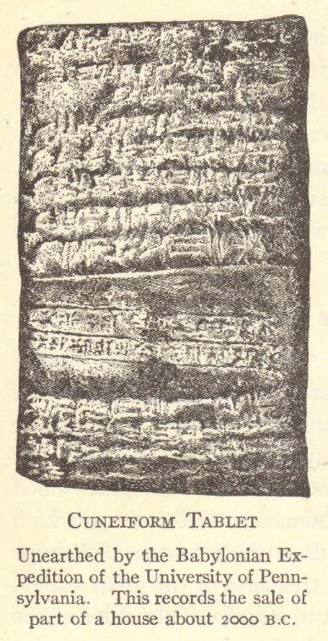
Hebrews’ Fate
Israel
  Conquered by Assyria (721 B.C.E.)
Judah
  Conquered by King Nebuchadnezzar of Babylon (586 B.C.E.)
  Temple destroyed
  Babylonian captivity (586-538 B.C.E.)
    Ended when Babylon was conquered by King Cyrus of Persia, who allowed the Hebrews to return to Jerusalem

Slide 9
Second temple period
Peace under Persian rule for two centuries
  Jerusalem Temple rebuilt in 516 BCE
Alexander the Great conquered Persia and took over Palestine (333-325 B.C.E.)
  Greeks ruled for approximately 150 years
Maccabean Revolt (167-164 B.C.E.)
  Independent country for 100+ years
Roman Conquest (63 B.C.E.)
  Jewish kings (Herodians) ruled under Roman protection
  6 C.E. – became an imperial province

Slide 10
The Jewish-Roman Wars
Jewish Rebellion, 66-73 CE
Kitos War, 115-117 CE
Bar Kokhba Revolt, 132-136 CE

Slide 11
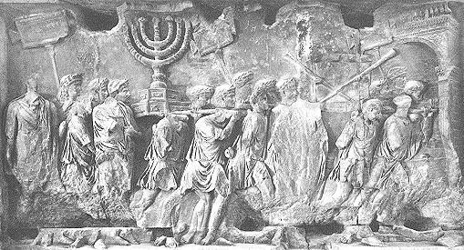
First Jewish-Roman War
Jewish rebellion (66-73 C.E.)
First Jewish-Roman War
Revolt crushed by future Emperor Titus
Second Temple destroyed
  Treasures displayed in Rome
Detail from the Arch of Titus in Rome

Slide 12
Kitos War, 115-117 CE
Revolt by Jews throughout the Roman Empire
Cyprus, Egypt, Judea, Libya, Mesopotamia, and Syria
Sparked when Roman forces fought the Parthians
Romans won
Second Jewish-Roman War

Slide 13
Bar Kokhba Revolt (132-136 CE)
Last (Third) Jewish-Roman War
Jews led by Simon bar Kokhba
  Many believed him to be the messiah
Crushed by the Romans
  Led by Hadrian
Results
  Jewish Diaspora (barred from Jerusalem)
  Early Christians began to separate themselves from Judaism

Slide 14
HEBREW CONTRIBUTIONS
Monotheism – belief in one god
Jewish Talmud
  Book of Jewish laws and thoughts
Christianity and Islam
  World’s two largest religions are based around Jewish beliefs, practices, and teachings
Jewish Tanakh
  Largely the same as the Christian Old Testament
  Many stories have counterparts in the Muslim Qu’ran (Koran)

Slide 15
REView questions
Where did the Hebrews originate?
Who is considered to be the first real king of the Hebrews?
Who built the first Jerusalem Temple?
How did the Hebrews come to form two separate kingdoms, Israel and Judah?
What is the Babylonian captivity?
Describe the Jewish revolt of 66-73 C.E. and its consequences.

