Slide 1
The Hittites
© Student Handouts, Inc. www.studenthandouts.com

Slide 2
Early History
Little known about them until archaeological discoveries of early 20th century
Migrated to Asia Minor (modern Turkey) from northern Europe circa 3000 B.C.E.

Slide 3
First Hittite Empire
1900 B.C.E.
Empire stretched from Aegean Sea to Euphrates River

Slide 4
Second Hittite Empire
1500-1200 B.C.E.
Included Asia Minor, Palestine, and Syria
Decline and fall
Continuous warfare with Egypt
1200 B.C.E. – conquered by northern barbarians
Eventually absorbed by Assyria

Slide 5
Economy
Link between Mesopotamia and western Asia
Had monopoly on Armenian and European metals for hundreds of years
Developed iron for tools and weapons
Wealth from trade of gold, iron, lead, and silver
Trade shown in numerous excavated clay tablets

Slide 6
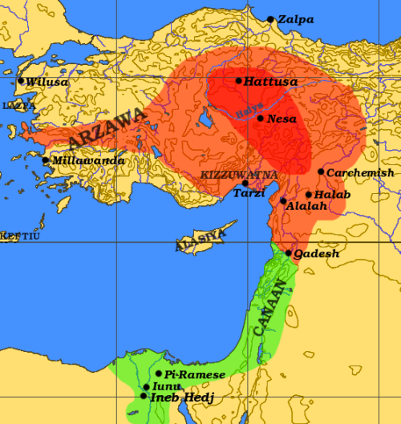
Government
Ruled by a king
Heavily fortified city walls
Written laws show Babylonian influence

Slide 7
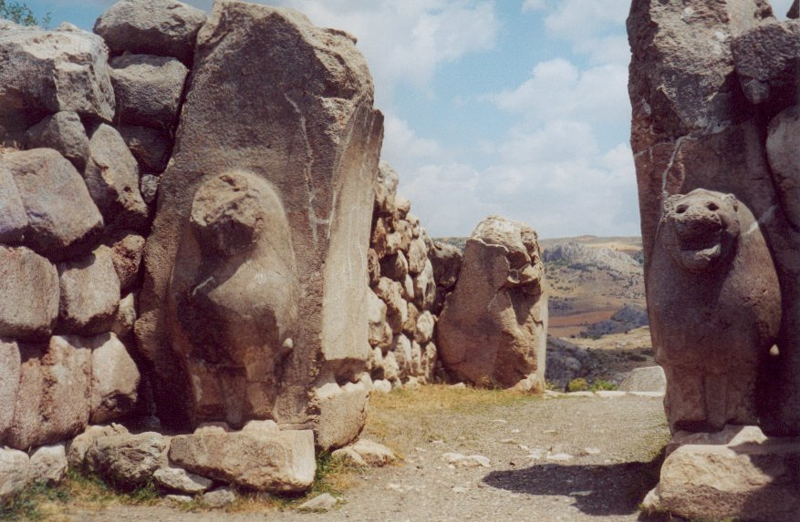
Art
Crude
Stone lions at city entrances
Carvings of animals and warriors

Slide 8
Review Questions
Where was the Hittite empire located?
What major contribution did the Hittites make to military warfare and world civilization?
Describe the decline and fall of the Hittite empire.
Describe Hittite art.

