Slide 1
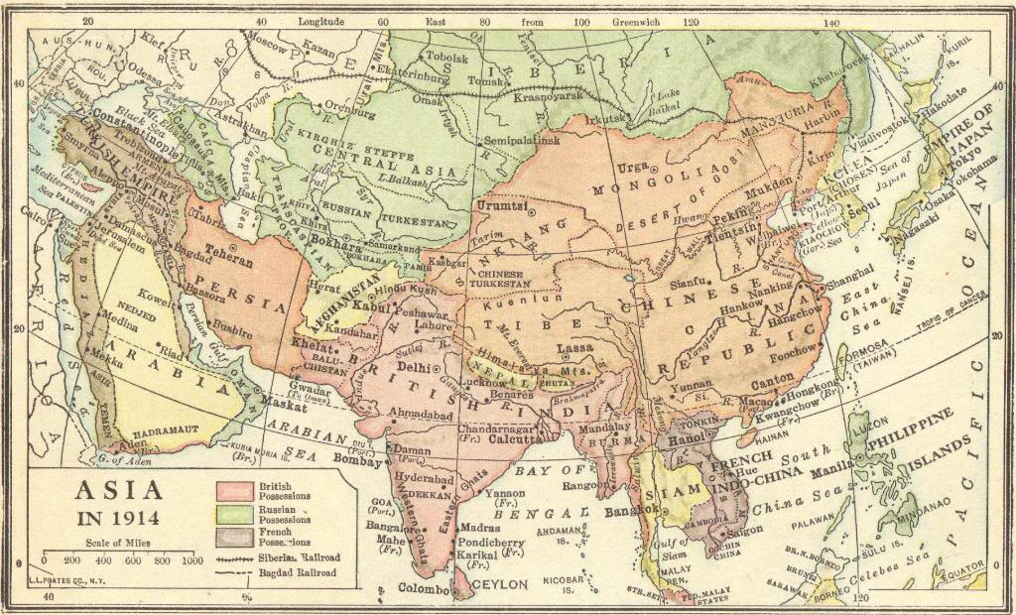
IMPERIALISM IN EAST ASIA
© Student Handouts, Inc. www.studenthandouts.com

Slide 2
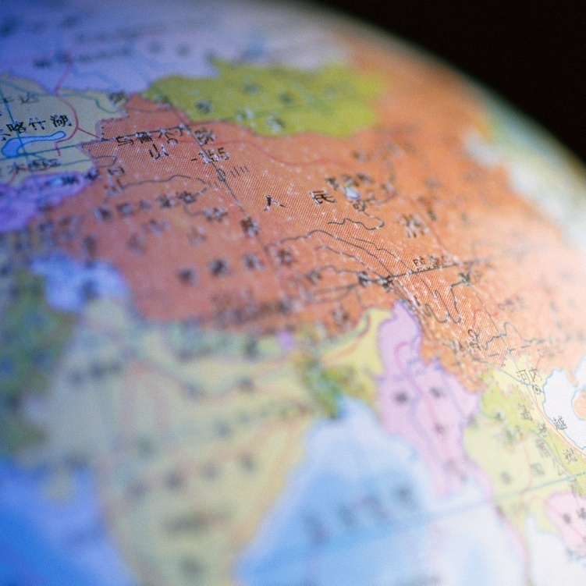
GEOGRAPHY
Vast territory with rich history
Natural resources
  Coal, oil, rubber, tin, etc.
Raw materials and exports
  Rice, tea, silk, spices, etc.
Notes:
Possible anecdote: Rubber trees imported from South America.

Slide 3
POPULATION
World’s most populous region
China – #1 in world population
India – #2 in world population
Other countries – Burma (Myanmar), Cambodia, Ceylon (Sri Lanka), Indonesia, Korea, Laos, Malaysia, Pakistan, Philippines, Thailand, Vietnam, etc.
Notes:
Possible anecdotes: Current statistics on countries’ populations.

Slide 4
FOREIGN INFLUENCES
Early 19th to Early 20th Centuries
Great Britain
  Burma, China, India, Malaya, New Guinea, Singapore, etc.
Holland (Netherlands – the Dutch)
  East Indies
France
  China and French Indochine (Indo-China)
Notes:
Possible anecdote: These slides provide only the briefest overview of foreign imperialism in East Asia. Supplement with more detailed information.

Slide 5
FOREIGN INFLUENCES
Early 19th to Early 20th Centuries
Germany
  Pacific islands – Carolines, Marianas, Marshalls
  Shantung peninsula
Russia
  Siberia to the Pacific Ocean
  Manchuria
Japan
  Formosa
  Manchuria
  Korea
Notes:
Possible anecdote: These slides provide only the briefest overview of foreign imperialism in East Asia. Supplement with more detailed information.

Slide 6
GROWING NATIONALISM
Increased during and after World War I
Ideals of democracy, freedom, and nationalism increased with industrialization
Largely independent following World War II
“Hot spots” during the Cold War
  Korean War
  Vietnam War
Notes:
Possible anecdote: This is a very brief overview of the decolonization of East Asia. Greater detail is included in subsequent PowerPoint presentations, particularly those covering the histories of individual nations.

