Slide 1
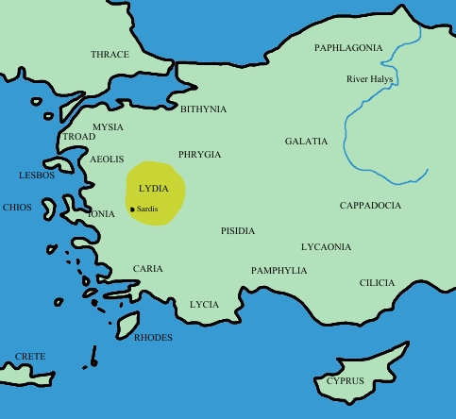
The Lydians
© Student Handouts, Inc.
www.studenthandouts.com

Slide 2
Early History
Lydians originally from Europe
Small states throughout Asia Minor following fall of the Hittites
10th century B.C.E. – dominated western Asia Minor (modern-day Turkey)

Slide 3
Lydian Civilization
400 years of prosperity
Mineral wealth
  Especially gold and electrum
    Electrum – mixture of gold and silver found in riverbeds
Controlled Asia Minor’s trade routes
Conquered by Persians (547 B.C.E.)

Slide 4
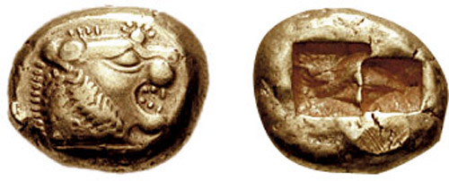
Lydians Coined Money
Before the Lydians, goods had to be traded for other goods
  Only thing close to money were lumps of gold and silver, which had to be repeatedly weighed and tested for purity
Lydians made standard-sized pieces of gold and silver and stamped them with their value
  Invention of money
Use of money spread quickly
  Helped to spread international trade

Slide 5
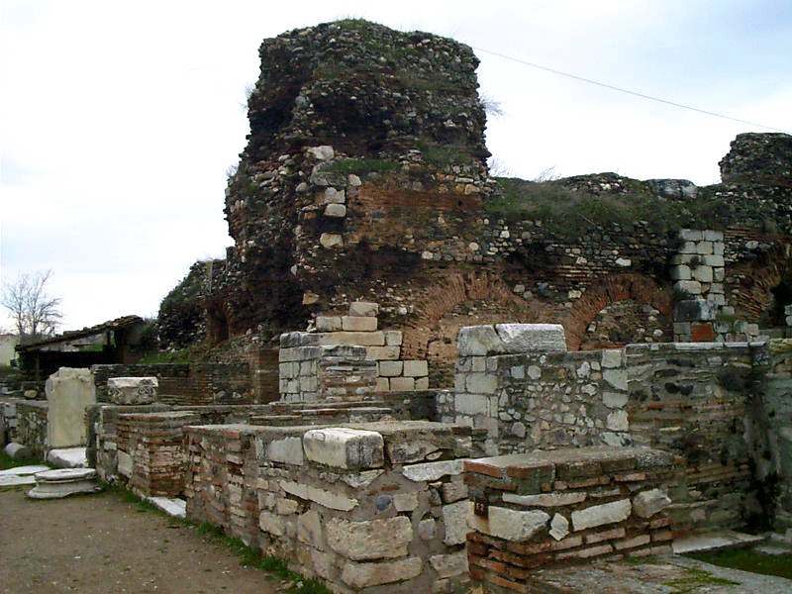
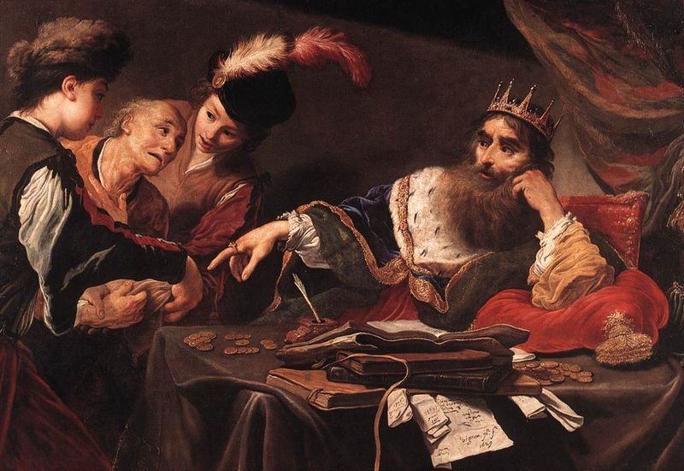
Government
Capital – Sardis – trading center
Ruled by a king
  Most famous king was Croesus – “as rich as Croesus”
Sardis
Croesus

Slide 6
Review Questions
Where was Lydia located?
What are the Lydians credited with inventing?
What Lydian king is world-famous for his wealth?

