Slide 1
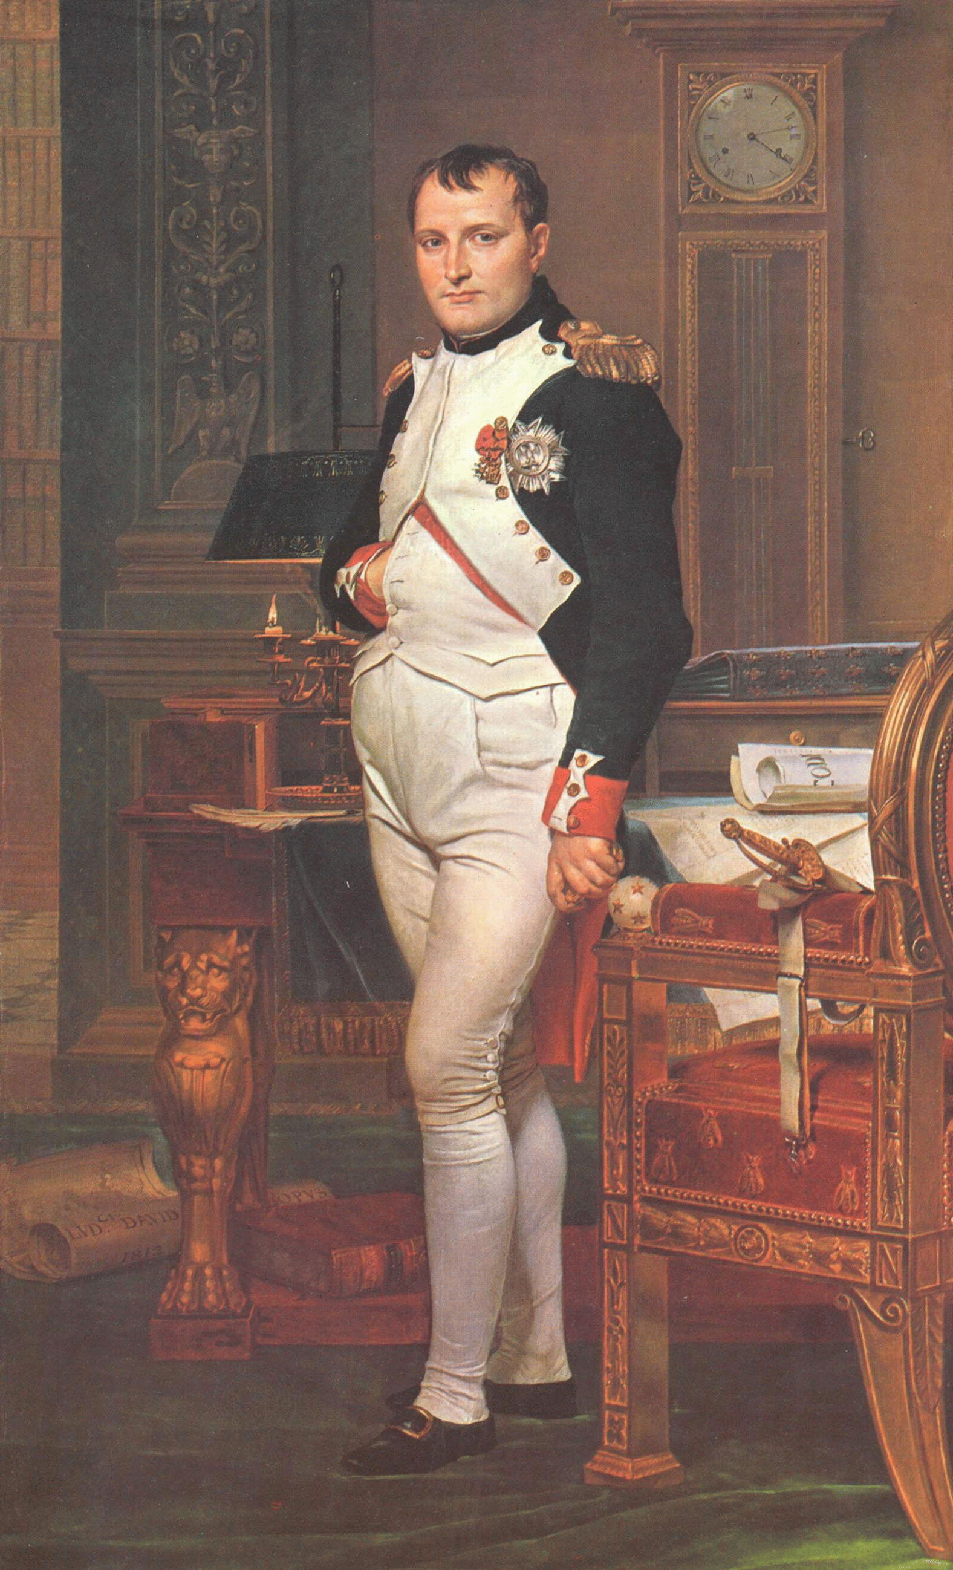
The Napoleonic Era
1799-1815
© Student Handouts, Inc.
www.studenthandouts.com

Slide 2
Napoleon’s Background
Born in Corsica in 1769
Military education
Favored Jacobins and republicanism
Military hero
  Drove British forces from port of Toulon in 1793
  Captured northern Italy and forced Austrian Hapsburgs to make peace
  1798 – Egyptian expedition

Slide 3
Napoleonic Campaign in Egypt:
1798-1801
Napoleon’s attempt to seize Egypt and undermine Britain’s access to India
  Napoleon took control of Egypt on land
  Brought along scientists
    Studied the pyramids, etc.
    Discovered the Rosetta stone
    British took control of Egypt and all discoveries following the defeat of the French forces in Egypt
Battle of the Nile – August 1-3, 1798
  Britain’s Horatio Nelson defeated French naval forces
  Napoleon and his troops became stranded in Egypt
  August, 1799 – Napoleon snuck past the British blockade in the Mediterranean and returned to Paris

Slide 4
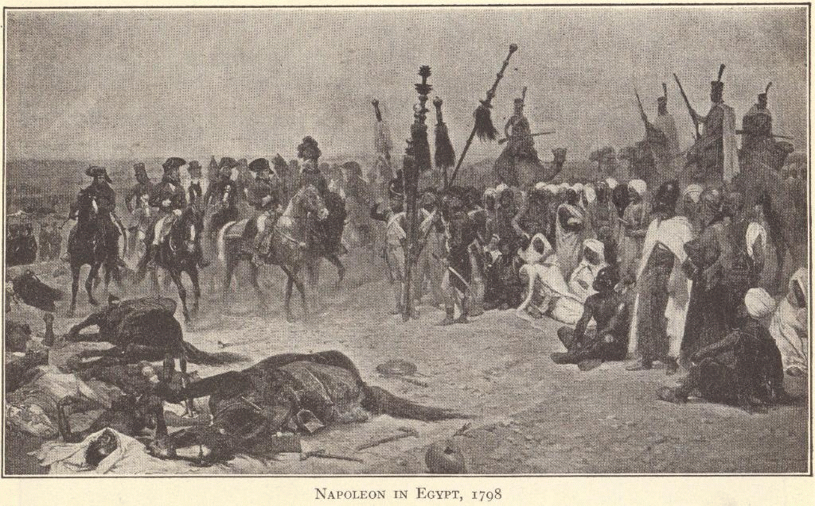
Napoleon in Egypt, 1798

Slide 5
Napoleon’s Rise to Power
1799
  Snuck past British blockade in Mediterranean
  Took control of the Directory by coup d’état
  Set up three-man Consulate
    With himself as First Consul
1802
  Consul for life
1804
  Crowned himself emperor
Plebiscite
  Popular vote done by ballot
  Napoleon always held plebiscites
  Everyone always voted for his policies
Democratic despotism
  He had absolute power regardless of the fact that he held plebiscites

Slide 6
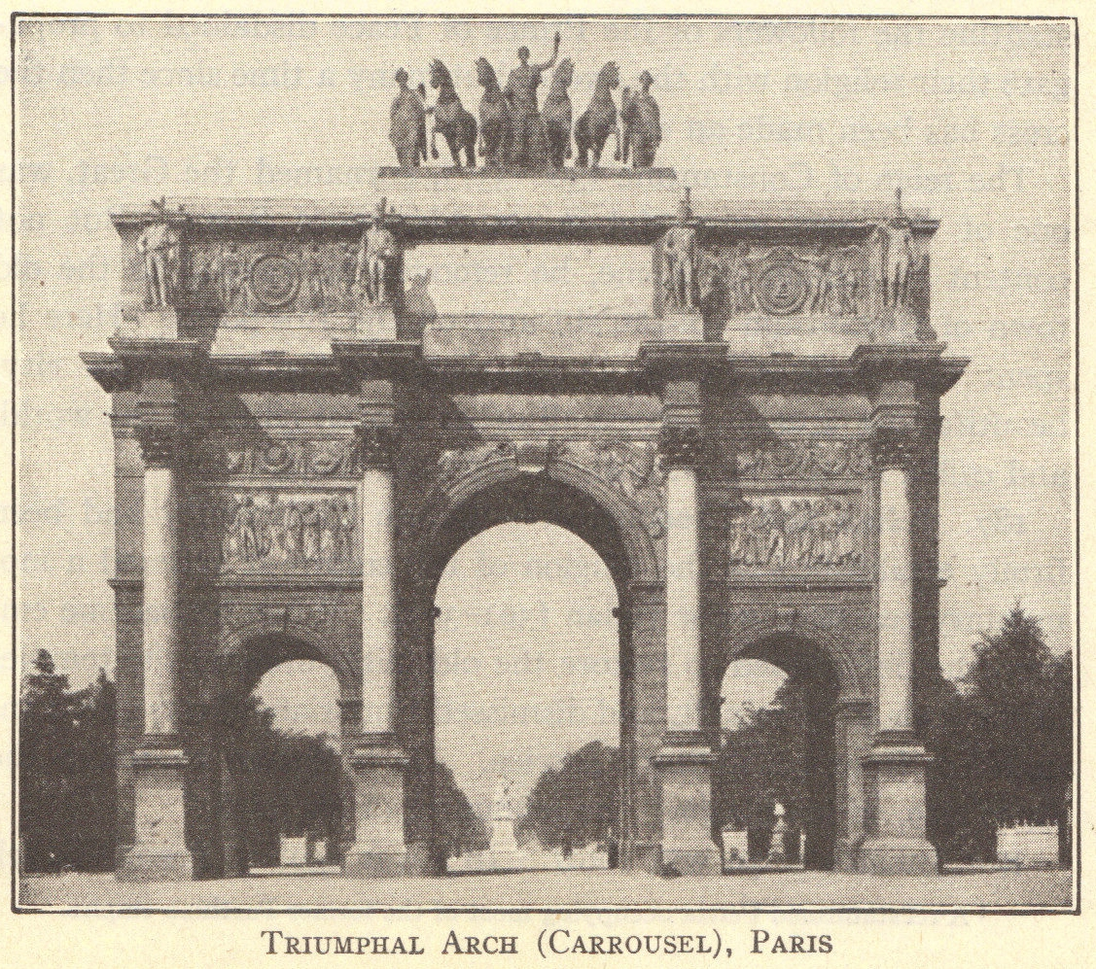
Arc de Triomphe in Paris, which was erected in 1806 to honor the soldiers of Napoleon.
Its nationalistic style set the tone for public monuments until World War I.

Slide 7
Napoleon’s Reforms
Class System
Strengthened the national government
Ran an efficient bureaucracy
Religion – Concordat of 1801
Church under government control
Government
Controlled prices
Encouraged industrial growth
Strengthened the nation’s infrastructure
Education
Nationally-controlled public schools
Economy
Émigrés could return if swore loyalty to new French gov’t.
Peasants kept lands they’d bought from Church and nobles
New nobility established through a meritocracy (e.g., Legion of Honor)
Laws – Napoleonic Code
Equality before the law
Religious freedom
Religious tolerance
End to feudalism
But women lost many of their rights

Slide 8
Napoleon’s Empire
1804-1812: Military successes due to leadership skills, large armies, and surprise tactics
Annexed parts of Germany and Italy as well as Belgium and the Netherlands
Replaced Holy Roman Empire with French-controlled Federation of the Rhine
Cut off half of Prussia to form Grand Duchy of Warsaw (historical Poland)
Placed puppet rulers on conquered thrones (e.g., Joseph Bonaparte as king of Spain)
Formed alliances
  Including divorcing Josephine de Beauharnais to marry Marie Louise of Austria
Nationalism grew with Napoleon’s successes
  Both in France and in the areas he conquered

Slide 9
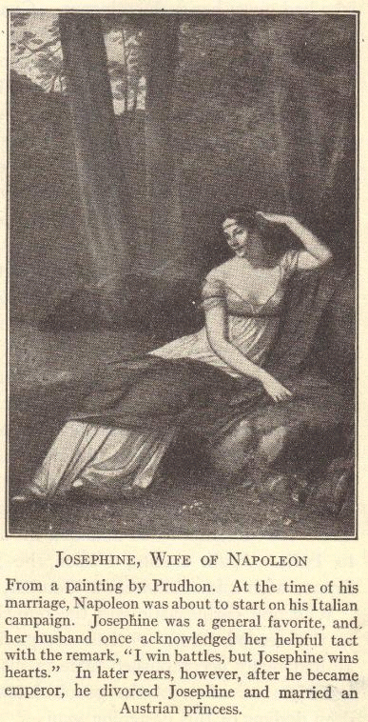
Empress Josephine
Napoleon’s first wife, Josephine de Beauharnais, aided her husband’s career through her interpersonal skills and political connections.

Slide 10
British Opposition to Napoleon
1805
  France tried to invade Great Britain
  Admiral Horatio Nelson defeated him at the Battle of Trafalgar
    Nelson was killed in this naval battle
Napoleon struck back with the Continental System
  No trade between the European continent and Great Britain
Great Britain responded with blockades
  British attacks on American ships still trading with France helped spark the War of 1812 in the U.S.
Continental system failed because European countries wanted and needed trade

Slide 11
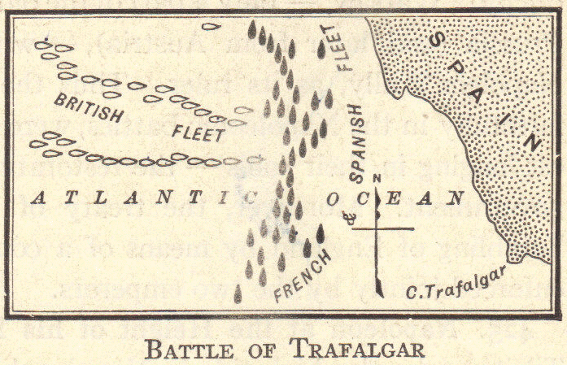
Battle of Trafalgar:
October 21, 1805

Slide 12
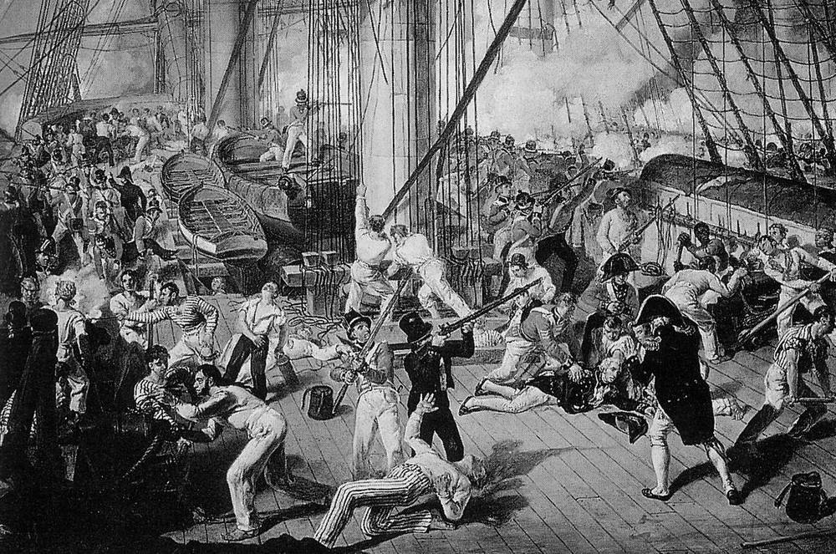
Battle of Trafalgar: October 21, 1805
Death of Horatio Lord Nelson

Slide 13
Review Questions
What were the results of France’s Egyptian Campaign?
How did Napoleon come to power in France?
Describe Napoleon’s reforms.
Why did nationalism spread throughout Europe during the Napoleonic era?
Who was Nelson and what role did he play in the eventual defeat of Napoleon?

Slide 14
Napoleon Spreads Revolution
Napoleon spread revolution with his Grande Armée
Supported liberal reforms in conquered lands
Abolished nobility and feudalism
Set up meritocracies
Ended Church privileges
Napoleonic Code spread even to areas beyond the French empire
  Such as the Spanish and Portuguese colonies in Latin America

Slide 15
Decline of Napoleon’s Empire
Europeans hated the Continental System
Revolutionary ideals of self-government spurred nationalism in conquered states
Peninsular War in Spain and Portugal
  People of Iberian Peninsula pledged loyalty to Church and king
    Aided by the British
  Local rulers formed juntas to maintain power
    Did not actually want to give up all of their power to a returning Spanish or Portuguese king
    Wanted to keep many elements of republicanism
  Guerrilla warfare against French rule of Joseph Bonaparte
War with Austria
  1805 – Battle of Austerlitz – French won
  1809 – Battle of Wagram – French won
  But the Austrian opposition illustrated the commitment to end French domination in Europe

Slide 16
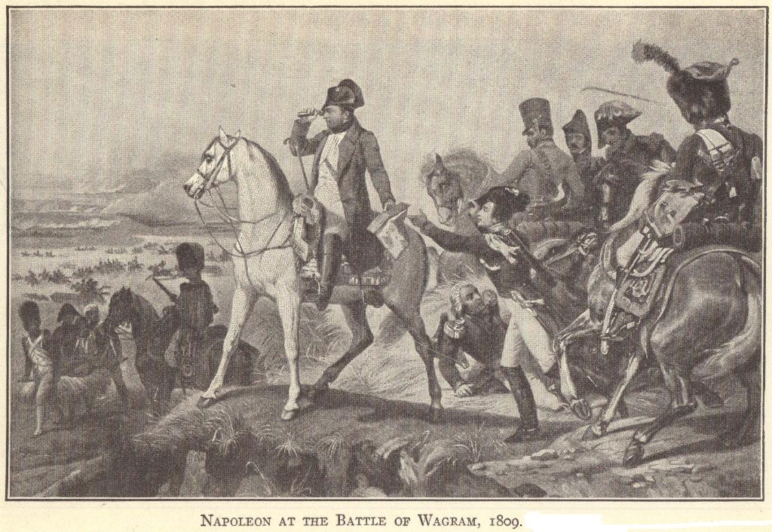
Battle of Wagram, 1809

Slide 17
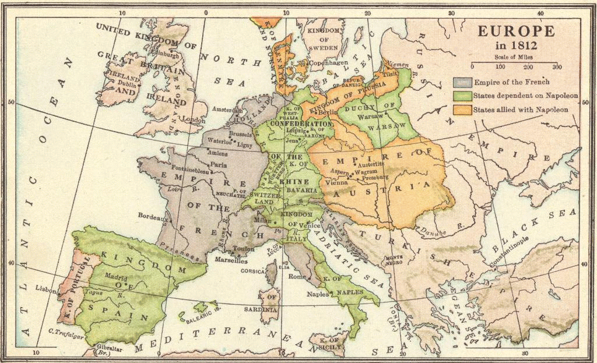
Map of Europe in 1812

Slide 18
Napoleon’s Invasion of Russia
Tsar Alexander I withdrew from the French alliance because of the unpopularity of the Continental System and Grand Duchy of Warsaw.
Napoleon assembled the Grande Armée from 20 nations (almost 600,000 soldiers) to invade Russia in 1812.
Russians abandoned Moscow and used the scorched-earth policy when retreating to starve the Grande Armée.
It worked. Napoleon pulled out in October, 1812.
Of Napoleon’s original nearly 600,000 soldiers, only 20,000 survived the cold, hungry trek back across Eastern Europe (the rest died or deserted).

Slide 19
Napoleon’s Abdication
1813 – Quadruple Alliance of Austria, Great Britain, Prussia, and Russia defeated Napoleon at the Battle of the Nations in Leipzig.
1814 – Napoleon abdicated and was exiled to Elba in the Mediterranean.
Louis XVIII, brother of the guillotined Louis XVI, was made king of France. Louis XVIII was disliked, and the returning émigrés were distrusted.
During the peace conference in Vienna, Napoleon escaped from Elba and Louis XVIII fled.

Slide 20
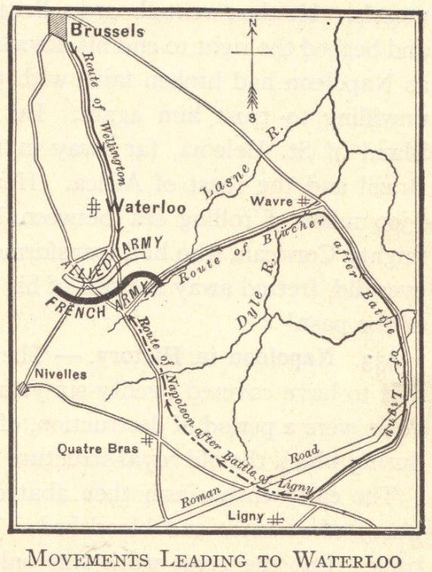
The Hundred Days
March 20, 1815
  Napoleon marched triumphantly into Paris
June 18, 1815
  Battle of Waterloo (in Belgium)
Napoleon was defeated
  Exiled to St. Helena in the South Pacific

Slide 21
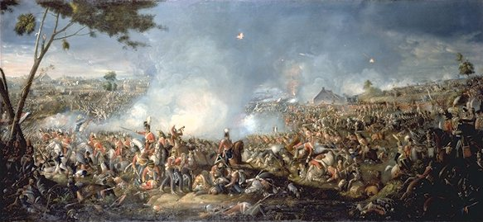
Battle of Waterloo, 1815

Slide 22
Napoleon’s Legacy
Died in 1821 on St. Helena
Controversial historical figure
  Pros
    Established meritocracy
    Held plebiscites
    Spread revolutionary ideals
  Cons
    Absolute ruler
    Ruled an empire with puppet kings
    Took away many rights of women
International legacy
  Destruction of the Holy Roman Empire led to the creation of Germany
  1803 – Sold the Louisiana Territory to the United States
  Created nationalistic fervor throughout the world

Slide 23
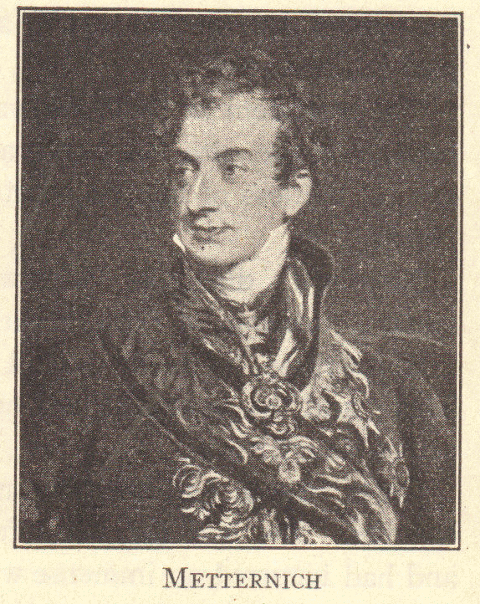
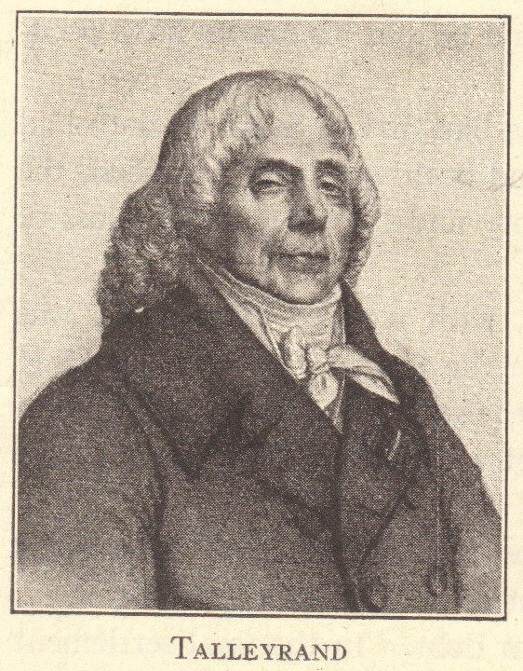
Congress of Vienna
September, 1814, through June, 1815
Austria, Great Britain, Prussia, and Russia sought to:
  Restore the Old Regime
  Establish a balance of power

Slide 24
Important Leaders at the Congress of Vienna
Prince Clemens von Metternich of Austria – wanted to roll back the clock to 1792
Lord Robert Castlereagh of Great Britain – wanted to end the French military threat
Tsar Alexander I of Russia – wanted to set up a “holy alliance” of Christian rulers who would unite to suppress future revolutions
Prince Charles Maurice de Talleyrand of France – shrewdly played these leaders off of one another to get a good deal for France

Slide 25
Results of the Congress of Vienna
Redrew the European map to surround France with strong countries
Principle of legitimacy – restored the hereditary (“legitimate”) monarchies
Concert of Europe – European leaders would meet to address their concerns
For the most part, large-scale war was avoided for 100 years (until World War I in 1914)
Failure to realize the power of nationalism

Slide 26
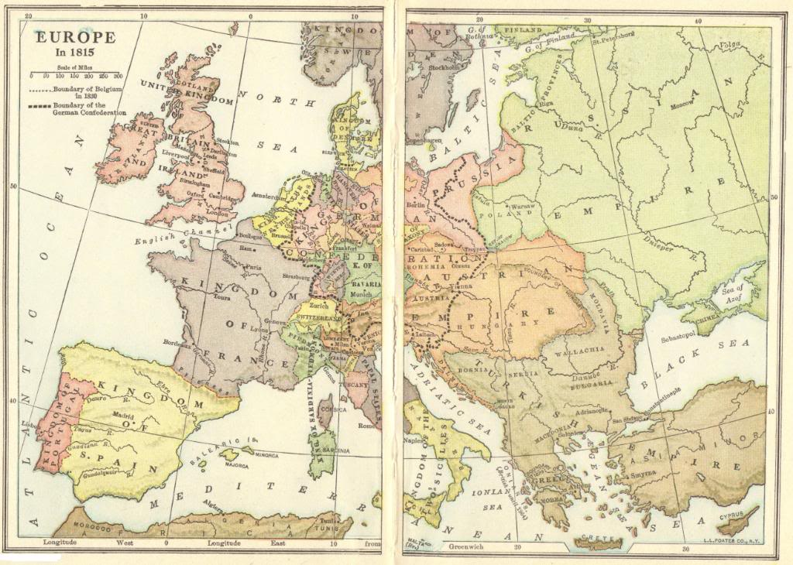

Slide 27
Review Questions
What political and social reforms did Napoleon make in the lands he conquered?
Describe the events of the Peninsular War.
Describe the map of Europe in 1812.
What events brought about Napoleon’s abdication?
At what battle was Napoleon finally defeated?
Was Napoleon a good leader? Why or why not? Look at this question from the perspectives of a French peasant, French émigré, Spanish peasant, and Spanish noble.

