Slide 1
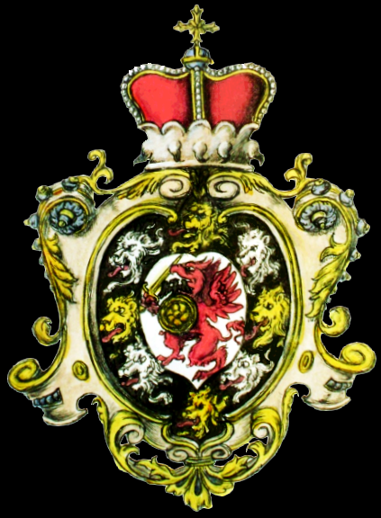
The Decline and Fall of the Romanov Dynasty in Russia
© Student Handouts, Inc.

Slide 2
The Last 5 Tsars
1801-1825
Alexander I
1825-1855
Nicholas I
1855-1881
Alexander II
1881-1894
Alexander III
1894-1917
Nicholas II

Slide 3
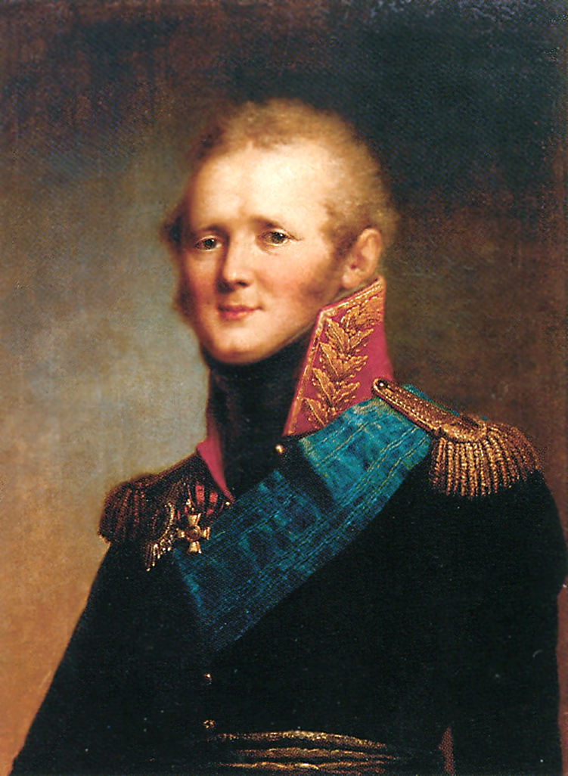
Alexander I (ruled 1801-1825)
Grandson of Catherine the Great
Inherited throne after father (Paul I) murdered
Ruled Russia during the Napoleonic wars
Expanded Russian empire with Finland and part of Poland
Initially introduced reforms but later took these back
Died of typhus

Slide 4
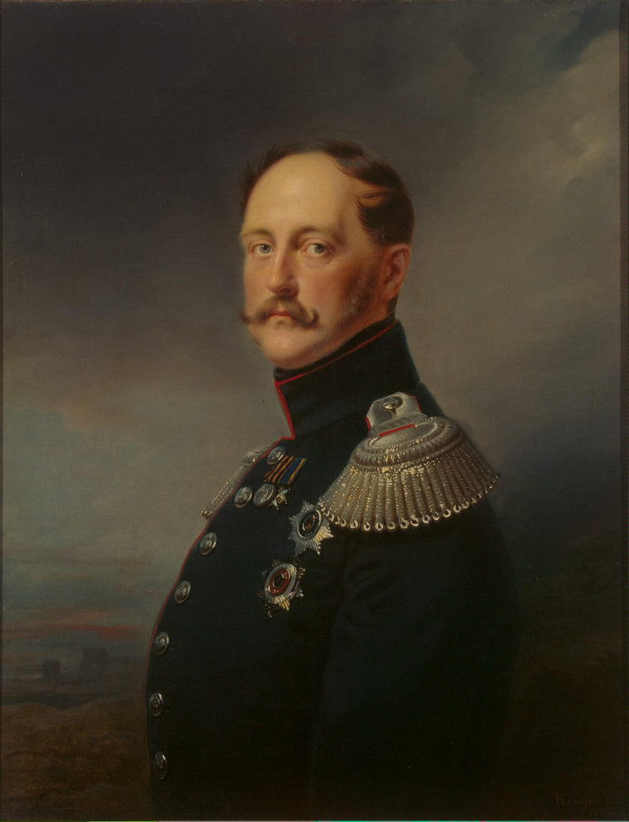
Nicholas I (ruled 1825-1855)
Younger brother of Alexander I
Decembrist Revolt (1825)
  Attempted coup after Nicholas I’s older brother, Constantine, declined the throne (after Alexander I died of typhus)
  Nicholas I’s reaction set the tone for his firm rule of Russia
Highly reactionary
  Principles of “Autocracy, Orthodoxy, and Nationality”
Feared nobles’ reaction to potential reforms, such as abolishing serfdom

Slide 5
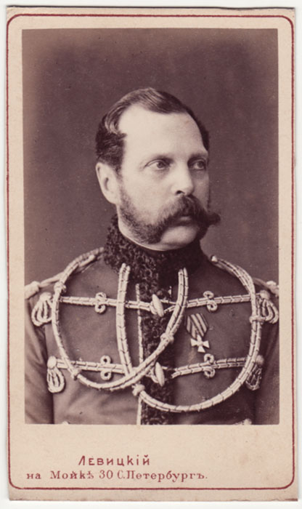
Alexander II (ruled 1855-1881)
Crimean War (1853-1856)
  Loss of war prompted military modernization
    Universal military conscription
Reforms
  Allowed for early form of corporations (LLCs)
  1861—emancipated the serfs
  Police force
  Local self-government (zemstvo)
  Had finished plans for a duma the day before his assassination
Assassination
  Attempts in 1866, 1879, 1880
  1881—bomb set by members of Narodnaya Volya (People’s Will), a nihilist group

Slide 6
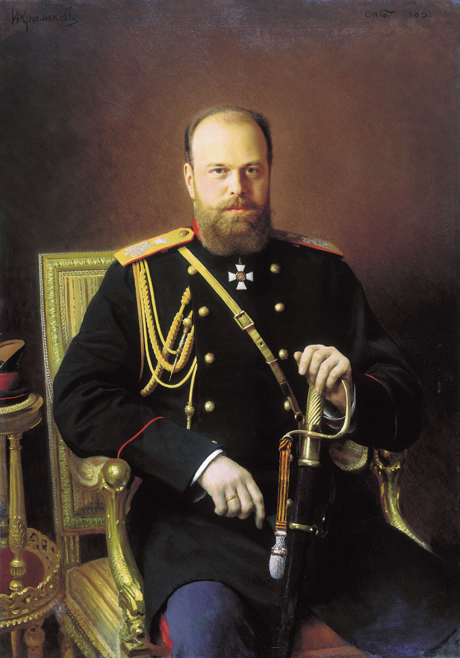
Alexander III (ruled 1881-1894)
Along with his son, the future Nicholas II, he witnessed Alexander II’s assassination
  Anti-Semitism—blamed Jews for his father’s assassination
    May Laws (1882)—harsh restrictions on all Jews
    Pogroms—led to Jewish immigration to the U.S. and elsewhere
      Film reference: “Fiddler on the Roof”
Return to principles of “Nationality, Autocracy, and Orthodoxy”
  Put local control in the hands of appointed officials
  Secret police
  Strict censorship
  Political prisoners exiled to Siberia
Died of kidney disease at age 49

Slide 7
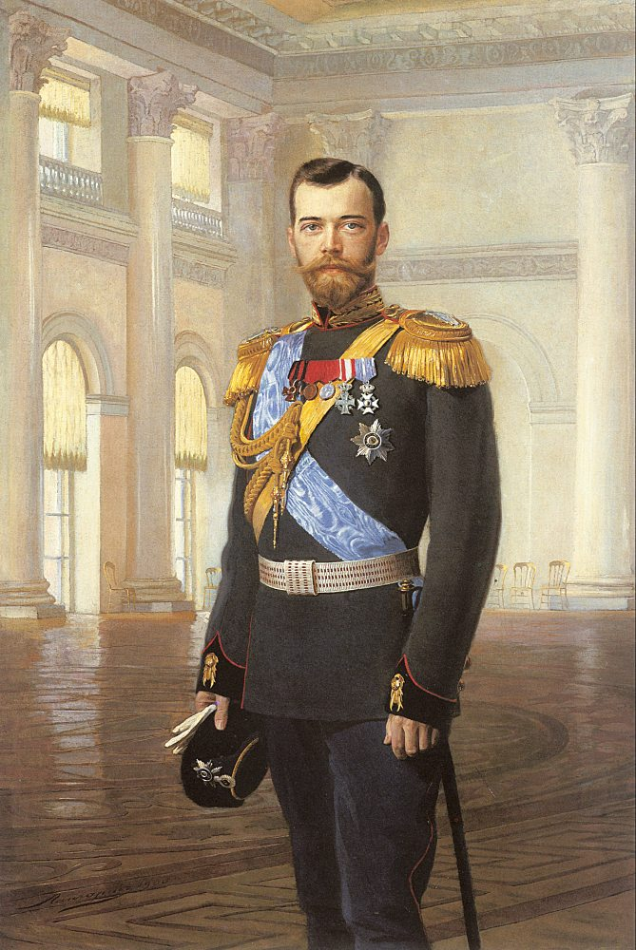
Nicholas II (ruled 1894-1917)
Married Alexandra, a granddaughter of Queen Victoria of Great Britain
  Their son, Alexei, was a hemophiliac
    Treated by the “mad monk” Grigori Rasputin
Completed the Great Siberian Railway
  Port at Vladivostok in the east
  Russians have historically sought warm-water ports
Rejected calls for democratic reforms
Last Russian tsar
  Executed along with his wife and children in 1918

Slide 8
Russo-Japanese War (1904-1905)
Imperial rivalry between Japan and Russia over Korea and Manchuria
Japanese surprise attack at Port Arthur, Manchuria
  First modern defeat in war of a European power by a non-European power
Treaty of Portsmouth (1905)
  Russians left Manchuria
  Japan gained recognition of Korea as part of its sphere of influence (i.e., imperialism)
  Japan gained the southern half of Sakhalin Island

Slide 9
Russian Revolution of 1905
Among long-standing complaints, the people were unhappy over Russia’s defeat in the Russo-Japanese War
Bloody Sunday (January, 1905)
  Peaceful protesters, led by a priest named Gapon, marched on the Winter Palace in St. Petersburg with a petition
  Shot at by tsar’s forces
  92 dead and hundreds wounded

Slide 10
Russian Duma
August, 1905—Duma organized as an advisory body
  But this wasn’t well received
October Manifesto
  Legislative powers for the Duma and civil liberties for the people
Nicholas II repeatedly butted heads with the Duma
  Socialists and revolutionaries kept winning seats

Slide 11
World War I and 1917 Revolution
Russians joined with Great Britain and France to fight the Germans and Austrians
  Russian army suffered terrible losses due to outdated equipment and poor leadership
  Tsar came to the front to lead troops, leaving Tsarina Alexandra to rule
  Tsarina disliked
    Foreign heritage
    Influence of Rasputin
1917
  These factors, along with food shortages and general discontent, led to full-scale revolution
  Russia withdrew from World War I
  Civil war in Russia over which group would rule Russia
  Tsar and his family assassinated by Bolsheviks in 1918

Slide 12
